Slide 1
The slides used in this presentation are intended to be used in an event with verbal elaboration by a knowledgeable presenter. The slides highlight key U.S. product safety requirements for discussion. The text is not a comprehensive statement of legal requirements or policy and should not be relied upon for that purpose. Moreover, with the passage of time, it may not reflect the latest information. You should consult official versions of U.S. statutes and regulations, as well as published CPSC guidance when making decisions that could affect the safety and compliance of products entering U.S. commerce.

Slide 2
Overview of Children’s Sleepwear Requirements
This presentation was prepared by CPSC Staff. It has not been reviewed or approved by the Commission and may not reflect its views.

Slide 3
The US CPSC is a federal government agency charged with protecting the public from unreasonable risks of injury or death associated with the use of consumer products under the agency's jurisdiction.
$1 Trillion
Deaths, injuries, and property damage from consumer product incidents cost the nation more than $1 trillion annually.¹
¹ https://www.cpsc.gov/s3fs-public/FY2019PBR.pdf
CPSC is committed to protecting consumers from products that pose a fire, electrical, chemical, biological, or mechanical hazard.
CPSC's work to improve the safety of the more than 15,000 types of consumer products in its jurisdiction - such as toys, cribs, power tools, cigarette lighters, textiles, and household chemicals – has contributed to a decline in the rate of deaths and injuries associated with consumer products over the past 40 years.

Slide 4
Topics
Flammable Fabrics Act
Scope of Apparel Requirements
Children’s Sleepwear
Other CPSA Requirements
Certification Requirements
Chemical Content
Tracking Labels
Small Parts
Summary of Requirements by Product Type
Resources

Slide 5
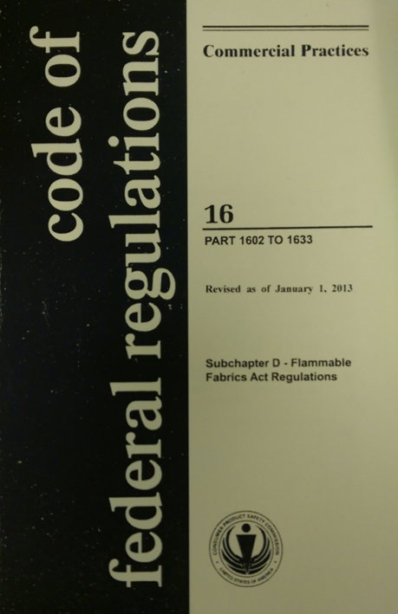
Flammable Fabrics Act (FFA)
Primary authority for CPSC-regulated textiles
Focus on flammability performance
Regulations:
Clothing Textiles
16 CFR part 1610
Vinyl plastic film
16 CFR part 1611
Children’s sleepwear
16 CFR parts 1615/1616
Carpets and rugs
16 CFR parts 1630/1631
Mattresses and mattress pads
16 CFR part 1632
Mattress sets
16 CFR part 1633

Slide 6
Clothing Textiles
CPSC Children’s Sleepwear Requirements

Slide 7
Children’s Sleepwear
Standard for the Flammability of Children’s Sleepwear
Sizes 0 Through 6X (16 CFR part 1615)
Sizes 7 Through 14 (16 CFR part 1615)
Applies to garments intended to be worn primarily for sleeping or activities related to sleeping
Examples: nightgowns, pajamas, robes
Specifies a sampling scheme and testing procedures to determine the flammability of children’s sleepwear
Char length may not exceed 17.8 cm (7.0 in) (average)
No single sample may burn the full length

Slide 8
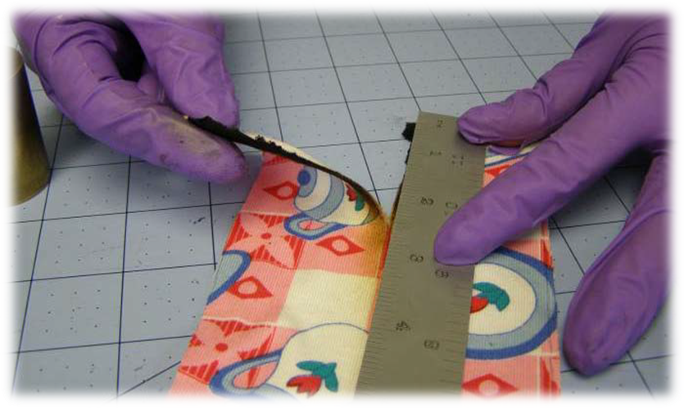
Children’s Sleepwear
All children’s sleepwear fabrics, trim, and garments must be flame resistant and self-extinguish (not continue to burn) when removed from a small, open-flame ignition source.

Slide 9
Children’s Sleepwear
What determines whether a garment is considered children’s sleepwear?
Suitability for sleeping, likelihood of garment to be used for sleeping
Garment and fabric features
Marketing, merchandising/display, intended use
Items marketed as “loungewear” or similar terms are also subject to the requirements.
https://www.cpsc.gov/s3fs-public/pdfs/blk_pdf_sleepwearpolicy.pdf

Slide 10
Children’s Sleepwear
What does not require sleepwear testing?
Diapers and underwear
Infant garments (9 months or younger)
Tight-fitting sleepwear
These categories are defined in §§1615.1(a)(1)-(3) and 1616.2(a)(1)-(2).
Must meet clothing textile requirements (1610).

Slide 11
Children’s Sleepwear
What is an infant garment?
Size 9 months or younger (clearly labeled)
One-piece garment
Does not exceed 64.8 cm (25.75”) in length
Two-piece garment
Has no piece exceeding 40 cm (15.75”) in length

Slide 12
Children’s Sleepwear
What is a tight-fitting sleepwear garment?
Based on size, meets prescribed maximum dimensions in specific garment locations.
Tables can be found in §§1615.1(o) and 1616.2(m).
Must meet labeling and hang tag requirements.

Slide 13
Children’s Sleepwear
How do you measure a tight-fitting sleepwear garment?
Diagrams 1-3 in 16 CFR parts 1615 and 1616
Appendix B in laboratory manual

Slide 14
Children’s Sleepwear
Fabric Sampling
Sample
Test
Launder 50 times
Test
Garment Sampling
Prototype
Test seams
Test any trim
Production
Test longest seam only

Slide 15
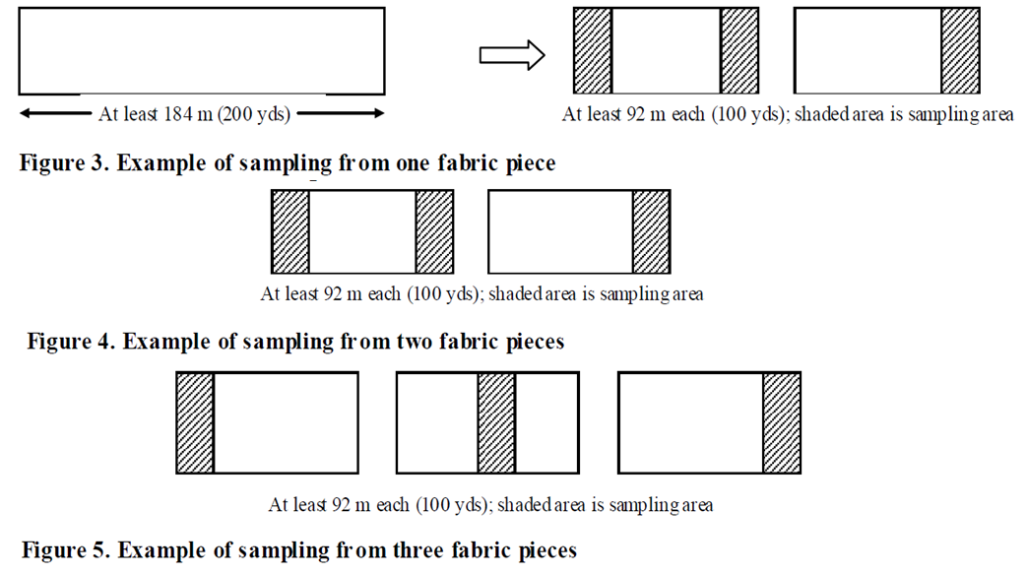
Children’s Sleepwear
Specified Production Sampling
Multiple stages of testing are required, following prescriptive sampling plans (tightened fabric sampling plan below).

Slide 16
Children’s Sleepwear
Fabric Production Unit (FPU)
Either 4 or 6 samples (5 specimens each).
Test half in finished state (as produced or after 1 laundering cycle) and half after 50 laundering cycles.
Garment Production Unit (GPU)
Prototype
Seams: for the longest seam type, 3 samples (5 specimens each) and 3 samples (5 specimens each) made up of the other seam types that are least 10 inches long.
Trim: for each trim type and orientation, 3 samples (5 specimens).
Production (garments)
For the longest seam type, 3 samples (5 specimens each).
A second set of samples is required for recordkeeping.
A second set of samples is required to be produced and maintained for recordkeeping

Slide 17
Children’s Sleepwear
What can make up an FPU?
Up to 4,600 m (5,000 yd) of fabric; 9,200 m (10,000 yd) for a Reduced Sampling Plan
Fabrics of different colors or different print patterns (not both) of the same fabric
To include different colors or prints in a single FPU equivalent performance must be shown through testing.

Slide 18
Children’s Sleepwear
What can make up a GPU?
Up to 500 dozen finished garments
Must maintain a specific identity exclusive of size, trim, findings, color, and print patterns.
A specific identity uses the same fabric, thread, and longest seam type.
Solid colors or different print patterns (with same flammability performance based on tests), but not both.
Prototype
Characterize flammability of all types of seams and decorative trim.
Production
Verify the flammability performance of the prototype after full-scale production.

Slide 19
Children’s Sleepwear
Seams
Prototype stage: Test all seam types at least 10 inches long, including side seams, arm holes, collars, or yokes, whether ruffled, straight, gathered, or a combination.
Do not test seams used to attach functional materials or findings or untrimmed coverbind edge finishes or hems.
Production stage: Only the longest seam type is required to be tested.

Slide 20
Children’s Sleepwear
Trim
Trim is defined as decorative materials, such as ribbons, laces, embroidery, screen prints, or ornaments.
Test all decorative trim types at prototype stage.
Different colors of trim are considered different trim types.
Test in a horizontal or vertical configuration, determined by location and orientation on the garment.
Functional edge bindings, functional findings (ex. zippers, buttons), and individual pieces less than 5.08 cm (2 in) are not required to be tested.
See Appendix E in the children’s sleepwear laboratory manual for more information.

Slide 21
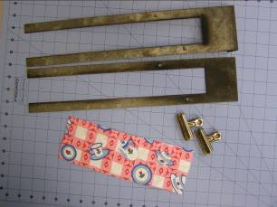
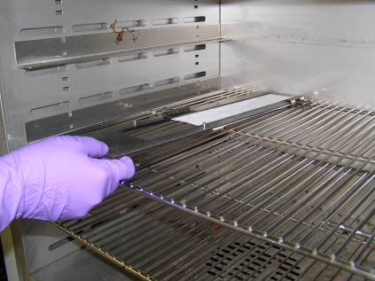
Children’s Sleepwear
Test Preparation:
Specimen size: 8.9 cm x 25.4cm (3.5” x 10.0”)
Conditioning Requirements:
Oven Temperature: 105 ± 3°C (221 ± 5 °F)
Duration 30 ± 2 minutes

Slide 22
Children’s Sleepwear
Test Procedure:
38 mm (1.5 in) flame impinges on the bottom edge of a specimen mounted vertically for 3 seconds.
Allowed to burn until the flame self extinguishes or burns entire specimen.
Char length is measured.

Slide 23
Children’s Sleepwear
Recordkeeping (see §§1615.31(e) and 1616.31(d))
General
Sampling plans; FPU or GPU of all garments; test results for all stages of testing (including test results used to include different colors or prints); disposition of any failing or rejected items; fiber content and manufacturing specifications; identification, composition, and details of any FR treatments; sales information.
Fabrics
Identical set of fabric samples to those tested (and FPU details).
Garments
Details of construction, fiber content, and manufacturing specifications; sampling details; identical set of all prototype and production samples to those tested; remains of tested samples; FPU and GPU details and records; a complete untested garment from each style and type.

Slide 24
Children’s Sleepwear

Slide 25
Certification, Chemical Content, Tracking Labels, Small Parts
Other CPSC Requirements

Slide 26
Certification
General Use Product
General Certificate of Conformity (GCC)
Does not require third party testing
Applies to adult apparel
Children’s Product
Children’s Product Certificate (CPC)
Requires third party testing by a CPSC-accepted laboratory for all regulations to which the product is subject
Applies to all children’s apparel
Issued by manufacturer (if domestic) or importer of record. An importer can rely on testing performed by a manufacturer to issue a certificate as long as due care is exercised and all CPSC requirements are met.

Slide 27
Chemical Content
Lead Content (FHSA)
Products designed and intended primarily for children 12 years or younger
Concentration may not exceed 100 ppm
Applies to children’s apparel and sleepwear (zippers, buttons, etc.)
Lead in Paint and Surface Coatings (CPSA)
Products designed and intended primarily for children 12 years or younger and some general use furniture
Concentration may not exceed 90 ppm
Applies to children’s general apparel and sleepwear (screen prints)
Phthalate Content (CPSA)
Children’s toys and child care articles (products used to facilitate sleeping and feeding for children 3 years or younger)
Only certain phthalates
Concentration may not exceed 0.1 %
Applies to children’s sleepwear and some apparel (bibs)
Third party testing by a CPSC-accepted laboratory is required

Slide 28
Chemical Content
Determinations
Lead
§1500.91: Certain materials will not exceed lead limits.
Textiles made from certain fiber types, dyed and undyed (including some prints).
Phthalates
§1308.2: Certain plastics with specified additives will not exceed the specified phthalates content limits.
Includes polypropylene and polyethylene.

Slide 29
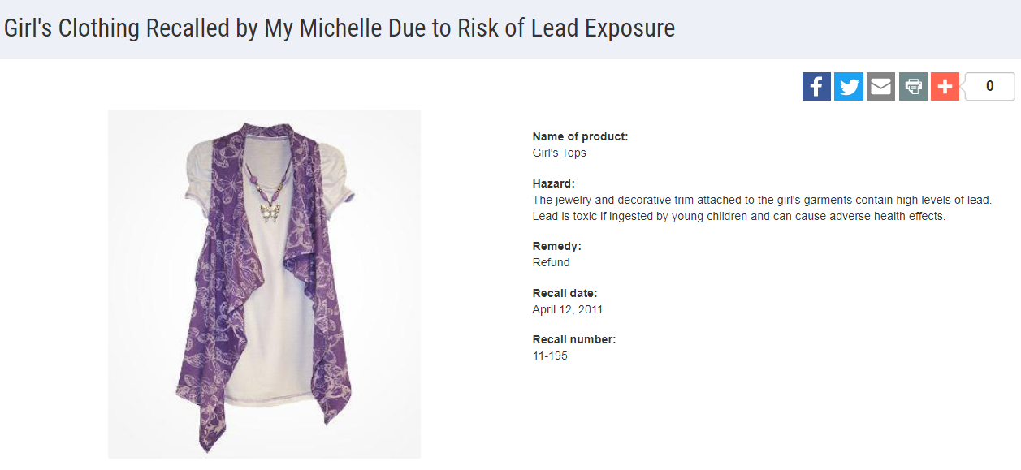
Chemical Content

Slide 30
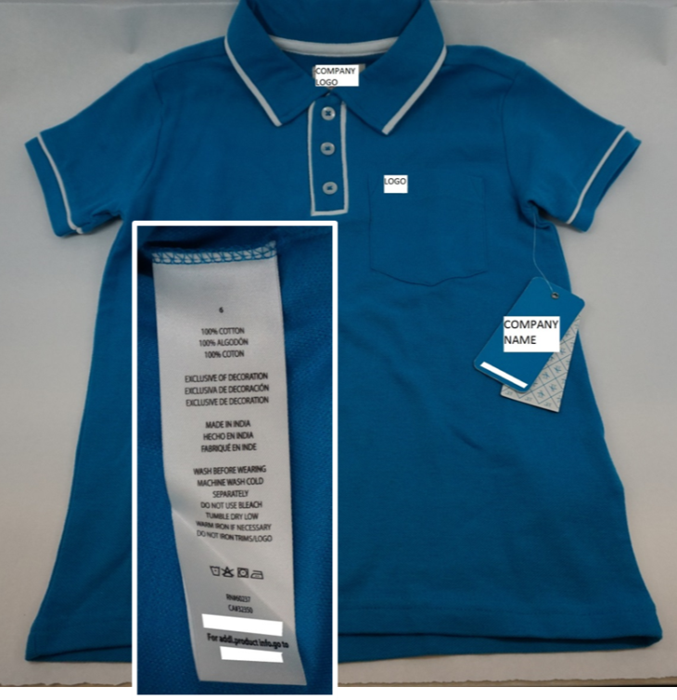
Tracking Labels
For products designed and intended primarily for children 12 years or younger, a permanent, distinguishing mark (tracking label) must:
Be affixed to the product and its packaging, visible and legible.
Provide certain identifying information:
Manufacturer or private labeler name;
Manufacturing location and date of manufacture;
Detailed information on manufacturing (ex. Batch, run, lot or style number) or other identifying characteristics; and
Any other information to facilitate ascertaining the specific source of the product.

Slide 31
Small Parts
Intended to prevent deaths and injuries to children from choking
Products intended for children under 3 years
Children’s Clothing and Accessories
Fabrics and buttons are exempted from small parts regulations and testing requirements
16 CFR § 1501.3(d)
If buttons are not secure due to poor construction they may pose a substantial product hazard and need to be reported to the CPSC

Slide 32
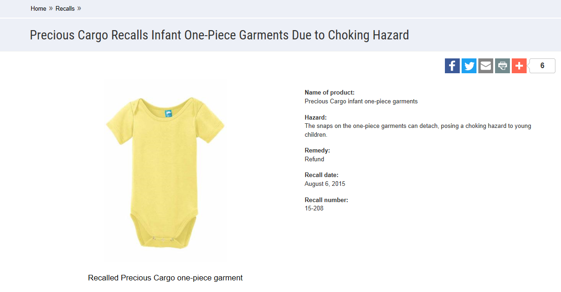
Small Parts

Slide 33
Children’s Sleepwear
Summarization of CPSC Children’s Sleepwear Requirements

Slide 34
Children’s Sleepwear
CPC and third party testing by a CPSC-accepted laboratory
Children’s Sleepwear (or Clothing Textiles/Vinyl Plastic Film)
Lead content (zippers, buttons)
Lead in paint or surface coating (screen printing)
Phthalate (feet on pajamas; only under 3)
Tracking label

Slide 35
Questions?
Submit questions in Spanish or English to :
CPSCenlasAmericas@CPSC.GOV

Slide 36
Resources

Slide 37
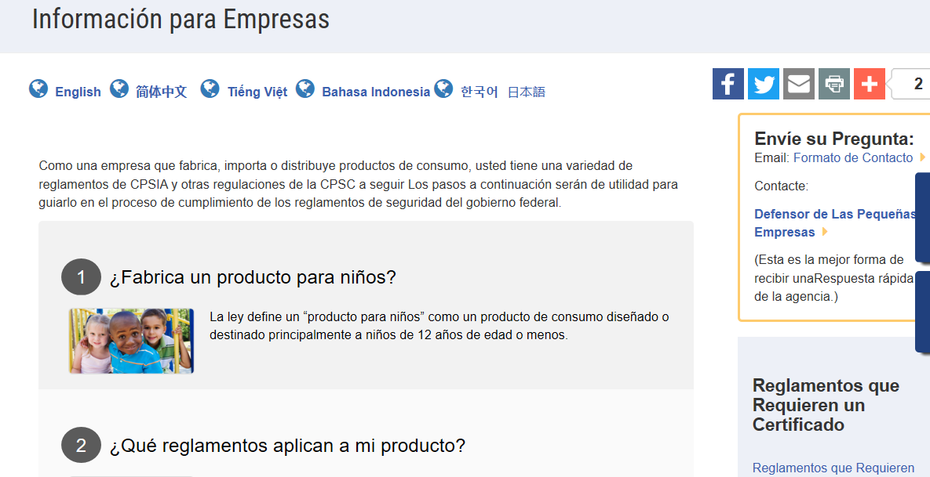
https://www.cpsc.gov/es/Business--Manufacturing/Business-Education
Resources in Spanish at cpsc.gov

Slide 38
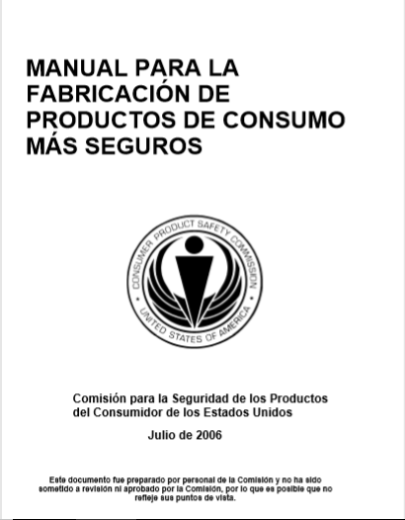
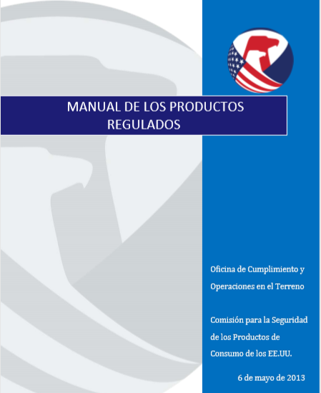
Resources in Spanish at cpsc.gov
https://www.cpsc.gov/s3fs-public/pdfs/blk_pdf_handbookspanishjul06.pdf
https://www.cpsc.gov/s3fs-public/TheRegulatedProductsHandbookSp.pdf

Slide 39
http://business.cpsc.gov
Online tool designed specifically to help businesses comply with federal consumer product safety requirements.
Asks a series of guided questions, and based on the answers produces a downloadable (PDF) report.
Provides customized guidance with links to product safety regulations that may apply to the product and important information on labeling, certification and testing requirements.

Slide 40
Regulatory Robot
Regulatory Robot is a tool to help identify which mandatory standards are applicable
Does not give details of requirements within a specific standard
User inputs product features
Regulatory Robot outputs list of standards and requirements
User references source documents for specific requirements

Slide 41
Regulations
https://www.cpsc.gov/Regulations-Laws--Standards/Statutes/Flammable-Fabrics-Act/
Laboratory Test Manual for 16 CFR Part 1610: Standard for the Flammability of Clothing Textiles
English: https://www.cpsc.gov/s3fs-public/Flammability%20of%20Clothing%20Textiles%20Test%20Manual_1610.pdf
Laboratory Test Manual for 16 CFR Parts 1615 and 1616: Standard for the Flammability of Children’s Sleepwear
English: https://www.cpsc.gov/s3fs-public/Flammability%20of%20Children's%20Sleepwear%20Test%20Manual_1615_1616.pdf
Apparel Resources
(In English)

Slide 42
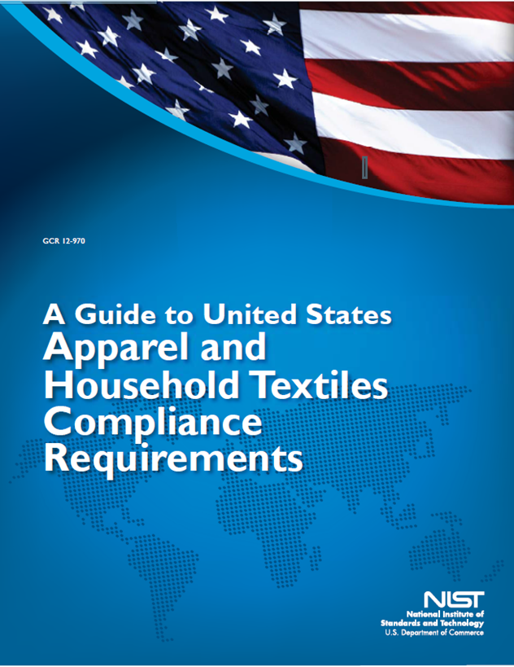
Apparel Resources
(In English)
https://nvlpubs.nist.gov/nistpubs/ir/2016/NIST.IR.8115.pdf

Slide 43
Definition of children’s product – 16 CFR Part 1200
Certificates of conformity – 16 CFR Part 1110
Third-party testing – 16 CFR Parts 1107, 1109, and 1112
Tracking information – 15 USC § 2063(a)(5)
Mandatory reporting requirements – 15 USC §2064
CPSC Business Resources
(In English)
CPSC-Accepted Laboratories Search Page:
www.cpsc.gov/LabSearch

