Slide 1
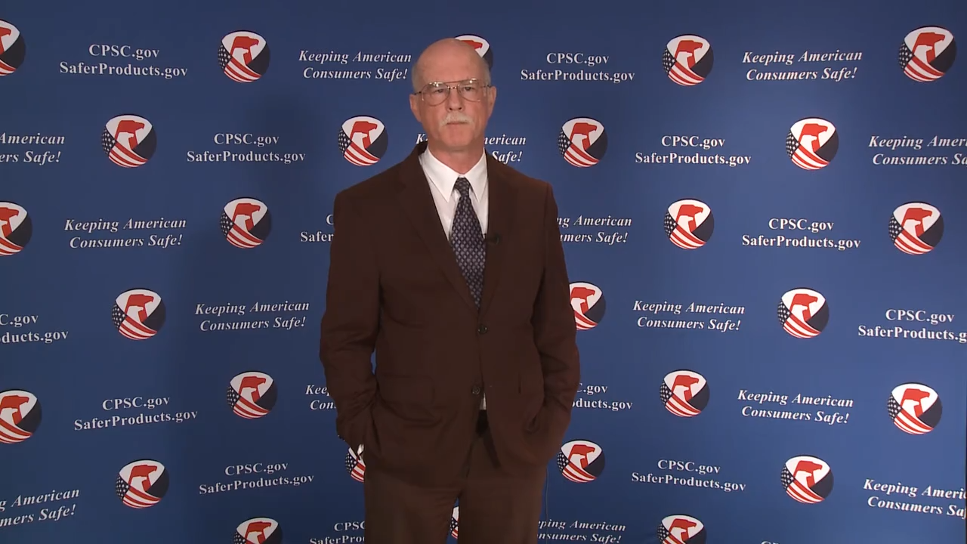
Video: Welcome to the 2020 CPSC Podcast Series - Overview of U.S. Apparel Requirements

Slide 2
Podcast Series 2020
Overview of U.S. Apparel Requirements
This presentation was prepared by CPSC Staff. It has not been reviewed or approved by the Commission and may not reflect its views.

Slide 3


Biographies
Sylvia Chen
U.S. Consumer Product Safety Commission
Program Manager for East Asia and Pacific
Office of International Programs
Weiying Tao, Ph.D.
U.S. Consumer Product Safety Commission
Textile Technologist
Division of Engineering
Sylvia Chen is Program Manager for East Asia and Pacific at the U.S. Consumer Product Safety Commission (CPSC). In that role, she is responsible for managing the Commission’s bilateral and multi-lateral programs related to consumer product safety in Australia, Japan, Korea, Taiwan and New Zealand. She also supports the CPSC’s work with China. Since she joined the CPSC in 2008, Sylvia has been working with product safety regulators, industry organizations, manufacturers, exporters, buyers and other sourcing professionals to provide them with guidance and technical support in understanding U.S. requirements, in particular, the latest requirements for consumer products. To that end, she has organized or coordinated many of the agency’s international education and outreach activities.
Sylvia has a Bachelor of Arts degree in English and American Literature from Peking University. In 1991, she graduated from The Ohio State University with a Master’s degree in East Asian Studies.
Dr. Weiying Tao is a Textile Technologist at the CPSC. She joined the CPSC in 1999. Her work at the CPSC focuses on the safety of textile products.
Before joining the CPSC, Dr. Tao conducted research on materials mainly related to textiles for the USDA Southern Regional Research Center. She has more than 20 peer-reviewed publications.
She graduated from Louisiana State University in 1991, with a Ph.D. in Material Science.

Slide 4

The US CPSC is a federal government agency charged with protecting the public from unreasonable risks of injury or death associated with the use of consumer products under the agency's jurisdiction.
$1 Trillion
Deaths, injuries, and property damage from consumer product incidents cost the nation more than $1 trillion annually.¹
¹ https://www.cpsc.gov/s3fs-public/FY2019PBR.pdf
CPSC is committed to protecting consumers from products that pose a fire, electrical, chemical, biological, or mechanical hazard.
CPSC's work to improve the safety of the more than 15,000 types of consumer products in its jurisdiction - such as toys, cribs, power tools, cigarette lighters, textiles, and household chemicals – has contributed to a decline in the rate of deaths and injuries associated with consumer products over the past 40 years.

Slide 5
CPSC’s Podcast Series
Podcast | Topics
#1 | Selling Safe Electrical Products to the U.S. Market
#2 | Overview of U.S. Apparel Requirements
#3 | Bicycle Regulations Safety Standards
#4 | Overview of U.S. Mattress Requirements
#5 | Durable Infant or Toddler Products Common Requirements
#6 | Overview of Carriage and Stroller Requirements
#7 | Toy Safety
“Questions on this Presentation? Send an email to CPSCinChina@cpsc.gov”

Slide 6
The slides used in this podcast are not a comprehensive statement of legal requirements or policy and should not be relied upon for that purpose. You should consult official versions of U.S. statutes and regulations, as well as published CPSC guidance when making decisions that could affect the safety and compliance of products entering U.S. commerce. Note that references are provided at the end of the presentation.

Slide 7
Overview of U.S. Apparel Requirements

Slide 8
Topics
Flammable Fabrics Act
Scope of Apparel Requirements
  Clothing Textiles, Drawstrings
Other CPSA Requirements
  Certification Requirements
  Chemical Content
  Tracking Labels
  Small Parts
Summary of Requirements by Product Type
Resources

Slide 9
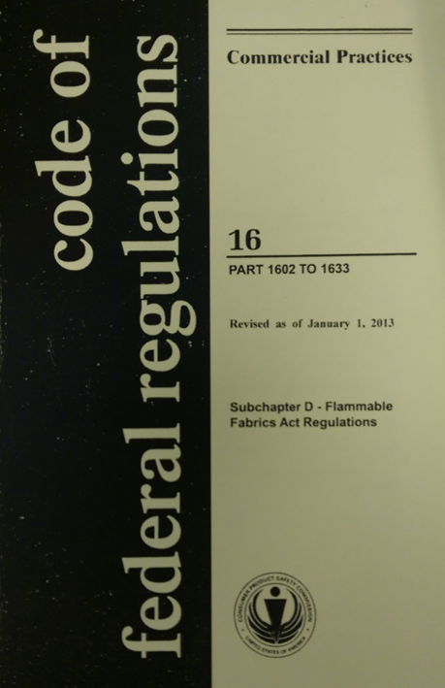
Flammable Fabrics Act (FFA)
Primary authority for CPSC-regulated textiles
Focus on flammability performance
Regulations:
  Clothing Textiles
    16 CFR part 1610
  Vinyl plastic film
    16 CFR part 1611
  Children’s sleepwear
    16 CFR parts 1615/1616
  Carpets and rugs
    16 CFR parts 1630/1631
  Mattresses and mattress pads
    16 CFR part 1632
  Mattress sets
    16 CFR part 1633

Slide 10
Clothing Textiles and Drawstrings
CPSC Apparel Requirements

Slide 11
Clothing Textiles
Applies to:
  All textiles used for adult and children’s wearing apparel.
Does not apply to:
  Hats, gloves, footwear, and interlining fabrics, with some exceptions (see §1610.1(c)).
  Children’s sleepwear must meet a more stringent standard.

Slide 12
Clothing Textiles
Some fabrics are exempted from testing requirements:
  All plain-surface fabrics greater than or equal to 88.2 g/m² (2.6 oz/yd²).
  Any fabric made in whole or with a blend of the following fiber types only:
    Acrylic, modacrylic, nylon, olefin, polyester, wool.
Know your fabric surface type, fiber type(s), and fabric weight

Slide 13
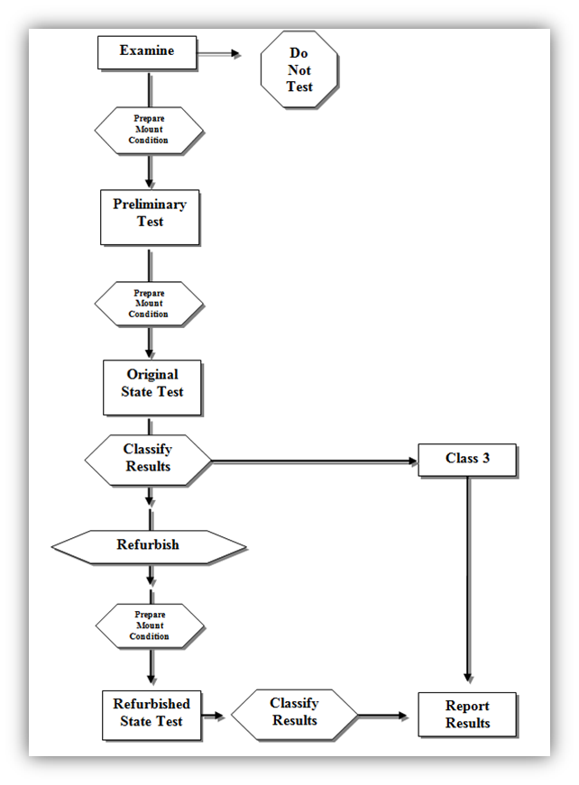
Clothing Textiles
Determine fiber type and fabric construction
Preliminary test
Prepare and condition
Test
Preliminary classification
Refurbish and repeat test
Final classification
Report

Slide 14
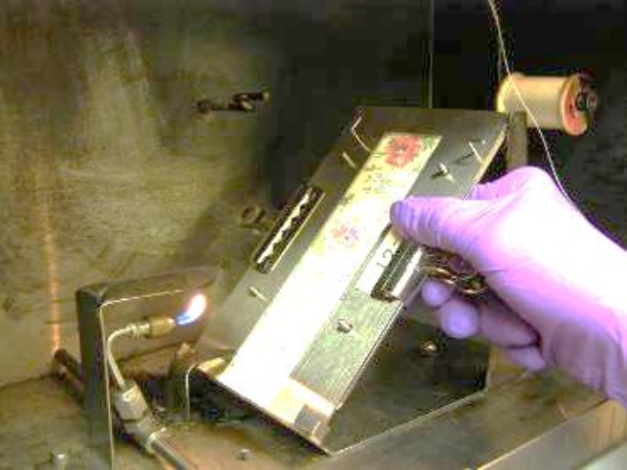
Clothing Textiles
Test Procedure
  16 mm (5/8 in) flame impinges on specimen mounted at 45-degree angle for 1 second.
  Record time to burn full length or until stop thread breaks.
  Results of several tests are averaged, and a Class designation is assigned.

Slide 15
Clothing Textiles
Classification
  Class 1
    Plain and raised fiber surface fabrics
    No unusual burning characteristics and are acceptable for use in clothing
  Class 2
    Raised fiber surface fabrics only
    Intermediate flammability- use with caution
  Class 3
    Plain and raised fiber surface fabrics
    Fabrics are dangerously flammable and CANNOT be used in wearing apparel
Classification | Plain Surface | Raised Fiber Surface
Class 1 | Average burn time > 3.5 s | Average burn time > 7.0 s OR Average burn time is 0-7 s with no base burns (SFBB)
Class 2 | N/A | Average burn time is 4-7 s with base burn (SFBB)
Class 3 | Average burn time < 3.5 s | Average burn time < 4.0 s with base burn (SFBB)

Slide 16
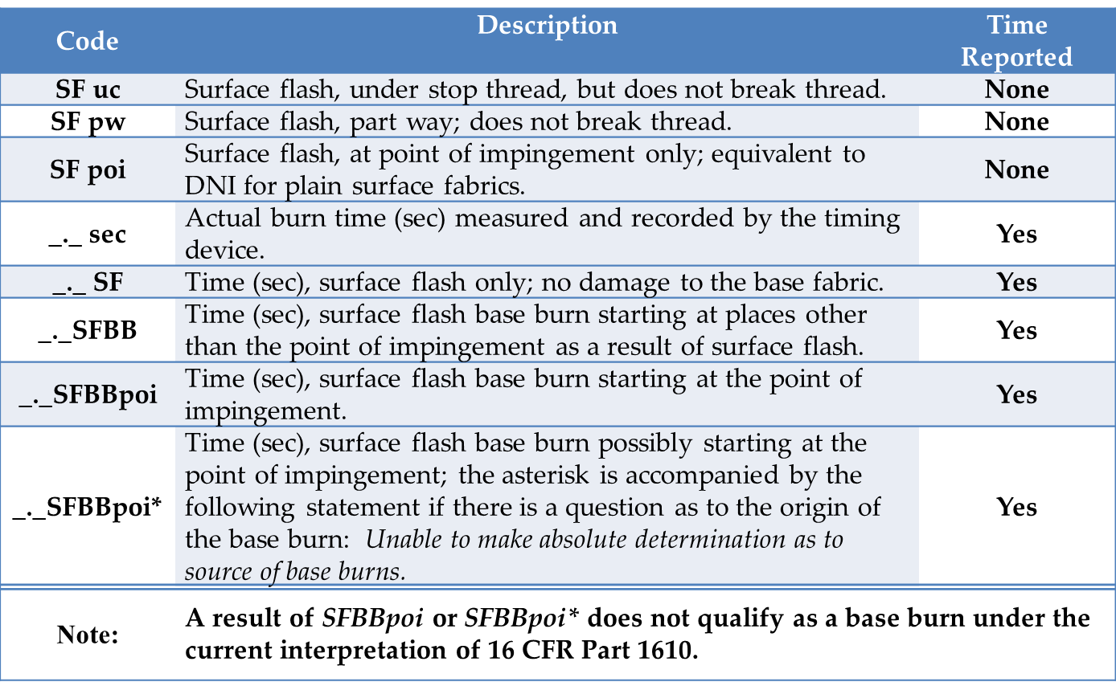
Clothing Textiles
Classification Codes (raised fiber surface only)

Slide 17
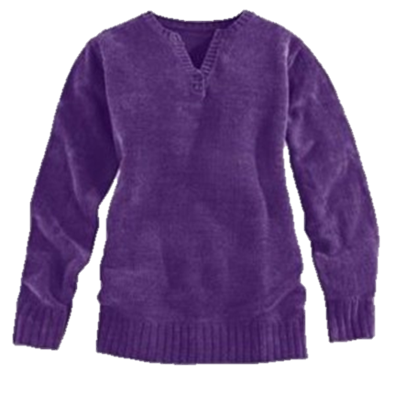
Clothing Textiles
Common Types of Noncompliant Fabrics
  Lightweight, sheer fabrics of rayon and silk
    Example: Scarves
  Raised fiber surface cellulose or cellulose-blend fabrics
    Examples: rayon and rayon-blend chenille, cotton and cotton-blend fleece, cotton terry

Slide 18
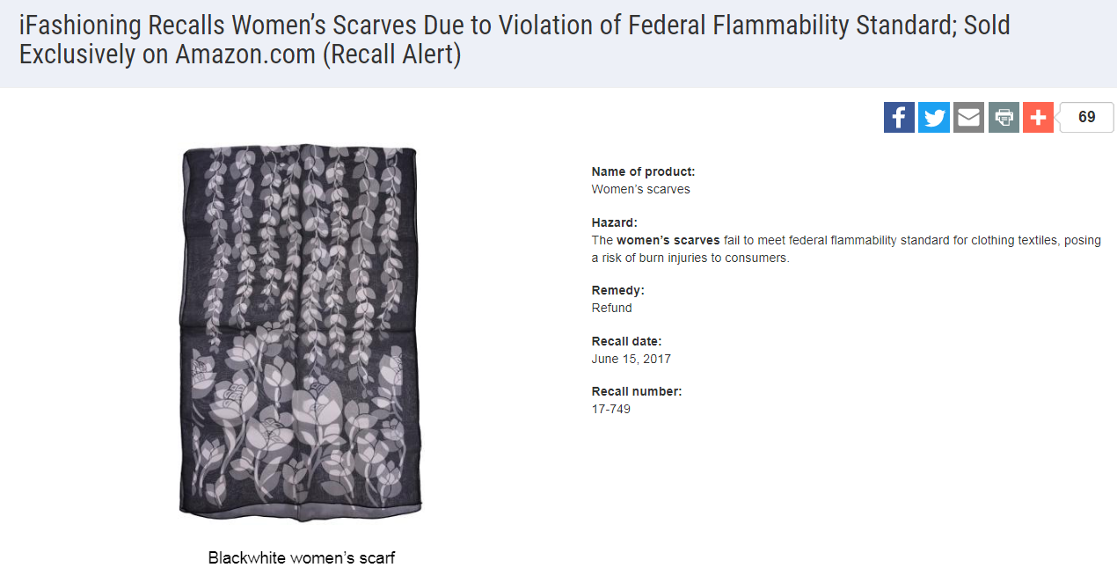

Clothing Textiles

Slide 19
Clothing Textiles
  Recordkeeping (see §1610.38)
  Test results, including classification
  Fiber composition, fabric finish and type, and any other identifying information
  Fabric swatch

Slide 20
Vinyl Plastic Film
Standard for the Flammability of Vinyl Plastic Film (16 CFR part 1611)
Applies to non-rigid, unsupported vinyl plastic film, including transparent, translucent, and opaque material used in wearing apparel subject to the FFA
  Examples: disposable diapers, raincoats, some costumes
Specifies testing procedures to determine the average burn time of vinyl plastic film
  May not exceed 1.2 inches per second (average)
Same recordkeeping as 16 CFR part 1610

Slide 21
Drawstrings
Young children can be seriously injured or subject to fatal entanglement if the drawstrings of the upper outerwear they are wearing catches or snags.
CPSC issued guidelines (1996) later adopted by ASTM in 1997 (ASTM F1816-97)
  May 2006 letter to industry
  Commission determined in 2011 that drawstrings on children’s upper outerwear present a substantial product hazard and issued a rule under 15(j) of the Consumer Product Safety Act (CPSA).
  https://www.cpsc.gov/s3fs-public/pdfs/blk_media_drawstringrule.pdf

Slide 22
Drawstrings
Applies to drawstrings at the neck or waist on upper outwear.
  Clothing generally intended to be worn on the exterior of other garments (ex. jackets, ski vests, anoraks, and sweatshirts).
  Ties are considered drawstrings and are subject to the requirements.
Does not apply to:
  Underwear, inner clothing layers, pants, shorts, swimwear, dresses and skirts. These items are not considered upper outerwear.
Belts are not drawstrings and are not subject to the requirements.

Slide 23
Drawstrings
Hood and neck area (sizes 2T through 12)
  Not allowed
  Use alternative closures, such as snaps, buttons, Velcro, and elastic.
Waist and bottom drawstrings (sizes 2T to 16)
  Allowed, but must meet certain requirements:
    Drawstring must not extend more than 3 inches from the channel when the garment is expanded to its fullest width.
    Continuous drawstrings must be bar tacked or stitched through to prevent the drawstring from being pulled through its channel.
    Cord locks, knots, toggles, or other attachments at the free ends of drawstrings are prohibited (even on fully retractable drawstrings).

Slide 24
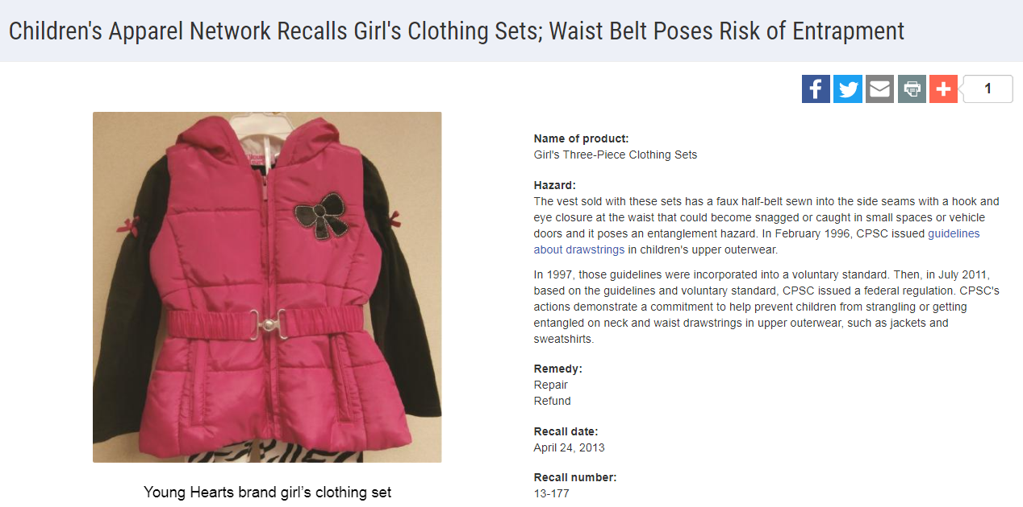
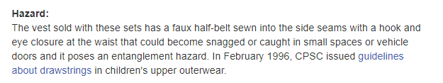
Drawstrings

Slide 25
Certification, Chemical Content, Tracking Labels, Small Parts
Other CPSC Requirements

Slide 26
Certification
General Use Product
  General Certificate of Conformity (GCC)
  Does not require third party testing
  Applies to adult apparel
Children’s Product
  Children’s Product Certificate (CPC)
  Requires third party testing by a CPSC-accepted laboratory for all regulations to which the product is subject
  Applies to all children’s apparel
Issued by manufacturer (if domestic) or importer of record. An importer can rely on testing performed by a manufacturer to issue a certificate as long as due care is exercised and all CPSC requirements are met.

Slide 27
Chemical Content
Lead Content (FHSA)
  Products designed and intended primarily for children 12 years or younger
  Concentration may not exceed 100 ppm
  Applies to children’s apparel and sleepwear (zippers, buttons, etc.)
Lead in Paint and Surface Coatings (CPSA)
  Products designed and intended primarily for children 12 years or younger and some general use furniture
  Concentration may not exceed 90 ppm
  Applies to children’s general apparel and sleepwear (screen prints)
Phthalate Content (CPSA)
  Children’s toys and child care articles (products used to facilitate sleeping and feeding for children 3 years or younger)
  Only certain phthalates
  Concentration may not exceed 0.1 %
  Applies to children’s sleepwear and some apparel (bibs)
Third party testing by a CPSC-accepted laboratory is required

Slide 28
Chemical Content
Determinations
  Lead
    §1500.91: Certain materials will not exceed lead limits.
    Textiles made from certain fiber types, dyed and undyed (including some prints).
  Phthalates
    §1308.2: Certain plastics with specified additives will not exceed the specified phthalates content limits.
    Includes polypropylene and polyethylene.

Slide 29
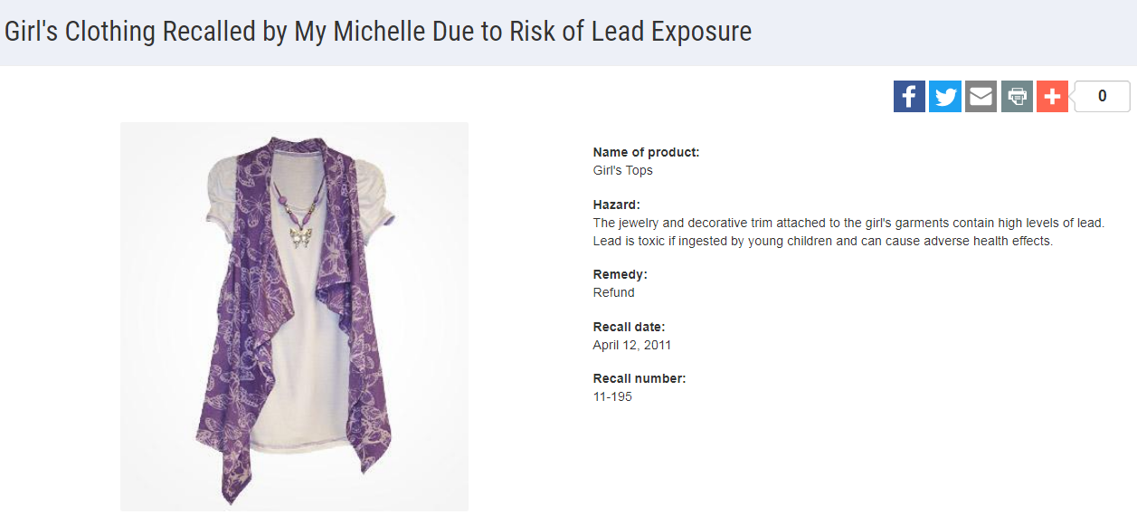

Chemical Content

Slide 30
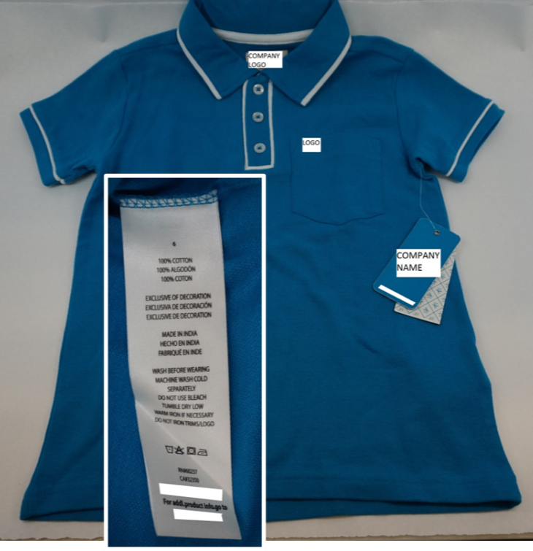
Tracking Labels
For products designed and intended primarily for children 12 years or younger, a permanent, distinguishing mark (tracking label) must:
Be affixed to the product and its packaging, visible and legible.
Provide certain identifying information:
  Manufacturer or private labeler name;
  Manufacturing location and date of manufacture;
  Detailed information on manufacturing (ex. Batch, run, lot or style number) or other identifying characteristics; and
  Any other information to facilitate ascertaining the specific source of the product.

Slide 31
Small Parts
Intended to prevent deaths and injuries to children from choking
Products intended for children under 3 years
Children’s Clothing and Accessories
  Fabrics and buttons are exempted from small parts regulations and testing requirements
    16 C.F.R. § 1501.3(d)
    If buttons are not secure due to poor construction they may pose a substantial product hazard and need to be reported to the CPSC

Slide 32
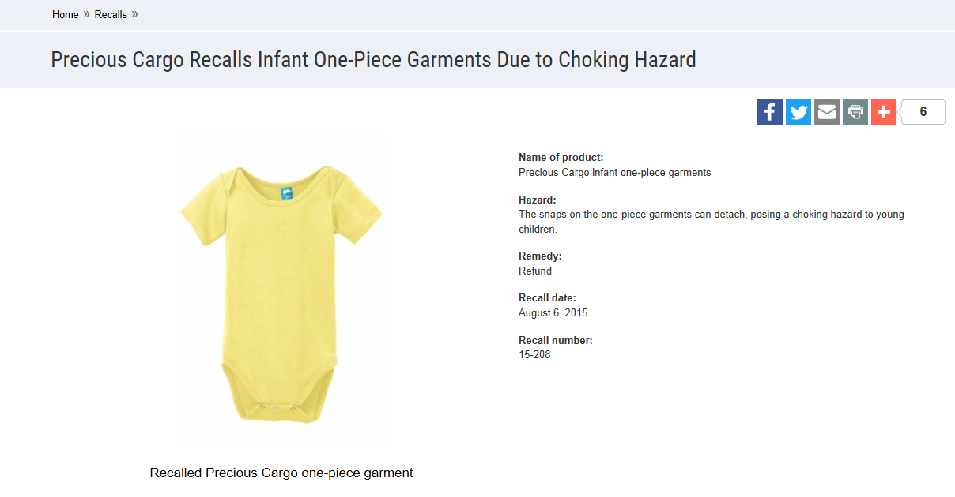

Small Parts

Slide 33
Adult and Children’s Apparel
Summarization of CPSC Apparel Requirements

Slide 34
Adult Apparel
GCC
Must meet Clothing Textile (or Vinyl Plastic Film) requirements.
Enforcement policy (March 2016)
  Adult apparel exempt from testing does not require a GCC to be issued.
  https://www.cpsc.gov/s3fs-public/StatementofPolicyEnforcmentDiscretionRegardingGeneralConformityAdultWearingApparelExemptfromTesting.pdf

Slide 35
Children’s Apparel
CPC and third party testing by a CPSC-accepted laboratory
Clothing Textile (or Vinyl Plastic Film)
Lead content (zippers, buttons)
Lead in paint or surface coating (screen printing)
Phthalate (bibs)
Tracking label
Drawstring; does not require certification, but standard must be met.

Slide 36

Questions?
Submit questions in English or Chinese to this podcast:
CPSCinChina@CPSC.GOV

Slide 37
Resources

Slide 38
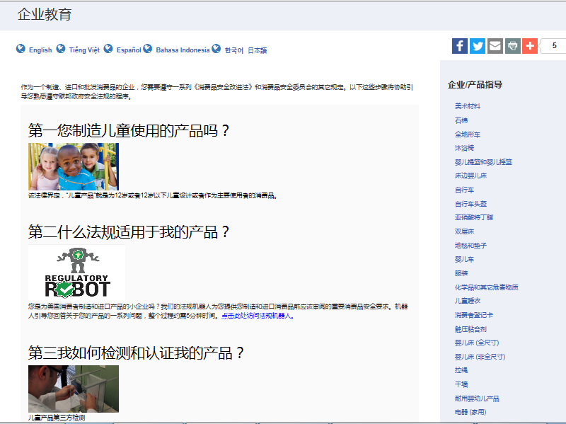

https://www.cpsc.gov/zh-CN/Business--Manufacturing/Business-Education
Chinese Resources at cpsc.gov

Slide 39
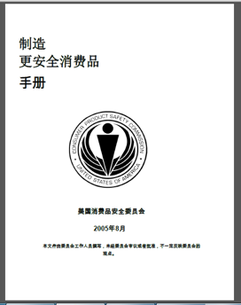
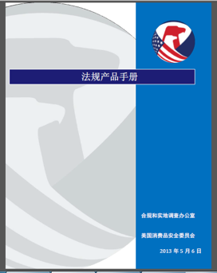
Chinese Resources at cpsc.gov
https://www.cpsc.gov/s3fs-public/HandbookforManufacturingChinese.pdf (中文版本 )
https://www.cpsc.gov/s3fs-public/pdfs/blk_pdf_handbookenglishaug05.pdf (英文版本)
https://www.cpsc.gov/s3fs-public/THE%20REGULATED%20PRODUCT%20HANDBOOK_050613%20CHN%20Final_0.pdf (中文版本 )
https://www.cpsc.gov/s3fs-public/RegulatedProductsHandbook.pdf (英文版本)

Slide 40
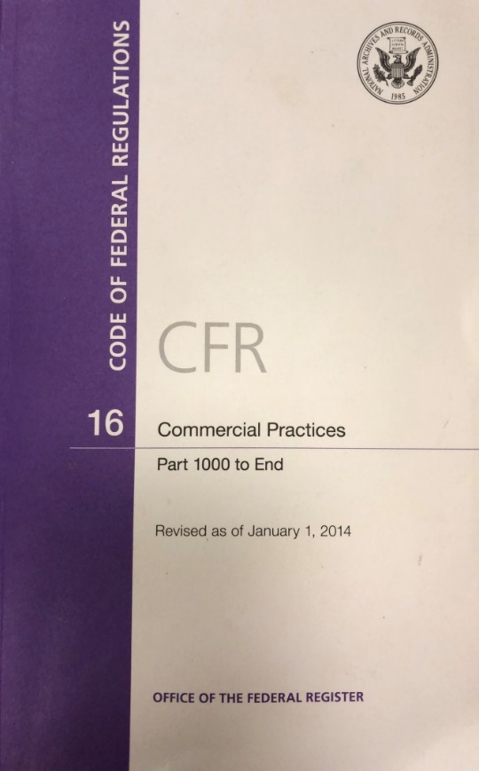
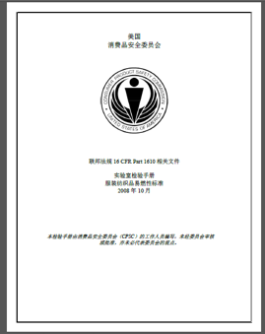
Chinese Resources at cpsc.gov
CFR: Commercial Practices
https://www.govinfo.gov/content/pkg/CFR-2017-title16-vol2/pdf/CFR-2017-title16-vol2.pdf (英文版本)
CPSC Laboratory Manuals:
https://www.cpsc.gov/s3fs-public/Laboratory-test-manual-16-CFR-Part-1610-Ch.pdf?MhtbUWNy6jmOPx9b6f.RErt.n.2n_d_h (中文版本)
https://www.cpsc.gov/s3fs-public/Flammability%20of%20Clothing%20Textiles%20Test%20Manual_1610.pdf (英文版本)

Slide 41
Definition of children’s product – 16 CFR Part 1200
Certificates of conformity – 16 CFR Part 1110
Third-party testing – 16 CFR Parts 1107, 1109, and 1112
Tracking information – 15 USC § 2063(a)(5)
Mandatory reporting requirements – 15 USC §2064
CPSC Business Resources
CPSC-Accepted Laboratories Search Page:
www.cpsc.gov/LabSearch

Slide 42


http://business.cpsc.gov
Online tool designed specifically to help businesses comply with federal consumer product safety requirements.
Asks a series of guided questions, and based on the answers produces a downloadable (PDF) report.
Provides customized guidance with links to product safety regulations that may apply to the product and important information on labeling, certification and testing requirements.

Slide 43
Regulatory Robot
Regulatory Robot is a tool to help identify which mandatory standards are applicable
  Does not give details of requirements within a specific standard
User inputs product features
Regulatory Robot outputs list of standards and requirements
User references source documents for specific requirements

Slide 44
Regulations
https://www.cpsc.gov/Regulations-Laws--Standards/Statutes/Flammable-Fabrics-Act/
Laboratory Test Manual for 16 CFR Part 1610: Standard for the Flammability of Clothing Textiles
English: https://www.cpsc.gov/s3fs-public/Flammability%20of%20Clothing%20Textiles%20Test%20Manual_1610.pdf
Chinese: https://www.cpsc.gov/s3fs-public/Laboratory-test-manual-16-CFR-Part-1610-Ch.pdf?MhtbUWNy6jmOPx9b6f.RErt.n.2n_d_h
Laboratory Test Manual for 16 CFR Parts 1615 and 1616: Standard for the Flammability of Children’s Sleepwear
English: https://www.cpsc.gov/s3fs-public/Flammability%20of%20Children's%20Sleepwear%20Test%20Manual_1615_1616.pdf
Chinese: https://www.cpsc.gov/s3fs-public/Flammability-of-Childrens-Sleepwear-Test-Manual_1615_16-6-Ch.pdf?Qc5b50jB2AmTEfKBj7SzepQWRsqLDN2c
Apparel Resources

Slide 45
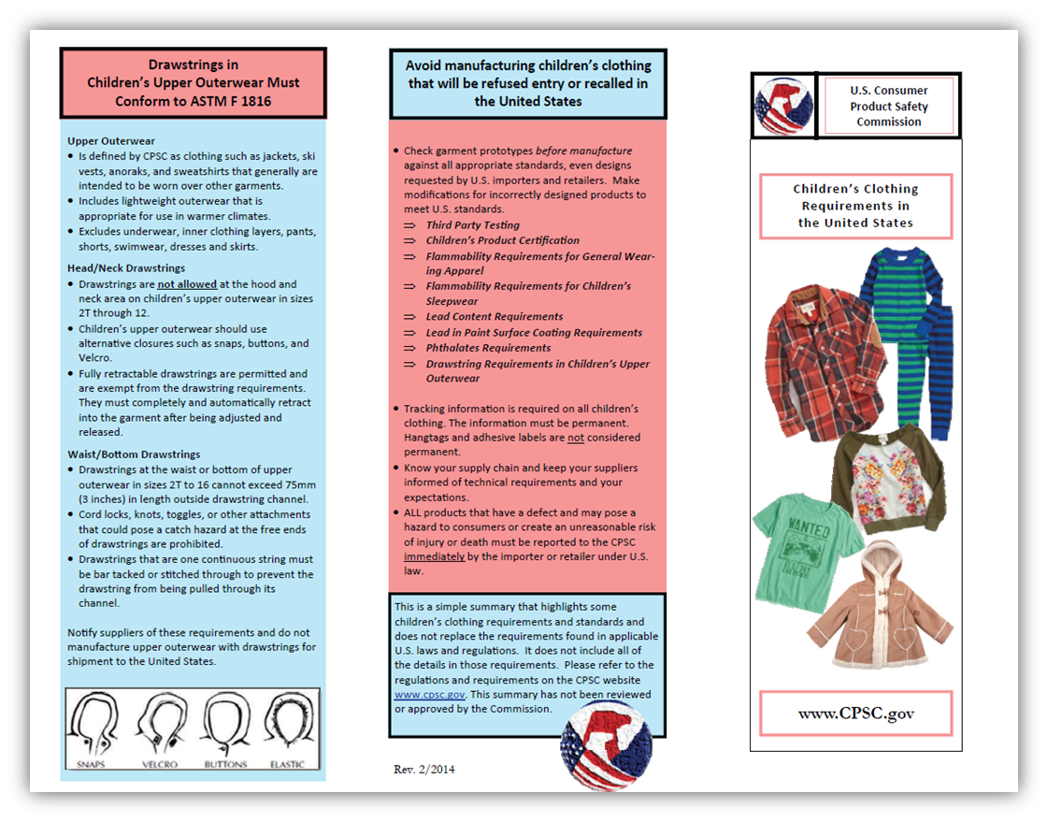
Apparel Resources
https://www.cpsc.gov/safety-education/safety-guides/clothing-and-accessories

Slide 46
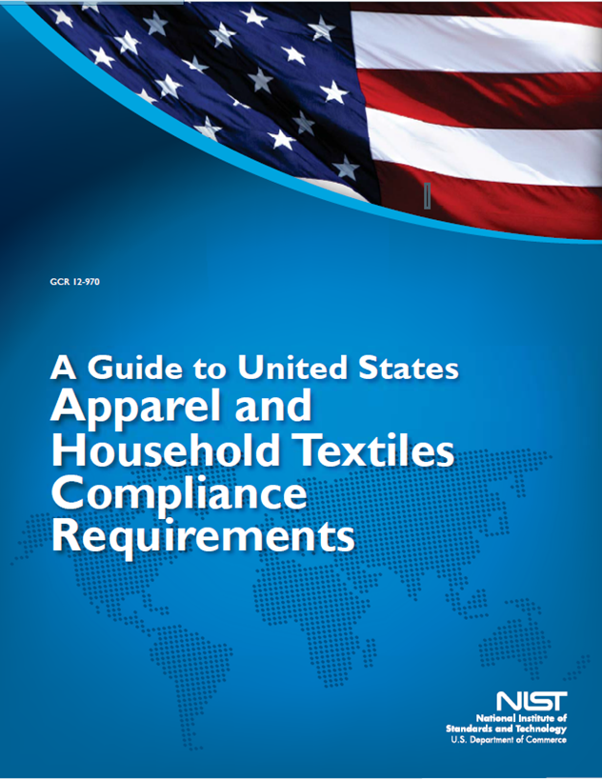
Apparel Resources
https://nvlpubs.nist.gov/nistpubs/ir/2016/NIST.IR.8115.pdf

