Slide 1
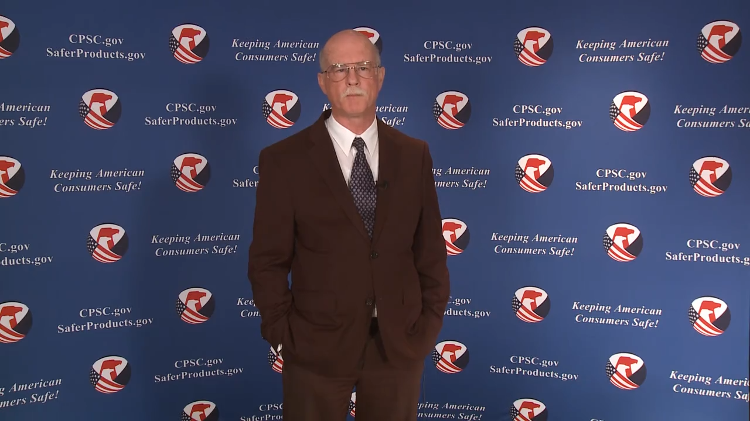
Video: Welcome to the 2020 CPSC Podcast Series-Overview of U.S. Strollers and Carriages Requirements

Slide 2
Podcast Series 2020
Overview of U.S. Strollers and Carriages Requirements
This presentation was prepared by CPSC Staff. It has not been reviewed or approved by the Commission and may not reflect its views.

Slide 3

Biographies
Sylvia Chen
U.S. Consumer Product Safety Commission
Program Manager for East Asia and Pacific
Office of International Programs
Sylvia Chen is Program Manager for East Asia and Pacific at the U.S. Consumer Product Safety Commission (CPSC). In that role, she is responsible for managing the Commission’s bilateral and multi-lateral programs related to consumer product safety in Australia, Japan, Korea, Taiwan and New Zealand. She also supports the CPSC’s work with China. Since she joined the CPSC in 2008, Sylvia has been working with product safety regulators, industry organizations, manufacturers, exporters, buyers and other sourcing professionals to provide them with guidance and technical support in understanding U.S. requirements, in particular, the latest requirements for consumer products. To that end, she has organized or coordinated many of the agency’s international education and outreach activities.
Sylvia has a Bachelor of Arts degree in English and American Literature from Peking University. In 1991, she graduated from The Ohio State University with a Master’s degree in East Asian Studies.

Slide 4

The US CPSC is a federal government agency charged with protecting the public from unreasonable risks of injury or death associated with the use of consumer products under the agency's jurisdiction.
$1 Trillion
Deaths, injuries, and property damage from consumer product incidents cost the nation more than $1 trillion annually.¹
¹ https://www.cpsc.gov/s3fs-public/FY2019PBR.pdf
CPSC is committed to protecting consumers from products that pose a fire, electrical, chemical, biological, or mechanical hazard.
CPSC's work to improve the safety of the more than 15,000 types of consumer products in its jurisdiction - such as toys, cribs, power tools, cigarette lighters, textiles, and household chemicals – has contributed to a decline in the rate of deaths and injuries associated with consumer products over the past 40 years.

Slide 5
CPSC’s Podcast Series
Podcast | Topics
#1 | Selling Safe Electrical Products to the U.S. Market
#2 | Overview of U.S. Apparel Requirements
#3 | Bicycle Regulations Safety Standards
#4 | Overview of U.S. Mattress Requirements
#5 | Durable Infant or Toddler Products Common Requirements
#6 | Overview of U.S. Strollers and Carriages Requirements
#7 | Toy Safety
“Questions on this Presentation? Send an email to CPSCinChina@cpsc.gov”

Slide 6
The slides used in this podcast are not a comprehensive statement of legal requirements or policy and should not be relied upon for that purpose. You should consult official versions of U.S. statutes and regulations, as well as published CPSC guidance when making decisions that could affect the safety and compliance of products entering U.S. commerce. Note that references are provided at the end of the presentation.

Slide 7
Overview of U.S. Strollers and Carriages Requirements

Slide 8
Topics
Carriages and Strollers History
Defining Carriages & Strollers
Labeling & Instructional Literature Requirements
Product Registration Requirement
Testing Requirements
Product Hazards
Children’s Product Certificate
Recall Examples
Have Questions?
CPSC Business Resources

Slide 9
Carriages & Strollers History
Notice of Proposed Rulemaking - May 20, 2013
Previous Standards: Incorporated ASTM F833-13b with a modification to address head entrapment hazards associated with multi-positional/adjustable grab bars.
  Applied to products manufactured beginning on September 10, 2015 through October 1, 2016.
16 C.F.R. Part 1227 incorporating ASTM F833-15 (without modification.)
  Effective date: October 2, 2016 (on products manufactured on or after this date.)
Current Standard: 16 C.F.R. Part 1227 incorporating ASTM F833-19 (without modification.)
  Effective date: November 5, 2019 (on products manufactured on or after this date.)

Slide 10
Defining Carriages & Strollers
Carriage Definition – ASTM F833-19
  “[W]heeled vehicle generally used for the transport of an infant who is generally in a lying down position. The motive power is supplied by a person or persons pushing or pulling on a handle attached to the vehicle. A carriage may be capable of being folded for storage.”
Stroller Definition – ASTM F833-19
  “[W]heeled vehicle for the transport of infants or children generally in a sitting-up or semi-reclined position. The motive power is supplied by a person moving at a walking rate while pushing on a handle attached to the stroller. A stroller generally is capable of being folded for storage. Strollers normally are used for children from infancy to 36 months of age.”

Slide 11
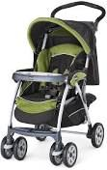
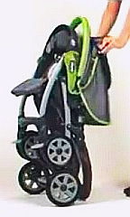
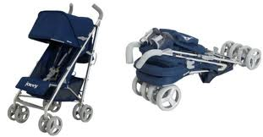
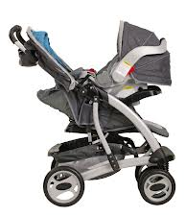
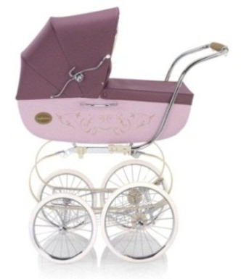

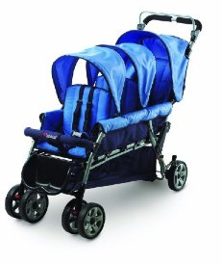
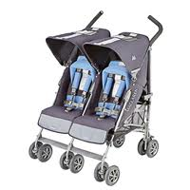
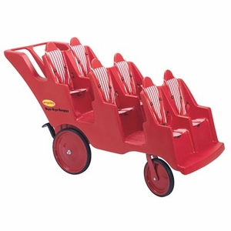
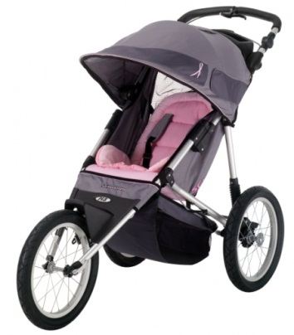

Examples of Carriages & Strollers
3D Umbrella Stroller
Travel System
Carriage
Full-size 2D Stroller
Tandem Stroller
Side-by-Side Stroller
Multi-Occupant Stroller
Jogging Stroller
*Photos are for illustration purposes only and not meant as an endorsement of the products shown.

Slide 12
Labeling Information
Marking and Labeling (Permanently on Product and Packaging) – per ASTM F833-19 and applicable law:
  Manufacturer/Distributor/Seller Name and
  Place of business (city, state, and U.S. mailing address, including zip code) and U.S. telephone number (per 16 C.F.R. §1130.4.)
  Code or mark identifying the date (month and year minimum) of manufacture.
  Batch or run number, if used (CPSIA tracking information requirement)
  There is also a requirement that the maximum weight of the intended user be listed on the packaging.
Check out website FAQs:
www.cpsc.gov/TrackingLabel

Slide 13

Warning Requirements
Warning statements are required to be on the products and in their instructional literature.
WARNING Never leave child unattended.
Products manufactured with a restraint system:
  WARNING Avoid serious injury from falling or sliding out.
  Always use seat belt (or manufacturer may insert another word(s) to describe their restraint system).
Products with reclined carriage position(s):
  WARNING Child may slip into leg openings and strangle. Never use in reclined carriage position(s) unless (manufacturer to insert product specific instructions.) (Not required on units that do not have openings or that automatically reduce the size of all openings.)
Products with removable-wheel fork assembly or three wheeled strollers (such as jogging strollers) with locking front swivel wheel require additional warning statements.
Other: WARNING Children can choke on foam. Only use with the cover installed.

Slide 14
Instructional Literature Requirements
Instructional literature may be on the package or included in leaflet form.
Shall be easy to read and understand and in English.
Instructions shall include assembly, maintenance, cleaning, and operating (including folding) information.
Instructions must state the maximum weight of the intended user.
Instructions must also contain the same warnings as required for the product.
Depending on the design of the product, warning statements related to arm bar foam may also be needed.

Slide 15
Instructional Literature Requirements
Additional instructions for products as follows:
  Units manufactured with restraint system – instructions describing the use of the restraint system, and
    WARNING Avoid serious injury from falling or sliding out. Always use seat belt (or manufacturer may insert another word(s) to describe their restraint system.)
  Convertible carriage/strollers requiring manual operation to comply with occupant retention requirements -
    WARNING Child may slip into leg openings and strangle. Never use in reclined carriage position(s) unless (manufacturer to insert product specific instructions.)

Slide 16
Instructional Literature Requirements
Additional instructions for products as follows:
  Products with removable fork assembly - describe proper assembly and maintenance procedures for these mechanisms.
  Products supplied with package carrying accessories with original equipment- state the maximum weight recommended and warn that excessive weight may cause hazardous unstable condition to exist.
  Products not supplied with package carrying accessories - warn that unstable hazardous conditions may exist if these accessories are added onto the product.

Slide 17
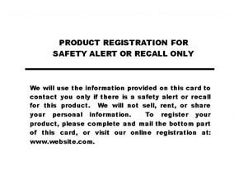
Product Registration Requirement
Manufacturers of Durable Infant or Toddler Products must include a product registration form attached to the product – 16 C.F.R. Part 1130.
  Provide consumers with postage-paid product registration card
  Maintain records of names, addresses, emails, and other contact info on consumers that register their products
  Permanently place the manufacturer or importer’s name and U.S.-based contact info, model name and number, and date of manufacture on each durable product
    Please note, even if your company is located outside of United States, you must have U.S. contact information.
  Intended to improve recall effectiveness
  Alert consumers in the event of recall.
Product Registration Card FAQs
site is a good reference

Slide 18
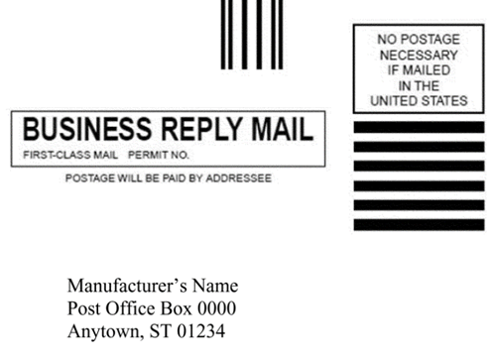
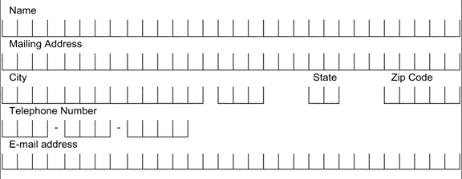
An example of a registration form
产品注册表的范例
Manufacturer’s U.S. contact information: address and registration website.
If no registration website, email is required. 制造商的美国联系信息：
地址和注册网站。如果没有注册网站， 则需要电子邮件。
Purpose statement 目的声明
Manufacturer’s Contact Information
PRODUCT REGISTRATION FOR SAFETY ALERT OR RECALL ONLY
Manufacturer’s Name
111 Main St., Anytown, ST 01234
www.website.com
Phone Number-Toll-Free (if available)
Consumer keeps
消费者保存
We will use the information provided on this card to contact you only if there is a safety alert or recall for this product. We will not sell, rent, or share your personal information. To register your product, please complete and mail the bottom part of this card, or visit our online registration at: www.website.com
Model Name: ABC
Model Number: 123
Manufacture Date: January 1, 2020
Pre-printed product info. 预印产品信息
KEEP THIS TOP PART FOR YOUR RECORD. FILL OUT AND RETURN BOTTOM PART.
Postage paid 邮资已付
Consumer’s Address And Contact Information
Place for consumers to fill in their contact info. 消费者填写联系信息的地方。
Consumer mails out
消费者邮寄
Manufacturer’s Name
Post Office Box 0000
Anytown, ST 01234
Model Name: ABC
Model Number: 123
Manufacture Date: January 1, 2020
Pre-printed product info. 预印产品信息
Manufacturer’s U.S. mailing address.
制造商的美国邮寄地址
FRONT
BACK

Slide 19
Registration Form
产品注册表: 消费者保存的部分
Purpose statement
目的声明
PRODUCT REGISTRATION FOR SAFETY ALERT OR RECALL ONLY
front side 前面
We will use the information provided on this card to contact you only if there is a safety alert or recall for this product. We will not sell, rent, or share your personal information. To register your product, please complete and mail the bottom part of this card, or visit our online registration at: www.website.com
Manufacturer’s U.S. contact information: address and registration website. If no registration website, email is required.
制造商的美国联系信息：
地址和注册网站。
如果没有注册网站，
则需要电子邮件。
Manufacturer’s Contact Information
Manufacturer’s Name
111 Main St., Anytown, ST 01234
www.website.com
Phone Number-Toll-Free (if available)
back side
后面
Model Name: ABC
Model Number: 123
Manufacture Date: January 1, 2020
Pre-printed product info.
预印产品信息
KEEP THIS TOP PART FOR YOUR RECORD. FILL OUT AND RETURN BOTTOM PART.

Slide 20
Registration Form
产品注册表: 消费者邮寄的部分
Postage paid
邮资已付
front side
前面
Manufacturer’s Name
Post Office Box 0000
Anytown, ST 01234
Manufacturer’s U.S. mailing address
制造商的美国邮寄地址
Place for consumers to fill in their contact info.
消费者填写联系信息
的地方
Consumer’s Address And Contact Information
back side
后面
Pre-printed product info.
预印产品信息
Model Name: ABC
Model Number: 123
Manufacture Date: January 1, 2020

Slide 21
Testing Requirements (Chemical)
Lead Content Testing – 15 U.S.C. §1278a
  Limit: No more than 100 ppm in any accessible parts of children’s products
  Materials that do not exceed the lead limit in untreated, unadulterated state – 16 CFR §1500.91
    Wood, Paper and similar materials made from wood
    CMYK process printing inks
    Natural fibers (dyed or undyed) including, but not limited to, cotton, linen, hemp, bamboo, sisal, silk, wool (sheep)
    Manufactured fibers (dyed or undyed) including, but not limited to, rayon, lyocell, acetate, triacetate, rubber, polyester, nylon, acrylic, modacrylic, spandex

Slide 22
Testing Requirements (Chemical)
Lead in Paint and Similar Surface Coatings – 16 C.F.R. Part 1303
  Limit: No more than 90 ppm in paint and surface coatings
Phthalates (plasticizers) – 16 CFR Part 1307
  Carriages and strollers that contain plasticized parts designed, marketed, or intended to facilitate sleep (i.e., carriages or reclining strollers) or facilitate eating (i.e., food tray.)
  Limit: Permanent Ban –No more than 0.1% of DEHP, DBP, BBP, DINP, DIBP, DPENP, DHEXP, or DCHP.

Slide 23
Testing Requirements (Chemical)
Phthalates: Determinations Regarding Certain Plastics - 16 C.F.R. Part 1308
  Effective Date: September 29, 2017
  Seven plastics removed from independent third-party testing requirement for compliance with phthalates prohibitions:
    Polypropylene (PP)
    Polyethylene (PE)
    High-impact polystyrene (HIPS)
    Acrylonitrile butadiene styrene (ABS)
    General purpose polystyrene (GPPS)
    Medium-impact polystyrene (MIPS)
    Super-high-impact polystyrene (SHIPS)

Slide 24
Testing Requirements (Physical & Mechanical)
Small Parts – 16 C.F.R. Part 1501
  Small part fits entirely into a small parts cylinder specified in the regulation
  No small parts can be included on the stroller or carriage before testing or liberated during testing
Exposed Wood Parts – must be smooth and free of splinters
Hazardous Sharp Points or Edges - 16 C.F.R. §§1500.48, 1500.49
  No sharp points or edges before and after testing.
Exposed coil springs - accessible to the occupant must be covered or designed to prevent injury from entrapment.
Restraint system - required on all products except carriages designed only for an infant, must include waist and crotch restraint and meet additional performance specifications.

Slide 25
Testing Requirements (Physical & Mechanical)
Latching Mechanisms – units that fold shall have a latching device that prevents the unit from unintentional folding when placed in the manufacturer’s recommended use position.
Scissoring, Shearing, and Pinching – unit must be designed to prevent injuries such as finger amputations, laceration, and crush injuries to the occupant when members or components rotate or move relative to one another.
Toy Accessories – if sold with unit must meet US Toy Standard, ASTM F963 requirements.
Cord/Strap Length – limitations on loop perimeter length and free stretched length of cords and straps originating within or extending into occupant space in order to prevent strangulation in the cord.

Slide 26
Testing Requirements (Physical & Mechanical)
Performance Requirements:
  Parking Brake to address fall hazard
  Static Load to address tip overs and collapses
  Stability to address tip overs
  Restraining System to address fall hazard
  Occupant Retention for carriages and convertible carriages/strollers to address falls
  Combination Unit of a Car Seat on a Stroller to address falls, tip overs, and collapses

Slide 27
Testing Requirements (Physical & Mechanical)
Performance Requirements:
  Impact Test to address car seat detachment and to ensure product integrity
  Passive Containment/Foot Opening to address head and torso entrapment
  Wheel and Swivel Assemblies Detachment to address falls and tip overs
  Car Seat on a Stroller or Convertible Carriage/Stroller Test to address head entrapment
  Tray/Grab Bar must have a protective covering

Slide 28
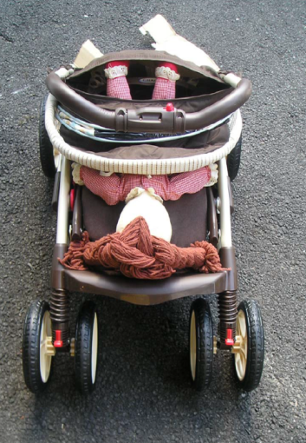
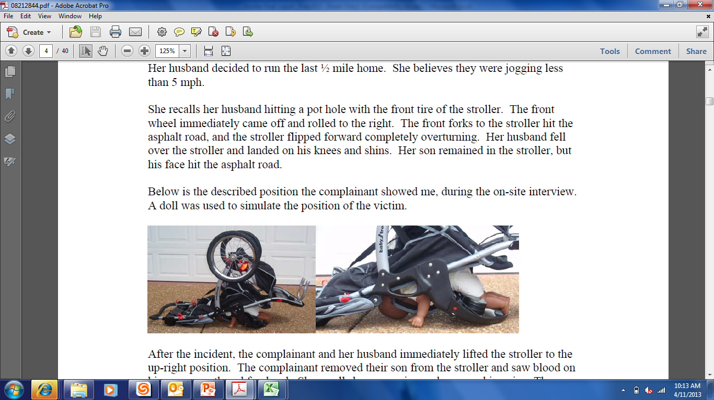
Product Hazards
Collapsed Stroller
Wheel Issues/Fall Hazard
Wheel and Swivel Assemblies Detachment Testing required.
Warning Label Requirement on Jogging Strollers to LOCK front swivel wheel (where equipped) before jogging.
Latching Mechanisms Testing required for prevention of unintentional folding.
*Photos are for illustration purposes only.

Slide 29
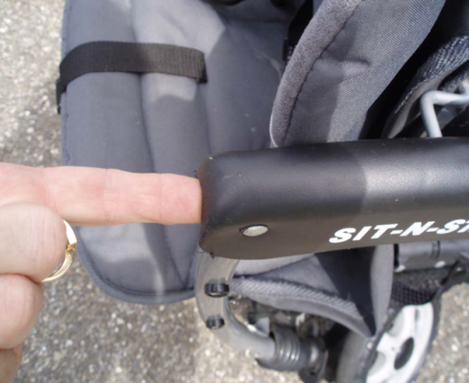
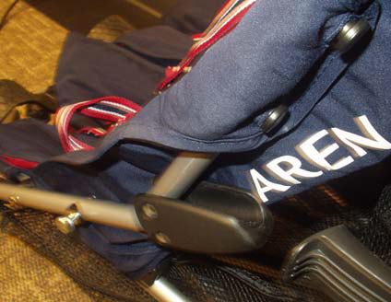

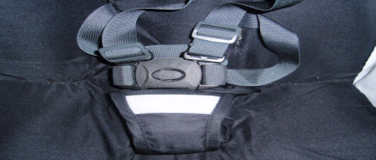
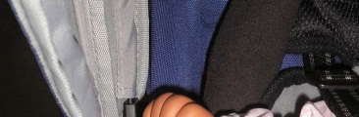
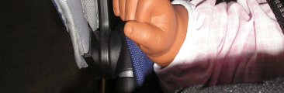

Product Hazards
Pinch Points (shown on Frame, Hinges, and Canopy)
Scissoring, Shearing, and Pinching testing required using test probes of specified diameter.
*Photos are for illustration purposes only.

Slide 30
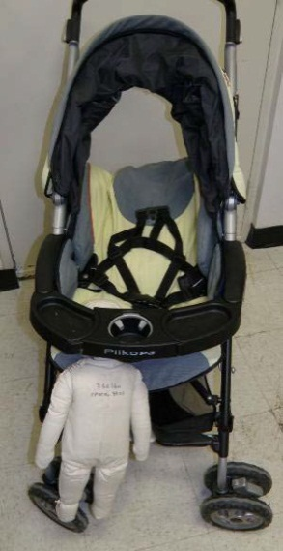
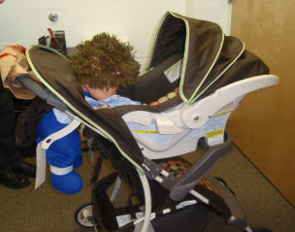
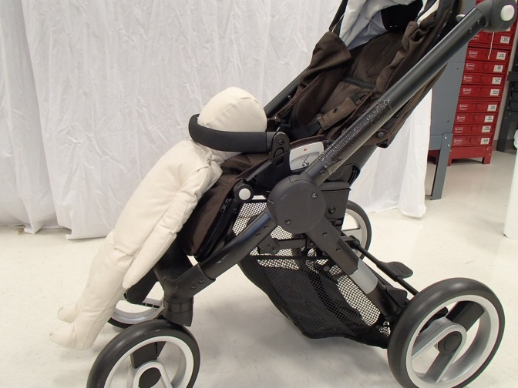
Product Hazards
Entrapment (shown at food tray, stroller handle with car seat, and at grab bar)
Passive Containment/Foot Opening Testing required using head and torso probes.
*Photos are for illustration purposes only.

Slide 31
Testing Requirements: Finding a Testing Lab
Find a CPSC-accepted lab via our website: www.cpsc.gov/labsearch
  Can Narrow search by Region (by country)
  Can Narrow search by Scope (or specific product testing needed)
    16 C.F.R. Part 1227, Safety Standard for Carriages and Strollers (incorporating by reference ASTM F833-19)

Slide 32
Testing Requirements: Frequency of Testing
Periodic Testing Rule (for products in continuous production) – 16 C.F.R. §1107.21
After initial testing, periodic testing required at a minimum of:
  Once per year
  Every two years with a Production Testing Plan
  Every three years using a testing laboratory accredited to ISO/IEC 17025:2005(E).
  ***Vast majority of manufacturers and importers must test children’s products once per year.
Material Change – 16 C.F.R. §1107.23
  Change that the manufacturer makes to their product’s design, to the manufacturing process, or to the source of component parts for the product, which a manufacturer, exercising due care, knows, or should know, could affect the product’s ability to comply with the applicable children’s product standards.

Slide 33
Children’s Product Certificates
  All children’s products require a Children’s Product Certificate (CPC)
Availability of Certificates (CPC/GCC) –
  Certificates must “accompany” each product or shipment of products covered by the same certificate.
  A copy of the certificate must be “furnished to each distributor or retailer of the product” (no requirement to provide to ultimate consumer).
  A copy of the certificate must be made available to the Commission and Customs upon request.
Electronic certificates are acceptable but must be created in advance and made available to the Commission or to the Customs authorities as soon as the product or shipment itself is available for inspection.
www.cpsc.gov/CPC

Slide 34
Children’s Product Certificates
  Description of product(s) covered by certificate
  Citation to each CPSC safety rule to which you are certifying compliance
    15 U.S.C. §1278a - Total Lead Content
    16 C.F.R. Part 1303 – Lead in Paint and Surface Coatings
    15 U.S.C. §2057c – Ban on Phthalates in Toys and Child Care Articles Used to Facilitate Sleeping or Eating (if applicable based on how product is designed, intended for use, and marketed)
    16 C.F.R. Part 1501 – Small Parts Regulation
    16 C.F.R. Part 1227, ASTM F833-19 – Carriages & Strollers
  Importer/Domestic Manufacturer contact information
  Contact information for person maintaining test records
  Date and Place of Manufacture
  Location of Testing and Date of Test on which certification is based
  Contact information of testing laboratory

Slide 35
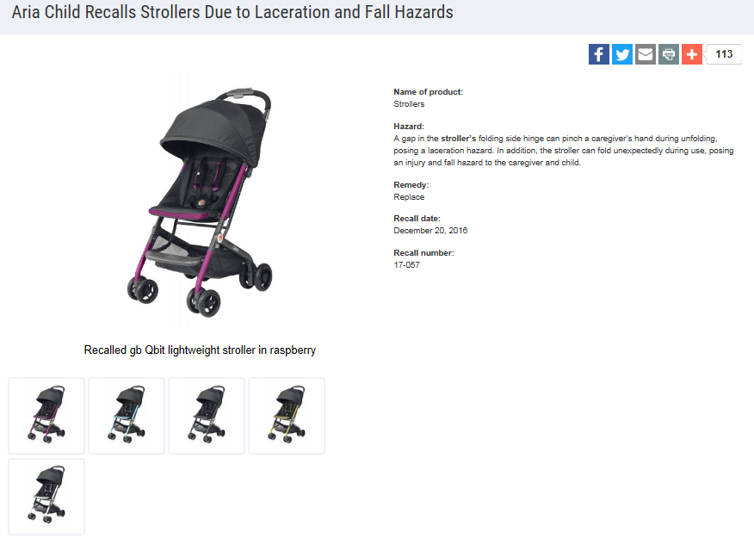
Recall Examples

Slide 36
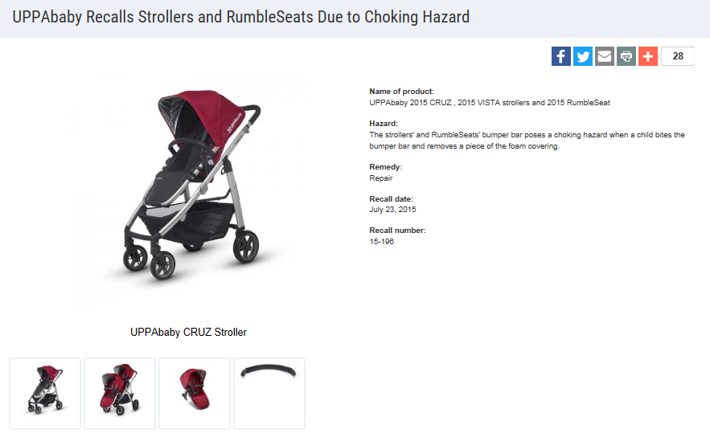
Recall Examples

Slide 37

Questions?
Submit questions in English or Chinese to this podcast:
CPSCinChina@CPSC.GOV

Slide 38
Resources

Slide 39
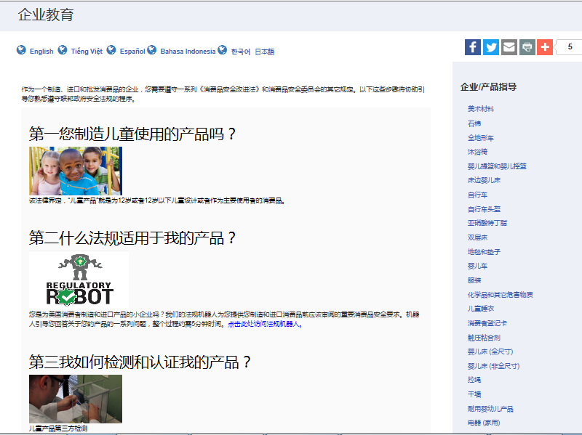
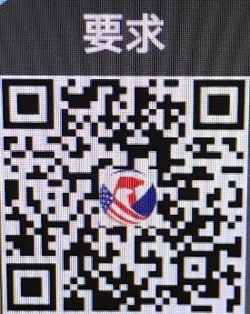
https://www.cpsc.gov/zh-CN/Business--Manufacturing/Business-Education
Chinese Resources at cpsc.gov

Slide 40
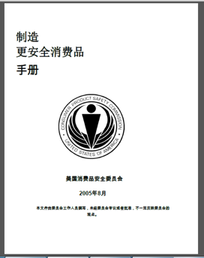
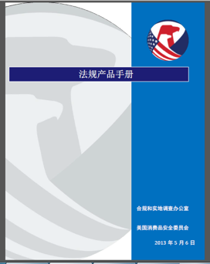
Chinese Resources at cpsc.gov
https://www.cpsc.gov/s3fs-public/HandbookforManufacturingChinese.pdf (中文版本 )
https://www.cpsc.gov/s3fs-public/pdfs/blk_pdf_handbookenglishaug05.pdf (英文版本)
https://www.cpsc.gov/s3fs-public/THE%20REGULATED%20PRODUCT%20HANDBOOK_050613%20CHN%20Final_0.pdf (中文版本 )
https://www.cpsc.gov/s3fs-public/RegulatedProductsHandbook.pdf (英文版本)

Slide 41
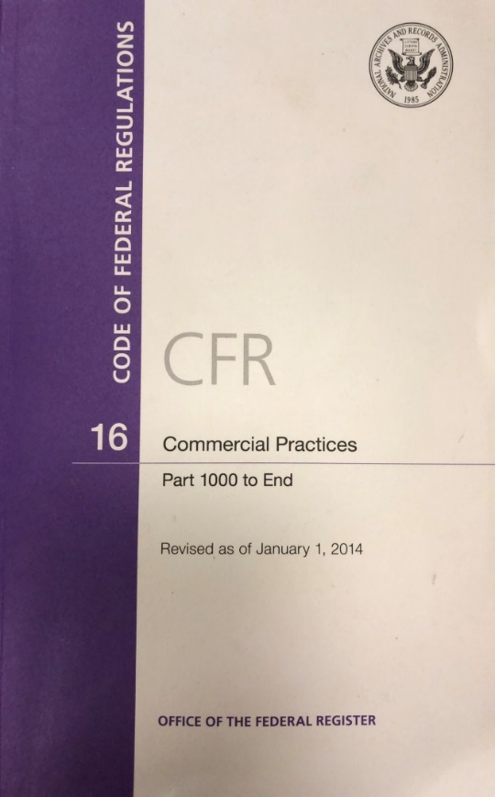
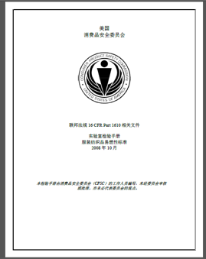
Chinese Resources at cpsc.gov
CFR: Commercial Practices
https://www.govinfo.gov/content/pkg/CFR-2017-title16-vol2/pdf/CFR-2017-title16-vol2.pdf (英文版本)
CPSC Laboratory Manuals:
https://www.cpsc.gov/s3fs-public/Laboratory-test-manual-16-CFR-Part-1610-Ch.pdf?MhtbUWNy6jmOPx9b6f.RErt.n.2n_d_h (中文版本)
https://www.cpsc.gov/s3fs-public/Flammability%20of%20Clothing%20Textiles%20Test%20Manual_1610.pdf (英文版本)

Slide 42
Definition of children’s product – 16 CFR Part 1200
Certificates of conformity – 16 CFR Part 1110
Third-party testing – 16 CFR Parts 1107, 1109, and 1112
Tracking information – 15 USC § 2063(a)(5)
Mandatory reporting requirements – 15 USC §2064
CPSC Business Resources
CPSC-Accepted Laboratories Search Page:
www.cpsc.gov/LabSearch

Slide 43

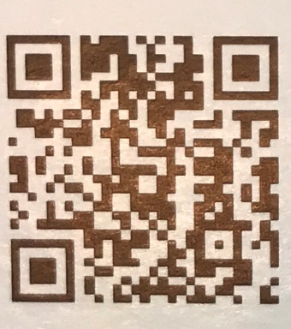
http://business.cpsc.gov
Online tool designed specifically to help businesses comply with federal consumer product safety requirements.
Asks a series of guided questions, and based on the answers produces a downloadable (PDF) report.
Provides customized guidance with links to product safety regulations that may apply to the product and important information on labeling, certification and testing requirements.

Slide 44
Regulatory Robot
Regulatory Robot is a tool to help identify which mandatory standards are applicable
  Does not give details of requirements within a specific standard
User inputs product features
Regulatory Robot outputs list of standards and requirements
User references source documents for specific requirements

Slide 45
Revisions to Safety Standard for Carriages and Strollers
https://www.federalregister.gov/d/2019-16524
Carriages and Strollers Buisnesss Guidance & Small Entity Compliance Guide
https://www.cpsc.gov/Business--Manufacturing/Business-Education/Business-Guidance/Carriages-and-Strollers/
Regulatory Robot Report
https://business.cpsc.gov/robot/decision/viewreport/6-82.30-82
CPSC Business Resources-Carriages and Strollers

