Slide 1
These slides highlight key U.S. product safety requirements for discussion. The text is not a comprehensive statement of legal requirements or policy and should not be relied upon for that purpose. Moreover, with the passage of time, the slides may not reflect the latest information. You should consult official versions of U.S. statutes and regulations, as well as published CPSC guidance when making decisions that could affect the safety and compliance of products entering U.S. commerce. Note that reference materials are listed at the end of the presentation.

Slide 2
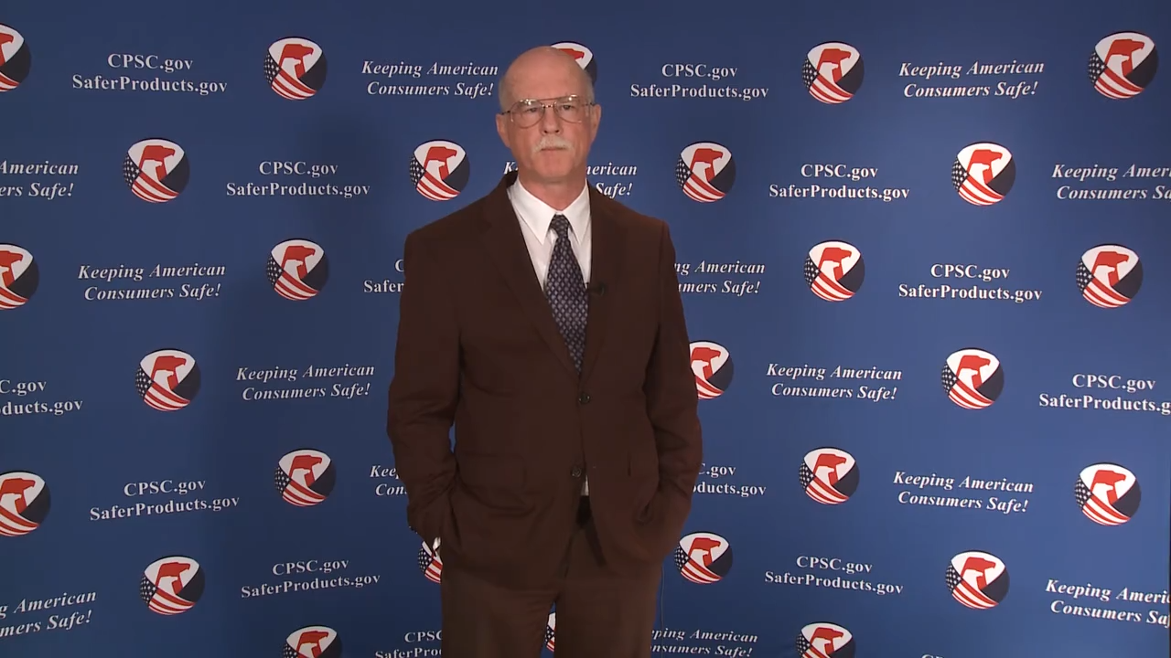
Video: Welcome to CPSC China Podcast Series- CPSC’s Import Screening Program

Slide 3
CPSC’s Import Screening Program
Presented by:
Sylvia Chen, Program Manager, and
Marcy Van Winkle, Port Investigator
2022
This presentation was prepared by CPSC staff. It has not been reviewed or approved by the Commission and may not reflect its views.

Slide 4

Biographies
Sylvia Chen
U.S. Consumer Product Safety Commission
Program Manager for East Asia and Pacific
Office of International Programs
Sylvia Chen is responsible for managing the Commission’s bilateral and multilateral programs related to consumer product safety in Australia, Japan, Korea, Taiwan, and New Zealand. She also supports the CPSC’s work with China. Since she joined the CPSC in 2008, Sylvia has been working with product safety regulators, industry organizations, manufacturers, exporters, buyers, and other sourcing professionals to provide them with guidance and technical support in understanding U.S. requirements, in particular, the latest requirements for consumer products. To that end, she has organized or coordinated many of the agency’s international education and outreach activities.
Sylvia has a Bachelor of Arts degree in English and American Literature from Peking University. In 1991, she graduated from The Ohio State University with a Master’s degree in East Asian Studies.

Slide 5

The US CPSC is a federal government agency charged with protecting the public from unreasonable risks of injury or death associated with the use of consumer products under the agency's jurisdiction.
$1 Trillion
Deaths, injuries, and property damage from consumer product incidents cost the nation more than $1 trillion annually.¹
¹ https://www.cpsc.gov/s3fs-public/FY2019PBR.pdf
CPSC is committed to protecting consumers from products that pose a fire, electrical, chemical, biological, or mechanical hazard.
CPSC's work to improve the safety of thousands of types of consumer products in its jurisdiction - such as toys, cribs, power tools, cigarette lighters, textiles, and household chemicals - has contributed to a decline in the rate of injuries associated with consumer products over nearly 50 years.

Slide 6
CPSC’s China Podcast Series
Podcast | Topics
#1 | Selling Safe Electrical Products to the U.S. Market
#2 | Overview of U.S. Apparel Requirements
#3 | CPSC Bicycle Regulations and U.S. and International Safety Standards
#4 | Overview of U.S. Mattress Requirements
#5 | Durable Infant or Toddler Products: Common Requirements
#6 | Overview of U.S. Strollers and Carriages Requirements
#7 | Toy Safety Requirements and Mandatory Standards
#8 | Overview of Children’s Sleepwear Requirements
#9 | Enhancing the Safety of Emerging Technology through Risk Assessment: Wearables
#10 | Overview for Battery Safety Requirements
#11 | Overview of Gates and Enclosures Requirements

Slide 7
CPSC’s China Podcast Series (Continued)
Podcast | Topics
#12 | Overview of Consumer Safety and Micromobility Devices
#13 | Overview of Cribs and Play Yards Requirements
#14 | Product Safety and Compliance: Best Practices for Buyers Exporting Consumer Goods to the United States
#15 | U.S. Flammability Requirements for Upholstered Furniture
#16 | How to Find Safety Requirements for Your Product Using CPSC’s Regulatory Robot
#17 | CPSC’s Import Screening Program
#18 | Overview of CPSC’s Third Party Laboratory Program for Children’s Products
#19 | Infant Sleep Product Safety Requirements
#20 | Children's Folding Chairs/Stools Safety Requirements
“Questions on this presentation? Send an email to CPSCinChina@cpsc.gov”

Slide 8
Presentation Agenda
Importing Overview
CPSC at the Port
    Screening and Targeting of CPSC-Regulated Products
    Detention, Conditional Release, and Evaluation Processes
National Statistics
Demonstration Video

Slide 9
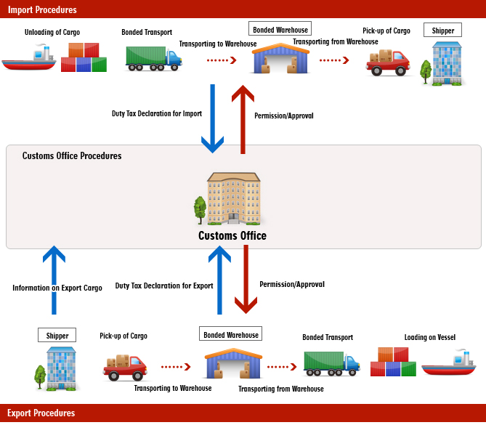

Importing Overview - CPSC at the Port
1. Cargo is loaded onto a container ship in the foreign port of lading – cargo manifests are filed.
CPSC HQ and
CPSC at the ports
CPSC HQ and
Local CPSC

Slide 10
Importing Overview - CPSC at the Port
2. Ship travels to the US and enters a Port of Unlading.
CPSC HQ and
CPSC at the ports
CPSC HQ and
Local CPSC

Slide 11
Importing Overview - CPSC at the Port
3. Entries are filed, by Customs brokers, for all cargo on board (before or after arrival).
CPSC HQ and
CPSC at the ports
CPSC HQ and
Local CPSC

Slide 12
Importing Overview - CPSC at the Port
4. CBP, CPSC review cargo information and decide if an entry or shipment requires further examination.
CPSC HQ and
CPSC at the ports
CPSC HQ and
Local CPSC

Slide 13
Importing Overview - CPSC at the Port
5. Entries with holds are flagged for additional examination.
CPSC HQ and
CPSC at the ports
CPSC HQ and
Local CPSC

Slide 14
Importing Overview - CPSC at the Port
6. Containers are unloaded and distributed via truck or rail direct to importer if released/conditionally released or to a Customs Examining Station if exam required.
CPSC HQ and
CPSC at the ports
CPSC HQ and
Local CPSC

Slide 15

CPSC at the Port
How are CPSC exams targeted?
  National Operation
  Local Targeting
  U.S. Customs & Border Protection (CBP) Referrals

Slide 16
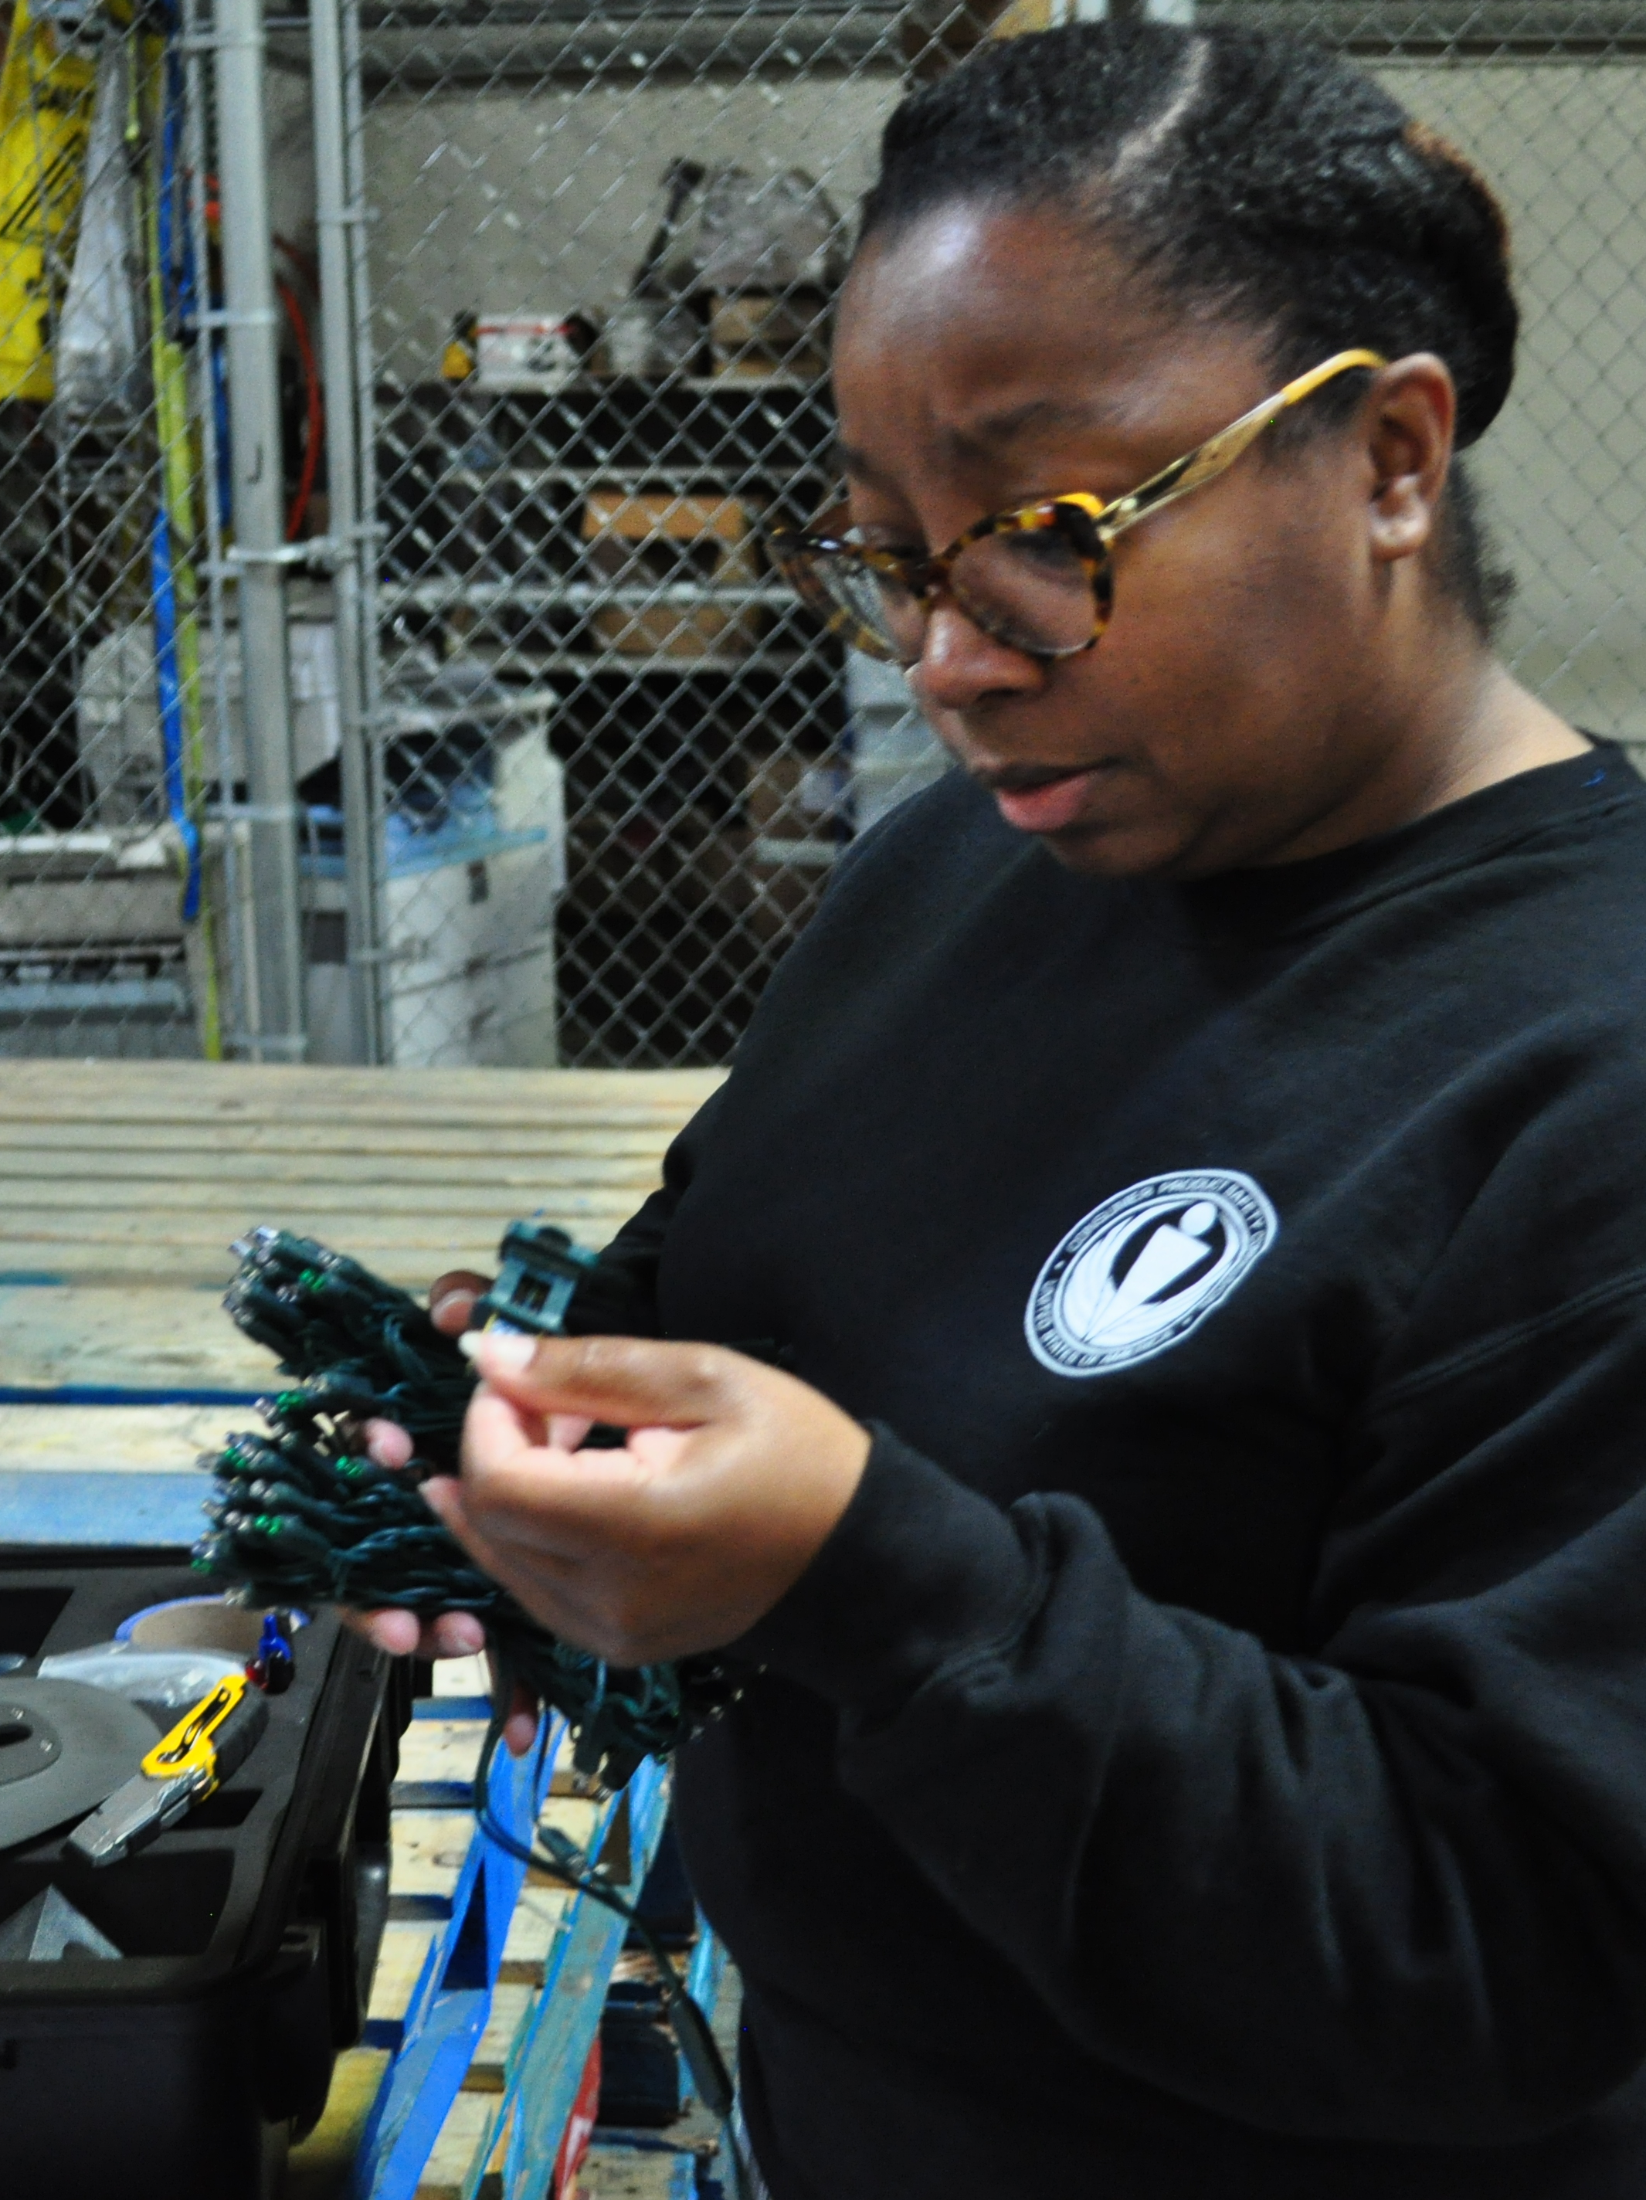
CPSC at the Port
How are CPSC products screened?
  Products are screened according to the applicable requirements:
  Consumer Product Safety Act (CPSA)
  Consumer Product Safety Improvement Act (CPSIA)
  Federal Hazardous Substances Act (FHSA)
  Flammable Fabrics Act (FFA)
  Labeling of Hazardous Art Materials Act (LHAMA)
  Poison Prevention Packaging Act (PPPA)
  U.S. Toy Standard (ASTM F963-17)

Slide 17
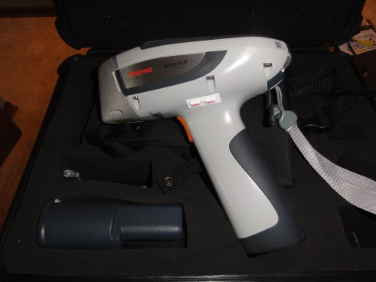
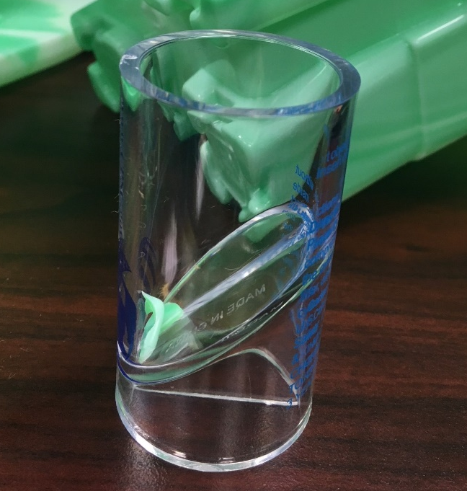
CPSC at the Port
  How are CPSC products screened?
  Products are screened using tools, templates, and screening guides:
  XRF: X-Ray Fluorescence analyzer
  FTIR: Fourier-Transform Infrared spectroscopy device
  Screening templates
      Small parts cylinder
      Rattle template
      Pacifier template
      Small ball template
      Toys with spherical ends template
      Expanding materials template

Slide 18

CPSC at the Port
When products fail screening
Samples are collected for testing and/or evaluation
Shipment is detained or conditionally released

Slide 19
When Products Fail Screening
Detention
Product must remain at a CBP-bonded facility until completion of CPSC testing/evaluation
CPSC’s detention authority: 60-day detention
Conditional Release
Product is conditionally released, pending completion of CPSC testing/evaluation
60-day conditional release authority

Slide 20
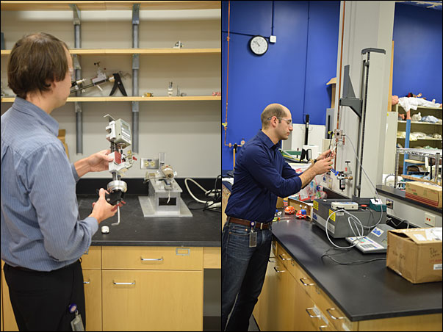
CPSC Evaluation Process
Where do samples collected by CPSC go?
Office of Compliance (Compliance Officer)
Human Factors for age determination
CPSC laboratory for chemical and/or mechanical testing
Sample Storage Facility
  Samples are not returned

Slide 21
CPSC Evaluation Process
CPSC Compliance Officers (CO) at Headquarters are responsible for evaluating the information received from all sources.
If the product is non-compliant, the CO contacts the Importer of Record to discuss the test results and next steps:
  Seizure
  Conditional Release for Reconditioning
  Correct Future Production

Slide 22
CPSC Evaluation Process (continued)
The Importer of Record’s compliance history may be taken into consideration

Slide 23
What Happens if a Seizure Determination is Made?
If a determination is made that the goods are to be seized:
  CPSC issues a request to CBP for seizure of the goods and CPSC’s involvement with the shipment ends.
  CBP then takes authority and begins the official seizure process.
  Parties with questions about the merchandise after this point should contact CBP.

Slide 24
CPSC Reconditioning Process
CPSC Expectations: Importer reconditions products into compliance within the specified time period and provides proof that the reconditioning process is complete.

Slide 25
CPSC Reconditioning Process (continued)
CPSC issues a notification to CBP when the reconditioning process is complete and verified
Product is released into commerce
If product is not reconditioned, CPSC may require that the product be destroyed by the importer or redelivered to CBP for seizure

Slide 26
CPSC FY21 Violations
Primary | Rate*
Mechanical | 9%
Lead | 7%
Chemical | 5%
ATV | 4%
Electrical | 3%
Flammability | 3%
Phthalates | 2%
Fireworks | 1%
Lighters | <1%
Other | 1%
Secondary | Rate
Certificates | 63%
Tracking Labels | 44%
Product Registration | 2%
Despite extensive outreach and education to the trade community, we are still battling high levels of lead and significant mechanical hazards in Children’s Products.
You can help to reduce these hazards by following all US CPSC safety regulations.
* Percent of samples collected with violation. Entries can have more than one violation type.

Slide 27
CPSC Seizures by Commodity

Slide 28
Third Party Testing for Children’s Products:
Tips for Manufacturers, Suppliers, and Buyers
Make sure the test report is less than one year old, unless otherwise required.
Is the laboratory CPSC-accredited? Is that lab accredited to perform the required testing? You can gather this information via the CPSC website: Third-Party Testing Laboratory Accreditation & Small Entity Compliance Guide | CPSC.gov
Make sure that the product tested is the actual product that you order. Frequently, the test report is for a similar item, but not the exact item. Or the item tested via third-party lab does not include the part that failed CPSC testing.

Slide 29
Third Party Testing for Children’s Products:
Tips for the Manufacturers, Suppliers, and Buyers (continued)
Make sure that every component part of the product is tested for the applicable standards.
For children’s products that are intended for use by a child under 3 years, make sure that the laboratory conducts all additional required testing for products in this category. Pay attention to the “Applicant Specified Age” section on the test report.
  For information on age determinations, please visit CPSC’s Age Determination Guidelines (2020 Version)

Slide 30
Field Screening Demonstration Video
(approximately 30 minutes)

Slide 31

Questions?
Submit questions in English or Chinese to this podcast:
CPSCinChina@CPSC.GOV

Slide 32
Resources

Slide 33
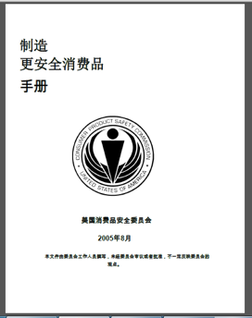
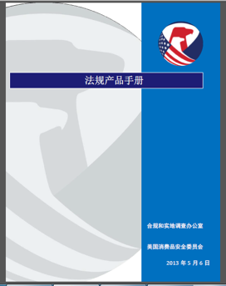
Chinese Resources at cpsc.gov
https://www.cpsc.gov/s3fs-public/HandbookforManufacturingChinese.pdf (中文版本 )
https://www.cpsc.gov/s3fs-public/pdfs/blk_pdf_handbookenglishaug05.pdf (英文版本)
https://www.cpsc.gov/s3fs-public/THE%20REGULATED%20PRODUCT%20HANDBOOK_050613%20CHN%20Final_0.pdf (中文版本 )
https://www.cpsc.gov/s3fs-public/RegulatedProductsHandbook.pdf (英文版本)

Slide 34
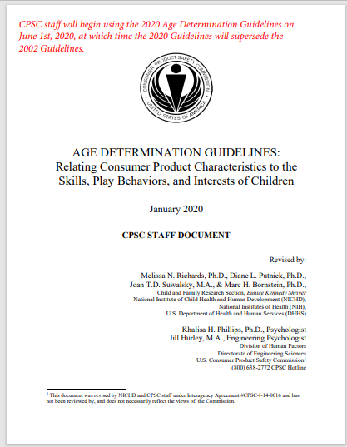
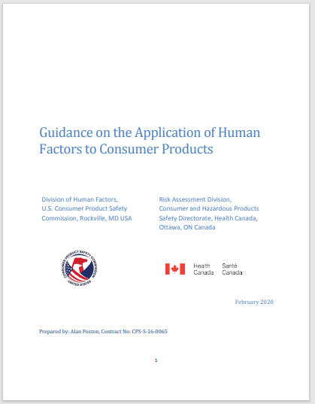
Chinese Resources at cpsc.gov
English: Updating Age Determination Guidelines for Toys (cpsc.gov)
Chinese: Updating Age Determination Guidelines for Toys (cpsc.gov)
English: Human Factors Standard Practice (cpsc.gov)

Slide 35
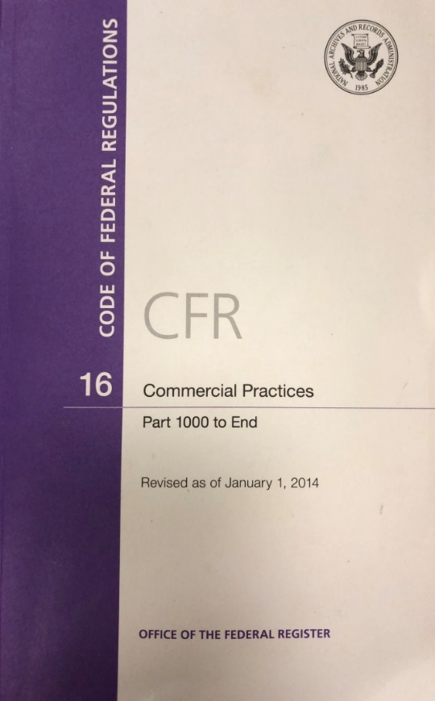
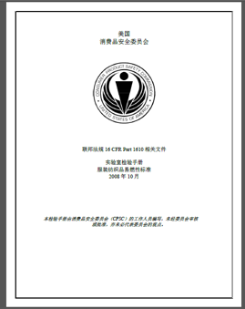
Chinese Resources at cpsc.gov
CFR: Commercial Practices
https://www.govinfo.gov/content/pkg/CFR-2017-title16-vol2/pdf/CFR-2017-title16-vol2.pdf (英文版本)
CPSC Laboratory Manuals:
https://www.cpsc.gov/s3fs-public/Laboratory-test-manual-16-CFR-Part-1610-Ch.pdf?MhtbUWNy6jmOPx9b6f.RErt.n.2n_d_h (中文版本)
https://www.cpsc.gov/s3fs-public/Flammability%20of%20Clothing%20Textiles%20Test%20Manual_1610.pdf (英文版本)

Slide 36
Definition of children’s product – 16 CFR Part 1200
Certificates of conformity – 16 CFR Part 1110
Third-party testing – 16 CFR Parts 1107, 1109, and 1112
Tracking information – 15 USC § 2063(a)(5)
Mandatory reporting requirements – 15 USC §2064
CPSC Business Resources
CPSC-Accepted Laboratories Search Page:
www.cpsc.gov/LabSearch

Slide 37


http://business.cpsc.gov
Online tool designed specifically to help businesses comply with federal consumer product safety requirements.
Asks a series of guided questions, and based on the answers produces a downloadable (PDF) report.
Provides customized guidance with links to product safety regulations that may apply to the product and important information on labeling, certification and testing requirements.

Slide 38
Regulatory Robot
Regulatory Robot is a tool to help identify which requirements are applicable
  Does not list details of requirements
User inputs product features
Regulatory Robot outputs list of requirements
User references source documents for specific requirements

