Slide 1
The slides in this presentation are intended to be used in an event with verbal elaboration by a knowledgeable presenter. The slides highlight key U.S. product safety requirements for discussion. The text is not a comprehensive statement of legal requirements or policy and should not be relied upon for that purpose. Moreover, with the passage of time, it may not reflect the latest information. You should consult official versions of U.S. statutes and regulations, as well as published CPSC guidance when making decisions that could affect the safety and compliance of products entering U.S. commerce.

Slide 2
Video: Welcome to the 2021 CPSC Podcast Series - Cribs and Play Yards

Slide 3
Overview of
U.S. Battery-Powered Toy Safety Requirements
This presentation was prepared by CPSC Staff. It has not been reviewed or approved by the Commission and may not reflect its views.

Slide 4
Biography
Sylvia Chen
U.S. Consumer Product Safety Commission
Program Manager for East Asia and Pacific
Office of International Programs
Sylvia Chen is responsible for managing the Commission’s bilateral and multilateral programs related to consumer product safety in Australia, Japan, Korea, Taiwan, and New Zealand. She also supports the CPSC’s work with China. Since she joined the CPSC in 2008, Sylvia has been working with product safety regulators, industry organizations, manufacturers, exporters, buyers, and other sourcing professionals to provide them with guidance and technical support in understanding U.S. requirements, in particular, the latest requirements for consumer products. To that end, she has organized or coordinated many of the agency’s international education and outreach activities.
Sylvia has a Bachelor of Arts degree in English and American Literature from Peking University. In 1991, she graduated from The Ohio State University with a Master’s degree in East Asian Studies.

Slide 5
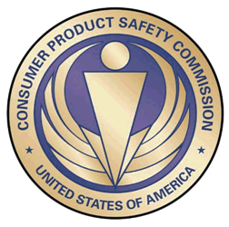
The US CPSC is a federal government agency charged with protecting the public from unreasonable risks of injury or death associated with the use of consumer products under the agency's jurisdiction.
$1 Trillion
Deaths, injuries, and property damage from consumer product incidents cost the nation more than $1 trillion annually.¹
¹ https://www.cpsc.gov/s3fs-public/FY2019PBR.pdf
CPSC is committed to protecting consumers from products that pose a fire, electrical, chemical, biological, or mechanical hazard.
CPSC's work to improve the safety of the more than 15,000 types of consumer products in its jurisdiction - such as toys, cribs, power tools, cigarette lighters, textiles, and household chemicals – has contributed to improved safety standards for consumer products over the past 40 years.

Slide 6
Overview of
U.S. Battery-Powered Toy Safety Requirements

Slide 7
ASTM F963-17 is the industry consensus standard for toy safety in the United States.
Although industry consensus standards are typically not mandatory, this one is.
The U.S. Congress made ASTM F963 a federal requirement, by law.
CPSC enforces compliance with F963 as a technical regulation.

Slide 8
F963-17 is MANDATORY in the United States
Process –
The Consumer Product Safety Improvement Act of 2008 makes F963 mandatory for toys in the United States.
CPSIA requires that ASTM notify CPSC if ASTM proposes revisions to F963.
The revised F963 standard goes into force after 180 days as a matter of law, unless CPSC notifies ASTM that the proposed revision does NOT improve the safety of toys.
You can read the last federal register notice here: Federal Register: Safety Standard Mandating ASTM F963 for Toys.

Slide 9
Main Sections of Importance for Electrical/Battery Safety of F963-17
Under Section 4, Safety Requirements:
4.4 – Electrical/Thermal Energy
4.25 – Battery Operated Toys
Under Section 8, Test Methods:
8.17 – Stalled Motor Test for Battery-Operated Toys
8.18 – Tests for Battery-Powered Ride-On Toys
8.19 – Test for Toys that Contain Secondary Cells or Batteries
Although these are the most relevant for ride-on type toys, the user is encouraged to read the table of contents of the F963-17 specification to determine if their specific toy has other requirements that may be applicable (and required because the standard is mandatory).

Slide 10
F963-17, Section 4.4 Electrical/Thermal Energy
Toys intended for connection to 120 V AC must comply with 16 CFR 1505, published under the Federal Hazardous Substances Act (FHSA).

Slide 11
F963-17, Section 4.25 Battery Operated Toys (1 of 2)
Refers to [ANSI] C18.1 or IEC 60086-1 as reference standards for alkaline batteries.
Repeat testing for other battery chemistries if they are intended to be used with the product and if using rechargeable batteries, the batteries should be fully charged when the test is completed.
Maximum DC voltage between accessible (touch) points cannot exceed 24 V nominal.
Battery Compartment requirements.
No mixing of battery chemistries in same circuit.

Slide 12
F963-17, Section 4.25 Battery Operated Toys (2 of 2)
Temperature limit on battery surface during testing (<71°C).
4.25.8.1 Specific Requirements for Lithium-ion and lithium-ion polymer batteries.
4.25 also requires flammability testing for battery connectors and that battery chargers be suitable for the battery chemistry and certified to applicable NRTL certifications (UL, CSA, TUV, VDE, MET, IEC, etc.).
NRTL stands for “Nationally Recognized Testing Laboratory”.
4.25.11.1 references specific battery and cell standards to consider when determining the suitability of the certification for the intended toy application (specific product).

Slide 13
F963-17, Section 8.17 Stalled Motor Test for Battery-Operated Toys
Start with a new toy and fresh alkaline batteries (or whichever batteries the product is intended to use.
Follow the test method described in 8.17.1 and 8.17.2.
The test should not result in the battery operating outside its intended specifications.
The test should not result in the battery temperatures exceeding those identified in 4.25.7.
There should be no leaking, explosion, or fire as a result of the stalled motor test.

Slide 14
F963-17, Section 8.18 Tests for Battery-Powered Ride-On Toys
8.18.2 Low Power Circuit Determination
8.18.3 Maximum Temperature Test
8.18.4 Stalled Motor Test for Battery Powered Ride-On Toys
8.18.5 Nuisance Tripping Test
8.18.6 Switch Endurance and Overload Tests
8.18.7 Battery Overcharge Test
8.18.8 Short Circuit Protection Test
8.18.9 Strain Relief Test
All of these tests are descriptive. If you need more guidance, go to Section 2 Referenced Documents on the reference standards for additional test method details.

Slide 15
F963-17, Section 8.19 Test for Toys that Contain Secondary Cells or Batteries
Secondary Cells are rechargeable cells and should not be mixed with non-rechargeable cells on the same circuit.
Be mindful when conducting these cycling tests with regard to battery chemistry (nickel metal hydride - NiMH, lead acid, lithium-ion, etc.).
Remember, there are also different chemistries of lithium batteries too (LFP vs. NMC/LCO) to consider.

Slide 16
Any questions, go to Section 2 Referenced Documents
Section 2 is an excellent source of information.
2.1 ASTM Standards
2.2 ANSI Standards (American National Standards Institute)
2.3 European Union Standards
2.4 Federal Standards (USA)
2.5 ISO and IEC Standards (Int’l Standards Organization and Int’l Electrotechnical Commission, respectively)
2.6 UL Standards (Underwriters Laboratories)
2.7 Canadian Standards
2.8 Other Documents

Slide 17
Best Manufacturing Practices: Assuring Safety of Lithium-Ion Cell-Powered Products
Lithium Battery Safety Basics
There are various electrode chemistries including LCO, LMO, NMC, and LFP, which have different performance specs and varying levels of safety – be aware of the differences and make sure it’s the best one for the application.
Cells contain flammable electrolytes - defective or abused cells can enter thermal runaway condition, producing extreme heat and energetic disassembly.
Critical safety circuits to control voltage, current and temperature during charge and discharge, keep cells within their safe operating area.

Slide 18
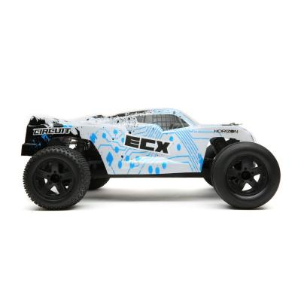
Recent Battery Powered Toy Product Recall (Horizon Hobby)
https://www.cpsc.gov/Recalls/2017/Horizon-Hobby-Recalls-Remote-Controlled-Model-Vehicles
April 25, 2017
The remote-control car was experiencing short circuiting on the electronic speed control circuit.

Slide 19
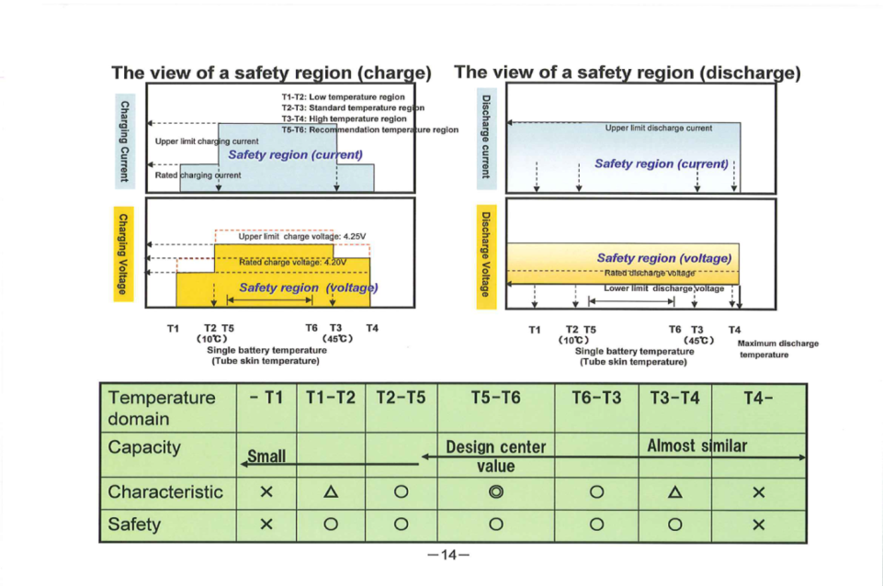
Best Manufacturing Practices – Assuring Lithium Cell Safety
Maintain cells within their specified safety region during charging and discharging.
*Japan Electronics and Information Technology Industries Association and Battery Association of Japan Source: http://home.jeita.or.jp/page_file/20110517171451_cub9MvYFEh.pdf

Slide 20
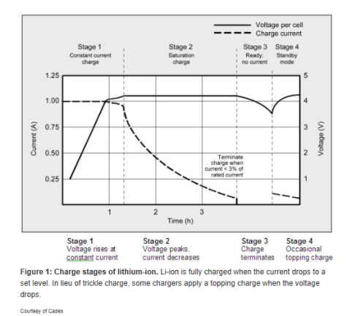
Best Manufacturing Practices – Assuring Lithium Cell Safety Addition Industry Guidance
Disable charging:
If cell surface temperatures are exceeded;
If cell is below 3 V
or initiate pre-charge charging rate.
When charge current drops to .05C (no trickle charging),
Balance cells in multi-cell packs;
Assure that the charger is compatible with the cells/battery.
*Source: http://batteryuniversity.com/learn/article/charging_lithium_ion_batteries

Slide 21
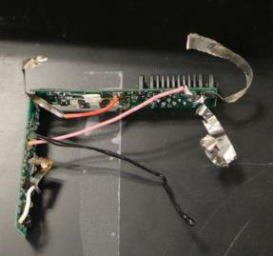
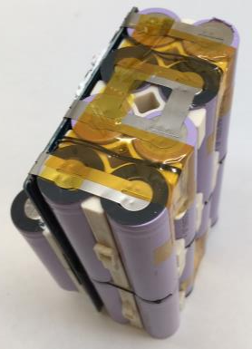
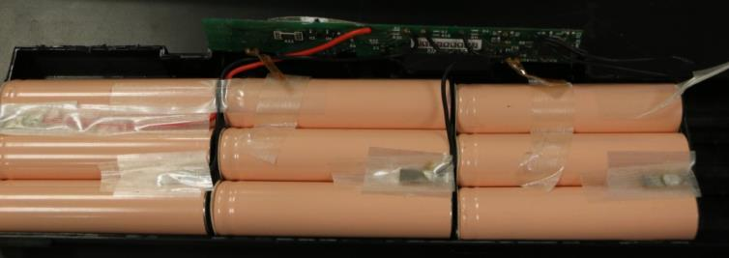
Best Manufacturing Practices – Assuring Lithium Cell Safety Additional Guidance – Thermal Management
Use thermal sensors to monitor cell surface temperatures (red circles) and/or thermal insulators (green arrows) to avoid excess temperatures.

Slide 22
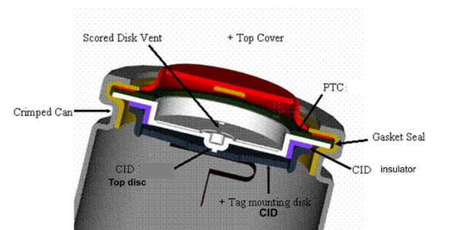
Best Manufacturing Practices – Assuring Lithium Cell Safety Select cells with Integral Protection
Current Interrupt Device (CID)
Disconnects cell from terminal under excessive internal pressure.
Resettable Positive Temperature Coefficient (PTC)
Limits current (May not be suitable for high-drain applications);
Does not protect against thermal runaway due to internal faults.

Slide 23
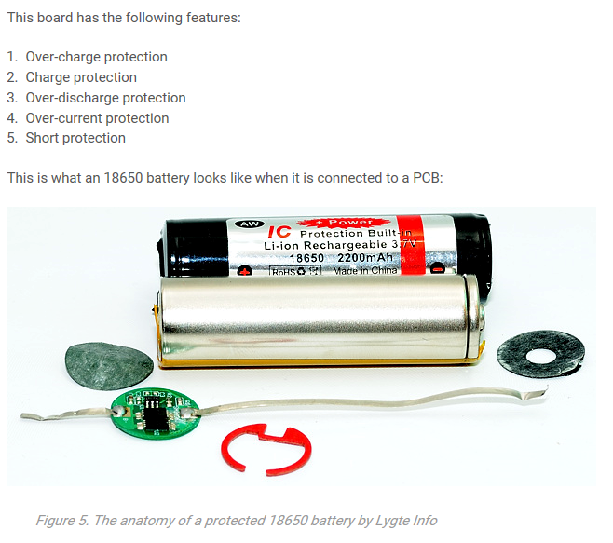
Best Manufacturing Practices – Assuring Lithium Cell Safety Select cells with Integral Protection
User replaceable cells need an integral Battery Management System to provide charge control and to protect against
Over-charge;
Over-discharge;
External short-circuit.
Source: https://batterybro.com/blogs/18650-wholesale-battery-reviews/18306003-battery-safety-101-anatomy-ptc-vs-pcb-vs-cid

Slide 24
Best Manufacturing Practices – Assuring Lithium Cell Safety Staff Recommendations
Lithium-ion battery safety requires diligence from producer to user.
Lithium-ion battery products should:
Be designed and built in accordance with applicable industry consensus standards; the system from charger to cell should be evaluated together for complete compatibility.
Use high quality cells, suitable for the application
In accordance with manufacturer’s specifications.
Be manufactured in strict accordance with industry standard quality control processes.
Maintain configuration control with only approved material or component substitutions subject to impact assessments.

Slide 25
Best Manufacturing Practices – Assuring Lithium Cell Safety Staff Recommendations
Staff recommends lithium-ion battery products:
Be properly marked with warning labels to inform/educate users of the potential hazards and to closely follow manufacturer’s instructions for proper use.
Be third-party certified by an accredited laboratory.
Under CPSC’s statutes, manufacturers, importers, distributors, and retailers are responsible to assure consumer products to do not present an unreasonable risk of injury or death.

Slide 26
Questions?
Please Contact: CPSCinChina@cpsc.gov

Slide 27
Resources

Slide 28
CPSC’s China Podcast Series
International Video and Podcast Series | CPSC.gov
Podcast | Topics
#1 | Selling Safe Electrical Products to the U.S. Market
#2 | Overview of U.S. Apparel Requirements
#3 | CPSC Bicycle Regulations and U.S. and International Safety Standards
#4 | Overview of U.S. Mattress Requirements
#5 | Durable Infant or Toddler Products: Common Requirements
#6 | Overview of U.S. Strollers and Carriages Requirements
#7 | Toy Safety Requirements
#8 | Overview of Children’s Sleepwear Requirements
#9 | Enhancing the Safety of Emerging Technology through Risk Assessment: Wearables
#10 | Overview for Battery Safety Requirements
#11 | Overview of Gates and Enclosures Requirements

Slide 29
CPSC’s China Podcast Series (Continued)
Podcast | Topics
#12 | Overview of Consumer Safety and Micromobility Devices
#13 | Overview of Cribs and Play Yards Requirements
#14 | Product Safety and Compliance: Best Practices for Buyers Exporting Consumer Goods to the United States
#15 | How to Find Safety Requirements for Your Product Using CPSC’s Regulatory Robot .
#16 | Flammability Requirements for Upholstered Furniture
#17 | CPSC’s Import Screening Program
#18 | Overview of CPSC’s Third Party Laboratory Program for Children’s Products
“Questions on this presentation? Send an email to CPSCinChina@cpsc.gov”

Slide 30
https://www.cpsc.gov/zh-CN/Business--Manufacturing/Business-Education
Chinese Resources at cpsc.gov

Slide 31
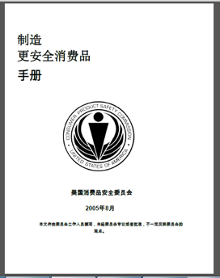
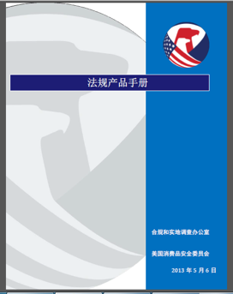
Chinese Resources at cpsc.gov
https://www.cpsc.gov/s3fs-public/HandbookforManufacturingChinese.pdf (中文版本 )
https://www.cpsc.gov/s3fs-public/pdfs/blk_pdf_handbookenglishaug05.pdf (英文版本)
https://www.cpsc.gov/s3fs-public/THE%20REGULATED%20PRODUCT%20HANDBOOK_050613%20CHN%20Final_0.pdf (中文版本 )
https://www.cpsc.gov/s3fs-public/RegulatedProductsHandbook.pdf (英文版本)

Slide 32
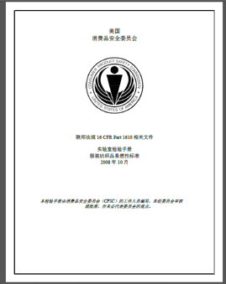
Chinese Resources at cpsc.gov
CFR: Commercial Practices
https://www.govinfo.gov/content/pkg/CFR-2017-title16-vol2/pdf/CFR-2017-title16-vol2.pdf (英文版本)
CPSC Laboratory Manuals:
https://www.cpsc.gov/s3fs-public/Laboratory-test-manual-16-CFR-Part-1610-Ch.pdf?MhtbUWNy6jmOPx9b6f.RErt.n.2n_d_h (中文版本)
https://www.cpsc.gov/s3fs-public/Flammability%20of%20Clothing%20Textiles%20Test%20Manual_1610.pdf (英文版本)

Slide 33
Definition of children’s product – 16 CFR Part 1200
Certificates of conformity – 16 CFR Part 1110
Third-party testing – 16 CFR Parts 1107, 1109, and 1112
Tracking information – 15 USC § 2063(a)(5)
Mandatory reporting requirements – 15 USC §2064
CPSC Business Resources
CPSC-Accepted Laboratories Search Page:
www.cpsc.gov/LabSearch

Slide 34
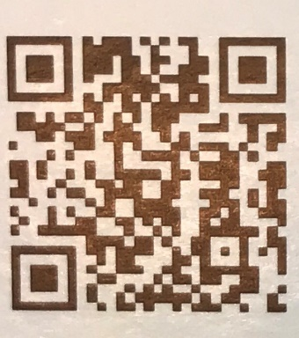
http://business.cpsc.gov
Online tool designed specifically to help businesses comply with federal consumer product safety requirements.
Asks a series of guided questions, and based on the answers produces a downloadable (PDF) report.
Provides customized guidance with links to product safety regulations that may apply to the product and important information on labeling, certification and testing requirements.

Slide 35
Regulatory Robot
Regulatory Robot is a tool to help identify which requirements are applicable
Does not list details of requirements
User inputs product features
Regulatory Robot outputs list of requirements
User references source documents for specific requirements

Slide 36
For more information, please visit:
www.CPSC.gov
https://www.cpsc.gov/Regulations-Laws--Standards/Voluntary-Standards/Topics/Batteries/
CPSC Podcasts:
International Video and Podcast Series | CPSC.gov
Episode #1: Selling Safe Electrical Products to the U.S. Market
Episode #7: Toy Safety Requirements
Episode #9: Overview of Battery Safety Requirements
Battery/Electrical Resources

