Slide 1
The slides used in this presentation are intended to be used in an event with verbal elaboration by a knowledgeable presenter. The slides highlight key U.S. product safety requirements for discussion. The text is not a comprehensive statement of legal requirements or policy and should not be relied upon for that purpose. Moreover, with the passage of time, it may not reflect the latest information. You should consult official versions of U.S. statutes and regulations, as well as published CPSC guidance when making decisions that could affect the safety and compliance of products entering U.S. commerce.

Slide 2
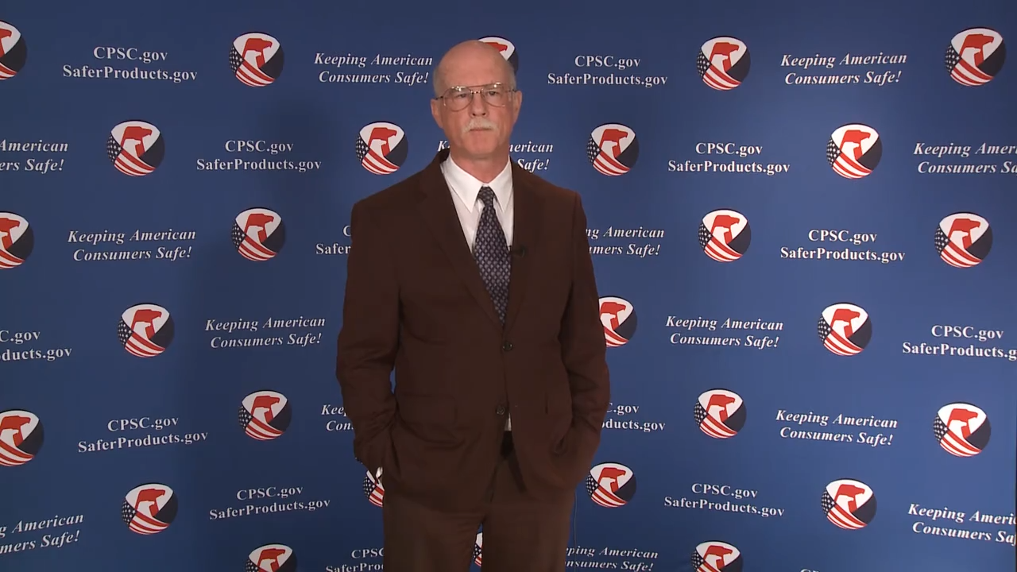
Video: Welcome to the 2021 CPSC Podcast Series – Overview of Battery Safety Requirements

Slide 3
Podcast Series 2021
Overview for Battery Safety Requirements
This presentation was prepared by CPSC Staff. It has not been reviewed or approved by the Commission and may not reflect its views.

Slide 4


Biographies
Sylvia Chen
U.S. Consumer Product Safety Commission
Program Manager for East Asia and Pacific
Office of International Programs
Joseph Tsai, Senior Compliance Officer
Regulatory Enforcement Division
Office of Compliance and Field Operations
U.S. Consumer Product Safety Commission
Sylvia Chen is Program Manager for East Asia and Pacific at the U.S. Consumer Product Safety Commission (CPSC). In that role, she is responsible for managing the Commission’s bilateral and multi-lateral programs related to consumer product safety in Australia, Japan, Korea, Taiwan and New Zealand. She also supports the CPSC’s work with China. Since she joined the CPSC in 2008, Sylvia has been working with product safety regulators, industry organizations, manufacturers, exporters, buyers and other sourcing professionals to provide them with guidance and technical support in understanding U.S. requirements, in particular the latest requirements for consumer products. To that end, she has organized or coordinated many of the agency’s international education and outreach activities.
Sylvia has a Bachelor of Arts degree in English and American Literature from Peking University. In 1991, she graduated from The Ohio State University with a Master’s degree in East Asian
Joseph joined the U.S. Consumer Product Safety Commission (CPSC) in April 2008, as a Compliance Officer in the Regulatory Enforcement Division of the Office of Compliance and Field Operations.
As a Compliance Officer, he is responsible for enforcing the mandatory regulations for children’s products, such as, toys, pacifiers, and rattles under the Federal Hazardous Substances Act (FHSA) and Consumer Product Safety Act (CPSA).
In addition, he advises stakeholders on requirements for tracking and certification for children’s products under the CPSA. His specific responsibilities include advisement on the implementation of regulations, standards, and bans under the FHSA and the CPSA, and providing advice and guidance to consumers and the regulated industry.
Prior to joining the CPSC, Mr. Tsai was an officer at U.S. Customs and Border Protection, and a research scientist with Scripps Research Institute, La Jolla, California. Mr. Tsai holds a Bachelor of Science degree from University of California, Los Angeles (UCLA), and a Master of Science degree from University of California, San Diego (UCSD).

Slide 5
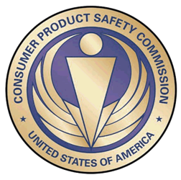
The US CPSC is a federal government agency charged with protecting the public from unreasonable risks of injury or death associated with the use of consumer products under the agency's jurisdiction.
$1 Trillion
Deaths, injuries, and property damage from consumer product incidents cost the nation more than $1 trillion annually.¹
¹ https://www.cpsc.gov/s3fs-public/FY2019PBR.pdf
CPSC is committed to protecting consumers from products that pose a fire, electrical, chemical, biological, or mechanical hazard.
CPSC's work to improve the safety of the more than 15,000 types of consumer products in its jurisdiction - such as toys, cribs, power tools, cigarette lighters, textiles, and household chemicals – has contributed to a decline in the rate of deaths and injuries associated with consumer products over the past 40 years.

Slide 6
CPSC’s Podcast Series 2021
Podcast | Topics
#1 | Overview of Children’s Sleepwear Requirements
#2 | Enhancing the Safety of Emerging Technology through Risk Assessment: Wearables
#3 | Overview of Battery Safety Requirements
#4 | Overview of Gates and Enclosures Requirements
#5 | Overview of Consumer Safety and Micromobility Devices
#6 | Overview of Cribs and Play Yards Requirements
“Questions on this Presentation? Send an email to CPSCinChina@cpsc.gov”

Slide 7
Overview of Battery Safety Requirements: Lithium-Ion Battery Safety for Consumer Products into the United States

Slide 8
Overview
Electrical Product Safety
Fire and Shock Data
Hazard Mitigation Strategies
Industry Consensus Standards
Technical Regulations
15(j) Requirement
Complying with Industry Consensus Standards
CPSC Data Systems
High-Energy Density Batteries Project
Battery Recalls
Root Causes
Case Study – Products with No Standard
Case Study – Products with Well-Established Standards
Best Manufacturing Practices - Assuring Safety of Lithium-Ion Cell-Powered Products

Slide 9
Electrical Product Safety
Electricity is a powerful, useful energy source that is potentially hazardous.
Electrical product failures or misuse can cause hazards, such as:
Fires
Electric shock
Thermal burns (from exposure to hot surfaces)
Chemical burns (from batteries),
Injuries (lacerations from moving parts) or
Loss of critical function (a smoke alarm not signaling a fire).
Products that generate, distribute, or use electrical energy should be compliant with applicable standards and installed according to applicable electrical codes to help minimize safety risks to consumers from these products.

Slide 10
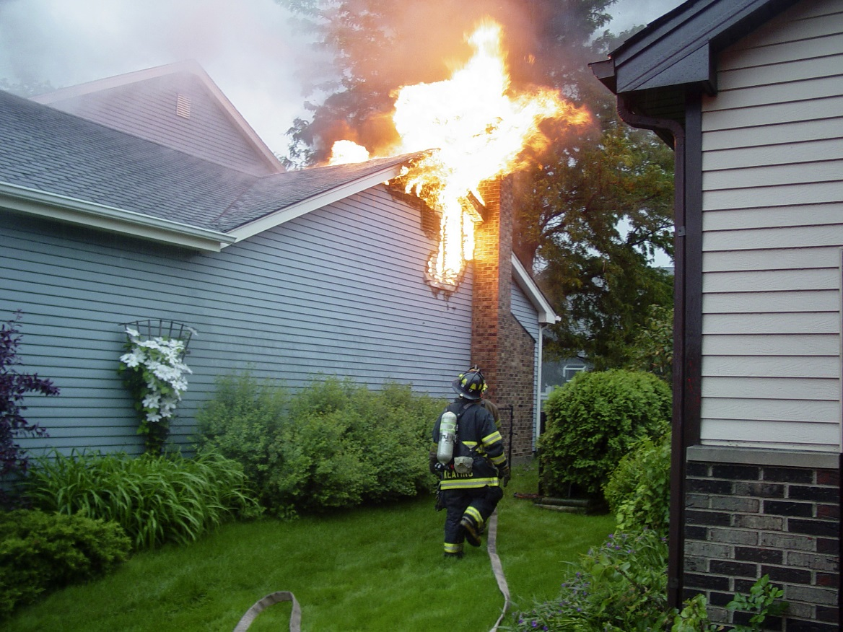

Electrical Fire Data
67,900 structure fires
from electrical equipment per year
660 deaths, 3,410 injuries $1.738 billion in property losses per year
Top electrical
Cooking equipment, such as range/ovens, microwaves and small appliances
Distribution systems, such as installed wiring
Heating and cooling equipment
¹ Average base on 2015-2017 data

Slide 11
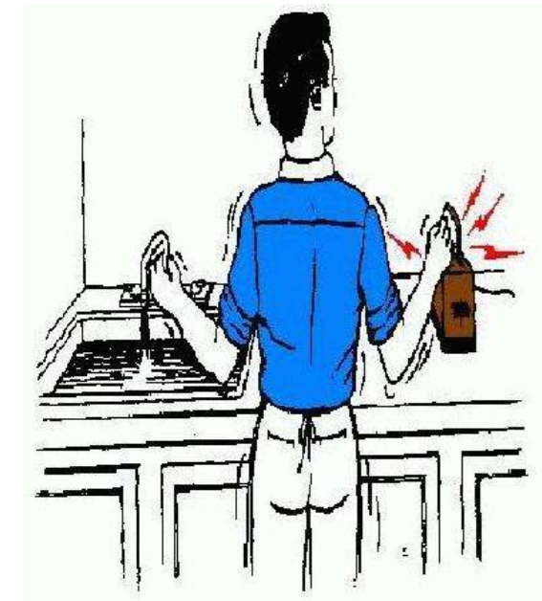
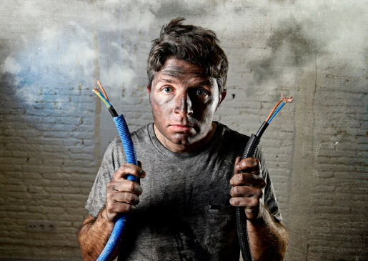
Electric Shock Data
60 consumer product-related electrocutions per year
Electrocutions have declined over time with increases in products incorporating double insulation, battery power, and the implementation of ground-fault circuit interrupters.
Top four involved products:
Large Appliances
Small Appliances
Power Tools
Lighting Equipment
¹ Average based on 2004 - 2013 data

Slide 12
Hazard Mitigation Strategies
CPSC staff uses a multipronged approach
Support improvements to industry consensus standards/codes
Distribute safety information to consumers
Create and enforce technical regulations and bans
Recall products with defects after identifying hazards through investigations

Slide 13
Hazard Mitigation Strategies: Industry Consensus Standards
Staff relies on industry consensus standards to establish minimum levels of safety.
Most electrical product safety standards have been developed and maintained under the auspices of Underwriters Laboratories (UL). Other standards developers for electrical product safety include the Institute of Electrical and Electronics Engineers (IEEE) and the National Electrical Manufacturers Association (NEMA)

Slide 14
Hazard Mitigation Strategies: Technical Regulations
CPSC statutes specify a consumer product safety technical regulation shall not be issued unless:
a current industry consensus standard is not likely to adequately reduce the risk of injury
there is not likely to be substantial compliance with the consensus standard
OR
Check the CPSC website or contact CPSC staff to determine what requirements your product needs to meet: https://www.cpsc.gov/Business--Manufacturing
Battery-operated toys, electric toys, and citizens band (CB) station antennas are some electrical products subject to technical regulations

Slide 15
Hazard Mitigation Strategies: Technical Regulations for Electrical Products
Battery-Operated Toys
ASTM F963-17, The Standard Consumer Safety Specification for Toy Safety, which is a comprehensive standard addressing numerous hazards that have been identified with toys. CPSC incorporated this industry consensus standard into a mandatory standard for toys (16 CFR part 1250).
Electric Toys
16 CFR 1505 – Requirements for electrically operated toys or other electrically operated articles intended for use by children. This covers any toy, game, or other article designed, labeled, advertised, or otherwise intended for use by children that is intended to be powered by electrical current from nominal 120 volt branch circuits
CB Antennas
16 CFR part 1204 - Safety Standard for Omnidirectional Citizens Band Base Station Antennas

Slide 16
Hazard Mitigation Strategies: The 15(j) Requirement
CPSC can recall products, or prevent importation of products, if they fail to meet critical safety requirements of a certain specific industry consensus standard
Section 15(j) of the CPSA provides authority to specify for any consumer product or class of consumer products, characteristics whose existence or absence are deemed a substantial product hazard under section 15(a)(2) of the CPSA.
A product within the scope of section 15(j) must have specific observable product characteristics that are required by a industry consensus standard.

Slide 17
Hazard Mitigation Strategies: The 15(j) Requirement
The Commission has determined that products that do not comply with a 15(j) regulated requirement present a defect and are a substantial product hazard.
Therefore products that do not comply with an applicable 15(j) requirement cannot be imported into or sold within the US.
Handheld hair dryers, holiday lights, and extension cords are electrical products subject to 15(j) regulated requirements

Slide 18
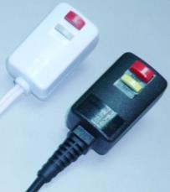
Hazard Mitigation Strategies: 15(j) Requirement - Handheld Hair Dryers
16 CFR § 1120.3(a) – Household and commercial handheld hair dryers must have an integral immersion protection circuit interrupter plug (as per UL 859 and UL 1727)

Slide 19


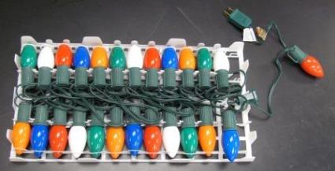
Hazard Mitigation Strategies: 15(j) Requirement – Seasonal and Decorative Lighting Products
16 CFR § 1120.3(c) – Seasonal and decorative lighting products must meet the minimum wire size requirements of UL 588, have sufficient strain relief and include integral overcurrent protection.

Slide 20
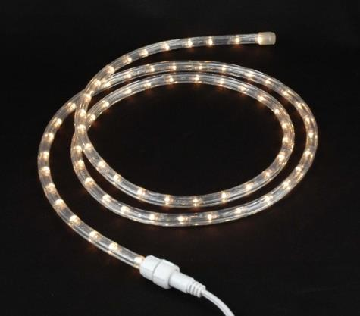
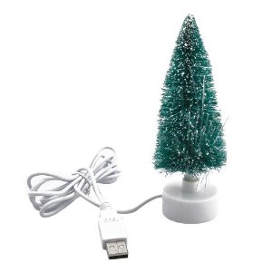
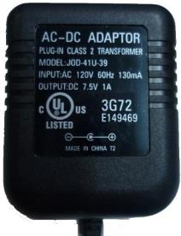
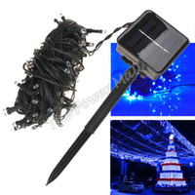
Hazard Mitigation Strategies: 15(j) Requirement – Seasonal and Decorative Lighting Products
Not In Scope
Class 2-powered Products
Solar-powered Products
Rope Lights/Luminaires

Slide 21
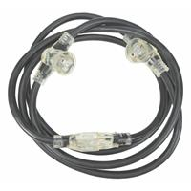
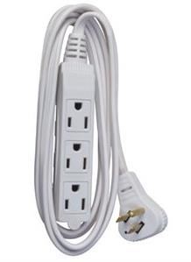
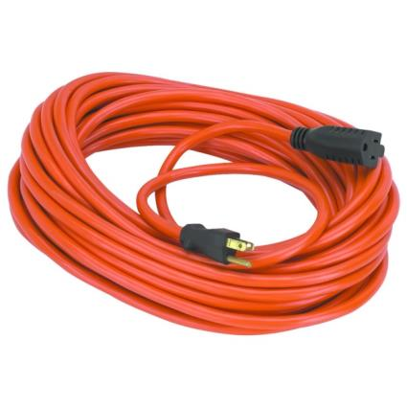
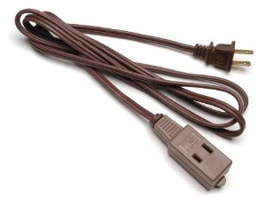
Hazard Mitigation Strategies: 15(j) Requirement – Extension Cords
16 CFR § 1120.3(d) – Extension Cords must meet the minimum wire size requirements of UL 817, have sufficient strain relief, be properly polarized and indoor-use cords must have outlet covers while outdoor-use cords must be jacketed.

Slide 22
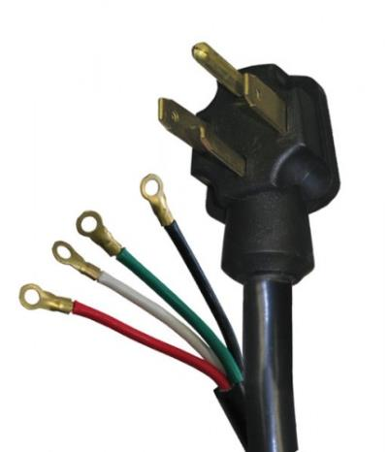
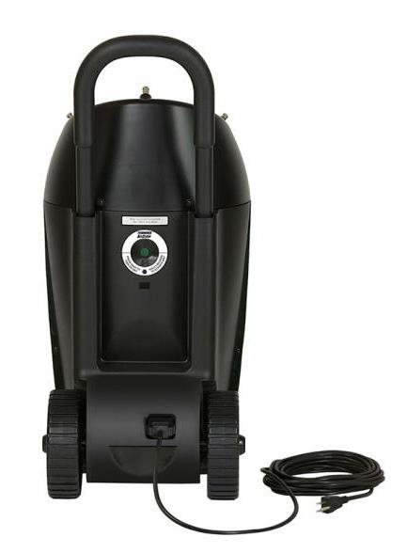
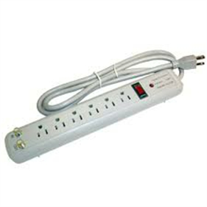
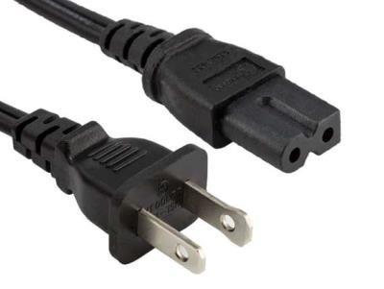
Hazard Mitigation Strategies: 15(j) Requirement – Extension Cords
Not In Scope
Detachable Power Supply Cords
Relocatable Power Taps
Appliance Cords

Slide 23
Hazard Mitigation Strategies: Complying with Industry Consensus Standards
Electrical products not subject to a regulation do not require certification by an accredited third party lab (e.g., UL, Intertek or CSA) to a industry consensus standard, but staff observes a high rate of voluntary compliance.
Many retailers will only sell electrical products if they have been third party certified.
Some states and municipalities require certification for all electrical products to be sold in those jurisdictions.
The Occupational Safety and Health Administration (OSHA) requires certification by a Nationally Recognized Testing Laboratory (NRTL) for electrical products used in a workplace.
CPSC staff strongly recommends that manufacturers or exporters/importers seek third party certification for their electrical products as a means of hazard mitigation.

Slide 24
Hazard Mitigation Strategies: Complying with Standards
Compliance with applicable regulations, standards, and the NEC are highly effective ways to mitigate hazards from equipment that generates, distributes, or uses electrical energy.
CPSC statutes assign the responsibility for safe products to all parts of the supply chain.
Importers, although reliant on foreign producers, are responsible for the safety of products they bring into the United States
All responsible
Manufacturers
Importers
Distributors
Retailers

Slide 25
Hazard Mitigation Strategies: Responsibility to Comply
Manufacturers and importers should follow best practices to ensure that their electrical products do not pose unreasonable risks of injury.
Comply with consensus standards and technical regulations
Obtain certification from an accredited lab to assure and demonstrate products meet applicable industry consensus standard
Maintain quality and configuration control
Assess impact of material or component substitutions

Slide 26
Industry Consensus Standards Process: CPSC Staff Participation
With such a heavy reliance on industry consensus standards, staff is engaged in the process of maintaining adequacy of industry consensus safety standards, including addressing emerging hazards, by actively participating through development and proposal of new or modified requirements.
Review standards for inadequacies
Analyze injury/death data for hazard patterns
Propose standards development or revisions
Conduct tests and evaluations to support findings
Participate in committees
This is an ongoing process that begins with staff gathering incident information from CPSC’s data collection systems.

Slide 27
Industry Consensus Standards Process: CPSC Data
Injury and potential injury incident data
Death certificates
In-depth investigations
National Electronic Injury Surveillance System
National Fire Incident Reporting System*
IPII
DTHS
INDP
NEISS
NFIRS
*NFIRS is operated by the United States Fire Administration

Slide 28
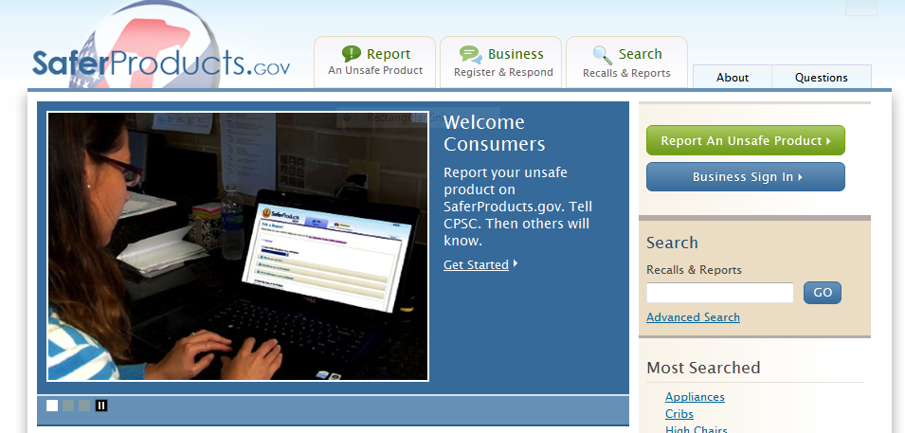
CPSC Data: IPPI
CPSC Data
Medical Examiners and Coroners Alert Program (MECAP)
News Clips
Hotline Calls
Internet Reports
Compliance Reports
Federal and State Agency Referrals
Other Reports
Provides anecdotal account of product-related incidents
Saferproducts.gov is CPSC’s public portal for incident reports and searches

Slide 29
CPSC Data: DTHS
Contracts with 50 states
Purchase approximately 8,000 per year
Time lag
Daily review
Analytical use
Death certificates provide specific details on death-related incidents caused by products but minimal product details

Slide 30
CPSC Data: INDP
CPSC Field staff conduct follow-up investigations on selected initial incident reports
On-site Investigations
Local-level collaboration
Medical examiner
Police
Fire
Sample collection opportunity
Telephone Interviews
INDP reports provide specific details on a product and its involvement in an incident

Slide 31
CPSC Data: NEISS
National sample
Data collected from approximately 100 hospital emergency rooms around the country
Submitted daily by hospital coders
Data weighted to provide consumer injury estimates nationwide
About 395,000 consumer product-related injury reports annually
Data available from 1980 to present
Provides statistically significant data with details on product-related injuries, but less detail on specific products

Slide 32
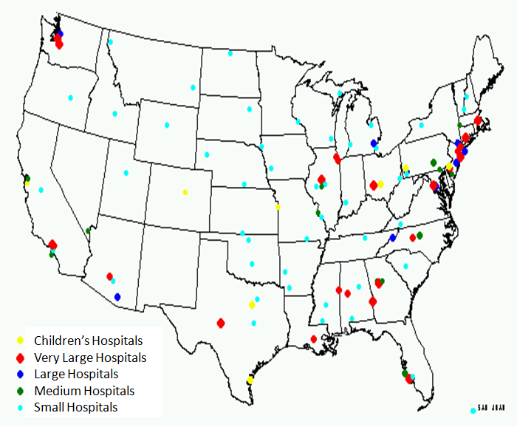
CPSC Data: NEISS Hospital Locations
San Juan

Slide 33
CPSC Data: NEISS Variables
Treatment date
Case number
Age
Sex
Injury diagnosis (2)
Body part injured
Disposition from ED
Products involved (2)
Locale
Type/work-related
Fire dept. involvement
Intent
Race/ethnicity
Narrative (2 lines)

Slide 34
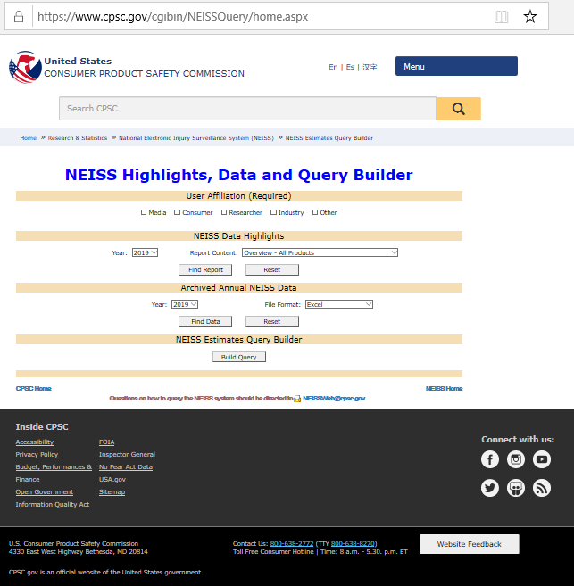
CPSC Data: NEISS – Data Accessible at CPSC.gov

Slide 35
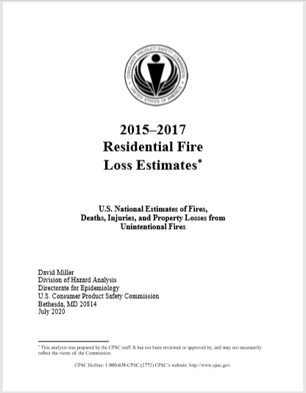
CPSC Data: NFIRS
NFIRS is a collection of voluntarily reported fire incidents input by the attending fire service.
This is not a statistical sample, but staff uses these data in conjunction with the National Fire Protection Association’s annual national fire survey to develop annual estimates of fires and their causes.
https://www.cpsc.gov/s3fs-public/2015to2017ResidentialFireLossEstimates.pdf?lrPHs2JTqq5ijz9zvLHL3zfukzWUKw_X

Slide 36
CPSC Hazard Mitigation Strategies: High-Energy Density Batteries Project
Since 2016, staff has been engaged in a project to address hazards associated with high energy density batteries in consumer products.
Efforts included industry consensus standards work, import surveillance and compliance, and industry, interagency, and intergovernmental cooperation. Staff issued two status reports on the project:
Status Report on High-Energy Density Batteries Project February 12, 2018 - https://www.cpsc.gov/s3fs-public/High_Energy_Density_Batteries_Status_Report_2_12_18.pdf?UksG80UJqGY0q4pfVBkbCuUQ5sNHqtwO
FY 2020 Status Report and Action Plan for the High-Energy Density Batteries Project March 2020 - https://www.cpsc.gov/s3fs-public/High%20Energy%20Density%20Batteries_Status%20Memo_FY20_1-6bCleared-04012020.pdf?Qj4t_otWKfBZYLpvu4l6sUvx9ZJfFc4f

Slide 37
CPSC Hazard Mitigation Strategies: High-Energy Density Batteries Project
Also staff sponsored the Naval Surface Warfare Center Carderock Division to conduct a study on lithium battery technology and an evaluation of mitigation techniques for multi-cell battery pack failures, issuing the following reports:
Emerging Energy Storage Technologies October 2020 - https://www.cpsc.gov/s3fs-public/NSWCCD-63-TR-2020-39_Emerging-Energy-Storage-Technologies_DIS_A_VERSION_ForPostingVersion12012020.pdf?wYqrWGArQLL53BlqSYr8RfCwb2eiznIT
Evaluation of Cell-to-Cell Propagation in Lithium-Ion Batteries Containing 18650 Sized Cells January 2020 - https://www.cpsc.gov/s3fs-public/Consumer%20Product%20Safety%20Commission%20%28CPSC%29%20Staff’s%20Statement%20on%20Naval%20Surface%20Warfare%20Center%2C%20Carderock%20Division’s%20%28NSWCCD%29%20Report%20on%20“Evaluation%20of%20Cell-to-Cell%20Propagation%20in%20Lithium-Ion%20Batteries%20Containing%2018650%20Sized%20Cells”.pdf?KKybsoSCNBqeX46SxJbUq2NqkkzZk_Wd
Staff is continuing to evaluate means of mitigating multicell battery pack failures and is participating in a cooperative effort with Canadian and Mexican governments to evaluate power banks.

Slide 38
Battery Product Recalls: Fiscal Years 2017-2020
From FY 2017 to FY 2020, there were 32 recalls of 15 different types of products, totaling nearly 1.75 M units
Product Type | Number of Recalls | TOTAL Units Recalled
Laptop/Notebook Computers | 8 | 880,132
Hoverboard/Self-balancing Scooter | 6 | 5,220
Power Bank | 4 | 448,243
Speakers | 2 | 205,621
Hand/Foot Warmers | 2 | 16,707
Guitar | 1 | 81,491
Motorized Blinds | 1 | 57,361
video Monitor | 1 | 26,423
Cellphone | 1 | 10,065
Lantern | 1 | 5,855
Sound Machine | 1 | 4,976
Skateboard | 1 | 3,490
Power Recliner | 1 | 2,185
Golf Cart | 1 | 1,049
Vape Pen | 1 | 384

Slide 39
Battery Recalls: Top Four Recalls by Number of Units (2017-2020)
Firm | Product/Recall Number | No. of Units
Apple Inc. | Laptop 19-152 | 432,000
Amazon.com LLC | AmazonBasics Portable Power Bank 18-728 | 257,760
Daniel M. Friedman & Associates (Steven Madden Ltd) | Universal rechargeable power banks 19-017 | 170,500
Brookstone Stores, Inc. | Indoor/outdoor wireless speaker 19-090 | 164,511

Slide 40
Battery Recalls: Recalls of Lithium-ion Battery Products – Root Causes
Quality-Control Problems in Cell Manufacturing
Improper placement of leads
Contaminants in cell
Uneven forming of cell
Poor quality welds
Insufficient electrode overlap
Physical damage to cell
Missing insulating tape on terminal tab
Battery Pack Design Problems
No safety circuits
Inadequate (or any) overcharge/over-discharge protection
Inadequate physical protection

Slide 41
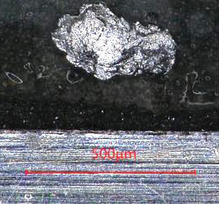
Battery Recalls: Recalls of Lithium-ion Battery Products – Example Root Cause
Cylindrical Cell Contamination – Certified Cell
Laptop overheating incidents revealed defective cells
Examined cells found to have metallic particles (iron) adhered to electrode
Metallic particles can perforate separator and short electrodes
Cell can overheat, possibly go into thermal runaway

Slide 42
Battery Recalls: Recalls of Lithium-ion Battery Products – Example Root Cause
Cylindrical Cell Contamination – Certified Cell
Root Cause: Manufacturing error when electrode-cutting chuck was repositioned improperly - interference occurred, creating iron particles
Corrective Actions Taken by Manufacturer:
Corrected alignment of chuck by next shift
Tracked assembly line production from affected dates
Limited scope of recalled products
Implemented process to control further issues with chuck alignment
Reviewed and reduced other metal-to-metal processes in cell manufacturing

Slide 43
Battery Recalls: General Cell Contamination Mitigation Actions
Processes used to mitigate cell contamination
Magnets to capture loose ferrous particles
Suction to capture other particles
Air ventilation and filtration systems in production areas to minimize contaminants
Cell dissection to look for foreign particles
X-rays – non-destructive inspection for foreign particles and assembly anomalies
CT Scanner – more detailed non-destructive inspection

Slide 44
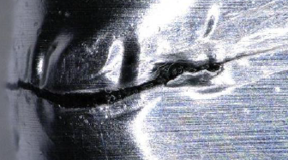
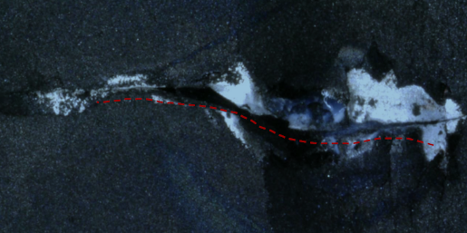
Battery Recalls: Root Cause – Physical Damage Example
Damaged outer foil in polymer cell
Can cause internal soft shorts
Mitigation Strategies
Improve handling procedures and enhance worker training
Conduct visual inspection before batteries leave the factory

Slide 45
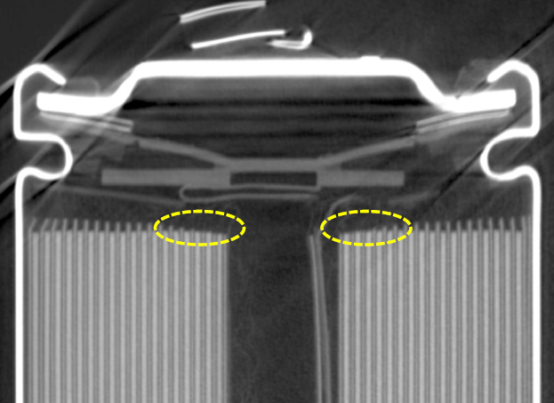
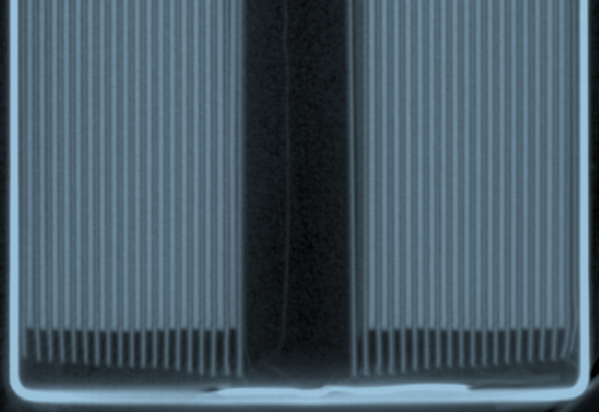
Battery Recalls: Root Cause – Electrode Overlap Example
Insufficient electrode overlap
May result in lithium plating at edges and eventual short circuit
Negative-to-positive electrode overlap > 100 µm*
* IEEE 1625 (Laptops) and IEEE 1725 (Cell phones) standards

Slide 46
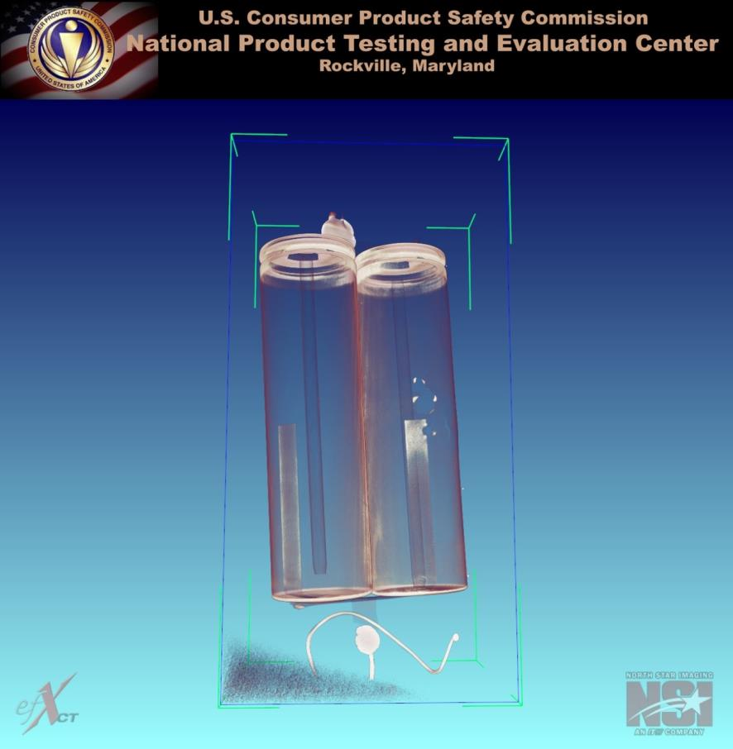
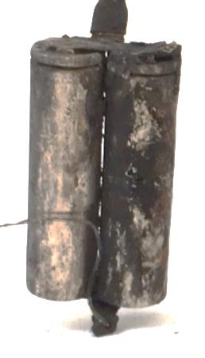
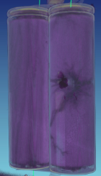
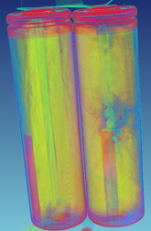
Battery Recalls: X-ray Analysis
X-rays and Computed Tomography x-rays are useful tools for cell screening, as well as failure analysis

Slide 47
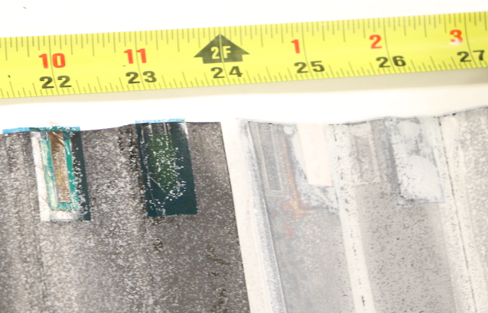
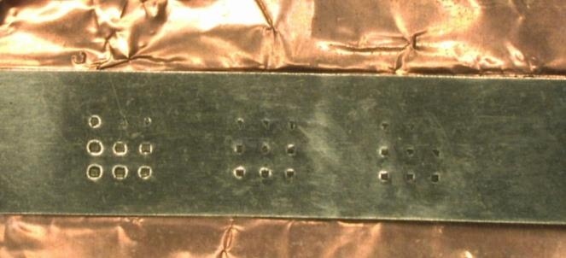
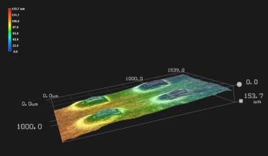
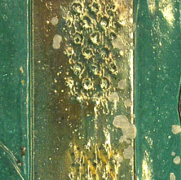
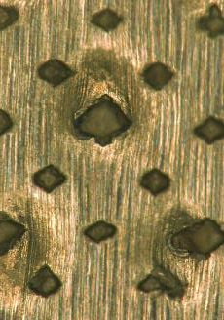
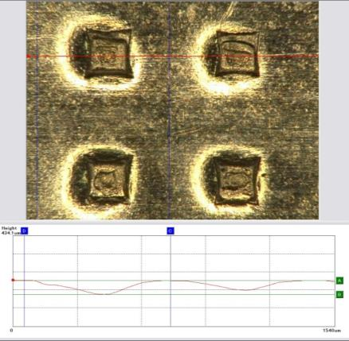
Battery Recalls: Analysis – Dissection and Visual Inspection
Excessive amplitude on ultrasonic welds can produce high peaks that could penetrate separator and cause shorts.
Each Layer thickness
Separator = 10 ~ 20 µm
Tabs = 20 ~ 80 µm
Cu and Al foil = 10 ~ 20 µm
Coatings = 40 ~ 60 µm

Slide 48
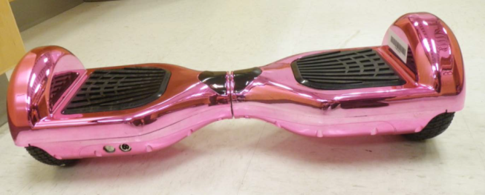
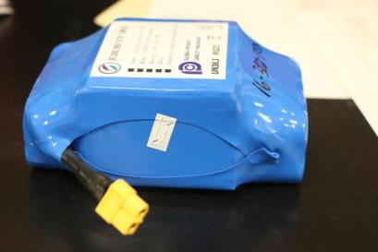
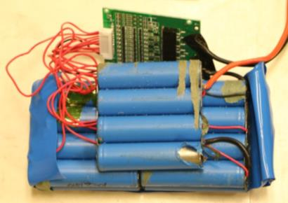
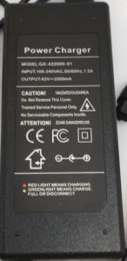
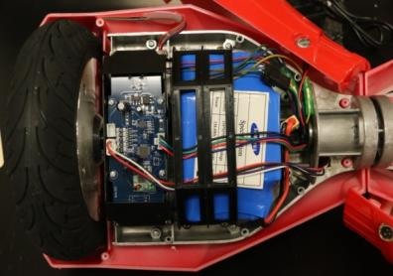
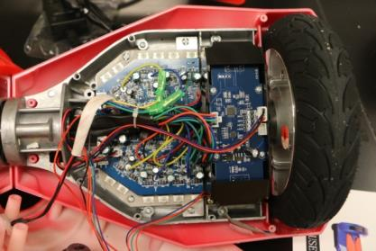
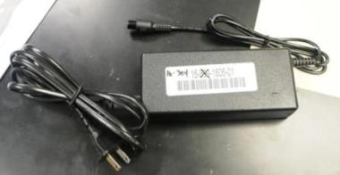
Case Study: Products with No Existing Standard
In late 2015, hoverboards flooded the U.S. market
These units were powered by a rechargeable lithium-ion multicell battery pack; there was no existing industry consensus standard for the end product

Slide 49
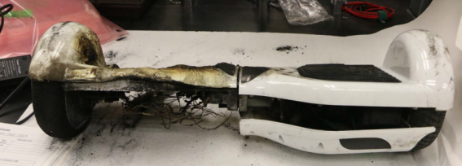
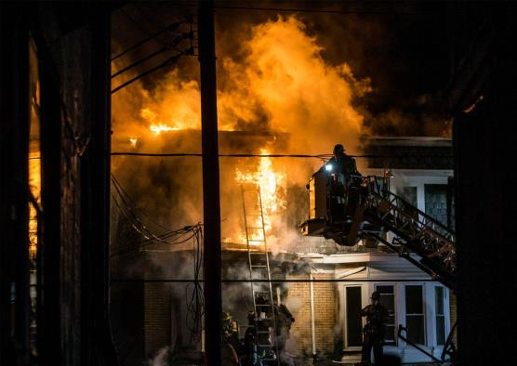
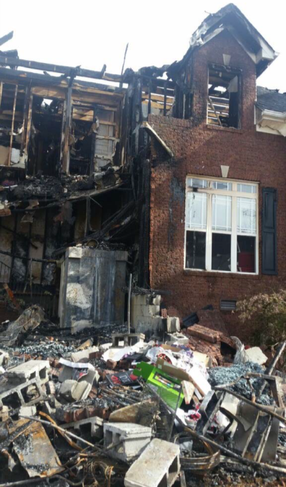
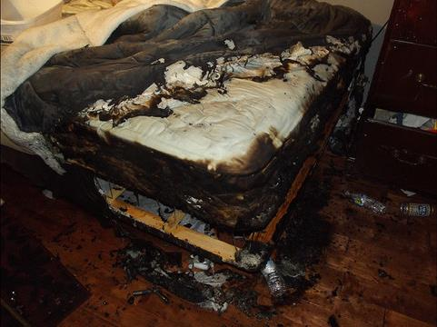
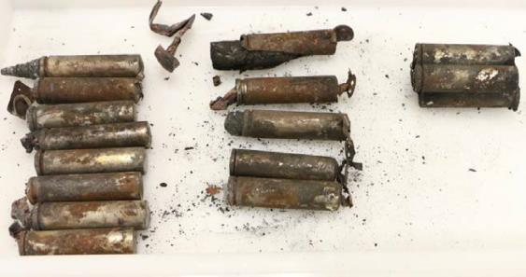
Case Study: Products with No Existing Standard
Almost immediately, incidents were occurring – fires and falls

Slide 50
Case Study: Hoverboard Incident Data – November 2015 - May 2017
Over 165 fire incidents, causing over $3M in property damages
Incidents occurred in 38 states
During and after charging
During and after riding
3 Deaths –1 fire (2 victims, young girls), 1 fall
Estimated over 10,000 Emergency Room Visits
~90% from falls, e.g. sudden stops and starts
~15% head injuries
~50% arm injuries
~40% fractures
~30% sprain/abrasions

Slide 51
2015/2016 CPSC Staff Assessments of Hoverboards
Staff examined incident units and tested exemplar units on a dynamometer and with riders
Fire incident units exhibited signs of thermal runaway leading to catastrophic failure of the entire battery pack
Units were largely similar in construction with 20 Type 18650 cylindrical lithium-ion cells in a 10S-2P (ten pairs of parallel-connected cells in series) configuration.

Slide 52


Case Study: 2015/2016 CPSC Staff Assessments of Hoverboards
Battery management system (BMS) circuits did not incorporate thermal sensing to prevent cell charge/discharge outside of temperature specifications
Internal wiring not installed in accordance with standard practices to protect against damage/shorting:
Loose wires not bundled/secure
Wires routed through openings in cast metal that was not deburred
Wiring not sheathed where passing through pivot

Slide 53


2015/2016 CPSC Staff Assessments of Hoverboards
Rider tests revealed peak battery currents over 20 A
Dynamometer tests showed battery case temperatures well above typical operating temperatures

Slide 54
2015/2016 CPSC Staff Assessments of Hoverboards - Conclusions
Inadequate BMS – Failed protective circuit safety analysis
Inadequate cells (pack) for system load requirements
Cells not certified to UL 1642 to ensure they have been manufactured in accordance with standards
Battery chargers not certified to standard (UL 1310, UL 1012, or UL 60950-1)
Wiring improperly secured and protected in the pivot base, exposed connections could cause short circuit
Units posed a risk of fire – over 500,000 units recalled

Slide 55


Case Study: Products with Well-Established Standards
Even products designed and constructed under well-established standards and with high rates of third party certification can pose risks of fire when best practices are not closely followed.
Photo Source: Google images

Slide 56

Case Study: Products with Well-Established Standards – Cell Phone Recalls
Despite adherence to industry consensus standards and products being certified, manufacturing errors occurred from two different cell manufacturers.
* Source: https://news.samsung.com/global/samsung-electronics-announces-cause-of-galaxy-note7-incidents-in-press-conference

Slide 57

Case Study: Products with Well-Established Standards – Cell Phone Recalls
* Source: https://news.samsung.com/global/samsung-electronics-announces-cause-of-galaxy-note7-incidents-in-press-conference

Slide 58
Case Study: Products with Well-Established Standards – Cell Phone Recalls
Consequently, the cell phone manufacturer reviewed its internal procedures to tighten its manufacturing controls to assure that it could detect problems. These included:
X-ray inspection of all cells to check battery corners
Voltage decay measurement procedures to identify cells with potential problems.
Increased sampling, cycling, dissection and examination of cycled cells.
Additional flexing tests of the phones
Proposed a review and upgrade of IEEE 1725

Slide 59
Best Manufacturing Practices: Assuring Safety of Lithium-Ion Cell-Powered Products
Lithium Battery Safety Basics
There are various electrode chemistries including LCO, LMO, NMC, and LFP, which have different performance specs and varying levels of safety – be aware of the differences and make sure it’s the best one for the application
Cells contain flammable electrolytes - defective or abused cells can enter thermal runaway condition, producing extreme heat and energetic disassembly
Critical safety circuits to control voltage, current and temperature during charge and discharge keep cells within their safe operating area

Slide 60

Best Manufacturing Practices – Assuring Lithium Cell Safety
Maintain cells within their specified safety region during charging and discharging
*Japan Electronics and Information Technology Industries Association and Battery Association of Japan Source: http://home.jeita.or.jp/page_file/20110517171451_cub9MvYFEh.pdf

Slide 61

Best Manufacturing Practices – Assuring Lithium Cell Safety Addition Industry Guidance
Disable charging:
If cell surface temperatures are exceeded
If cell is below 3 V
or initiate pre-charge charging rate
When charge current drops to .05C (no trickle charging)
Balance cells in multi-cell packs
Assure that the charger is compatible with the cells/battery
*Source: http://batteryuniversity.com/learn/article/charging_lithium_ion_batteries

Slide 62




Best Manufacturing Practices – Assuring Lithium Cell Safety Additional Guidance – Thermal Management
Use thermal sensors to monitor cell surface temperatures (red circles) and/or thermal insulators (green arrows) to avoid excess temperatures

Slide 63

Best Manufacturing Practices – Assuring Lithium Cell Safety Select cells with Integral Protection
Current Interrupt Device (CID)
Disconnects cell from terminal under excessive internal pressure
Resettable Positive Temperature Coefficient (PTC)
Limits current (May not be suitable for high-drain applications)
Does not protect against thermal runaway due to internal faults

Slide 64

Best Manufacturing Practices – Assuring Lithium Cell Safety Select cells with Integral Protection
User replaceable cells need an integral BMS to provided charge control and to protect against
Over-charge
Over-discharge
External short-circuit
Source: https://batterybro.com/blogs/18650-wholesale-battery-reviews/18306003-battery-safety-101-anatomy-ptc-vs-pcb-vs-cid

Slide 65
Best Manufacturing Practices – Assuring Lithium Cell Safety Staff Recommendations
Lithium-ion battery safety requires diligence from producer to user.
Lithium-ion battery products should:
Be designed and built in accordance with applicable industry consensus standards; the system from charger to cell should be evaluated together for complete compatibility.
Use high quality cells, suitable for the application
In accordance with manufacturer’s specifications
Be manufactured in strict accordance with industry standard quality control processes
Maintain configuration control with only approved material or component substitutions subject to impact assessments

Slide 66
Best Manufacturing Practices – Assuring Lithium Cell Safety Staff Recommendations
Staff recommends lithium-ion battery products:
Be properly marked with warning labels to inform/educate users of the potential hazards and to closely follow manufacturer’s instructions for proper use
Be third-party certified by an accredited laboratory
Under CPSC’s statutes, manufacturers, importers, distributors, and retailers are responsible to assure consumer products to do not present an unreasonable risk of injury or death.

Slide 67

Questions?
Submit questions in English or Chinese to this podcast:
CPSCinChina@CPSC.GOV

Slide 68
Resources

Slide 69


https://www.cpsc.gov/zh-CN/Business--Manufacturing/Business-Education
Chinese Resources at cpsc.gov

Slide 70


Chinese Resources at cpsc.gov
https://www.cpsc.gov/s3fs-public/HandbookforManufacturingChinese.pdf (中文版本 )
https://www.cpsc.gov/s3fs-public/pdfs/blk_pdf_handbookenglishaug05.pdf (英文版本)
https://www.cpsc.gov/s3fs-public/THE%20REGULATED%20PRODUCT%20HANDBOOK_050613%20CHN%20Final_0.pdf (中文版本 )
https://www.cpsc.gov/s3fs-public/RegulatedProductsHandbook.pdf (英文版本)

Slide 71


Chinese Resources at cpsc.gov
CFR: Commercial Practices
https://www.govinfo.gov/content/pkg/CFR-2017-title16-vol2/pdf/CFR-2017-title16-vol2.pdf (英文版本)
CPSC Laboratory Manuals:
https://www.cpsc.gov/s3fs-public/Laboratory-test-manual-16-CFR-Part-1610-Ch.pdf?MhtbUWNy6jmOPx9b6f.RErt.n.2n_d_h (中文版本)
https://www.cpsc.gov/s3fs-public/Flammability%20of%20Clothing%20Textiles%20Test%20Manual_1610.pdf (英文版本)

Slide 72
Definition of children’s product – 16 CFR Part 1200
Certificates of conformity – 16 CFR Part 1110
Third-party testing – 16 CFR Parts 1107, 1109, and 1112
Tracking information – 15 USC § 2063(a)(5)
Mandatory reporting requirements – 15 USC §2064
CPSC Business Resources
CPSC-Accepted Laboratories Search Page:
www.cpsc.gov/LabSearch

Slide 73


http://business.cpsc.gov
Online tool designed specifically to help businesses comply with federal consumer product safety requirements.
Asks a series of guided questions, and based on the answers produces a downloadable (PDF) report.
Provides customized guidance with links to product safety regulations that may apply to the product and important information on labeling, certification and testing requirements.

Slide 74
Regulatory Robot
Regulatory Robot is a tool to help identify which requirements are applicable
Does not list details of requirements
User inputs product features
Regulatory Robot outputs list of requirements
User references source documents for specific requirements

Slide 75
For more information, please visit:
www.CPSC.gov
https://www.cpsc.gov/Regulations-Laws--Standards/Voluntary-Standards/Topics/Batteries/
Battery Resources

