Slide 1
These slides highlight key U.S. product safety requirements for discussion. The text is not a comprehensive statement of legal requirements or policy and should not be relied upon for that purpose. Moreover, with the passage of time, the slides may not reflect the latest information. You should consult official versions of U.S. statutes and regulations, as well as published CPSC guidance when making decisions that could affect the safety and compliance of products entering U.S. commerce. Note that reference materials are listed at the end of the presentation.
Notes:
.

Slide 2
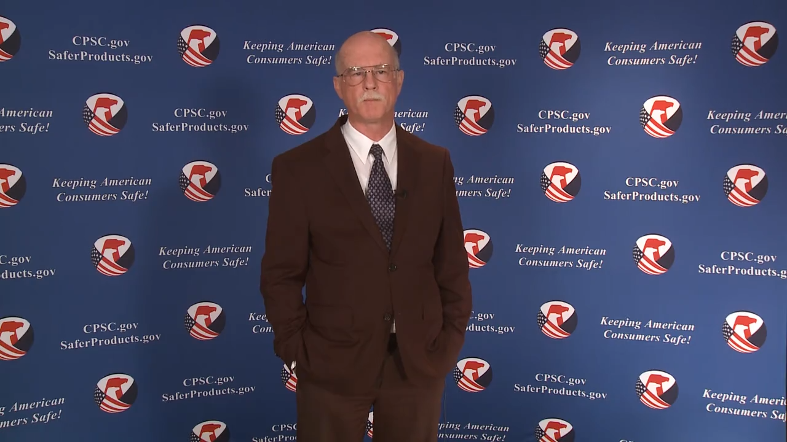
Video: Welcome to the China Podcast Series- CPSC’s Third Party Laboratory Testing Program
Notes:
Title page with photo.

Slide 3
China Podcast Series
Overview of CPSC’s Third Party Laboratory Program for Children’s Products
This presentation was prepared by CPSC Staff. It has not been reviewed or approved by the Commission and may not reflect its views.
Notes:
The graphic element in the lower right is optional and does not have to be used on the title page as shown.

Slide 4

Biographies
Sylvia Chen
U.S. Consumer Product Safety Commission
Program Manager for East Asia and Pacific
Office of International Programs
Sylvia Chen is responsible for managing the Commission’s bilateral and multilateral programs related to consumer product safety in Australia, Japan, Korea, Taiwan, and New Zealand. She also supports the CPSC’s work with China. Since she joined the CPSC in 2008, Sylvia has been working with product safety regulators, industry organizations, manufacturers, exporters, buyers, and other sourcing professionals to provide them with guidance and technical support in understanding U.S. requirements, in particular, the latest requirements for consumer products. To that end, she has organized or coordinated many of the agency’s international education and outreach activities.
Sylvia has a Bachelor of Arts degree in English and American Literature from Peking University. In 1991, she graduated from The Ohio State University with a Master’s degree in East Asian Studies.

Slide 5
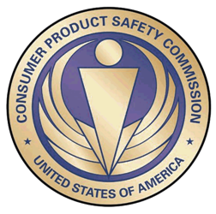
The US CPSC is a federal government agency charged with protecting the public from unreasonable risks of injury or death associated with the use of consumer products under the agency's jurisdiction.
$1 Trillion
Deaths, injuries, and property damage from consumer product incidents cost the nation more than $1 trillion annually.¹
¹ https://www.cpsc.gov/s3fs-public/FY2019PBR.pdf
CPSC is committed to protecting consumers from products that pose a fire, electrical, chemical, biological, or mechanical hazard.
CPSC's work to improve the safety of thousands of types of consumer products in its jurisdiction - such as toys, cribs, power tools, cigarette lighters, textiles, and household chemicals – has contributed to a decline in the rate of injuries associated with consumer products over nearly 50 years.

Slide 6
Overview of CPSC’s Third Party Laboratory Program for Children’s Products

Slide 7
Contents
Highlights of Consumer Product Safety Improvement Act of 2008 (CPSIA)* Requirements
Testing Laboratory: Baseline Requirements for CPSC Acceptance
ILAC-MRA
How to Find a CPSC-Accepted Laboratory
Tips for Working with a Lab for Testing Your Children’s Product
Resources

Slide 8
Section 102 – Consumer Product Safety Improvement Act of 2008 (CPSIA)*
Requires certification of regulated products by the U.S. manufacturer (includes importers) or U.S. private labeler
  General use consumer products
  Children’s products
Certification based on product testing
  A test of each general use consumer product or a reasonable test program
  Children’s Products - Third-party testing by a CPSC-accepted laboratory
  * The CPSIA amended the Consumer Product Safety Act (CPSA) Section 14 [15 U.S.C. § 2063] for Product Certification and Labeling

Slide 9
Product Certification
Initial certification required before product enters stream of commerce
Requirement for continued testing and recertification of children’s product
  Event-triggered testing
    Material change in:
      manufacturing process
      sourcing of materials
      product design
  Periodic testing
    Frequency
    Sampling Plan
      Representative samples
      Sample size
Source: 16 C.F.R. Part 1107 and Part 1110

Slide 10
Testing Laboratory: Baseline Requirements for CPSC Acceptance
The laboratory must be accredited by an accreditation body that is a signatory to the International Laboratory Accreditation Cooperation (ILAC) Mutual Recognition Arrangement (MRA).
The laboratory must apply to the CPSC (on-line application process) for recognition and must agree to fulfill the requirements of the CPSC program.
The scope of accreditation must include the testing methods/standards/regulations as shown on the CPSC application. Source: 16 C.F.R. Part 1112
Provides for the participation of domestic and foreign ABs and Testing Laboratories

Slide 11
Why CPSC Specifies the ILAC-MRA
Laboratory Accreditation Process
Identification of required standards
  ISO/IEC – 17025 requirement for testing laboratories
  ISO/IEC – 17011 requirement for ABs
  Specified CPSC regulations and standards
Existing accreditation system
International in scope
Global recognition
Demonstrated competence, peer-reviewed

Slide 12
Overview of Laboratory Acceptance Program
CPSC Rules for Acceptance of Accreditation and Rules to Maintain and Renew CPSC Acceptance
Adverse Actions: Withdrawal and Suspension of Acceptance of Accreditation
Appeals Process
Governmental and Firewalled Laboratories- Additional Submission Requirements:
  protections against undue influence
  no favorable treatment by government entities
Source: 16 C.F.R. Part 1112

Slide 13
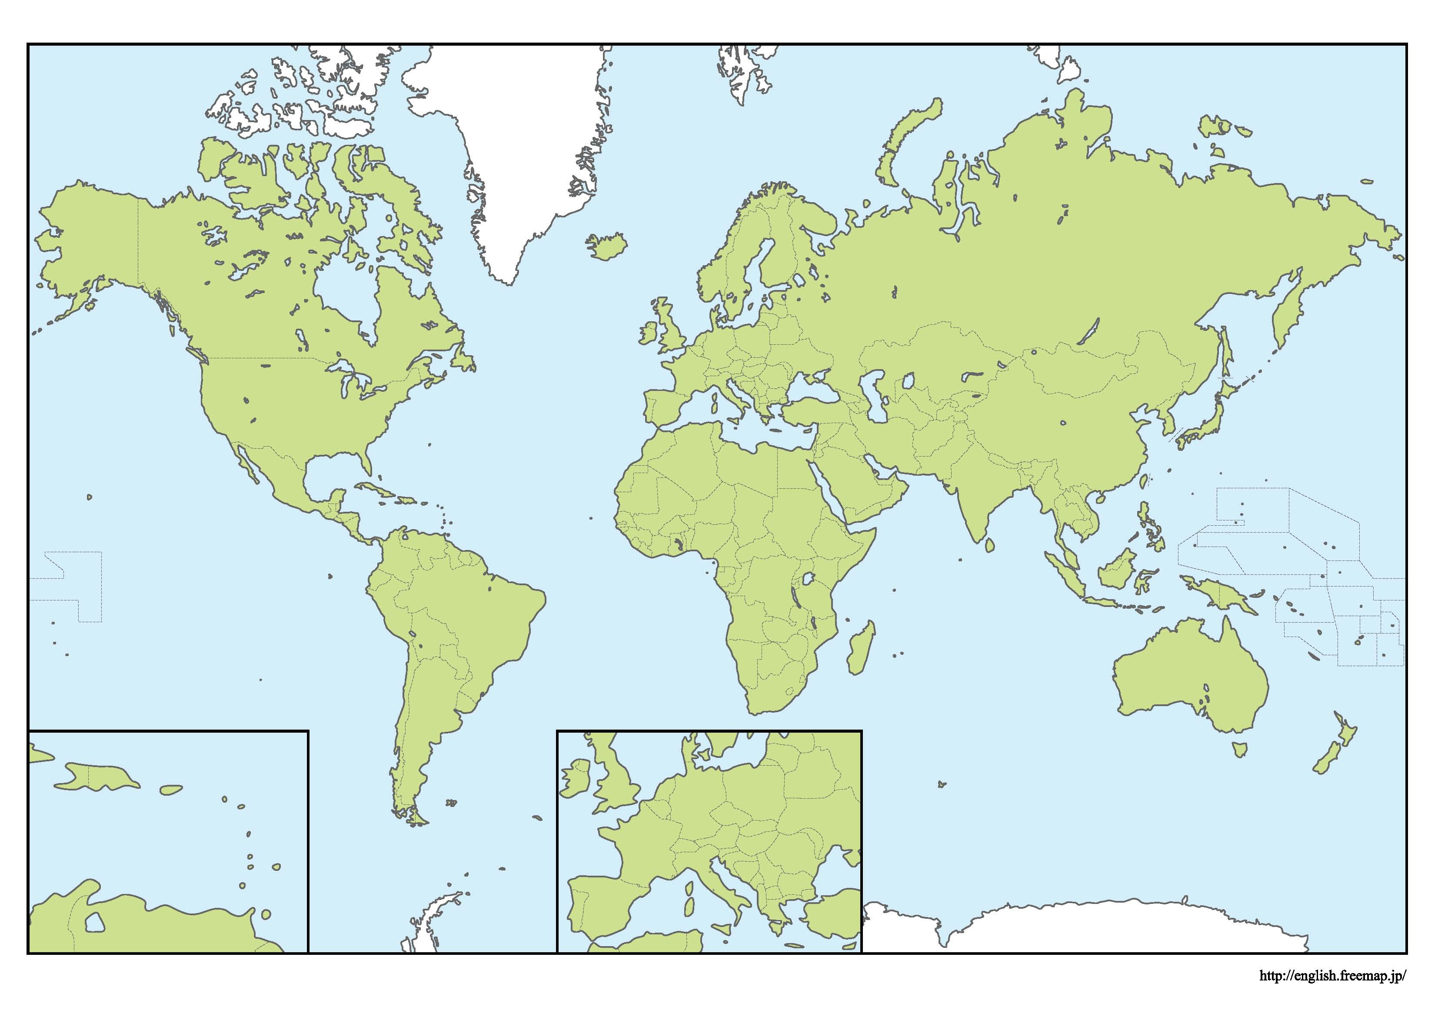
United Kingdom
13
Germany
20
USA
76
Bangladesh
16
China
250
South Korea
10
Italy
20
Taiwan
11
India
37
Vietnam
23
603 CPSC-accepted laboratories
Located in 48 economies
Accredited by
Full Member ILAC ABs
As of January 6, 2022
79% (476) of the
CPSC-accepted laboratories
are located in 10 economies
As of January 6, 2022

Slide 14
Austria - 1
Belgium - 1
Brazil – 3
Cambodia - 4
Canada – 3
Czech Republic - 1
Denmark - 2
Egypt - 2
Mauritius – 2
Mexico – 10
Morocco - 1
Pakistan - 5
Peru - 1
Philippines – 2
Poland - 1
Portugal – 3
Romania - 1
Singapore – 6
Slovakia - 1
Other Economies
106
Laboratories
Spain - 6
Sri Lanka – 4
Sweden - 1
Switzerland - 1
Thailand – 5
Tunisia - 3
Turkey – 7
United Arab Emirates – 1
El Salvador – 1
France – 6
Greece - 1
Guatemala - 2
Hungary - 1
Indonesia – 10
Israel - 1
Japan - 6
Malaysia - 5

Slide 15
How to Find a CPSC-Accepted Laboratory
CPSC-Accepted Laboratories Search Page:
www.cpsc.gov/LabSearch
See the instructional video on the website where you obtained this slidedeck for further explanation on how to find a CPSC-accepted laboratory.

Slide 16
Tips for Working with a Lab for Testing your Children’s Product

Slide 17
Security
Reports should:
Encrypt or add a security banner to the test report so that reports cannot be copied, edited, or changed in any manner.
Any type of certification or watermark that cannot be copied or altered would be helpful.

Slide 18

Include Photos
A picture is worth a thousand words.

Slide 19
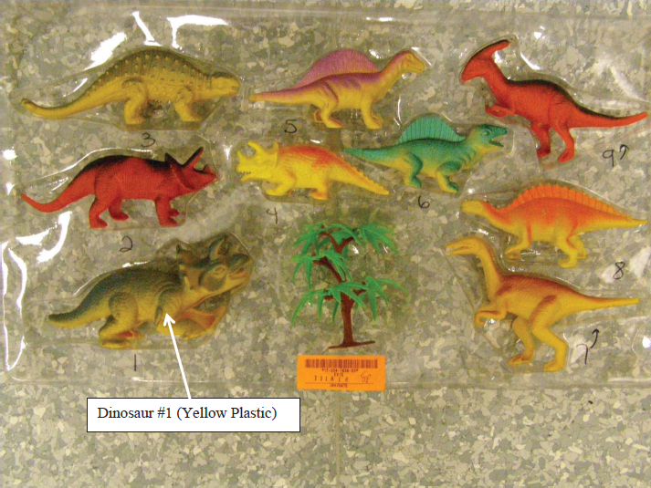
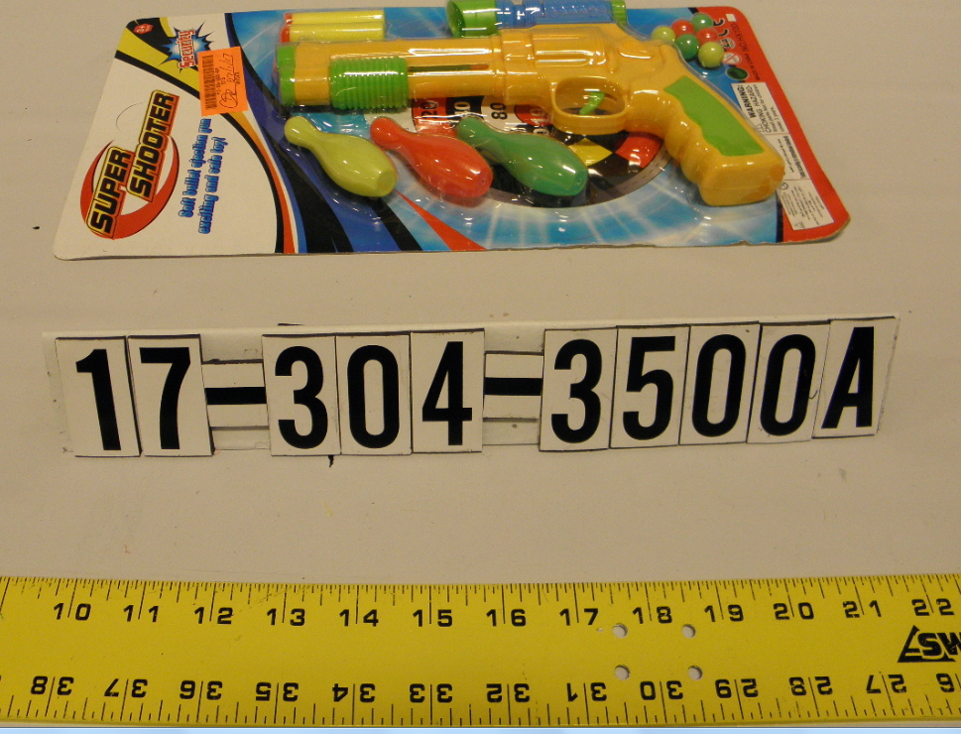
Measurements
Identify Products
Show the products tested. Use color photographs, with the items in close proximity to the camera lens, so that the products tested are easy to identify.

Slide 20
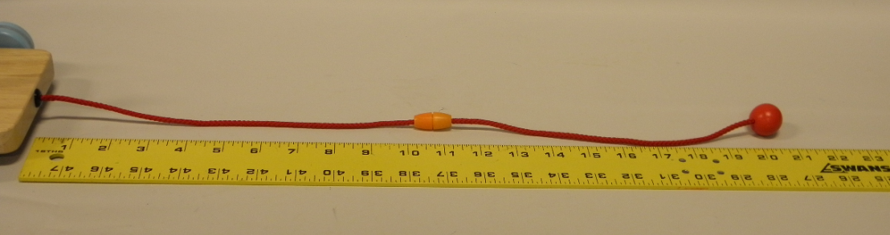
Measurements
Use a ruler or other visual indicator to show the measurement reading of a product feature that is subject to CPSC requirements.

Slide 21
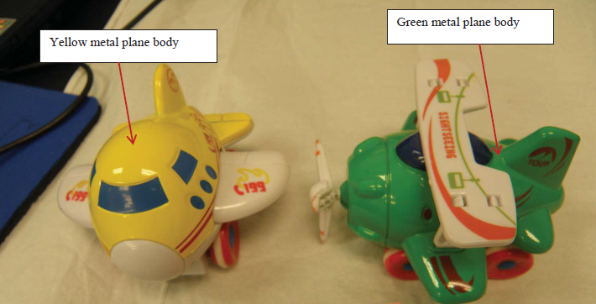
Identify Components Tested
  Identify components tested by using photographs. Show areas tested, for example, testing for lead content or paint.
  When testing a toy for lead, identify all accessible components of the toy that were tested.
Examples of Accessible Parts

Slide 22
Identify Number of Units
In the test report, state how many units of the product were tested.
Confidence is needed that samples tested are representative of a full manufacturing run.

Slide 23
Include Numerical Results
  Consider Measurement Error When Interpreting Test Results
  Look for useful details regarding pass/fail criteria when a numerical value is provided by the test, taking into consideration how measurement uncertainty creates compliance uncertainty.
  “P.”

Slide 24
  Consider Measurement Error When Interpreting Test Results
Example: The maximum measurement permitted for total lead content is 100 parts per million (ppm).
Product test results are 79 ppm
+/- limit of 20 ppm due to a laboratory’s measurement uncertainty

Slide 25
  Consider Measurement Error When Interpreting Test Results
You may need to test additional samples and/or you may not be able to certify that your product complies because 79 ppm + 20 ppm laboratory uncertainty = 99 ppm, which is under, but close to exceeding the federal requirements.
Ask the laboratory to provide a report that does not simply state “F” or “Fail,” but provide the value obtained and the measurement error.

Slide 26
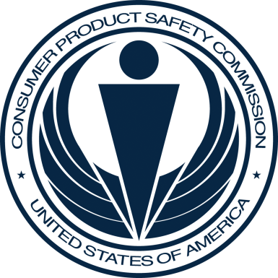
Questions?
Submit questions in English or Chinese to this podcast:
CPSCinChina@CPSC.GOV

Slide 27
Resources
Notes:
Optional title page with text.

Slide 28
CPSC’s China Podcast Series
International Video and Podcast Series | CPSC.gov
Podcast | Topics
#1 | Selling Safe Electrical Products to the U.S. Market
#2 | Overview of U.S. Apparel Requirements
#3 | CPSC Bicycle Regulations and U.S. and International Safety Standards
#4 | Overview of U.S. Mattress Requirements
#5 | Durable Infant or Toddler Products: Common Requirements
#6 | Overview of U.S. Strollers and Carriages Requirements
#7 | Toy Safety Requirements
#8 | Overview of Children’s Sleepwear Requirements
#9 | Enhancing the Safety of Emerging Technology through Risk Assessment: Wearables
#10 | Overview for Battery Safety Requirements
#11 | Overview of Gates and Enclosures Requirements

Slide 29
CPSC’s China Podcast Series (Continued)
Podcast | Topics
#12 | Overview of Consumer Safety and Micromobility Devices
#13 | Overview of Cribs and Play Yards Requirements
#14 | Product Safety and Compliance: Best Practices for Buyers Exporting Consumer Goods to the United States
#15 | How to Find Safety Requirements for Your Product Using CPSC’s Regulatory Robot .
#16 | Flammability Requirements for Upholstered Furniture
#17 | CPSC’s Import Screening Program
#18 | Overview of CPSC’s Third Party Laboratory Program for Children’s Products
#19 | Infant Sleep Product Safety Requirements
#20 | Children's Folding Chairs/Stools Safety Requirements
“Questions on this presentation? Send an email to CPSCinChina@cpsc.gov”

Slide 30
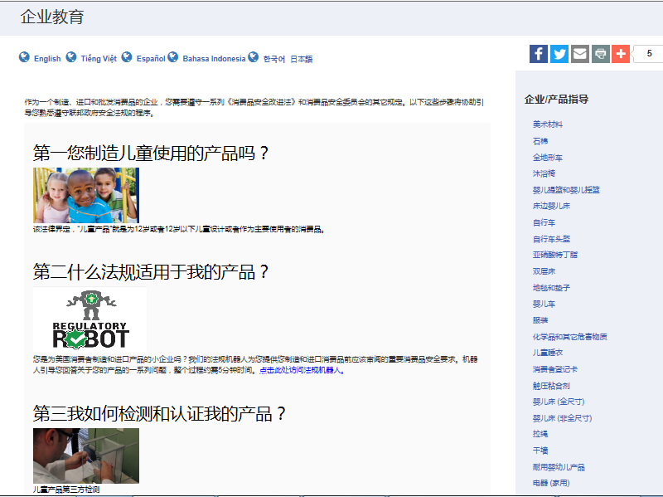

Chinese Language Resources at cpsc.gov

Slide 31
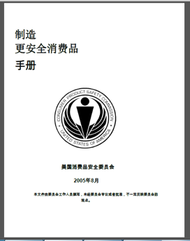
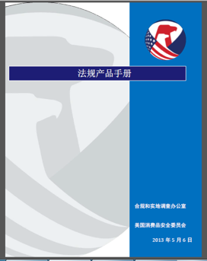
Chinese Language Resources at cpsc.gov
https://www.cpsc.gov/s3fs-public/HandbookforManufacturingChinese.pdf (中文版本 )
https://www.cpsc.gov/s3fs-public/pdfs/blk_pdf_handbookenglishaug05.pdf (英文版本)
https://www.cpsc.gov/s3fs-public/THE%20REGULATED%20PRODUCT%20HANDBOOK_050613%20CHN%20Final_0.pdf (中文版本 )
https://www.cpsc.gov/s3fs-public/RegulatedProductsHandbook.pdf (英文版本)

Slide 32
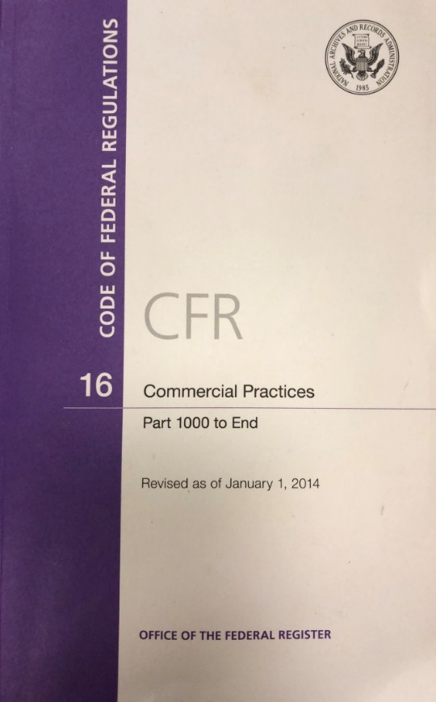
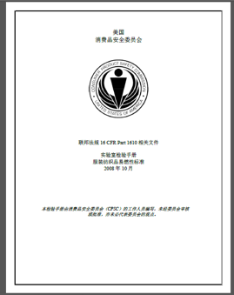
Chinese Language Resources at cpsc.gov
CFR: Commercial Practices
https://www.govinfo.gov/content/pkg/CFR-2017-title16-vol2/pdf/CFR-2017-title16-vol2.pdf (英文版本)
CPSC Laboratory Manuals:
https://www.cpsc.gov/s3fs-public/Laboratory-test-manual-16-CFR-Part-1610-Ch.pdf?MhtbUWNy6jmOPx9b6f.RErt.n.2n_d_h (中文版本)
https://www.cpsc.gov/s3fs-public/Flammability%20of%20Clothing%20Textiles%20Test%20Manual_1610.pdf (英文版本)

Slide 33
Definition of children’s product – 16 CFR Part 1200
Certificates of conformity – 16 CFR Part 1110
Third-party testing – 16 CFR Parts 1107, 1109, and 1112
Tracking information – 15 USC § 2063(a)(5)
Mandatory reporting requirements – 15 USC §2064
CPSC Business Resources
CPSC-Accepted Laboratories Search Page:
www.cpsc.gov/LabSearch

Slide 34

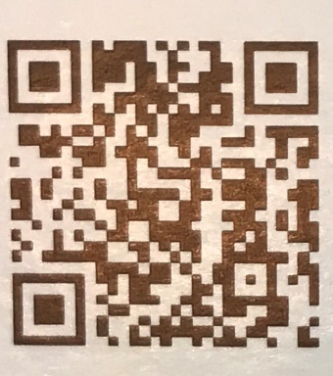
http://business.cpsc.gov
Online tool designed specifically to help businesses comply with federal consumer product safety requirements.
Asks a series of guided questions, and based on the answers produces a downloadable (PDF) report.
Provides customized guidance with links to product safety regulations that may apply to the product and important information on labeling, certification and testing requirements.

