Slide 1
The slides used in this presentation are intended to be used in an event with verbal elaboration by a knowledgeable presenter. These slides highlight key U.S. product safety requirements for discussion. The text is not a comprehensive statement of legal requirements or policy and should not be relied upon for that purpose. Moreover, with the passage of time, the slides may not reflect the latest information. You should consult official versions of U.S. statutes and regulations, as well as published CPSC guidance when making decisions that could affect the safety and compliance of products entering U.S. commerce. Note that reference materials are listed at the end of the presentation.
Notes:
.

Slide 2
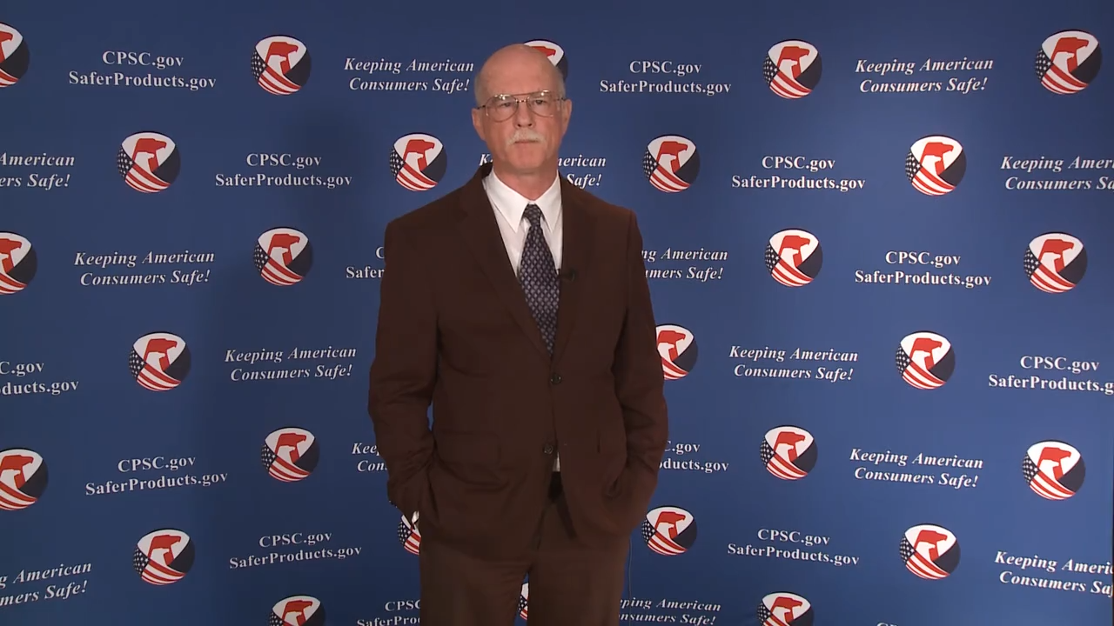
Video: Welcome to the 2021 CPSC Podcast Series- Overview of Gates and Enclosures Requirements

Slide 3
Podcast Series 2021
Overview of Gates and Enclosures Requirements
This presentation was prepared by CPSC Staff. It has not been reviewed or approved by the Commission and may not reflect its views.

Slide 4

Biography
Sylvia Chen
U.S. Consumer Product Safety Commission
Program Manager for East Asia and Pacific
Office of International Programs
Sylvia Chen is responsible for managing the Commission’s bilateral and multilateral programs related to consumer product safety in Australia, Japan, Korea, Taiwan, and New Zealand. She also supports the CPSC’s work with China. Since she joined the CPSC in 2008, Sylvia has been working with product safety regulators, industry organizations, manufacturers, exporters, buyers, and other sourcing professionals to provide them with guidance and technical support in understanding U.S. requirements, in particular, the latest requirements for consumer products. To that end, she has organized or coordinated many of the agency’s international education and outreach activities.
Sylvia has a Bachelor of Arts degree in English and American Literature from Peking University. In 1991, she graduated from The Ohio State University with a Master’s degree in East Asian Studies.

Slide 5

The US CPSC is a federal government agency charged with protecting the public from unreasonable risks of injury or death associated with the use of consumer products under the agency's jurisdiction.
$1 Trillion
Deaths, injuries, and property damage from consumer product incidents cost the nation more than $1 trillion annually.¹
¹ https://www.cpsc.gov/s3fs-public/FY2019PBR.pdf
CPSC is committed to protecting consumers from products that pose a fire, electrical, chemical, biological, or mechanical hazard.
CPSC's work to improve the safety of the more than 15,000 types of consumer products in its jurisdiction - such as toys, cribs, power tools, cigarette lighters, textiles, and household chemicals – has contributed to a decline in the rate of deaths and injuries associated with consumer products over the past 40 years.

Slide 6
CPSC’s 2021 Podcast Series
Podcast | Topics
#1 | Overview of Children’s Sleepwear Requirements
#2 | Enhancing the Safety of Emerging Technology through Risk Assessment: Wearables
#3 | Overview of Battery Safety Requirements
#4 | Overview of Gates and Enclosures Requirements
#5 | Overview of Consumer Safety and Micromobility Devices
#6 | Overview of Cribs and Play Yards Requirements
“Questions on this Presentation? Send an email to CPSCinChina@cpsc.gov”

Slide 7
Overview of Gates and Enclosures Requirements

Slide 8
Topics
Defining Gates and Enclosures
Labeling & Instructional Literature Requirements
Testing Requirements
Children’s Product Certificate
Recall Examples
Resources

Slide 9
Gates and Enclosures History
Notice of Proposed Rulemaking – July 7, 2019
Final Regulation Published – July 6, 2020
Existing Industry Consensus Standard: ASTM F1004-19
New Technical Regulation: 16 CFR part 1239, incorporating ASTM F1004-19 with two modifications for pressure-mounted gates:
  Gates with wall cups must include a separate, conspicuous warning label on the top rail of the gate regarding correct installation using wall cups in order to meet the 30-pound push-out force test
  Gates without wall cups must use visual side-pressure indicators to signal to consumers whether the gate is correctly installed in order to meet the 30-pound push-out force test
  Effective date: July 6, 2021 (on products manufactured on or after this date.)

Slide 10
Purpose of ASTM F1004-19
Addresses incidents of head and neck entrapment in children’s expansion gates and expandable enclosures
Addresses the ability of a pressure gate to resist push-out force
Does not address incidents in which gates or enclosures are blatantly misused

Slide 11
Defining Gates and Enclosures
Gate- 16 CFR part 1239
  “Barrier intended to be erected in an opening, such as a doorway, to prevent the passage of young children, but which can be removed by older persons who are able to operate the locking mechanism.”
Enclosure- 16 CFR part 1239
  “Self-supporting barrier intended to completely surround an area or play-space within which a young child may be confined”
These products are intended for young children age 6 months through 24 months.

Slide 12
Defining Gates and Enclosures
What about “Expansion” and “Expandable”?
  The ASTM F1004-19 standard refers to these categories as “Expansion Gates” and “Expandable Enclosures”
  ASTM F1004-19 includes “products known as expansion gates and expandable enclosures, or by any other name” (Section 1.2, emphasis added)
  CPSC staff's review of hazard patterns indicates that all children's gates and enclosures present the same hazards, whether they expand or not.
  16 CFR part 1239 addresses all children's gates and enclosures intended for confining a child, including non-expandable, fixed-sized gates and enclosures, as well as expandable products.

Slide 13
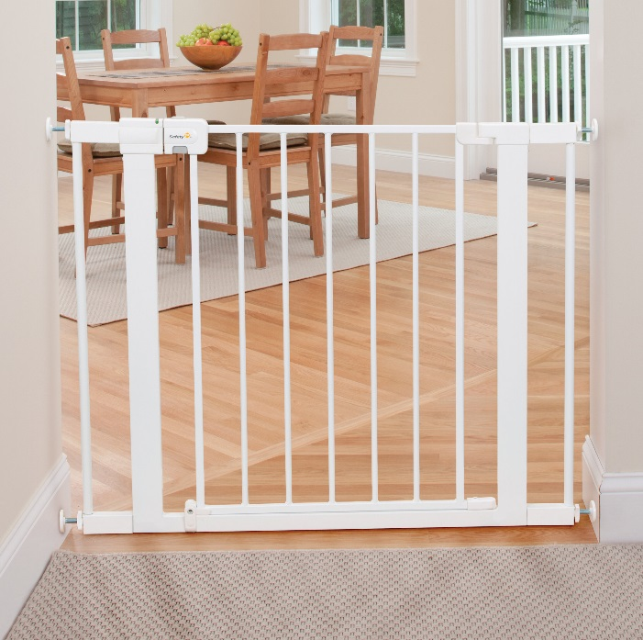
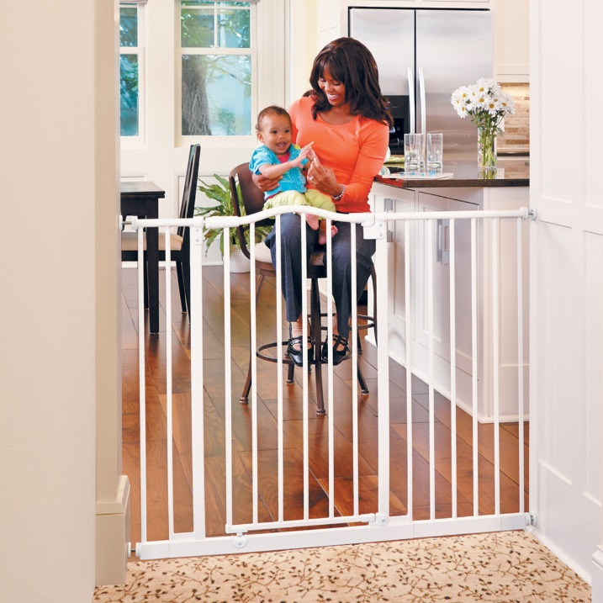
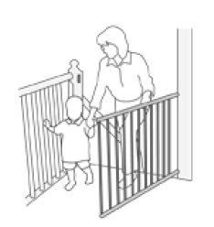
Defining Gates and Enclosures:
Gates*
*Photos are for illustration purposes only and not meant as an endorsement of the products shown.

Slide 14
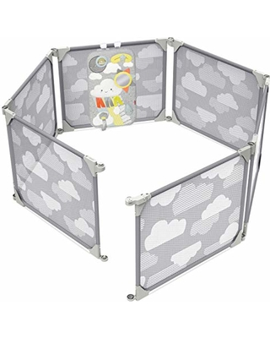
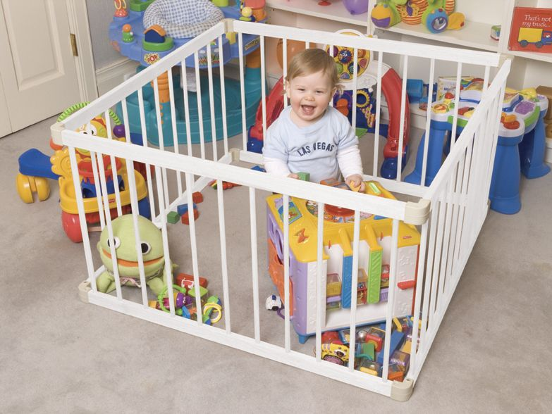
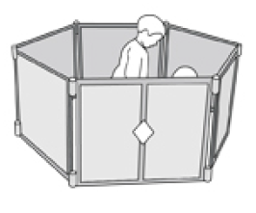
Defining Gates and Enclosures:
Enclosures*
*Photos are for illustration purposes only and not meant as an endorsement of the products shown.

Slide 15
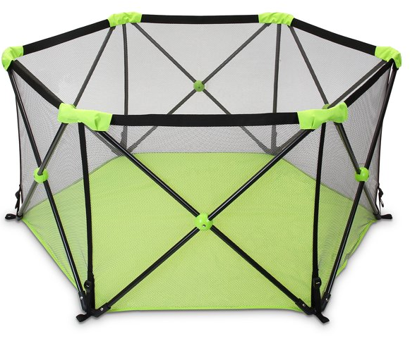
Is this product an enclosure?

Slide 16
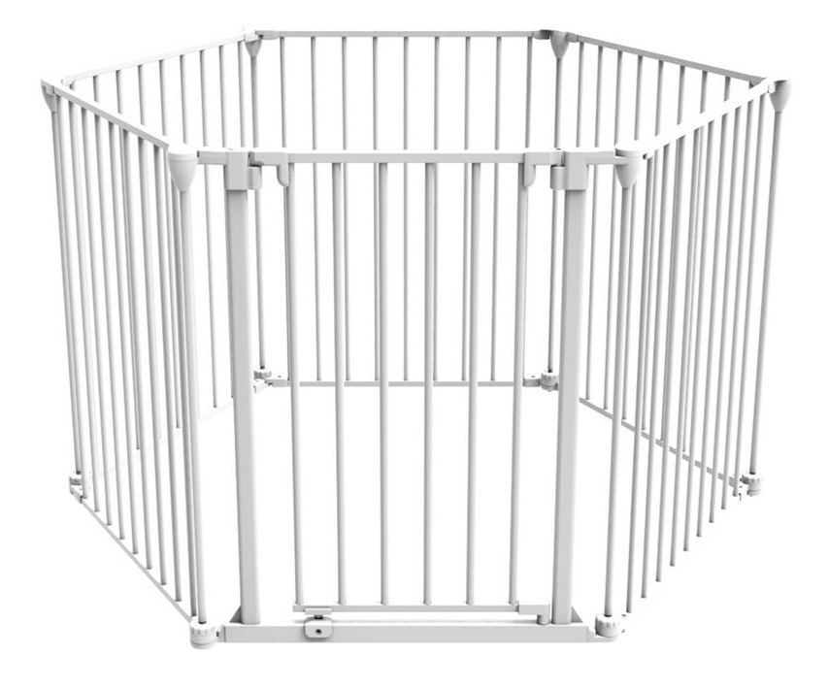
Enclosures vs. Play Yards*
Enclosures do not have attached floors.
They are within the scope of 16 CFR part 1239, Safety Standard for Gates and Enclosures.
Play Yards have attached floors.
They are within the scope of 16 CFR part 1221, Safety Standard for Play Yards.
*Photos are for illustration purposes only and not meant as an endorsement of the products shown.

Slide 17
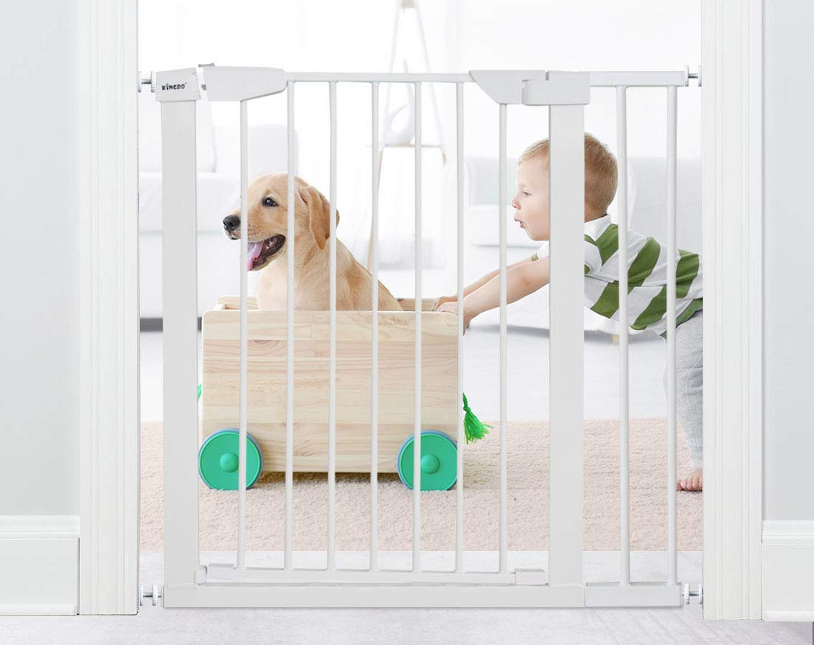
Is this product a child gate or a pet gate?

Slide 18
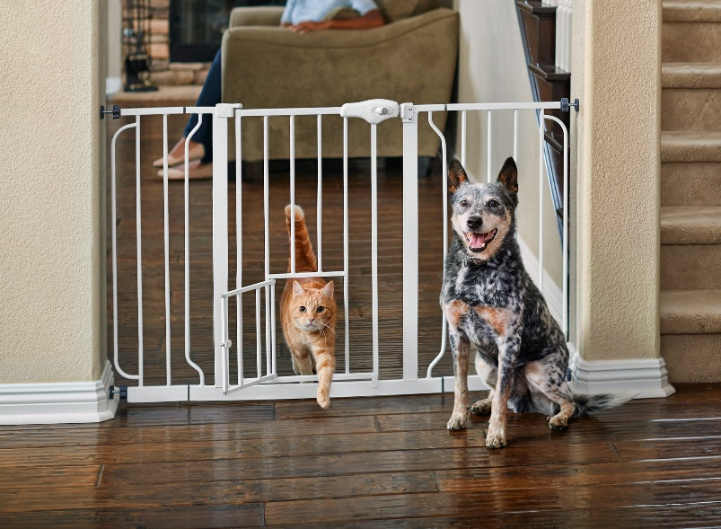
Child Gates vs. Pet Gates*
Gates intended for use with pets and children are within the scope of the standard.
Gates intended only for use with pets are not within the scope of the standard.
See www.cpsc.gov/childrensproduct for more information
*Photos are for illustration purposes only and not meant as an endorsement of the products shown.

Slide 19
Labeling and Instructional Literature
Marking and Labeling (Permanently on Product and Packaging) – per ASTM F1004-19
  Manufacturer/Distributor/Seller Name
  Place of business (city, state, and mailing address, including zip code) and telephone number (per 16 CFR §1130.4.)
  Code or mark identifying the date (month and year minimum) of manufacture.
  Batch or run number, if used (per CPSIA tracking information requirement)

Slide 20
Labeling and Instructional Literature
Informational Statements (included with product) should include:
  Assembly, installation, operating, folding, maintenance, and cleaning instructions as applicable
  All warning statements
  Applicable opening sizes with which the product is meant to be used
  Instructions to discontinue the use of the product if it becomes damaged, broken, or disassembled.
  For Gates:
    Statement of the limitations regarding the use of any included mounting hardware and information regarding where to install the gate relative to the floor.
  For Gates that are recommended for use at the top of stairs:
    Statement specifying where the gate must be installed as a minimum distance to the first step of the stairs.

Slide 21
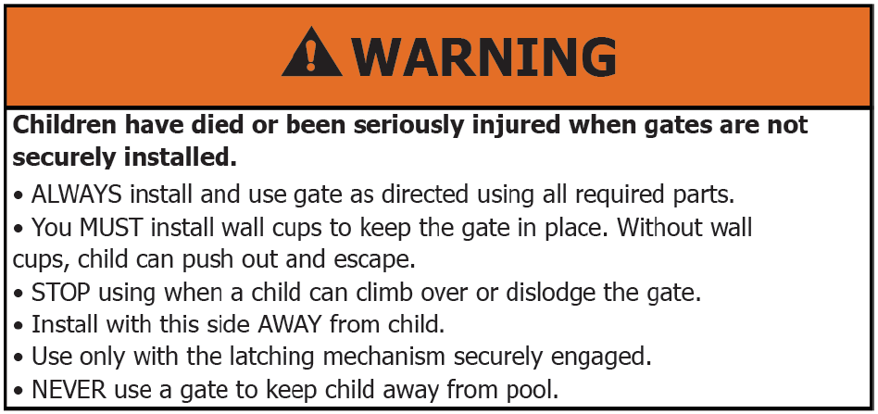
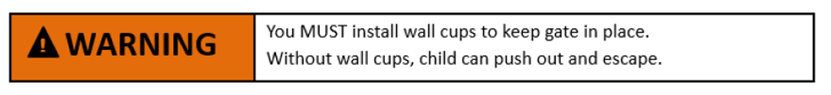
Labeling and Instructional Literature
Warning Label – ASTM F1004-19
  Example from Standard:
  Permanent, conspicuous, and in sans serif font.

Slide 22
Labeling and Instructional Literature
Retail Packaging should state:
  The recommended age of the user of the product
  That the product is not to be used with a child able to climb over or dislodge/open the gate
  The applicable opening sizes for the product
Retail Packaging for products with wall cups should include:
  The warning for wall cups: “You MUST install wall cups to keep gate in place. Without wall cups, children can push out and escape.”
    If the wall cups or other mounting hardware are packed in a hardware bag or similar container, the container shall be marked or labeled with the warning statement.

Slide 23
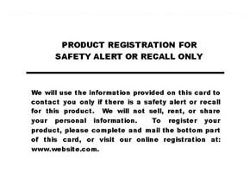
Product Registration Card Requirement
Manufacturers of Durable Infant and Toddler Products must include a product registration card attached to the product – 16 CFR part 1130
  Provide consumers with postage-paid product registration card
  Maintain records of names, addresses, emails, and other contact info on consumers that register their products
  Permanently place manufacturer name and contact info, model name and number, and date of manufacture on each durable product
Please refer to our website for more information.

Slide 24
Do I need to provide paper product registration cards if I sell direct-to-consumer and maintain contact information for all of my customers?

Slide 25
Do I need to provide paper product registration cards if I sell direct-to-consumer and maintain contact information for all of my customers?
Yes – there is no exception to the paper registration card requirements in 16 CFR 1130.

Slide 26
Chemical Testing Requirements
Lead Content Testing – 15 U.S.C. §1278a
  Limit: No more than 100 ppm in accessible parts of children’s products
  Materials that do not exceed the lead limit in untreated, unadulterated state – 16 CFR §1500.91
    Wood, Paper and similar materials made from wood
    CMYK process printing inks
    Natural fibers (dyed or undyed) including, but not limited to, cotton, linen, hemp, bamboo, sisal, silk, wool (sheep)
    Manufactured fibers (dyed or undyed) including, but not limited to, rayon, lyocell, acetate, triacetate, rubber, polyester, nylon, acrylic, modacrylic, spandex
Lead in Paint and Surface Coatings – 16 CFR part 1303
  Limit: No more than 90 ppm in paint and surface coatings
  Not applicable to items without a surface coating that can be scraped off of the substrate

Slide 27
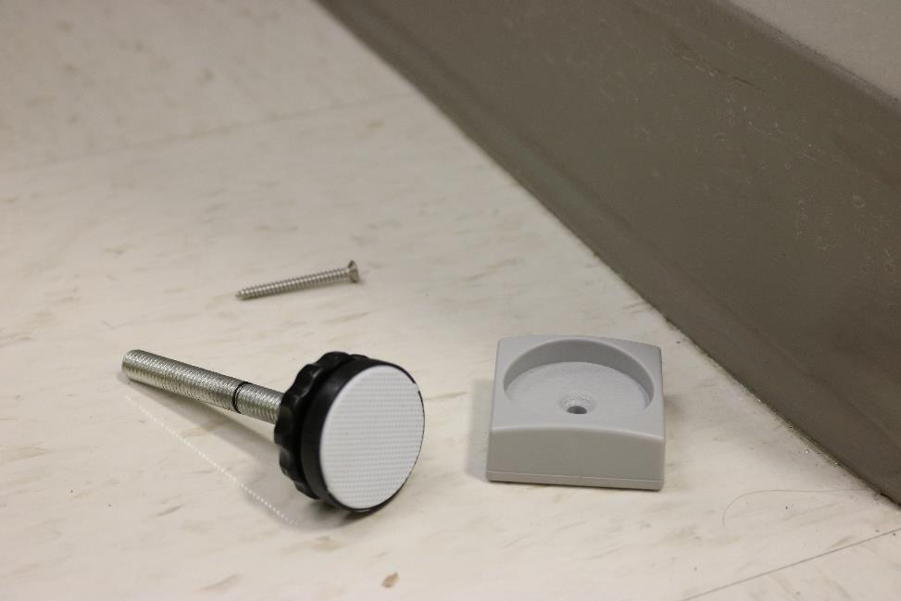
Does the mounting hardware included with my product need to meet total lead content requirements?

Slide 28
Does the mounting hardware included with my product need to meet total lead content requirements?
Yes – all accessible components of children’s products must meet the 100ppm limit on total lead content in 15 U.S.C. 1278a. (See 16 CFR 1500.91 for materials that may not require testing)

Slide 29
Physical/Mechanical Testing Requirements
Small Parts – 16 CFR part 1501
  Small part fits entirely into a small parts cylinder specified in the regulation
  Products intended for use by children under age 3 cannot have small parts
  Any components that detach from the product after use and abuse testing can be considered small parts
Sharp Points/Edges – 16 CFR §§1500.48-.49
  No hazardous sharp edges or points

Slide 30
Does the mounting hardware included separately with my product need to meet small parts requirements?

Slide 31
Does the mounting hardware included separately with my product need to meet small parts requirements?
No – testing shall be completed on products installed according to the manufacturer’s instructions. However, installation hardware cannot become liberated during testing to create a small part.

Slide 32
Physical/Mechanical Testing Requirements
Latching/Locking and Hinge Mechanism Durability Test
Automatic Closing System Test, if applicable
Locking Mechanism Test
Release Mechanism Test
Tension Test and Torque Test
Vertical Strength Test
Horizontal Push-Out Test
Completely-Bounded Openings and Bottom Spacing
Partially-Bounded Openings at the Uppermost Edge
Slat Strength Test

Slide 33
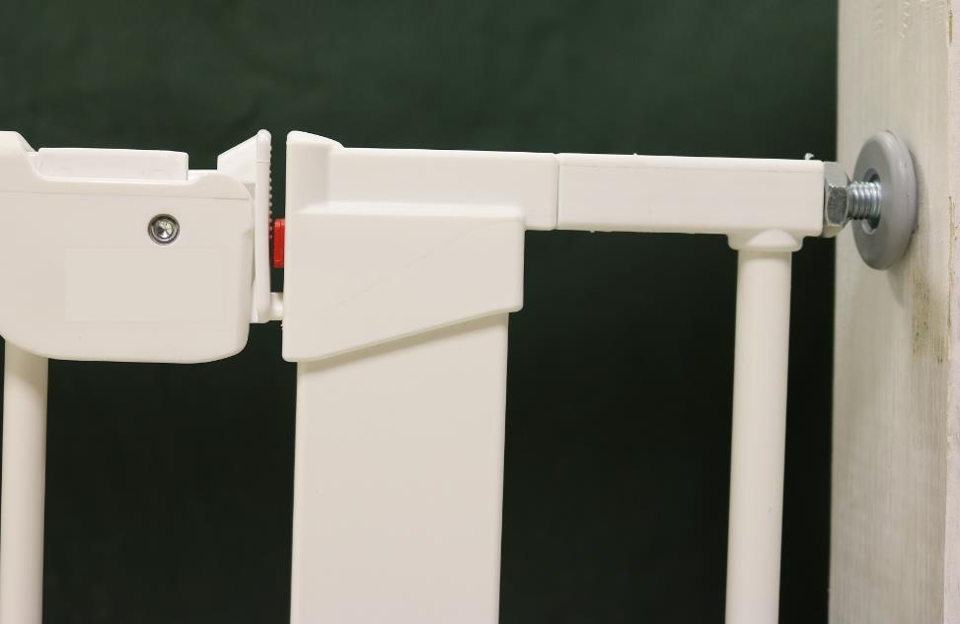
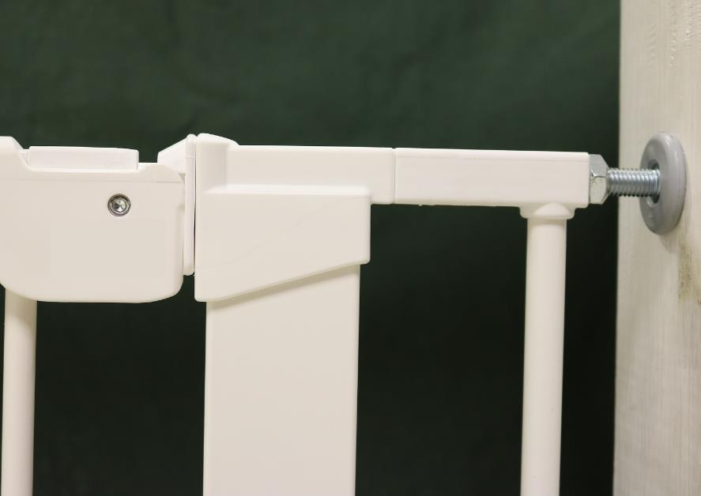
Visual Side-Pressure Indicator Example
Insufficient Pressure (Indicator Showing)
Sufficient Pressure (Indicator Not Showing)

Slide 34
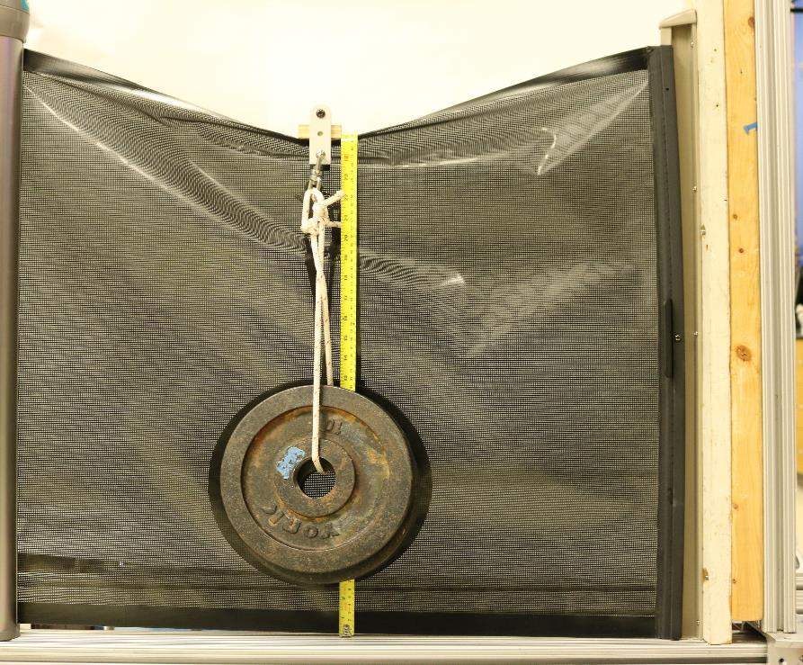
Vertical Strength Test Example
The uppermost top rails, edges, or framing components of the gates or enclosures shall not fracture, disengage, fold, or have a deflection that reduced the lowest point of the uppermost surface to a dimension of less than 22 inches from the floor when tested to section 7.8 of the standard.

Slide 35
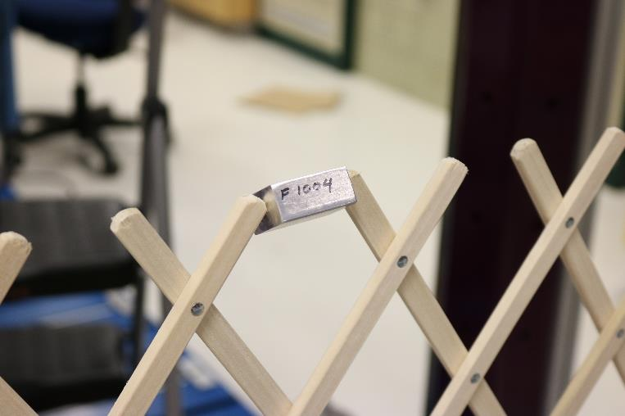
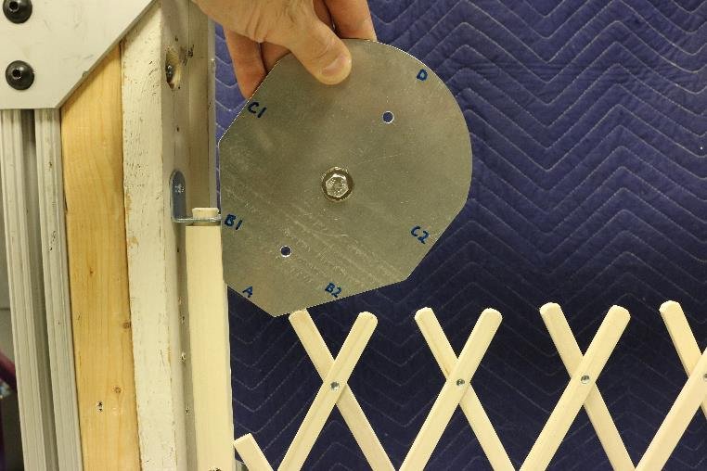
Partially Bounded Openings Testing Examples

Slide 36
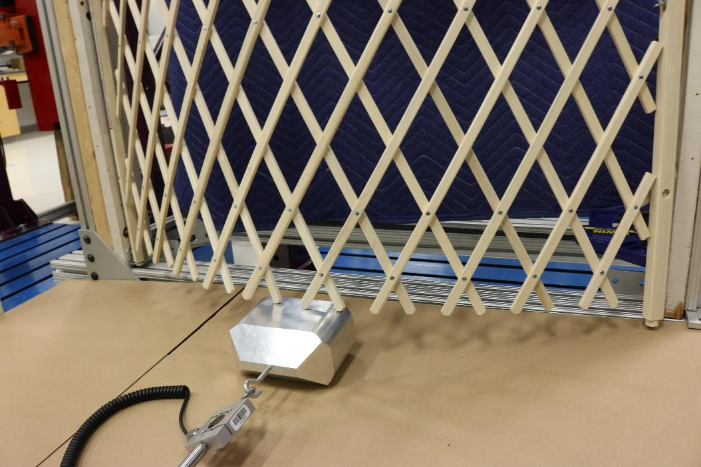
Completely Bounded Openings and Bottom Spacing

Slide 37
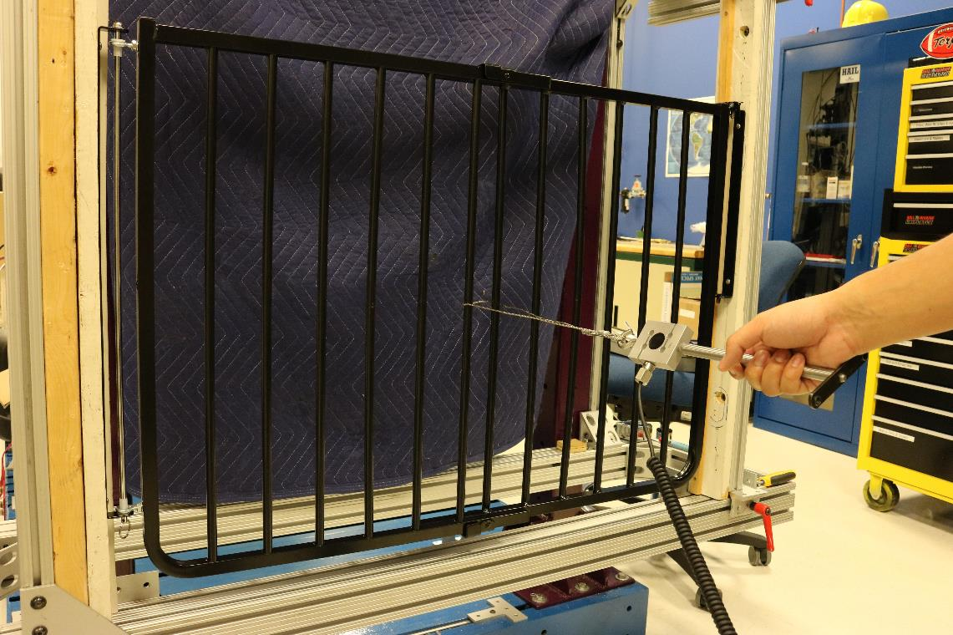
Horizontal Push-Out Test Example

Slide 38
Physical/Mechanical Testing Requirements
Performance Requirements per ASTM F1004:
  Structural Integrity (No sharp edges, exposed coils, Breakage of Attachment Systems)
  No opportunities for scissoring, shearing, or pinching
  Permanency of Labels and Warnings
  Adhesion Test for Warnings Applied Directly onto the Surface of the Product
  Holes or slats– shall not permit the passage of a test fixture when tested in manufacturer recommended positions

Slide 39
Toy Requirements
Gates: Toy accessories shall not be attached to, or sold with, a gate.
Enclosures: Toy accessories attached to, removable from, or sold with an enclosure must comply with the requirements of the U.S. Toy Safety Standard, which enforces ASTM F963-17 as a regulation.

Slide 40
Can I rely on in-house product safety testing on my gate or enclosure?

Slide 41
Can I rely on in-house product safety testing on my gate or enclosure in-house?
No – while in-house testing is encouraged, all durable infant or toddler products must be tested by a CPSC-Accepted Testing Laboratory, even for small batch manufacturers.
Find a CPSC-accepted lab via our website: www.cpsc.gov/labsearch

Slide 42
Children’s Product Certificates
  All children’s gates and enclosures require a Children’s Product Certificate (CPC).
Manufacturers and importers of children’s products must certify in a written certificate that their products comply with the applicable product safety regulations.
www.cpsc.gov/CPC

Slide 43
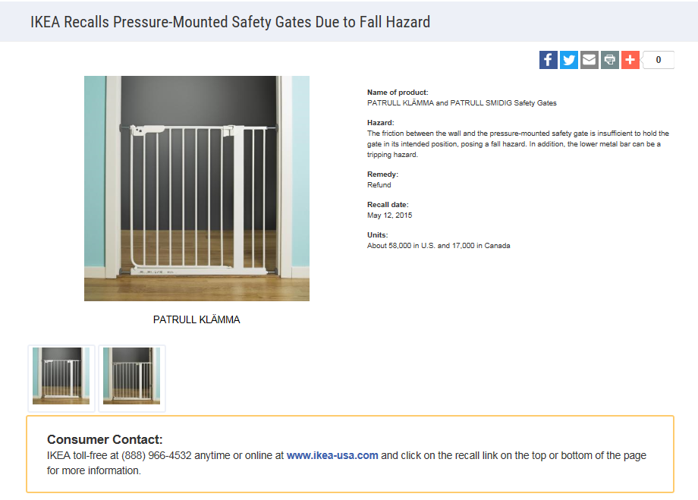
Recall Examples
Refund
Poses a fall hazard to children because of insufficient pressure to hold the gate in the intended position.

Slide 44
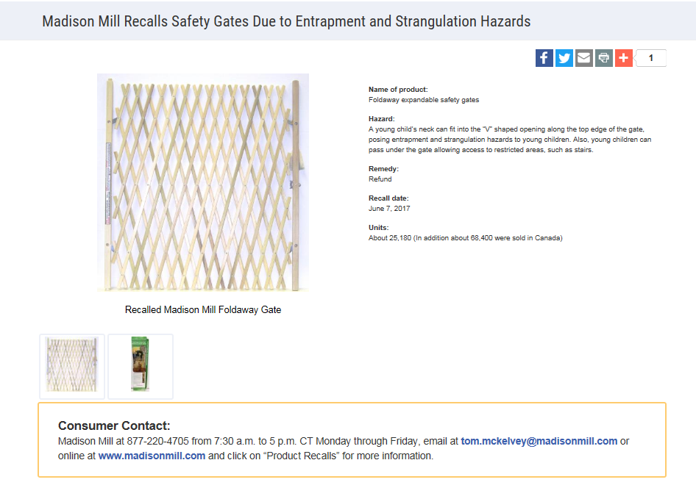
Recall Examples
Refund
Poses an entrapment and strangulation hazard to children because of the “V” shape openings along the top edge.

Slide 45

Questions?
Submit questions in English or Chinese to this podcast:
CPSCinChina@CPSC.GOV

Slide 46
Resources

Slide 47
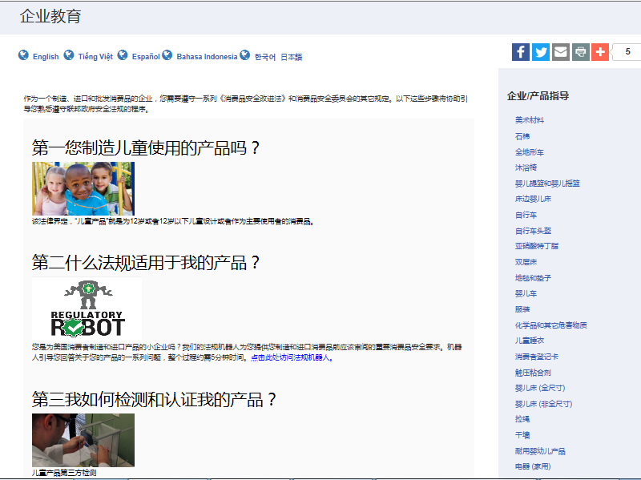

https://www.cpsc.gov/zh-CN/Business--Manufacturing/Business-Education
Chinese Resources at cpsc.gov

Slide 48
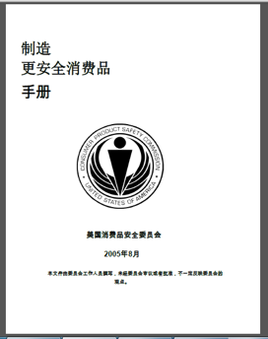
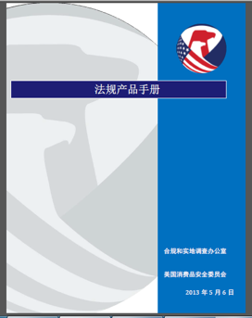
Chinese Resources at cpsc.gov
https://www.cpsc.gov/s3fs-public/HandbookforManufacturingChinese.pdf (中文版本 )
https://www.cpsc.gov/s3fs-public/pdfs/blk_pdf_handbookenglishaug05.pdf (英文版本)
https://www.cpsc.gov/s3fs-public/THE%20REGULATED%20PRODUCT%20HANDBOOK_050613%20CHN%20Final_0.pdf (中文版本 )
https://www.cpsc.gov/s3fs-public/RegulatedProductsHandbook.pdf (英文版本)

Slide 49
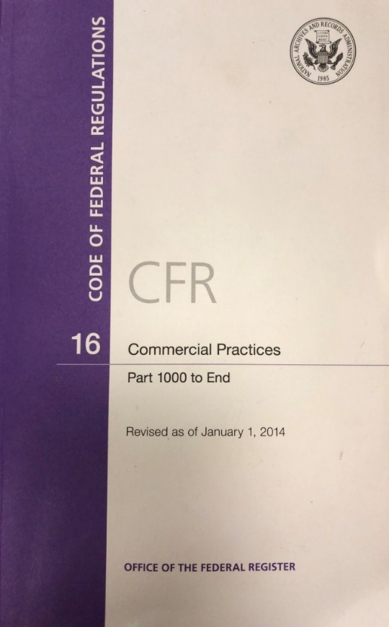
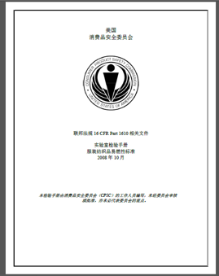
Chinese Resources at cpsc.gov
CFR: Commercial Practices
https://www.govinfo.gov/content/pkg/CFR-2017-title16-vol2/pdf/CFR-2017-title16-vol2.pdf (英文版本)
CPSC Laboratory Manuals:
https://www.cpsc.gov/s3fs-public/Laboratory-test-manual-16-CFR-Part-1610-Ch.pdf?MhtbUWNy6jmOPx9b6f.RErt.n.2n_d_h (中文版本)
https://www.cpsc.gov/s3fs-public/Flammability%20of%20Clothing%20Textiles%20Test%20Manual_1610.pdf (英文版本)

Slide 50
Definition of children’s product – 16 CFR Part 1200
Certificates of conformity – 16 CFR Part 1110
Third-party testing – 16 CFR Parts 1107, 1109, and 1112
Tracking information – 15 USC § 2063(a)(5)
Mandatory reporting requirements – 15 USC §2064
Lead content: 15 U.S.C. 1278a
Small Parts – 16 CFR part 1501
CPSC Business Resources
CPSC-Accepted Laboratories Search Page:
www.cpsc.gov/LabSearch

Slide 51

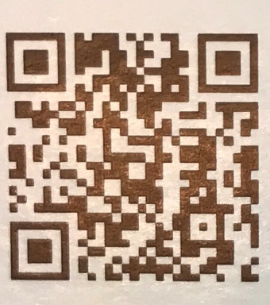
http://business.cpsc.gov
Online tool designed specifically to help businesses comply with federal consumer product safety requirements.
Asks a series of guided questions, and based on the answers produces a downloadable (PDF) report.
Provides customized guidance with links to product safety regulations that may apply to the product and important information on labeling, certification and testing requirements.

Slide 52
Regulatory Robot
Regulatory Robot is a tool to help identify which requirements are applicable
  Does not list details of requirements
User inputs product features
Regulatory Robot outputs list of requirements
User references source documents for specific requirements

Slide 53
Technical Regulation: 16 CFR part 1239, incorporating ASTM F1004-19
Gate- 16 CFR part 1239
Enclosure- 16 CFR part 1239
Play Yards 16 CFR part 1221
Child gate versus pet gate: www.cpsc.gov/childrensproduct
Registration card requirements in 16 CFR 1130.
CPSC Gates and Enclosures Resources

