Slide 1
These slides highlight key U.S. consumer product safety requirements for discussion. The presentation and slides are not a comprehensive statement of legal requirements or policy and should not be relied upon for that purpose. Moreover, with the passage of time, the slides may not reflect the latest information. You should consult official versions of U.S. statutes and regulations, as well as published CPSC guidance when making decisions that could affect the safety and compliance of products entering U.S. commerce. Note that reference materials are listed at the end of the presentation.

Slide 2
Video: Welcome to CPSC China Podcast Series-U.S. Flammability Requirements for Upholstered Furniture

Slide 3
China Podcast Series
U.S. Flammability Requirements for Upholstered Furniture
This presentation was prepared by CPSC Staff. It has not been reviewed or approved by the Commission and may not reflect its views.

Slide 4
Biographies
Sylvia Chen
U.S. Consumer Product Safety Commission
Program Manager for East Asia and Pacific
Office of International Programs
Sylvia Chen is responsible for managing the Commission’s bilateral and multilateral programs related to consumer product safety in Australia, Japan, Korea, Taiwan, and New Zealand. She also supports the CPSC’s work with China. Since she joined the CPSC in 2008, Sylvia has been working with product safety regulators, industry organizations, manufacturers, exporters, buyers, and other sourcing professionals to provide them with guidance and technical support in understanding U.S. requirements, in particular, the latest requirements for consumer products. To that end, she has organized or coordinated many of the agency’s international education and outreach activities.
Sylvia has a Bachelor of Arts degree in English and American Literature from Peking University. In 1991, she graduated from The Ohio State University with a Master’s degree in East Asian Studies.

Slide 5
The US CPSC is the federal government agency charged with protecting the public from unreasonable risks of injury or death associated with the use of consumer products under the agency's jurisdiction.
>$1 Trillion
Deaths, injuries, and property damage from consumer product incidents cost the nation more than $1 trillion annually.¹
¹ https://www.cpsc.gov/s3fs-public/FY2019PBR.pdf
CPSC is committed to protecting consumers from consumer products that pose a fire, electrical, chemical, biological, or mechanical hazard.
CPSC's work to improve the safety of thousands of types of consumer products in its jurisdiction - such as toys, cribs, power tools, cigarette lighters, textiles, and household chemicals – has contributed to a decline in the rate of injuries associated with consumer products over nearly 50 years.

Slide 6
CPSC’s China Podcast Series
Podcast | Topics
#1 | Selling Safe Electrical Products to the U.S. Market
#2 | Overview of U.S. Apparel Requirements
#3 | CPSC Bicycle Regulations and U.S. and International Safety Standards
#4 | Overview of U.S. Mattress Requirements
#5 | Durable Infant or Toddler Products: Common Requirements
#6 | Overview of U.S. Strollers and Carriages Requirements
#7 | Toy Safety Requirements and Mandatory Standards
#8 | Overview of Children’s Sleepwear Requirements
#9 | Enhancing the Safety of Emerging Technology through Risk Assessment: Wearables
#10 | Overview for Battery Safety Requirements
#11 | Overview of Gates and Enclosures Requirements

Slide 7
CPSC’s China Podcast Series (Continued)
Podcast | Topics
#12 | Overview of Consumer Safety and Micromobility Devices
#13 | Overview of Cribs and Play Yards Requirements
#14 | Product Safety and Compliance: Best Practices for Buyers Exporting Consumer Goods to the United States
#15 | U.S. Flammability Requirements for Upholstered Furniture
#16 | How to Find Safety Requirements for Your Product Using CPSC’s Regulatory Robot
#17 | CPSC’s Import Screening Program
#18 | Overview of CPSC’s Third Party Laboratory Program for Children’s Products
#19 | Infant Sleep Product Safety Requirements
#20 | Children's Folding Chairs/Stools Safety Requirements
“Questions on this presentation? Send an email to CPSCinChina@cpsc.gov”

Slide 8
Presentation Agenda
Origin of the federal upholstered furniture regulation
A brief overview of 16 CFR part 1640
Defining Upholstered Furniture
Labeling Requirements
Testing Requirements
Information regarding children’s upholstered furniture
CPSC Business Resources

Slide 9
Upholstered Furniture and House Fires
In house fires, upholstered furniture is often one of the first things to catch fire and was involved in the greatest number of fire deaths from to 2016-2018 according to the CPSC’s most recent Residential Fire Loss Estimates Report.
From 2016-2018, about 350 deaths and 550 injuries were associated with upholstered furniture fires each year.
This is 15 percent of the estimated annual average of total deaths associated with residential fires for the same period.

Slide 10
16 CFR Part 1640 Standard for the Flammability of Upholstered Furniture
A Brief Overview

Slide 11
16 CFR Part 1640: Key Points
In December 2020, the U.S. Congress passed a bill mandating nationwide compliance with California’s flammability standard for upholstered furniture, “California Technical Bulletin 117-2013” (or TB 117-2013) and added a labeling requirement.
The resulting federal regulation covering the flammability of upholstered furniture is found at 16 CFR part 1640.
Effective dates are June 25, 2021 for the regulation’s flammability performance requirements and June 25, 2022 for its labeling requirement

Slide 12
What is TB 117-2013?
The federal requirement was taken from a California regulation, TB 117-2013, published by the Bureau of Home Goods and Services (formerly known as the Bureau of Electronic and Appliance Repair, Home Furnishing and Thermal Insulation) of the Department of Consumer Affairs in 2013.
The California title is “Requirements, Test Procedure and Apparatus for Testing the Smolder Resistance of Materials Used in Upholstered Furniture”.
The prescribed test is a small-scale burn procedure intended to address fires caused by smoldering ignition and relies heavily on ASTM E 1353-08 a^{ε1} for its test methods.

Slide 13
TB 117-2013 and 16 CFR Part 1640
TB 117-2013 sets forth the requirements, test procedure, and apparatus for testing the smolder resistance of materials used in upholstered furniture from hazards associated with smoldering ignition. 16 CFR part 1640 codifies those requirements.
The 16 CFR part 1640 federal regulation refers specifically to TB 117-2013, which was published in 2013.
Future changes or updates to TB 117-2013 will not change the requirements for 16 CFR part 1640.

Slide 14
16 CFR Part 1640 and State and Local Flammability Laws
The legislation that resulted in 16 CFR part 1640 preempts U.S. States and other jurisdictions from establishing or continuing in effect their own flammability regulations designed to protect against the risk of occurrence of fire with respect to upholstered furniture.
The legislation does not preempt any State or local law, regulation, code, standard, or requirement that concerns other risks associated with upholstered furniture.

Slide 15
16 CFR Part 1640 Standard for the Flammability of Upholstered Furniture
Definitions and Examples

Slide 16
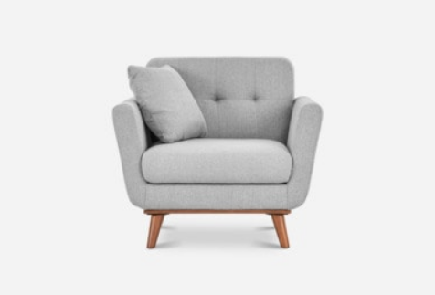
What products are covered in 16 CFR Part 1640?
The federal flammability regulation applies to upholstered furniture made in whole or in part of fabric or related material intended for use or that may reasonably be expected to be used in homes or other places of assembly or public accommodation where consumers will customarily use the upholstered furniture.

Slide 17
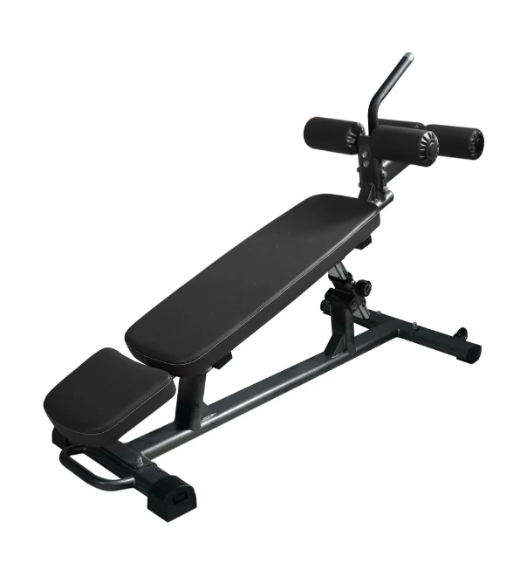
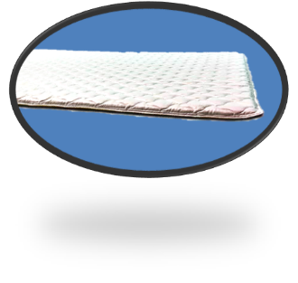
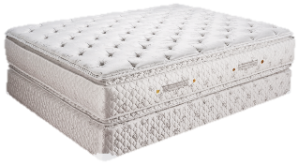
What products are not covered in 16 CFR Part 1640?
The federal regulation does not apply to the following products:
Bedding products
Mattresses/Mattress Pads
Mattress foundations
Outdoor furniture
Furniture used exclusively for physical fitness and exercise
Products obtained by a written prescription from a healthcare professional

Slide 18
What Is Upholstered Furniture Under 16 CFR Part 1640?
An article of seating furniture that
Is intended for indoor use; and
Is movable or stationary; and
Is constructed with an upholstered seat, back, or arm

Slide 19
What Is Upholstered Furniture Under 16 CFR Part 1640? (cont.)
An article of seating furniture that
Is made or sold with a cushion or pillow, whether or not that cushion or pillow is attached or detached to the article of furniture, or is stuffed or filled, or able to be stuffed or filled, in whole or in part, with any material, including a substance or material that is hidden or concealed by fabric or another covering, including a cushion or pillow belonging to, or forming a part of, the article of furniture; and

Slide 20
What Is Upholstered Furniture Under 16 CFR Part 1640? (cont.)
An article of seating furniture that
Together with the structural units of the article of furniture, any filing material, and the container and covering with respect to those structural units and that filling material, can be used as a support for the body of an individual, or the limbs and feet on an individual, when the individual sits in an upright or reclining position.

Slide 21
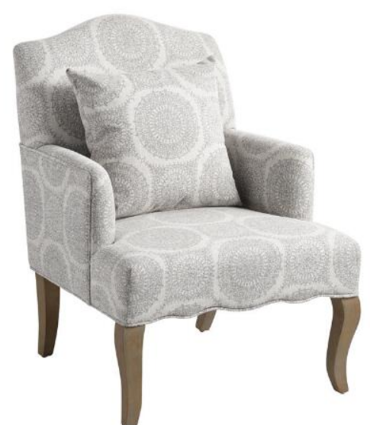
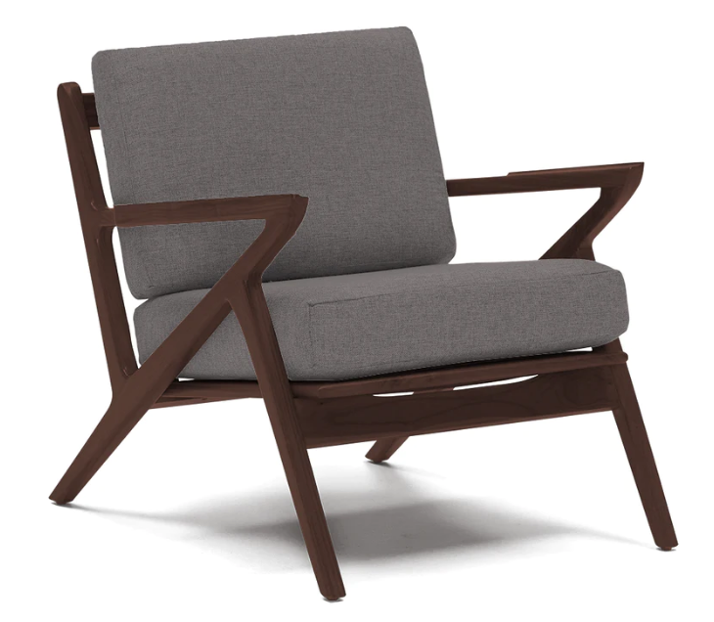
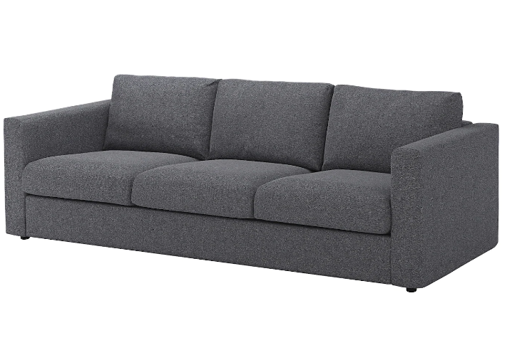
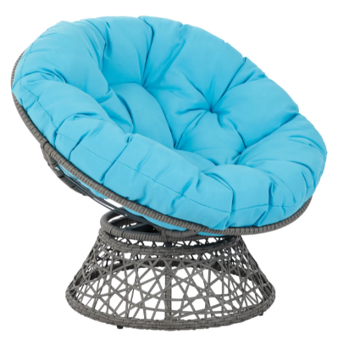
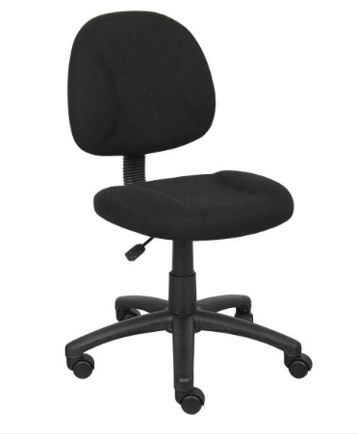
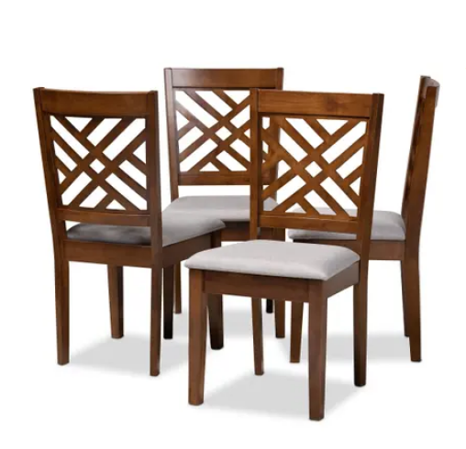
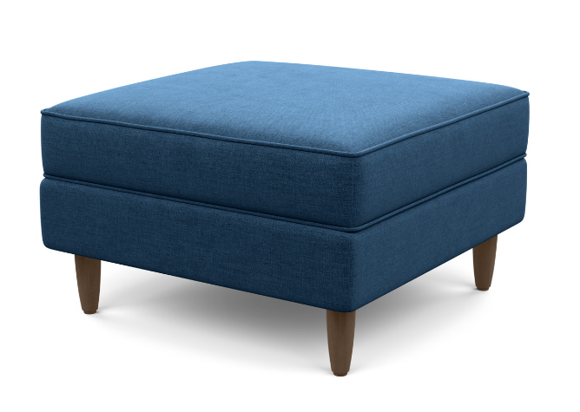
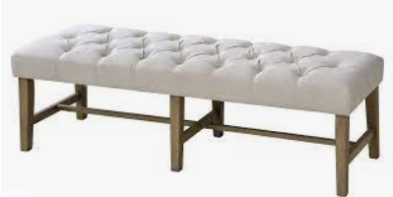
Examples of Upholstered Furniture

Slide 22
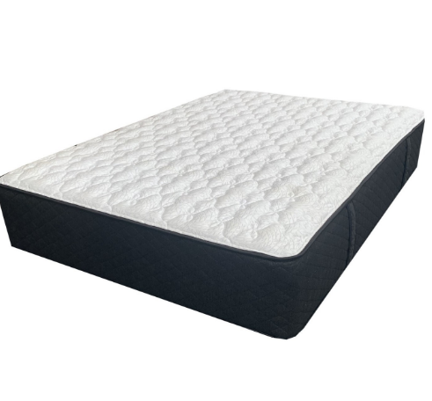
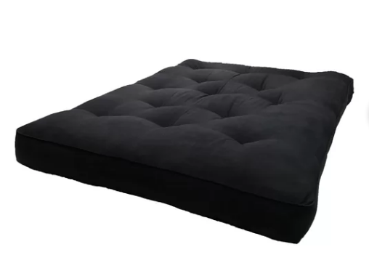
What is a “bedding product”?
Bedding products are not covered in 16 CFR part 1640.
A bedding product is:
An item that is used for sleeping or sleep-related purposes
Any component or accessory with respect to an item that is used for sleeping or sleep-related purposes, without regard to whether the component or accessory, as applicable is used alone, along with, or contained within a sleeping or sleep-related item
Foundations and Mattresses are defined in Section 1633.2 of title 16, Code of Federal Regulations and have their own specific requirements.

Slide 23
16 CFR Part 1640 Standard for the Flammability of Upholstered Furniture
Labeling Requirements

Slide 24
16 CFR Part 1640: Labeling Requirements
Starting June 25, 2022, all upholstered furniture manufactured, imported, or reupholstered for U.S. consumers must have a permanent label with the following statement:
“Complies with U.S. CPSC requirements for upholstered furniture flammability”
We recommend the label be located prominently on the product and be conspicuous to the consumer.

Slide 25
16 CFR Part 1640: Labeling Statement Requirements
The label’s statement should be at least 1/8-inch high (0.32 cm) and not smaller than other text on the label.
It should be in black text on a white background and surrounded by a black border.
The statement must appear on the front of the label in English.
The required federal label may be a separate label or can be added to the bottom of an existing California TB 117-2013 label.

Slide 26
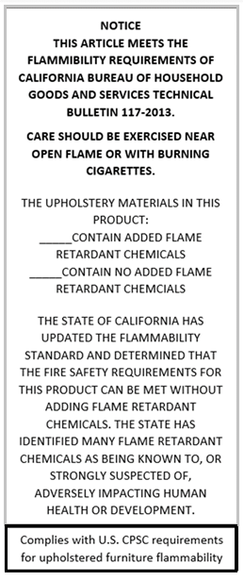
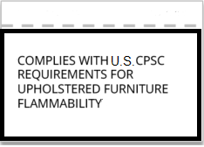
16 CFR Part 1640: Labeling Statement Examples
Example of a Combined Label
Example of a Separate Label

Slide 27
16 CFR Part 1640: Record Keeping
16 CFR part 1640 does not require a general certificate of conformity or recordkeeping requirements.
The permanent federally-required label will operate as the certification that the product is compliant with the flammability regulation.
It is a recommended best practice to maintain records for at least as long as the product remains in production.

Slide 28
16 CFR Part 1640 Standard for the Flammability of Upholstered Furniture
Testing Requirements

Slide 29
Testing Requirements: Introduction
16 CFR Part 1640 tests are designed to assess upholstered furniture’s resistance to combustion after exposure to smoldering cigarettes under specific conditions.
These tests apply to various components of upholstered furniture including
Cover fabrics
Barrier materials
Resilient filling materials
Decking materials

Slide 30
Testing Requirements: Introduction
Testing is for components, not finished product.
There are multiple paths a manufacturer can take that will result in a compliant design for their product, depending on which components comply.
For example:
Compliant cover fabric + compliant filling materials = a compliant construction
Any cover fabric + compliant barrier material = a compliant construction
Compliant cover fabric + compliant barrier material + any filling material = a compliant construction
Disclaimer: The examples above are examples and do not represent an exhaustive list.

Slide 31
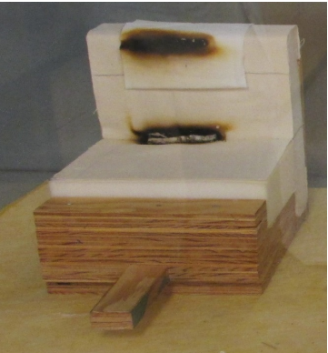
Testing Requirements Introduction
Each test involves a small bench-scale assembly with the component to be tested and other specified materials.
The assembly is exposed to a lighted cigarette as an ignition source.
The test fails if:
the mock-up test specimen continues to smolder after 45 minutes,
a char length greater than a specified amount for each type of component test is measured,
or the mock-up test specimen transitions to open flaming
Example of TB 117-2013-style mockup posttest. Char length is measured up from the crevice vertically.

Slide 32
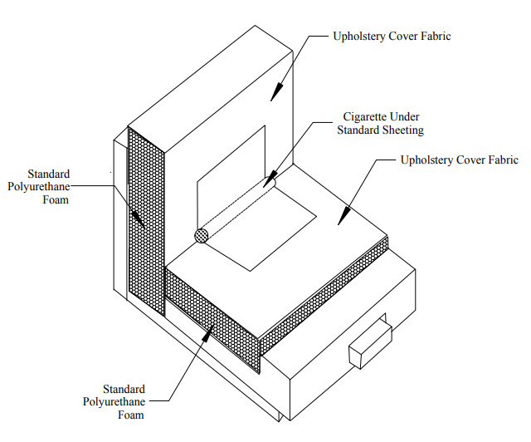
Testing Requirements: Cover Fabric Test
“Upholstery cover material” refers to the outermost layer of fabric or related material used to enclose the main support system or upholstery materials, or both, used in a piece of furniture.
Mock-up Assembly for Smoldering Ignition Resistance Test of Upholstery Cover Fabrics

Slide 33
Testing Requirements: Cover Fabric Test (cont.)
The cover fabric test method measures the tendency of upholstery cover fabrics to smolder and contribute to fire spreading when subject to a smoldering ignition source.
For furniture with cover fabrics that pass this test, the first layer of filling materials located below the cover fabric must also meet the test requirements for the Resilient Filling Material Test unless an appropriate smoldering barrier is present.

Slide 34
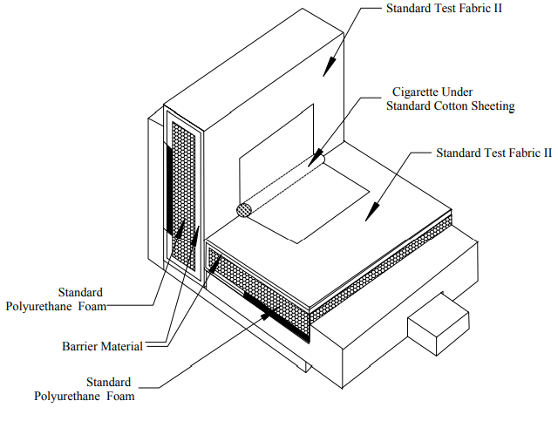
Testing Requirements: Barrier Materials Test
“Barrier (interliner) material” refers to the first layer of material (film, fabric, batting or pad) that lies under the cover fabric in order to reduce smoldering propensity of the piece of furniture.
Mock-up Assembly for Smoldering Ignition Resistance Test of Barrier Materials

Slide 35
Testing Requirements: Barrier Materials Test (cont.)
Upholstery cover fabrics that fail the cover fabric test can be used in upholstered furniture if a barrier (interliner) material that passes this test is used.
When a barrier is required, the barrier material must cover all sides and top of the seating cushion(s).
Exceptions: Non-reversible and non-detachable seating cushions do not require the use of the barrier material on the underside of the seating cushion.

Slide 36
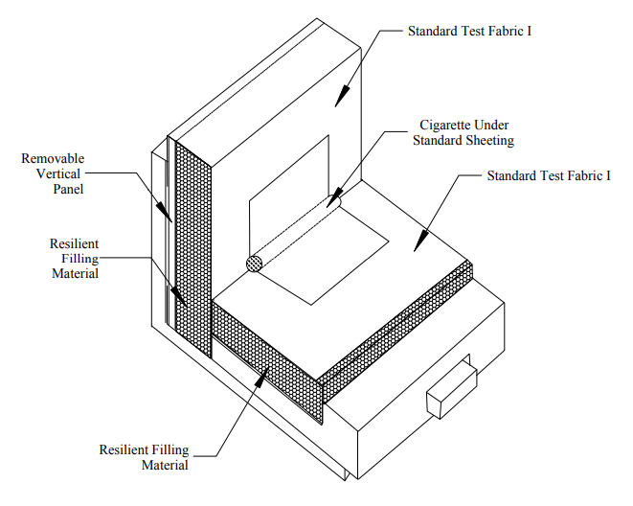
Testing Requirements: Resilient Filing Material Test
“Resilient filling material” is the resilient filling material in the form of batting, pads or loose fills used or intended to be used in upholstered furniture.
Resilient filling materials that fail this test can be used in upholstered furniture if a barrier (interliner) material that passes the Barrier Materials Test is used between the cover fabric and the filling materials.
Mock-up Assembly for Smoldering Ignition Resistance Test of Resilient Filling Component Materials

Slide 37
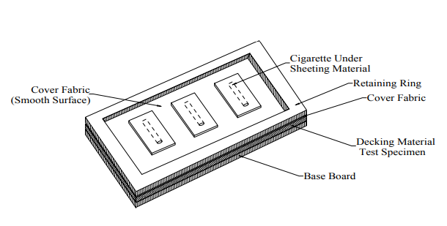
Testing Requirements: Decking Material Test
Decking in upholstered furniture is the upholstered support under the seat cushion in a loose seat construction.
This test method measures the tendency of decking materials to smolder and contribute to fire propagation, when subjected to a smoldering ignition source.
For decking materials that pass this test, the first layer of filling materials located below the decking material shall also meet the test requirements in the Resilient Filling Material Test.
Mock-up Assembly for Smoldering Ignition Resistance Test of Decking Materials

Slide 38
Testing Requirements Summary - Main Upholstery
 | Compliant Constructions*
Cover Fabric | Passes Section 1: Cover Fabrics Test | Passes Section 1: Cover Fabrics Test | Passes Section 1: Cover Fabrics Test | Fails Section 1: Cover Fabrics Test | Passes Section 1: Cover Fabrics Test | Fails Section 1: Cover Fabrics Test
Barrier (interliner) material | Passes Section 2: Barrier Materials Test | (no barrier used) | Fails Section 2: Barrier Materials Test | Passes Section 2: Barrier Materials Test | Passes Section 2: Barrier Materials Test | Passes Section 2: Barrier Materials Test
Resilient filling material | Passes Section 3: Resilient Filling Material Test | Passes Section 3: Resilient Filling Material Test | Passes Section 3: Resilient Filling Material Test | Passes Section 3: Resilient Filling Material Test | Fails Section 3: Resilient Filling Material Test | Fails Section 3: Resilient Filling Material Test
*This is a non-exhaustive chart for illustration purposes. See 16 CFR 1640 for more information.

Slide 39
Testing Requirements Summary - Main Upholstery
 | Non-Compliant Constructions*
Cover Fabric | Fails Section 1: Cover Fabrics Test | Fails Section 1: Cover Fabrics Test | Passes Section 1: Cover Fabrics Test | Fails Section 1: Cover Fabrics Test
Barrier (interliner) material | (no barrier used) | Fails Section 2: Barrier Materials Test | Fails Section 2: Barrier Materials Test | Fails Section 2: Barrier Materials Test
Resilient filling material | Fails Section 3: Resilient Filling Material Test | Fails Section 3: Resilient Filling Material Test | Fails Section 3: Resilient Filling Material Test | Passes Section 3: Resilient Filling Material Test
*This is a non-exhaustive chart for illustration purposes. See 16 CFR 1640 for more information.

Slide 40
16 CFR Part 1640 Standard for the Flammability of Upholstered Furniture
Children’s Products Requirements

Slide 41
16 CFR Part 1640 and Children’s Furniture
Both general-use upholstered furniture and upholstered furniture intended to be used by children must comply with 16 CFR part 1640.
However, the requirements of 16 CFR part 1640 are not subject to the testing and certification requirements of Section 14(a) of the Consumer Product Safety Act (CPSA).
This means U.S. manufacturers and importers of children’s products do not have to certify, in a written Children’s Product Certificate (CPC) based on test results from a CPSC-accepted laboratory, that their children’s products comply with 16 CFR Part 1640.
They do, however, have to certify, in a written CPC based on test results from a CPSC-accepted laboratory, that their product complies with all other applicable children’s product safety rules.

Slide 42
16 CFR Part 1640 and Durable Infant or Toddler Products
Certain durable infant and toddler products are exempt from 16 CFR part 1640:
Bassinets, booster seats, car seats, changing pads, floor play mats, highchairs, highchair pads, infant bouncers, infant carriers, infant seats, infant swings, infant walkers, nursing pads, nursing pillows, playpen side pads, play yards, portable hook-on chairs, and strollers
Other durable infant and toddler products, such as children’s folding chairs and folding stools, that are not on the list, but meet the definition of upholstered furniture, are subject to the flammability standard for upholstered furniture.
Please see https://www.regulations.gov/document/CPSC-2021-0007-0004 for more information regarding exemptions

Slide 43
16 CFR Part 1640 and Children’s Folding Chairs and Stools
Children's Folding Chairs and Stools that meet the definition of upholstered furniture (see 16 CFR §1640.3) must comply with:
The flammability and labeling requirements of 16 CFR Part 1640
Third-party testing for Lead in Surface Coatings if there are surface coatings and/or Total Lead Content if there are applicable accessible materials
Third-party testing for the durable infant and toddler product requirements in 16 CFR Part 1232, Safety Standard for Children's Folding Chairs and Stools
The Requirements for Consumer Registration of Durable Infant or Toddler Products (see 16 CFR Part 1130)
Please visit the CPSC’s Children’s Folding Chairs and Stools page for more information.

Slide 44
16 CFR Part 1640 and Children’s Products Conclusion
Other children's products that meet the definition of upholstered furniture (see 16 CFR 1640.3) must comply with:
The flammability and labeling requirements of 16 CFR 1640
Third-party testing for:
Lead in surface coatings if there are surface coatings and/or total lead content if there are applicable accessible materials
Any other requirements applicable to the specific product
Please see the CPSC’s Children’s Products Education Page for more information.

Slide 45
Questions?
Submit questions in English or Chinese to this podcast:
CPSCinChina@CPSC.GOV

Slide 46
Resources

Slide 47
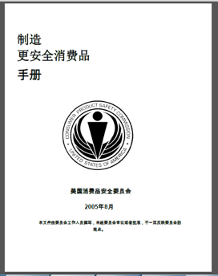
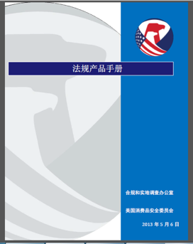
Chinese Resources at cpsc.gov
https://www.cpsc.gov/s3fs-public/HandbookforManufacturingChinese.pdf (中文版本 )
https://www.cpsc.gov/s3fs-public/pdfs/blk_pdf_handbookenglishaug05.pdf (英文版本)
https://www.cpsc.gov/s3fs-public/THE%20REGULATED%20PRODUCT%20HANDBOOK_050613%20CHN%20Final_0.pdf (中文版本 )
https://www.cpsc.gov/s3fs-public/RegulatedProductsHandbook.pdf (英文版本)

Slide 48
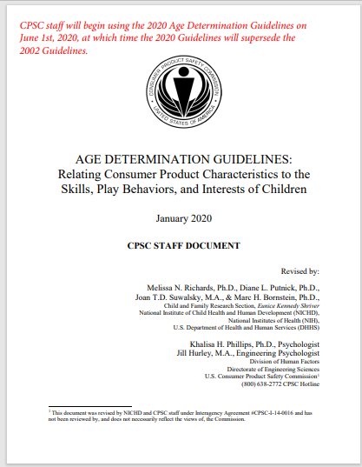
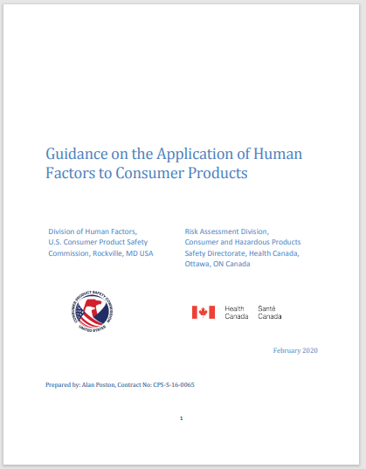
Chinese Resources at cpsc.gov
English: Updating Age Determination Guidelines for Toys (cpsc.gov)
Chinese: Updating Age Determination Guidelines for Toys (cpsc.gov)
English: Human Factors Standard Practice (cpsc.gov)

Slide 49
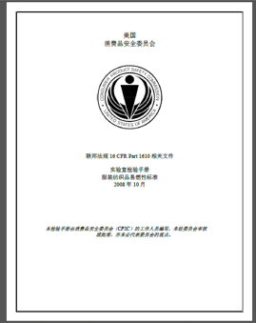
Chinese Resources at cpsc.gov
CFR: Commercial Practices
https://www.govinfo.gov/content/pkg/CFR-2017-title16-vol2/pdf/CFR-2017-title16-vol2.pdf (英文版本)
CPSC Laboratory Manuals:
https://www.cpsc.gov/s3fs-public/Laboratory-test-manual-16-CFR-Part-1610-Ch.pdf?MhtbUWNy6jmOPx9b6f.RErt.n.2n_d_h (中文版本)
https://www.cpsc.gov/s3fs-public/Flammability%20of%20Clothing%20Textiles%20Test%20Manual_1610.pdf (英文版本)

Slide 50
Definition of children’s product – 16 CFR Part 1200
Certificates of conformity – 16 CFR Part 1110
Third-party testing – 16 CFR Parts 1107, 1109, and 1112
Tracking information – 15 USC § 2063(a)(5)
Mandatory reporting requirements – 15 USC §2064
CPSC Business Resources
CPSC-Accepted Laboratories Search Page:
www.cpsc.gov/LabSearch

Slide 51
Direct Final Rule for 16 CFR part 1640:Federal Register : Standard for the Flammability of Upholstered Furniture
California Technical Bulletin 117-2013: https://www.regulations.gov/document/CPSC-2021-0007-0005
CPSC Upholstered Furniture Business Education Page: Upholstered Furniture Business Education | CPSC.gov
Furniture Flammability Resources

Slide 52
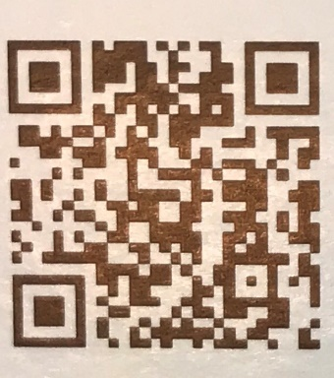
http://business.cpsc.gov
Online tool designed specifically to help businesses comply with federal consumer product safety requirements.
Asks a series of guided questions, and based on the answers produces a downloadable (PDF) report.
Provides customized guidance with links to product safety regulations that may apply to the product and important information on labeling, certification and testing requirements.

Slide 53
Regulatory Robot
Regulatory Robot is a tool to help identify which requirements are applicable
Does not list details of requirements
User inputs product features
Regulatory Robot outputs list of requirements
User references source documents for specific requirements

