Slide 1
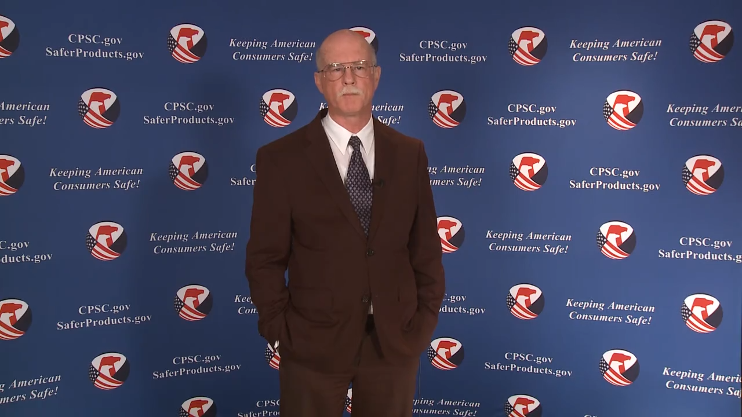
Welcome to the 2020 CPSC Podcast Series-Electrical Products

Slide 2
2020 Podcast Series
Selling Safe Electrical Products to the U.S. Market
This presentation is part of a podcast series that was prepared by CPSC staff. It has not been reviewed or approved by, and may not reflect the views of, the Commission.

Slide 3

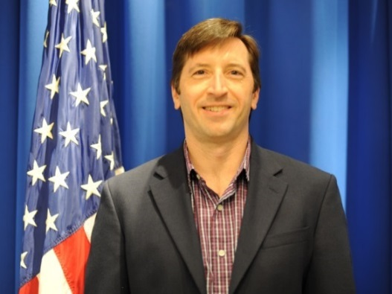
Biographies
Sylvia Chen
U.S. Consumer Product Safety Commission
Program Manager for East Asia and Pacific
Office of International Programs
Andrew Trotta
U.S. Consumer Product Safety Commission
Director, Division of Electrical Engineering, Office of Hazard Identification and Reduction
Sylvia Chen is Program Manager for East Asia and Pacific at the U.S. Consumer Product Safety Commission (CPSC). In that role, she is responsible for managing the Commission’s bilateral and multi-lateral programs related to consumer product safety in Australia, Japan, Korea, Taiwan and New Zealand. She also supports the CPSC’s work with China. Since she joined the CPSC in 2008, Sylvia has been working with product safety regulators, industry organizations, manufacturers, exporters, buyers and other sourcing professionals to provide them with guidance and technical support in understanding U.S. requirements, in particular the latest requirements for consumer products. To that end, she has organized or coordinated many of the agency’s international education and outreach activities.
Sylvia has a Bachelor of Arts degree in English and American Literature from Peking University. In 1991, she graduated from The Ohio State University with a Master’s degree in East Asian Studies.
Andrew Trotta is the Director for the Division of Electrical Engineering and Fire Sciences in the Directorate for Engineering Sciences at the U. S. Consumer Product Safety Commission, a post that he has held since 2007. He joined the CPSC staff as an electrical engineer in 1996. As part of his duties, Mr. Trotta represents CPSC on the Electrical Safety Foundation International Board of Directors and is on the Underwriters Laboratories (UL) Electrical Council. Mr. Trotta is a member of UL Standards Technical Panels on household cooking ranges, cooking appliances and room air fresheners and on the National Electrical Code (NEC) Code-making Panels 2 and 17.
Prior to joining the CPSC, Mr. Trotta conducted research and testing on shipboard electrical systems for the Naval Surface Warfare Center in Annapolis, MD beginning in 1986. Mr. Trotta graduated from Virginia Tech with a Bachelor of Science degree in Electrical Engineering in 1986.

Slide 4
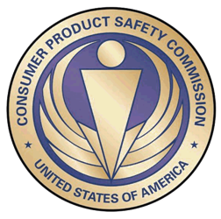
The US CPSC is a federal government agency charged with protecting the public from unreasonable risks of injury or death associated with the use of consumer products under the agency's jurisdiction.
$1 Trillion
Deaths, injuries, and property damage from consumer product incidents cost the nation more than $1 trillion annually.¹
¹ https://www.cpsc.gov/s3fs-public/FY2019PBR.pdf
CPSC is committed to protecting consumers from products that pose a fire, electrical, chemical, biological, or mechanical hazard.
CPSC's work to improve the safety of the more than 15,000 types of consumer products in its jurisdiction - such as toys, cribs, power tools, cigarette lighters, textiles, and household chemicals – has contributed to a decline in the rate of deaths and injuries associated with consumer products over the past 40 years.

Slide 5
CPSC’s Podcast Series
Podcast | Topics
#1 | Selling Safe Electrical Products to the U.S. Market
#2 | Overview of U.S. Apparel Requirements
#3 | Bicycle Regulations Safety Standards
#4 | Overview of U.S. Mattress Requirements
#5 | Registration and Labeling Requirements for Durable Infant and Toddler Products
#6 | Overview of Carriage and Stroller Requirements
#7 | Toy Safety
“Questions on this Presentation? Send an email to CPSCinChina@cpsc.gov”

Slide 6
The slides used in this podcast are not a comprehensive statement of legal requirements or policy and should not be relied upon for that purpose. You should consult official versions of U.S. statutes and regulations, as well as published CPSC guidance when making decisions that could affect the safety and compliance of products entering U.S. commerce. Note that references are provided at the end of the presentation.

Slide 7
Selling Safe Electrical Products to the U.S. Market

Slide 8
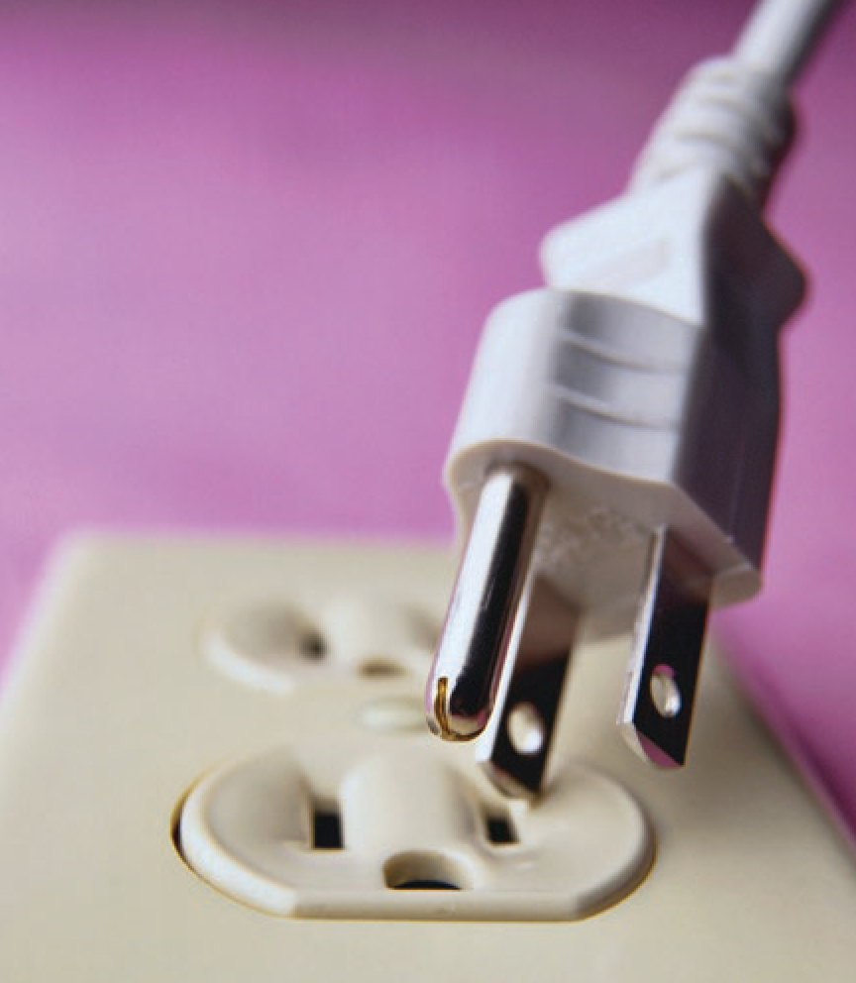
Today’s Presentation
Electrical Product Hazards
Electrical Product Standards
Electrical Product CPSC Regulations
Voluntary Standards Process
Other Requirements
Recalls
Multi-pronged Safety Approach
Responsibility to Comply
Best Practices
Resources

Slide 9
Electrical Product Hazards
Electricity is a powerful, useful energy source that is potentially hazardous.
Misuse of products or their failures can cause fires, electric shock, thermal burns (such as from exposure to hot surfaces), chemical burns (such as from batteries), other injuries (such as lacerations from moving parts) or loss of critical function (such as a smoke alarm not signaling a fire).
Equipment that generates, distributes, or uses electrical energy should be compliant with component and product standards and, if installed, installed in accordance with applicable electrical codes to mitigate safety risks.

Slide 10
Electrical Product Hazards in U.S. Homes
CPSC staff estimate an average of:
61,800 structure fires from electrical equipment per year from 2014 - 2016
640 deaths, more than 3,120 injuries, and almost $1.46 billion in property losses
Fires attributed mostly to:
Electric cooking equipment
Electrical distribution system
Electric heating and cooling equipment
48 consumer product-related electrocutions per year from 2010 - 2013

Slide 11
Electrical Product Hazard Prevention Strategies
Supporting improvements to voluntary standards/codes
Creating and enforcing technical regulations and bans
Recalling products with defects
Disseminating safety information to consumers
{
CPSC promotes electrical safety through a multipronged approach

Slide 12
Electrical Component and Product Standards
Electrical product safety heavily relies on compliance with voluntary industry consensus standards.
Most electrical product safety standards have been developed and maintained under the auspices of Underwriters Laboratories (UL). Other standards developers for electrical product safety include the Institute of Electrical and Electronics Engineers (IEEE) and the National Electrical Manufacturers Association (NEMA)
There are only five technical regulations for electrical products under CPSC’s jurisdiction.

Slide 13
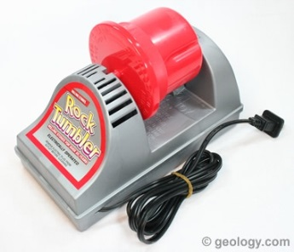
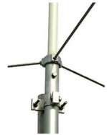
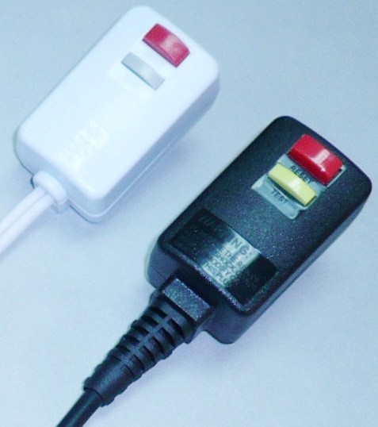
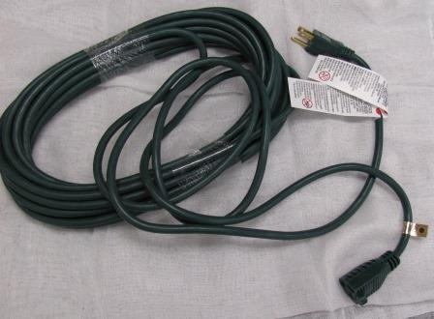
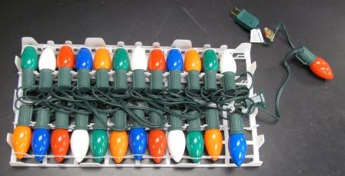
Electrical Product CPSC Regulations
16 CFR 1505 – Requirement for electrically operated toys or other electrically operated articles intended for use by children
16 CFR 1204 - Safety Standard for Omnidirectional Citizens Band Base Station Antennas

Slide 14
Consumer Product Safety Act Section 15(J)
Section 15(J) of the Consumer Product Safety Act refers to a list of items that are deemed a substantial product hazard if they are missing certain key identifiable characteristics that are known to reduce hazards.
A rule under Section 15(J) of the Consumer Product Safety Act, referred to also as the 15(J) rule, is not a consumer product safety rule that imposes performance or labeling requirements for newly manufactured products but rather highlights the need to adhere to industry standard safety features.
These rules allow the CPSC to rely on readily observable features of a product to determine whether the product presents a substantial product hazard and thus need to be stopped at import or recalled.

Slide 15
Examples of Products Under the Consumer Product Safety Act Section 15(J)
16 CFR 1120.3(a) – Household and commercial handheld hair dryers
These products require an integral immersion protection circuit interrupter plug as per UL 859 or UL 1727. Handheld hair dryers without this feature are considered to be substantial product hazards.
16 CFR 1120.3(c) – Seasonal and decorative lighting products
These products must meet minimal wire size requirements, sufficient strain relief, and integral over-current protection, as defined in UL 588. Products that do not meet these requirements will be considered substantial product hazards.
16 CFR 1120.3(d) – Extension Cords
Extension cords must have a minimum size of wire, sufficient strain relief, and proper polarization or the cord will be considered a substantial product hazard. In addition, for indoor- use cords, outlet covers and outlets are required. For outdoor use, cords are required to be jacketed. These requirements are all set forth in UL 817. Extension cords that don't meet these requirements are considered unsafe, and they will be recalled.

Slide 16
Third Party Certification
CPSC’s regulations do not require third party certification for electrical products with the exception of electric toys.There is a high rate of third party certification with voluntary standards because:
Many retailers will only sell electrical products if they have been third party certified
Some states and municipalities require certification for all electrical products sold in
their jurisdiction
The Occupational Safety and Health Administration (OSHA) requires certification for electrical products used in the workplace
Third party certification of products is a useful tool in ensuring that an unsafe product does not enter the market. Manufacturers should consider incorporating third party certification in their quality assurance/quality control programs. Importers/Exporters and retailers can also make use of this tool to prevent unsafe products from entering the market.

Slide 17
Voluntary Consensus Standards
Because CPSC relies on voluntary standards rather than mandatory regulations for many electrical products, the staff actively participates in the process of maintaining the standards by addressing emerging hazards through development and adoption of new or modified requirements.
This is an ongoing process that begins with reviewing incident information from CPSC’s data collection systems.

Slide 18
CPSC Data Collection Systems
Staff learns about product-related incidents from five databases
Injury and potential injury incident data
Death certificates
In-depth investigations
National Electronic Injury Surveillance System
National Fire Incident Reporting System*
IPII
DTHS
INDP
NEISS
NFIRS
*NFIRS is operated by the United States Fire Administration

Slide 19
Voluntary Standards – CPSC Staff Activities
Review existing standards for gaps or improvement
Analyze injury/death data for hazard patterns
Propose standards development or revisions
Conduct tests and evaluations to support findings
Participate in committees

Slide 20
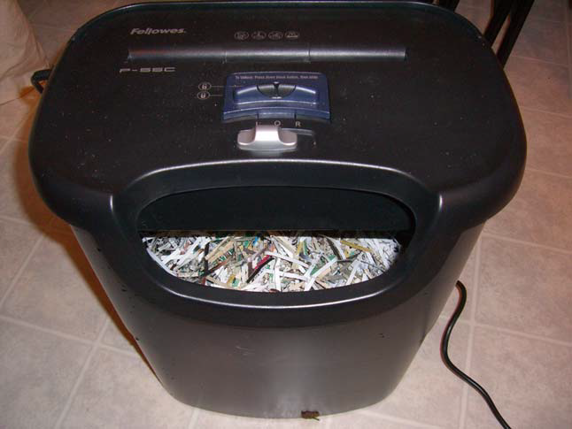
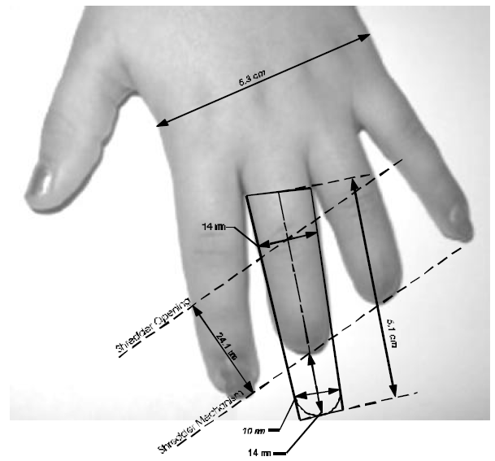
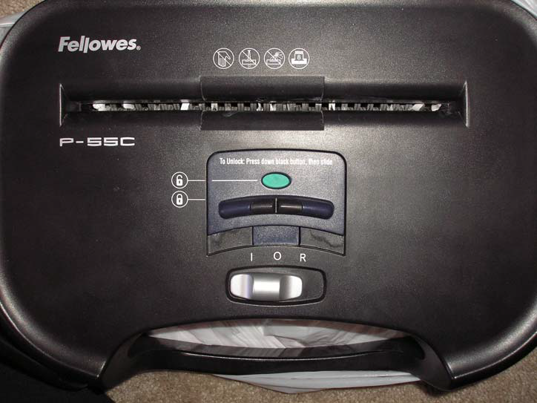
Voluntary Standards Process
VS Case Study #1: In 2004, document shredding machines were implicated in a number of hand injuries to small children.

Slide 21
Voluntary Standards Process
VS Case Study #1: Document Shredding Machines
Data Analysis
CPSC staff reviewed incident databases for paper shredder incidents to determine the causes and scenarios that led to hand injuries.

Slide 22
Voluntary Standards Process
VS Case Study #1: Document Shredding Machines
Data Analysis
The most severe injuries, finger amputations, occurred when a child (even under adult supervision) was feeding paper into a shredder and did not release the paper in time and their hand was pulled into the opening.

Slide 23
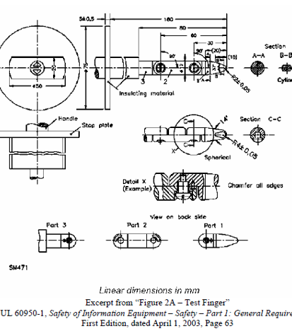
Voluntary Standards Process
VS Case Study #1: Document Shredding Machines
CPSC staff reviewed UL 60950-1 Information Technology Equipment – Safety – Part 1: General Requirements for accessibility to moving parts requirements for paper shredders

Slide 24
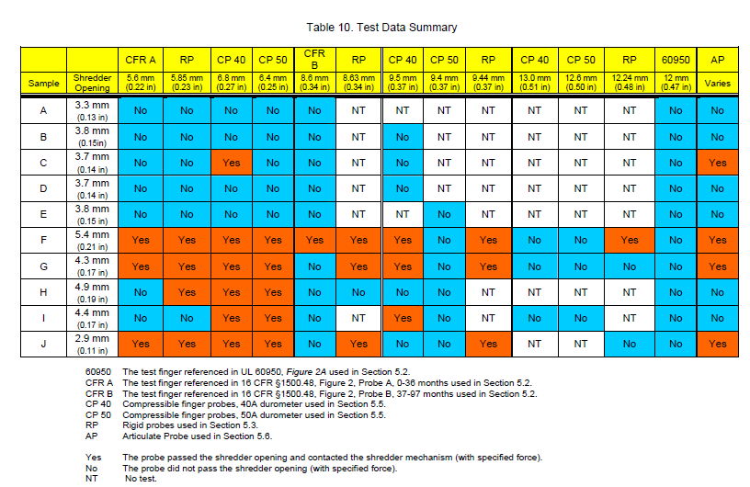
CPSC staff acquired 10 different paper shredders for analysis and examined them for design variations and to assess the effectiveness of various accessibility probes in preventing contact with moving parts.
Voluntary Standards Process
VS Case Study #1: Document Shredding Machines
Evaluation

Slide 25
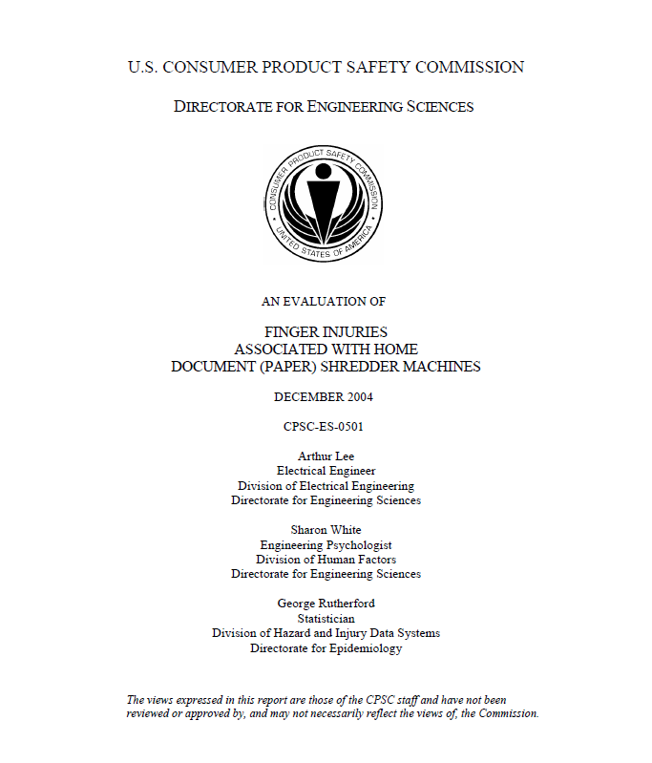
Voluntary Standards Process
VS Case Study #1: Document Shredding Machines
Standards Revision
CPSC staff issued its evaluation report on design/standard vulnerabilities and proposed formation of a working group to address the gaps in the standard.

Slide 26
Voluntary Standards Process
VS Case Study #1: Document Shredding Machines
Standards Panel Participation
CPSC staff participated in a UL 60950 working group to develop new test requirements to reduce access to hazardous moving parts.

Slide 27
Voluntary Standards Process
VS Case Study #1: Document Shredding Machines
Standards Panel Participation
Panel voted to accept proposed changes to UL 60950-1 to address moving parts accessibility.

Slide 28
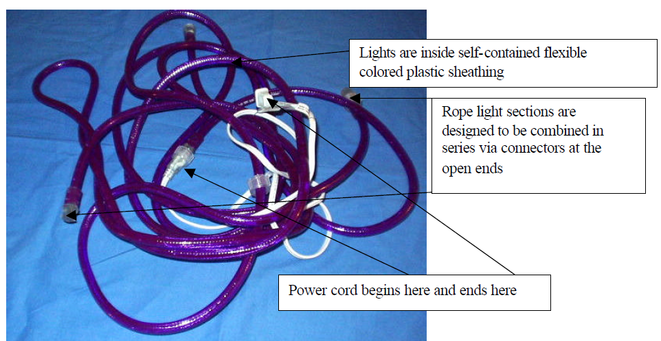
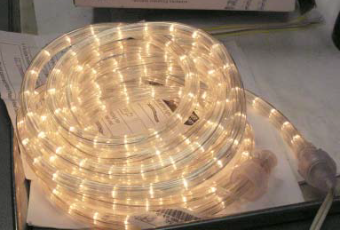
Voluntary Standards Process
VS Case Study #2: Flexible Lighting Products (Rope Lights) were becoming popular, but no applicable standard existed.
A rope light is a string of series and/or series-parallel connected lamps enclosed in a flexible polymeric tube or extrusion.

Slide 29
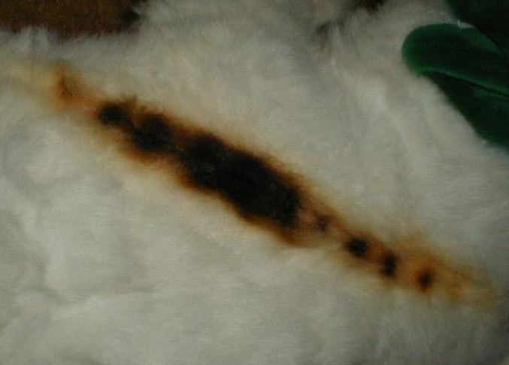
Voluntary Standards Process
VS Case Study #2: Flexible Lighting Products (Rope Lights) Data Analysis
Reports of incidents involving rope lights raised CPSC staff concerns about risk of shock or fire. Rope lights initially were only in use as a commercial product, but were now being sold for residential use.

Slide 30
Voluntary Standards Process
VS Case Study #2 : Rope Lights
Standards Review
There was no existing standard for rope lights. Although similar to holiday lights, a key difference is that they are installed for longer than 90 days.

Slide 31
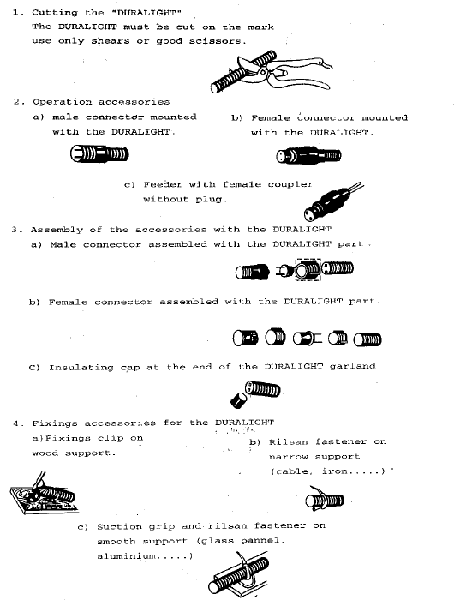
Voluntary Standards Process
VS Case Study #2 : Rope Lights
Evaluation
CPSC staff examined rope lights and defined the areas of concern for residential use, such as field configuration (cutting lights to length).

Slide 32
Voluntary Standards Process
VS Case Study #2 : Rope Lights
Standards Revision
CPSC staff proposed developing a new standard for rope lights based on identified potential hazards

Slide 33
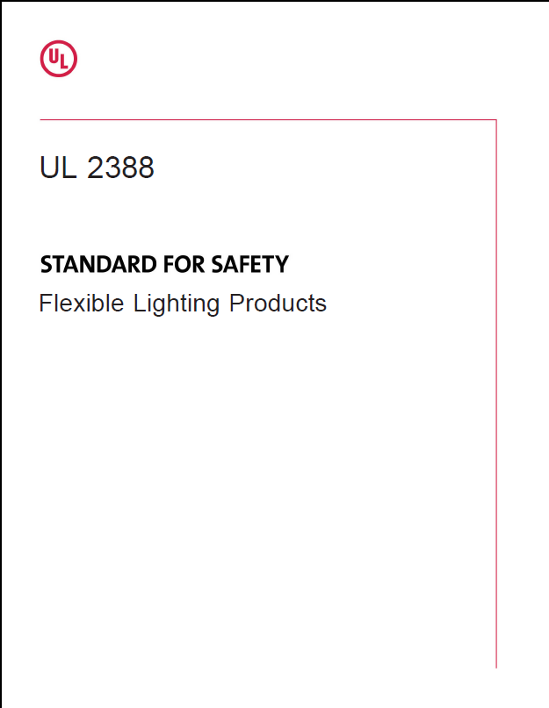
Voluntary Standards Process
VS Case Study #2 : Rope Lights
Standards Panel Participation
First Edition of UL 2388 – Standard for Safety of Flexible Lighting Products was issued July 3, 2002.

Slide 34
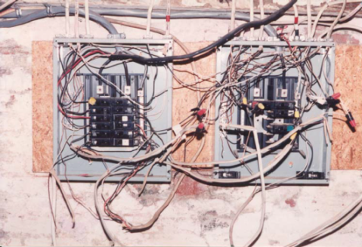
Other Requirements
Safe Installation = Electrical Safety
The National Electrical Code (NEC) covers the installation of electrical equipment in public and private premises.
Product standards requirements are in accordance with the NEC
The NEC is a consensus code published by the National Fire Protection Association. It is used as a model for adoption of law by state agencies and local municipalities.

Slide 35
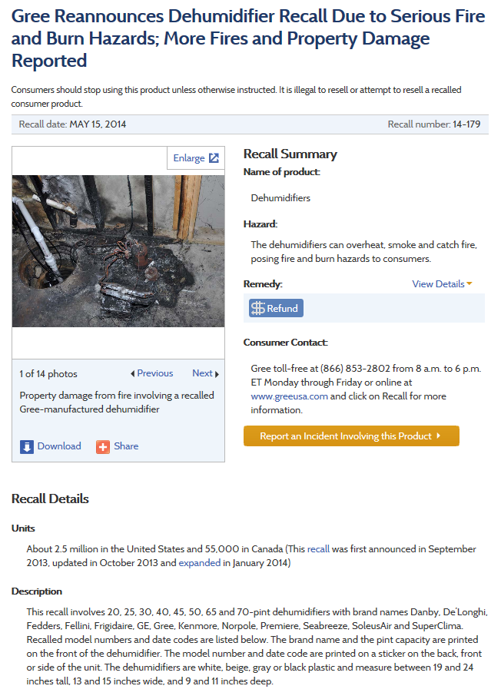
Recalls
A product that creates a substantial product hazard must be recalled, i.e., removed from sale, and those in consumer’s hands must be remedied through repair, replacement, or refund.

Slide 36
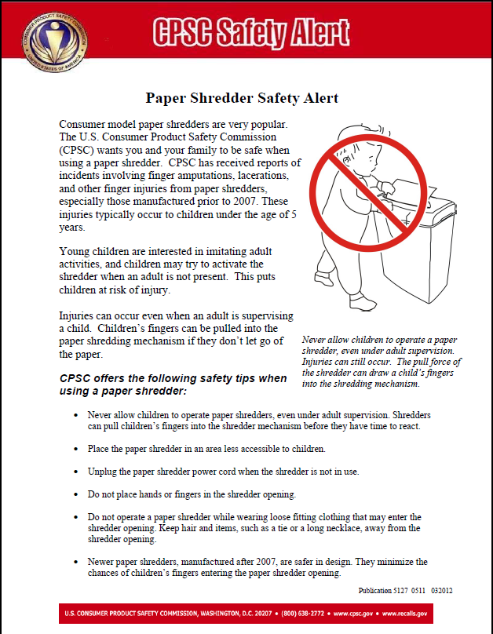
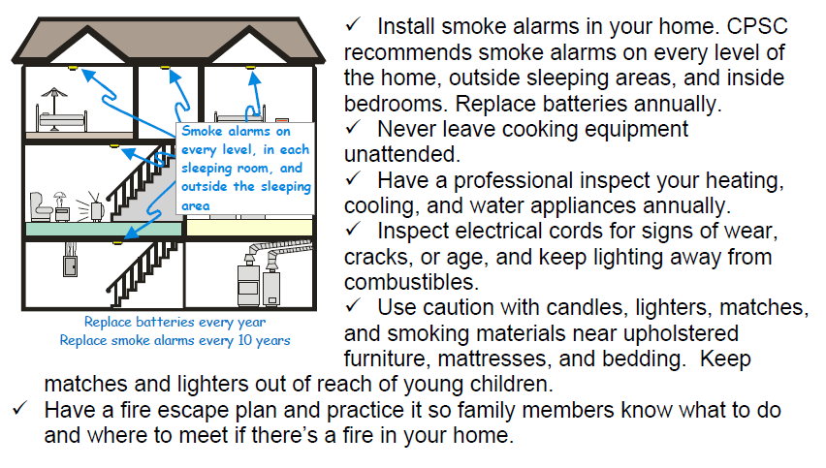
Consumer Education
In addition to working to make products safer, CPSC staff educates consumers to empower them to be proactive about safety in their homes.

Slide 37
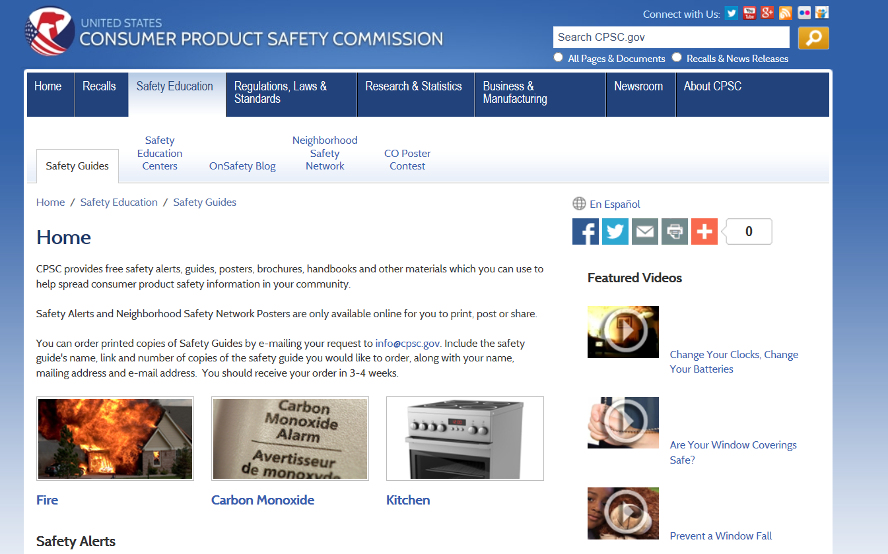
Safety Guides
www.cpsc.gov/en/Safety-Education/Safety-Guides/Home/

Slide 38
Multipronged Safety Approach
CPSC employs a comprehensive, multipronged approach to product safety by participating in development and revision of voluntary standards or promulgation of technical regulations to address emerging hazards, removing unsafe products from the market, and informing consumers about the potential dangers a product may pose and how to avoid getting hurt.

Slide 39
Multipronged Safety Approach
Comprehensive Case Study #1: Ingestions of small batteries (like button and coin cells) were causing serious internal injuries, sometimes resulting in deaths.
Button/coin cell batteries lodged in the esophagus can cause electrical current to hydrolyze fluid, leading to hydroxide burns
Can lead to severe injuries and death in as little as
2 hours
Victims can present nonspecific flu-like symptoms.
Delayed treatment allows extensive tissue damage to occur - fistulas, perforations, necrosis, stricture, and vocal cord paralysis.

Slide 40
Multipronged Safety Approach
Comprehensive Case Study #1: Button/coin cell battery ingestions
Educate consumers about the hazard
Revise/develop standards
Improve battery compartment design
Require a screw or two independent simultaneous motions to access battery
Improve packaging
Child resistant packaging
Improve warning /labeling
Hazard
Message
Improve battery design to mitigate or lessen the hazard

Slide 41
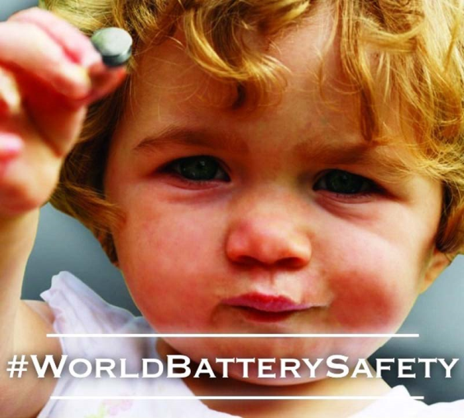
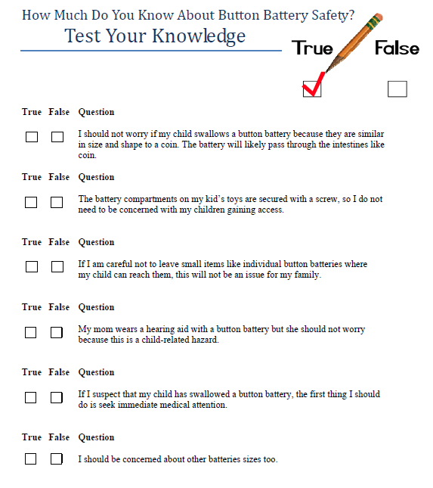
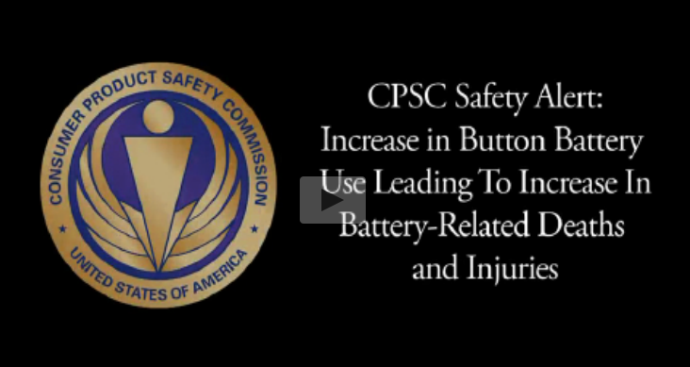
Multipronged Safety Approach
Comprehensive Case Study #1: Button/coin cell battery ingestions
Consumer Education
Safety Alert
Safety Poster
Safety Quiz
Safety Tips
Safety Video
International Outreach

Slide 42
Multipronged Safety Approach
Comprehensive Case Study #1: Button/coin cell battery ingestions
Standards Revision
Button/Coin cells are used in more than 50 product categories that have a voluntary standard
Two standards include requirements to prevent access by children
ASTM F963 Toy Safety
ASTM F2923-11 Children’s Jewelry
Goal: Broaden inaccessibility of batteries used in more devices to minimize exposure
UL 4200A – Standard for Safety for Products Incorporating Button or Coin Cell Batteries of Lithium Technologies published February 2015
Products that use button/coin cell batteries shall be designed to minimize the risk of children removing and ingesting or aspirating the batteries.
Door or closure secured by fastener or two motions
Enclosure/door/closure shall withstand a 1-meter drop, 2-Joule steel ball impact and 330 N crush force

Slide 43
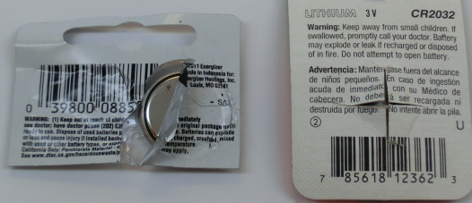
Multipronged Safety Approach
Comprehensive Case Study #1: Button/coin cell battery ingestions
Coin cells were easily removed from non-child-resistant coin cell packaging

Slide 44
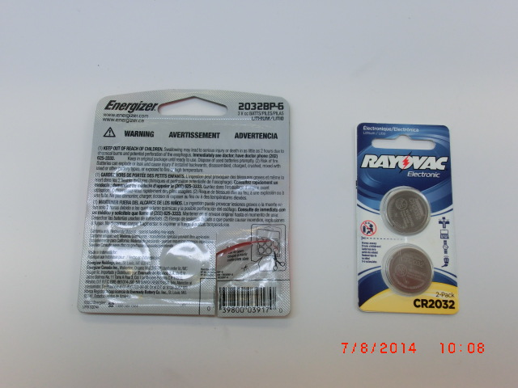
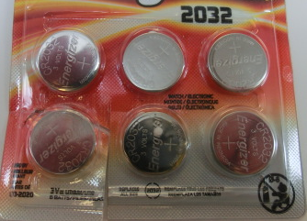
Multipronged Safety Approach
Comprehensive Case Study #1: Button/coin cell battery ingestions
New child-resistant coin cell packaging requires scissors to open
Improved warnings and “Keep out of reach” pictogram

Slide 45
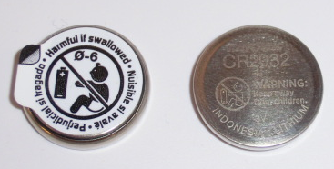
Multipronged Safety Approach
Comprehensive Case Study #1: Button/coin cell battery ingestions
Pictograms and warning
Safety tabs – need to be removed before using coin cell
Stamped or etched on battery

Slide 46
Multipronged Safety Approach
Comprehensive Case Study #1: Button/coin cell battery ingestions
Improvements to battery design under investigation
Various researchers have been exploring ways to improve battery designs
State-change coatings (cell non-conductive under non-use conditions)
Different anode metals to slow fluid hydrolization
Colorants to alert caregivers that child ingested cell
Limited success but still in early stages of evaluation

Slide 47
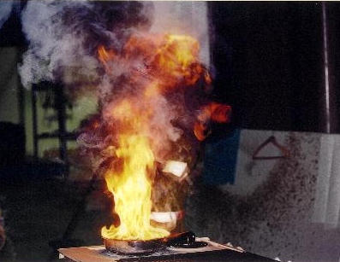
Multipronged Safety Approach
Comprehensive Case Study #2: Rangetop Cooking Fires
Cooking fires on electric cooktops have been a leading cause of fires for products under CPSC’s jurisdiction
CPSC Staff estimates that between 2014 and 2016 there were more than 16,000 fire service attended range fires each year
180 deaths
Over 1,500 injuries
More than $328 Million in losses
In most cases, the range was left unattended, allowing food to overheat and ignite
Standards did not address overheating of food

Slide 48
Multipronged Safety Approach
Comprehensive Case Study #2: Rangetop Cooking Fires
Develop new requirements for standard to mitigate risk of overheating food ignition
Develop experimental ignition-resistant ranges to demonstrate technical feasibility as basis for an approach to create new requirements for voluntary standards:
Determine viable parameters that indicate pending ignition
Design control system to measure and respond to overheating
Worked with stakeholders to develop test method and rationale
Educate consumers about the dangers of unattended cooking

Slide 49
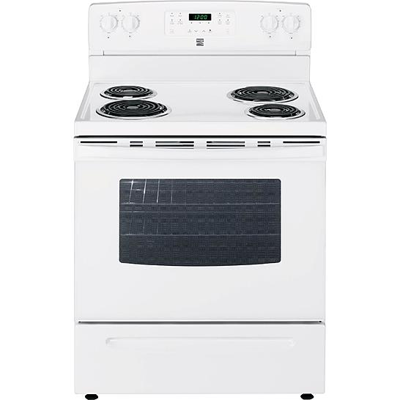
Multipronged Safety Approach
Comprehensive Case Study #2: Range top Cooking Fires
Developing new requirements
CPSC sponsored development of control systems for electric coil, glass ceramic radiant, and gas cooktop elements to limit pan temperatures without significantly prolonging normal cooking (2010)
A Coil Surface Unit Cooking Oil Ignition Test for UL 858 was published as new requirement in UL 858 June 18, 2015

Slide 50
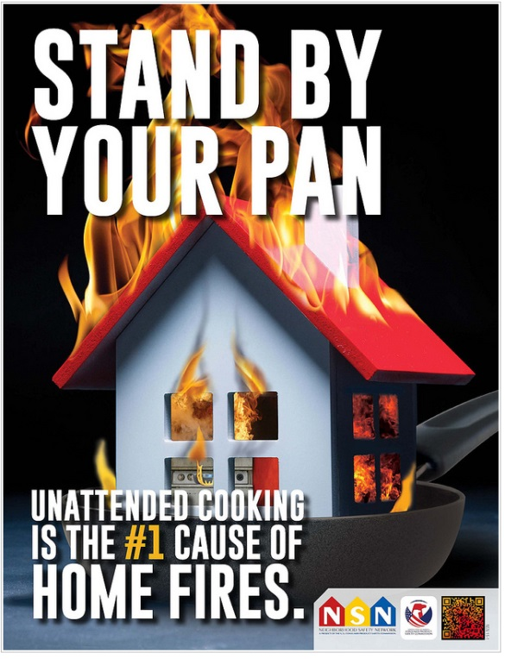
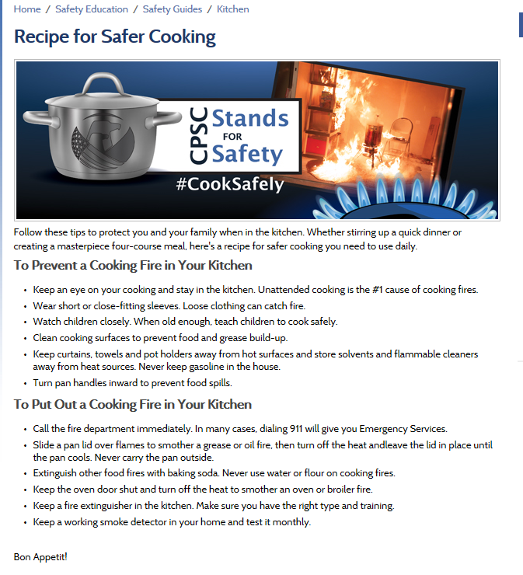
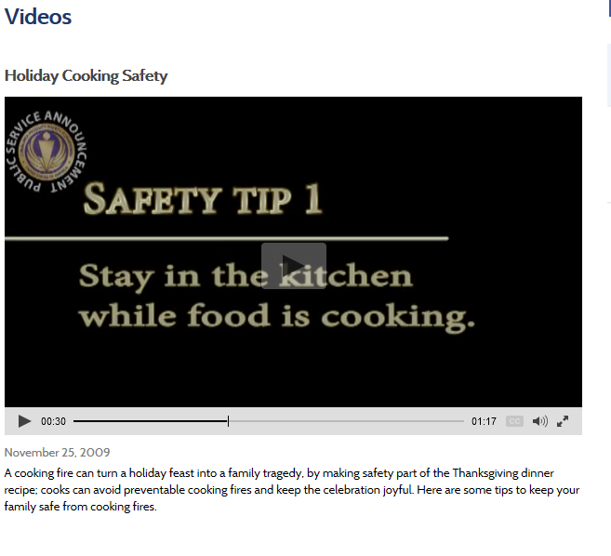
Multipronged Safety Approach
Comprehensive Case Study #2: Rangetop Cooking Fires
Consumer Education
Recipe for Safer Cooking
Seasonal Safety Alerts
Safety Poster

Slide 51
Responsibility to Comply
Compliance with applicable component, product and installation requirements are highly effective ways to mitigate hazards from equipment that generates, distributes, or uses electrical energy.
Under the CPSA, all members of the supply chain bear equal responsibility to assure the safety of their products.
All equally responsible
Manufacturers
Importers
Distributors
Retailers

Slide 52
Responsibility to Comply
Manufacturers, importers and retailers should follow best practices and employ robust quality control/quality assurance processes to ensure that products do not pose substantial risk of injury:
Comply with voluntary standards and mandatory regulations
Obtain third party certification for products
Maintain quality and configuration control
Assess impact of material or component substitutions

Slide 53
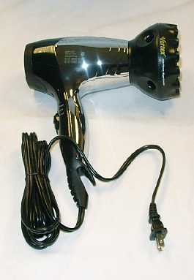
Follow Best Practices –Comply with CPSC Regulations
Case Study #1: This hair dryer is missing an immersion detection current interrupter (IDCI) plug and presents a risk of electrocution if dropped in water. It violates the requirements under 16 CFR section 1120.3(a).
CPSC seized products at the port.

Slide 54
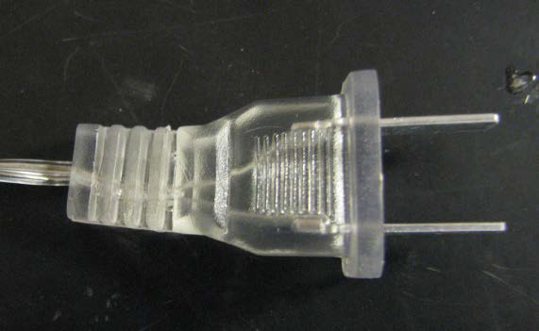
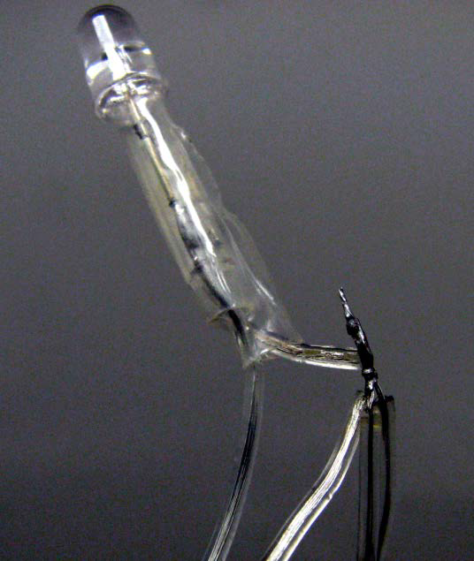
Follow Best Practices –Comply with CPSC Regulations
Case Study #2: Uncertified decorative lighting string did not meet UL 588 requirements; wire was undersized, plug lacked overcurrent protection, strain relief was inadequate, and circuit enclosure was not flame resistant. Posed fire and shock hazard. It violates the requirements under 16 CFR section 1120.3(c).
CPSC seized units at port.

Slide 55
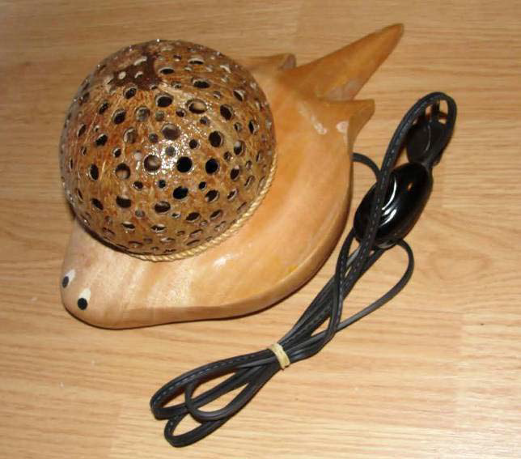
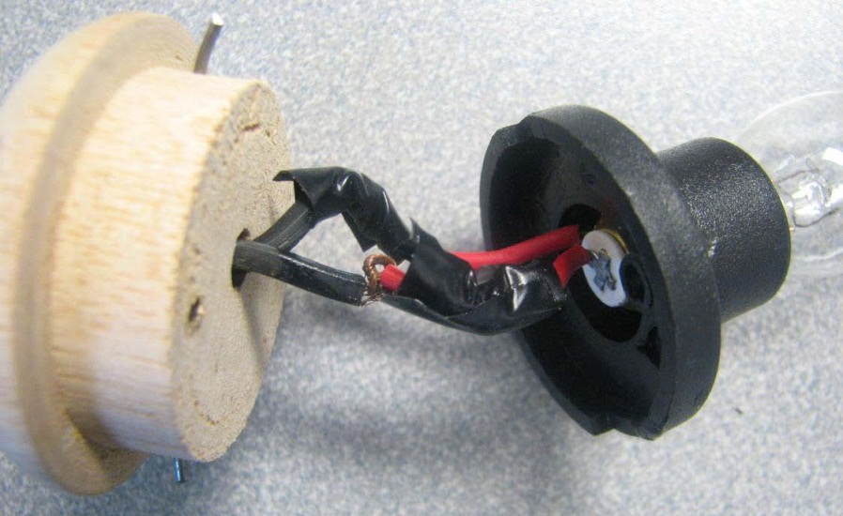
Follow Best Practices –Comply with Voluntary Standard
Products held at port and conditionally released
Case Study #3: Uncertified luminaire did not meet UL 153 requirements; it was assembled with poor workmanship, lacked proper strain relief on the power cord, and did not have a polarized plug. Posed fire and shock hazard.

Slide 56
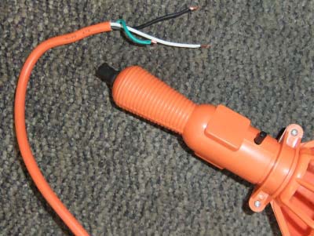
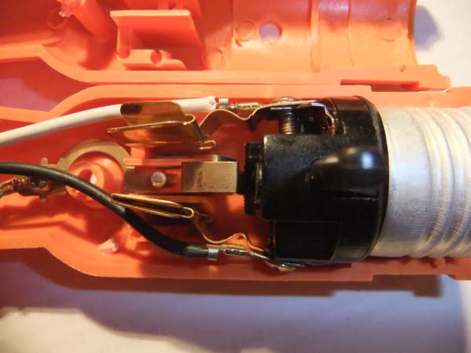
Follow Best Practices –Comply with Voluntary Standard
Case Study #4: Uncertified handheld work light did not meet UL 153 requirements; deficiencies included assembly with poor workmanship, undersized wire, inadequate strain relief on the power cord, and substandard components. Posed fire and shock hazard.
Products held at port and conditionally released.

Slide 57
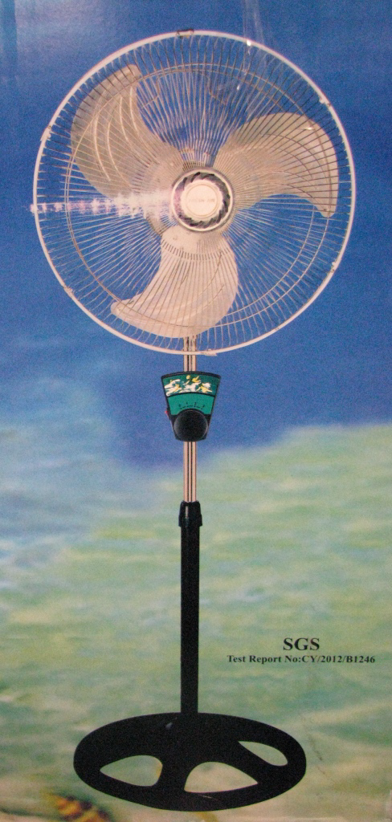
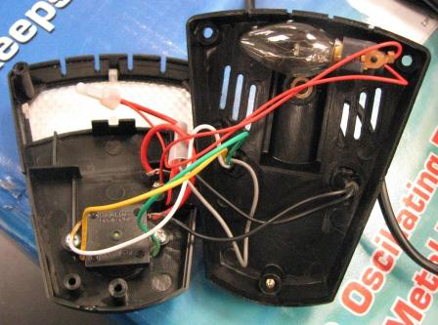
Follow Best Practices- Comply with Voluntary Standards
Case Study #5: Uncertified portable electric fan did not meet UL 507 requirements; deficiencies included motor without thermal protection, undersized wire, inadequate strain relief on the power cord, and lack of integral overcurrent protection in plug. Posed fire and shock hazard.
Products held at port and conditionally released.

Slide 58
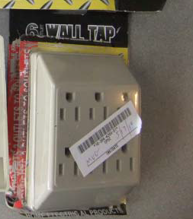
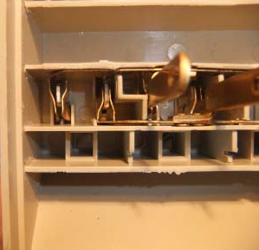
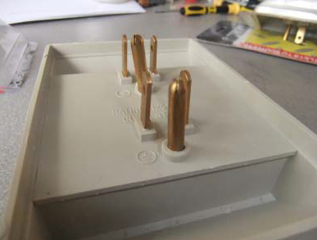
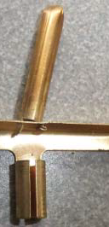
Follow Best Practices- Use Certified Parts within Specs
Case Study #6: Uncertified six-outlet current tap did not meet UL 498A. It was poorly constructed from inadequate materials. Sheet metal was too thin and flimsy, lacking strength to contact plug blades properly. Resulting loose connections can arc and overheat. Ground pin was poorly fastened to grounding bus. Unit posed fire and shock hazard.
Product held at port and conditionally released.

Slide 59



Follow Best Practices – Comply with Voluntary Standards
Case Study #7: Uncertified power tap was not compliant with standard. Power cord and internal wiring were severely undersized, and the cord strain relief was inadequate. Sheet metal busses were too thin and flimsy and deformed when a plug was inserted. Internal connections were poorly made and easily came loose. Unit posed fire and shock hazard.
Product held at port and conditionally released.

Slide 60






Follow Best Practices- Use Certified Parts within Specs
Case Study #8: Self-Balancing Electric Scooters or Hoverboards (powered by rechargeable lithium-ion battery pack); no safety standard at time of introduction to market; battery pack safety standard, UL 2271 or best practices, not used

Slide 61



Follow Best Practices – Use Certified Parts within Specs
Case Study #8: Self-Balancing Electric Scooters
Over 280 fires since 2015 in 43 states, causing 3 deaths, $>9M in damages
During and after charging
During and after riding
> 50,000 Emergency Room Visits
Sudden stops and starts caused rider falls, head injuries, and fractures

Slide 62

Follow Best Practices –Use Certified Parts within specs
Case Study #8: Staff thoroughly tested and analyzed units on the market, found that many used uncertified lithium-ion cells/chargers and did not follow typical safe cell operating practices to protect against operation at excessive temperatures, overcharging or over-discharging. Units posed fire hazard.
Fire incident units exhibited signs of thermal runaway leading to catastrophic failure of the entire battery pack
500,000 Units recalled

Slide 63
Follow Best Practices
In response to requests from retailers and manufacturers, UL issued UL 2272 - Outline of Investigation for Electrical Systems for Self-Balancing Scooters in January 2016 in order to certify units for electrical system safety.
Covers the electric drive train including the rechargeable battery and charger system combination for use in self-balancing scooters
Thereafter, UL assembled a Standards Technical Panel to convert the Outline to an industry consensus standard. UL published the 1st edition of UL 2272 – Electrical Systems for e-Mobility Devices in November 2016
ASTM International has been working on requirements for mechanical safety with contributions from CPSC staff experts

Slide 64


Follow Best Practices- Maintain Quality Control Processes
2 million units recalled.
Case Study #9: Third party-certified dehumidifier involved in fire incidents. Poor recordkeeping and failure to follow process controls allowed non-flame-resistant plastic resins to be used in enclosure molding in place of approved polymeric material. Insufficient flame resistance allowed internal failure to ignite surrounding plastic and propagate flames beyond unit.

Slide 65
Summary
Electrical safety requires diligence from manufacture to installation to use.
Electrical products should:
be designed and manufactured in accordance with applicable voluntary standards and comply with mandatory CPSC standards and state and local laws
have third-party certification from an accredited laboratory
be manufactured in accordance with robust quality systems
be subject to component and product safety standards that are continuously updated to address existing and emerging hazards

Slide 66
Questions?
Submit questions in English or Chinese to this podcast:
CPSCinChina@CPSC.GOV

Slide 67
Resources

Slide 68


https://www.cpsc.gov/zh-CN/Business--Manufacturing/Business-Education
Chinese Resources at cpsc.gov

Slide 69
Definition of children’s product – 16 CFR Part 1200
Certificates of conformity – 16 CFR Part 1110
Third-party testing – 16 CFR Parts 1107, 1109, and 1112
Tracking information – 15 USC § 2063(a)(5)
Mandatory reporting requirements – 15 USC §2064
CPSC Business Resources
CPSC-Accepted Laboratories Search Page:
www.cpsc.gov/LabSearch

Slide 70


Chinese Resources at cpsc.gov
https://www.cpsc.gov/s3fs-public/HandbookforManufacturingChinese.pdf (中文版本 )
https://www.cpsc.gov/s3fs-public/pdfs/blk_pdf_handbookenglishaug05.pdf (英文版本)
https://www.cpsc.gov/s3fs-public/THE%20REGULATED%20PRODUCT%20HANDBOOK_050613%20CHN%20Final_0.pdf (中文版本 )
https://www.cpsc.gov/s3fs-public/RegulatedProductsHandbook.pdf (英文版本)

Slide 71


Chinese Resources at cpsc.gov
CFR: Commercial Practices
https://www.govinfo.gov/content/pkg/CFR-2017-title16-vol2/pdf/CFR-2017-title16-vol2.pdf (英文版本)
CPSC Laboratory Manuals:
https://www.cpsc.gov/s3fs-public/Laboratory-test-manual-16-CFR-Part-1610-Ch.pdf?MhtbUWNy6jmOPx9b6f.RErt.n.2n_d_h (中文版本)
https://www.cpsc.gov/s3fs-public/Flammability%20of%20Clothing%20Textiles%20Test%20Manual_1610.pdf (英文版本)

Slide 72


http://business.cpsc.gov
Online tool designed specifically to help businesses comply with federal consumer product safety requirements.
Asks a series of guided questions, and based on the answers produces a downloadable (PDF) report.
Provides customized guidance with links to product safety regulations that may apply to the product and important information on labeling, certification and testing requirements.

Slide 73
Regulatory Robot
Regulatory Robot is a tool to help identify which mandatory standards are applicable
Does not give details of requirements within a specific standard
User inputs product features
Regulatory Robot outputs list of standards and requirements
User references source documents for specific requirements

Slide 74


CPSC Batteries Overview:
https://www.cpsc.gov/Regulations-Laws--Standards/Voluntary-Standards/Topics/Batteries/
FY 2020 Status Report and Action Plan for the High-Energy Density Batteries Project: https://www.cpsc.gov/s3fs-public/High%20Energy%20Density%20Batteries_Status%20Memo_FY20_1-6bCleared-04012020.pdf?Qj4t_otWKfBZYLpvu4l6sUvx9ZJfFc4f
Electrical Product Resources at cpsc.gov
2018 Status Report on High Energy Density Batteries Project: https://www.cpsc.gov/s3fs-public/High_Energy_Density_Batteries_Status_Report_2_12_18.pdf?UksG80UJqGY0q4pfVBkbCuUQ5sNHqtwO

