Slide 1
The slides used in this presentation are intended to be used in an event with verbal elaboration by a knowledgeable presenter. These slides highlight key U.S. product safety requirements for discussion. The text is not a comprehensive statement of legal requirements or policy and should not be relied upon for that purpose. Moreover, with the passage of time, the slides may not reflect the latest information. You should consult official versions of U.S. statutes and regulations, as well as published CPSC guidance when making decisions that could affect the safety and compliance of products entering U.S. commerce. Note that reference materials are listed at the end of the presentation.

Slide 2
Video: Welcome to the 2021 CPSC Podcast Series - Cribs and Play Yards

Slide 3
Overview of Cribs and Play Yards Requirements
Sylvia Chen
International Programs Manager
Office of International Programs
This presentation was prepared by CPSC staff. It has not been reviewed or
approved by the Commission and may not reflect its views.

Slide 4
Biography
Sylvia Chen
U.S. Consumer Product Safety Commission
Program Manager for East Asia and Pacific
Office of International Programs
Sylvia Chen is responsible for managing the Commission’s bilateral and multilateral programs related to consumer product safety in Australia, Japan, Korea, Taiwan, and New Zealand. She also supports the CPSC’s work with China. Since she joined the CPSC in 2008, Sylvia has been working with product safety regulators, industry organizations, manufacturers, exporters, buyers, and other sourcing professionals to provide them with guidance and technical support in understanding U.S. requirements, in particular, the latest requirements for consumer products. To that end, she has organized or coordinated many of the agency’s international education and outreach activities.
Sylvia has a Bachelor of Arts degree in English and American Literature from Peking University. In 1991, she graduated from The Ohio State University with a Master’s degree in East Asian Studies.

Slide 5
The US CPSC is a federal government agency charged with protecting the public from unreasonable risks of injury or death associated with the use of consumer products under the agency's jurisdiction.
$1 Trillion
Deaths, injuries, and property damage from consumer product incidents cost the nation more than $1 trillion annually.¹
¹ https://www.cpsc.gov/s3fs-public/FY2019PBR.pdf
CPSC is committed to protecting consumers from products that pose a fire, electrical, chemical, biological, or mechanical hazard.
CPSC's work to improve the safety of the more than 15,000 types of consumer products in its jurisdiction - such as toys, cribs, power tools, cigarette lighters, textiles, and household chemicals – has contributed to improved safety standards for consumer products over the past 40 years.

Slide 6
CPSC’s Podcast Series 2021
Podcast | Topics
#1 | Overview of U.S. Children’s Sleepwear Requirements
#2 | Enhancing the Safety of Emerging Technology Through Risk Assessment with a Focus on Wearables
#3 | Lithium-Ion Battery Safety for Consumer Products Imported into the United States
#4 | Overview of Gates and Enclosures Requirements
#5 | An Overview of Consumer Safety and Micromobility Devices
#6 | Overview of Cribs and Play Yards Requirements
“Questions on this Presentation? Send an email to CPSCinChina@cpsc.gov”

Slide 7
Introduction
How CPSC Defines Full-Size and Non-Full Size Cribs and Play Yards
On Product and Outer Product labeling requirements
Registration Card Requirements
Labeling Requirements
Children’s Product Certificates
Testing Requirements
Hazards
Recalls

Slide 8
Defining Full-Size Cribs
Full-Size Crib Definition – 16 CFR Part 1219 and ASTM F1169-19
A bed that is designed to provide sleeping accommodations for an infant that is intended for use in the home and is within a range of ±2 in. (±5.1 cm) of the interior length or width dimensions specified for full-size baby cribs summarized below.
The interior dimensions shall be 28 ± 5/8 in. (71 ± 1.6 cm) wide as measured between the innermost surfaces of the crib sides and 52 3/8 ± 5/8 in. (133 ± 1.6 cm) long as measured between the innermost surfaces of the crib end panels, slats, rods or spindles.

Slide 9
Defining Non-Full-Size Cribs & Play Yards
Non-Full-Size Crib Definition – 16 CFR Part 1220 and ASTM F406-19
crib that (1) is intended for use in or around the home, for travel and other purposes; and (2) has an interior length dimension either greater than 55 in. (139.7 cm) or smaller than 49 3⁄4 in. (126.3 cm), or an interior width dimension greater than 30 5⁄8 in.(77.7cm)or smaller than 25 3⁄8 in. (64.3 cm), or both.
Play Yard Definition – 16 CFR Part 1221 and ASTM F406-19
framed enclosure that includes a ﬂoor and has mesh or fabric sided panels primarily intended to provide a play or sleeping environment for children. It may fold for storage or travel.

Slide 10
Other Children’s Sleep Products Requirements
Bassinets and Cradles: 16 CFR Part 1218 / ASTM F2194-13
Bedside Sleepers: 16 CFR Part 1222 / ASTM F2906-13
Infant Sleep Products: 16 CFR Part 1236/ ASTM F3118-17a (with modifications)
Portable Bed Rails for Children: 16 CFR Part 1224 / ASTM F2085-19
Toddler Beds: 16 CFR Part 1217 / ASTM F1821-19e1

Slide 11
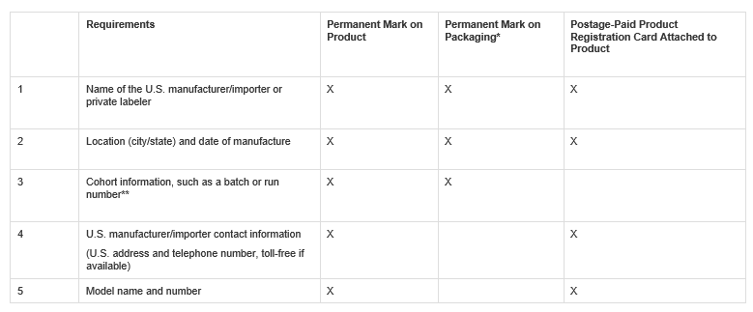
Product and Outer Package Labeling Requirements
Durable infant or toddler products, such as cribs and play yards, must be permanently marked with specific labeling information, including tracking labels, on the product and on the packaging. In addition, these types of products are required to have additional product markings and a product registration card (discussed later) attached to the product.
* If all of the required labeling information is visible on the product through outer or clear packaging, there is no need for the information to be on the outer package.
** Note: For very small production runs, a date code or other permanent identifying information may be considered sufficient cohort information.

Slide 12
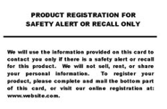
Product Registration Card Requirement
U.S. Manufacturers/Importers of Durable Infant or Toddler Products must include a product registration form attached to the product – 16 CFR Part 1130.
Provide consumers with postage-paid product registration card.
Maintain records of names, addresses, emails, and other contact info on consumers that register their products.
Permanently place manufacturer name and contact info, model name and number, and date of manufacture on each durable product.
Intended to improve recall effectiveness and safety alert warning to consumers.
Product Registration Card FAQs site is a good
reference.

Slide 13
Labeling Requirements and Instructional Literature
See ASTM F406-19 Section 9 and ASTM F1169-19 Section 8 for additional warning instructions regarding crib mattresses, sleep hazards, strangulation hazards, proper fastening, fall and entrapment hazards.
Warning statements requirements are very prescriptive, requiring specific font, size, color, and location.
The following are examples, not the actual labels.

Slide 14
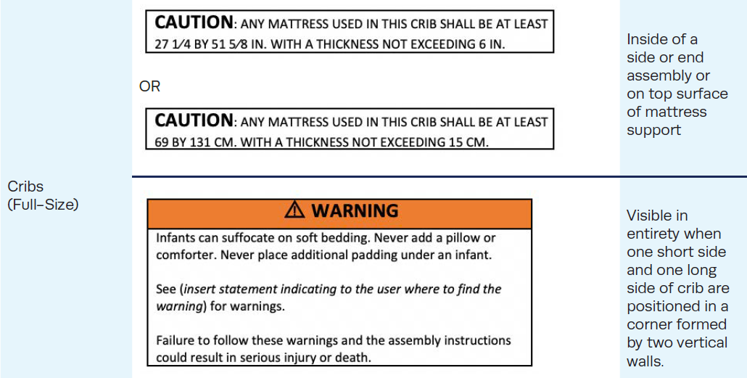
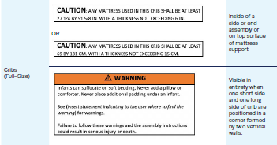
Labeling Requirements: Full-Size Cribs

Slide 15
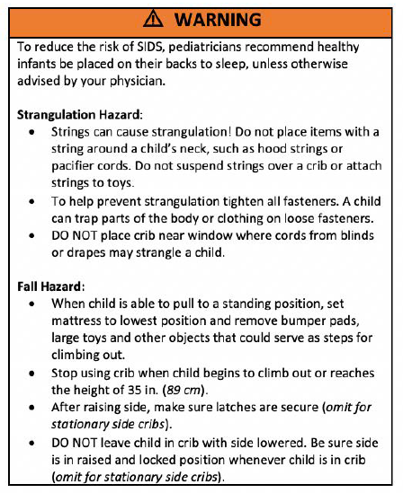
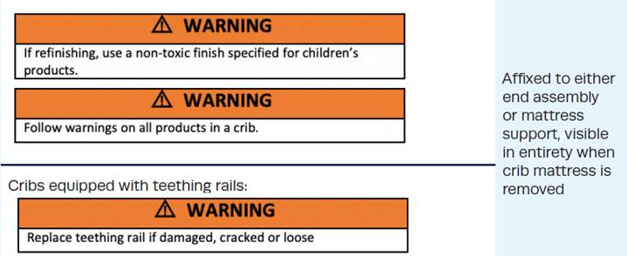
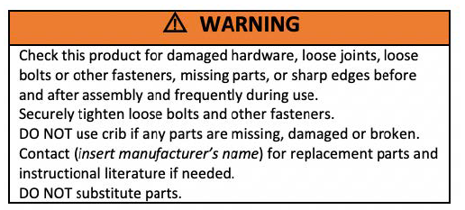
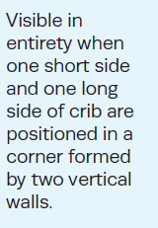
Labeling Requirements: Full-Size Cribs

Slide 16
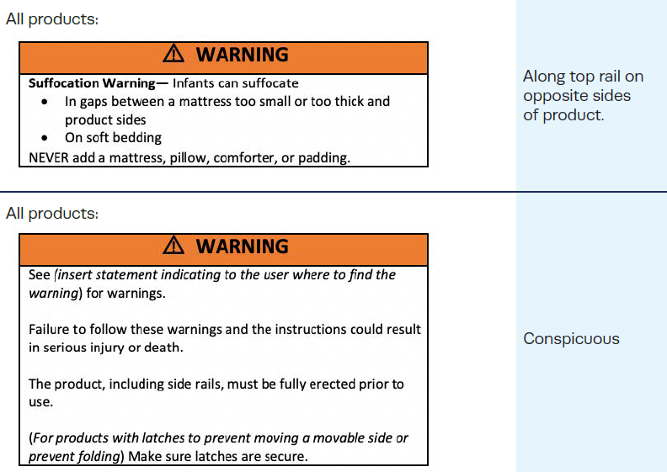
Labeling Requirements: Non-Full-Size Cribs/Play Yards

Slide 17
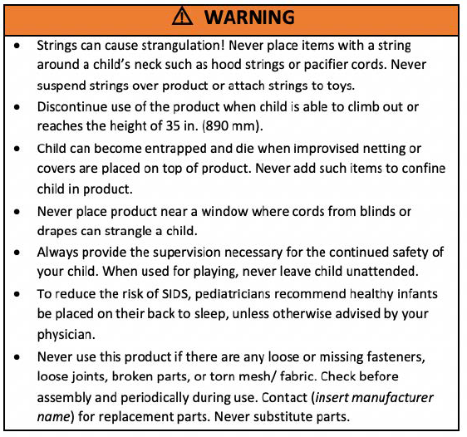
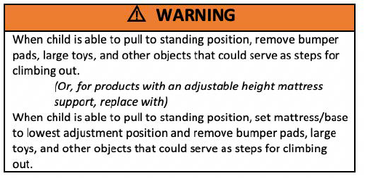
Labeling Requirements: Non-Full-Size Cribs/Play Yards

Slide 18
Labeling Requirements: Non-Full-Size Cribs/Play Yards
Labels must be permanently on product and packaging.
Products with accessories intended to be used with product:
WARNING Strangulation Hazard Always attach (describe attachment) securely. If (describe attachment) is not secured, child in product can lift or shift (describe attachment) and get neck trapped between (describe attachment) and frame.
Products with accessories intended to be removed when occupied:
WARNING (Statement describing the hazard) Never leave {describe attachment} in place when child is in non-full size crib/play yard.
Mesh products that are designed with drop top rails:
WARNING NEVER LEAVE INFANT IN PRODUCT WITH SIDES DOWN. Infant may roll into space between pad and loose mesh side causing suffocation.
WARNING Infants can suffocate • In gaps between a mattress too small or too thick and product sides • On soft bedding NEVER add a mattress, pillow, comforter, or padding.

Slide 19
Labeling Requirements: Non-Full-Size Cribs/Play Yards
Warning statements shall address the following at a minimum if applicable:
Never leave child in product with side lowered. Be sure side is in raised and locked position whenever child is in product.
Never use plastic shipping bags or other plastic ﬁlm as mattress covers not sold and intended for that purpose. They can cause suffocation.
Products not intended to hold water mattresses must address the following: Never use a water mattress with this product.
Products designed to use a water mattress must specify the maximum thickness and weight of the water mattress.
Products intended to be reﬁnished as described in the instructions: If reﬁnishing, use a nontoxic ﬁnish speciﬁed for children’s products.

Slide 20
Instructional Literature Requirements
Instructional literature may be on the package or included in leaflet form.
Should be easy to read and understand and in English.
Instructions shall include assembly, maintenance, cleaning, operating, folding, and warnings where applicable.
If a separate instruction sheet is used, include at the top of the ﬁrst page of the instructions:
Read all instructions BEFORE assembly and USE of product. KEEP INSTRUCTIONS FOR FUTURE USE.

Slide 21
Children’s Product Certificates
All children’s products require a Children’s Product Certificate (CPC)
Availability of Certificates (CPC/GCC) –
Certificates must “accompany” each product or shipment of products covered by the same certificate.
A copy of the certificate must be “furnished to each distributor or retailer of the product” (no requirement to provide to ultimate consumer).
A copy of the certificate must be made available to the CPSC and Customs upon request.
Electronic Certificates are acceptable but must be created no later than time of shipment or first distribution within the United States.

Slide 22
Children’s Product Certificates
Description of product(s) covered by certificate
Citation to each CPSC safety requirement to which you are certifying compliance
15 U.S.C. §1278a – Total Lead Content
16 CFR Part 1303 – Lead in Paint and Similar Surface Coatings
16 CFR Part 1307 – Phthalates Prohibition
16 CFR Part 1501 – Small Parts Regulation
16 CFR Part 1219, ASTM F1169-19 – Full-Size Cribs
Importer/Domestic Manufacturer contact information
Contact information for person maintaining test records
Date and Place of Manufacture
Location of Testing and Date of Test on which certification is based
Contact information of testing laboratory

Slide 23
Testing Requirements (Chemical)
Lead Content Testing – 15 U.S.C. §1278a
Limit: No more than 100 ppm in any accessible parts of children’s products.
Materials that do not exceed the lead limit in untreated, unadulterated state – 16 CFR §1500.91 such as
Wood, Paper and similar materials made from wood
CMYK process printing inks
Natural fibers (dyed or undyed) including, but not limited to, cotton, linen, hemp, bamboo, sisal, silk, wool (sheep)
Manufactured fibers (dyed or undyed) including, but not limited to, rayon, lyocell, acetate, triacetate, rubber, polyester, nylon, acrylic, modacrylic, spandex

Slide 24
Testing Requirements (Chemical)
Lead in Paint and Similar Surface Coatings- 16 CFR Part 1303
Limit: All children’s products and some furniture, for adults and children, must not contain a concentration of lead greater than 90 parts per million in paint or any similar surface coatings.

Slide 25
Testing Requirements (Chemical)
Phthalates Testing – 16 CFR Part 1307
Phthalates are chemical plasticizers used in the production of many types of plastic, certain inks, paints, and other products.
Testing applies to plasticized parts of toys and child care articles.
Childcare article is an item for a child under age 3 that facilitates eating or sleeping, or helps a child in sucking or teething, for example:

Slide 26
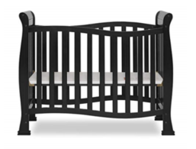
Testing Requirements (Chemical)
Phthalates: Determinations Regarding Certain Plastics - 16 CFR Part 1308
Effective Date: September 29, 2017
Seven plastics removed from independent third-party testing requirement for compliance with phthalates prohibitions:
Polypropylene (PP)
Polyethylene (PE)
High-impact polystyrene (HIPS)
Acrylonitrile butadiene styrene (ABS)
General purpose polystyrene (GPPS)
Medium-impact polystyrene (MIPS)
Super-high-impact polystyrene (SHIPS)

Slide 27
Testing Requirements (Physical & Mechanical)
Small Parts – 16 CFR Part 1501
Small part fits entirely into a small parts cylinder specified in the regulation.
Exposed Wood Parts – must be smooth and free of splinters.
Hazardous Sharp Points or Edges - 16 CFR §§1500.48, 1500.49
No sharp points or edges before and after testing.
Restraint system - required on all products except carriages designed only for an infant, must include waist and crotch restraint and meet additional performance specifications.
Exposed coil springs - accessible to the occupant must be covered or designed to prevent injury from entrapment.

Slide 28
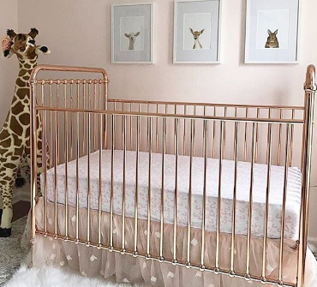
Testing Requirements (Physical & Mechanical)
Latching Mechanisms – Units that fold shall have a latching device that prevents the unit from unintentional folding when placed in the manufacturer’s recommended use position.
Scissoring, Shearing, and Pinching – Units must
be designed to prevent injury to the occupant
when members or components rotate or move
relative to one another.
Toy Accessories – If sold with unit, must meet
the federal toy safety requirements (ASTM F963).
Cord/Strap Length – No cord or strap made of
a flexible material, such as fabric, elastic, or
plastic having a free stretched length in excess of
7.4 in. shall be attached to a product.

Slide 29
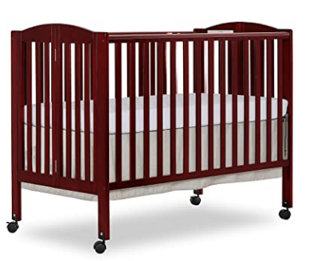
Testing Requirements (Physical & Mechanical)
Performance Requirements:
Cyclic Testing: to address structural integrity and hardware issues
Teething Rail to address gap hazard
Crib Side Latch: to address collapses and drop-side-related issues
Mattress Support System Vertical Impact: to address product integrity and collapses
Mattress Support System Test: to address fall hazard
Slat/Spindle Strength: to address slat breakages and detachments

Slide 30
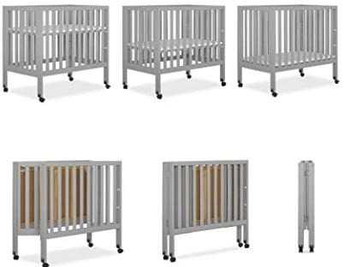
Product Hazards: Cribs
Slat strength test for folding sides to ensure structural integrity
For cribs incorporating folding or moveable sides for purposes of easier access to the occupant, storage and/or transport, each side segment (portion of side separated by hinges for folding) shall be tested separately.
Proper fastening: crib hardware must
include a locking device or method for
impeding loosening. Wood screws as
primary fasteners are restricted.
Mattress fit: eliminate hazardous gaps
in the crib.

Slide 31
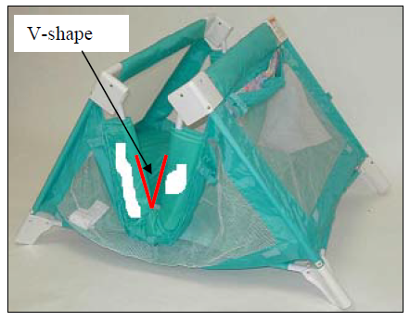
Product Hazards: Play Yards
Entrapment Hazards
Entrapment Hazards associated with side rails folding and creating a V-shape that could entrap a child’s neck.

Slide 32
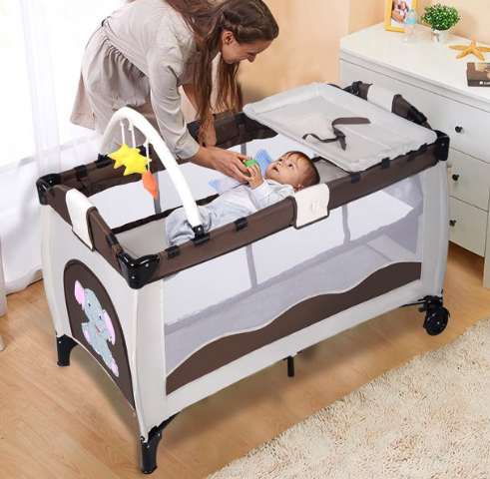
Product Hazards: Play Yards
Play yard accessories: testing is required to prevent separation of accessories from play yards.
Bassinet accessory key structural elements must be attached permanently.
Unsafe sleep environment: there are concerns about the addition of soft bedding, such as blankets, pillows, and quilted covers, which can create an unsafe sleep environment for an infant.

Slide 33
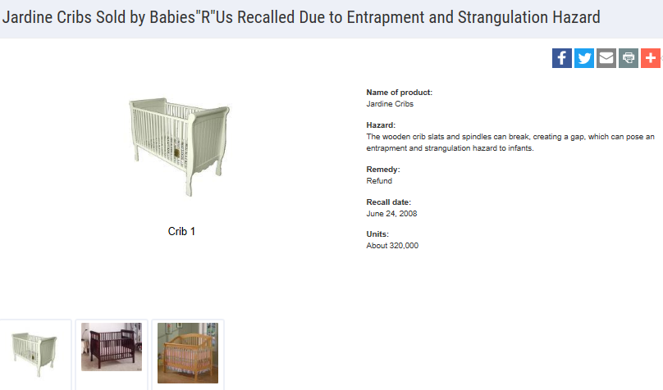
Recall Examples

Slide 34
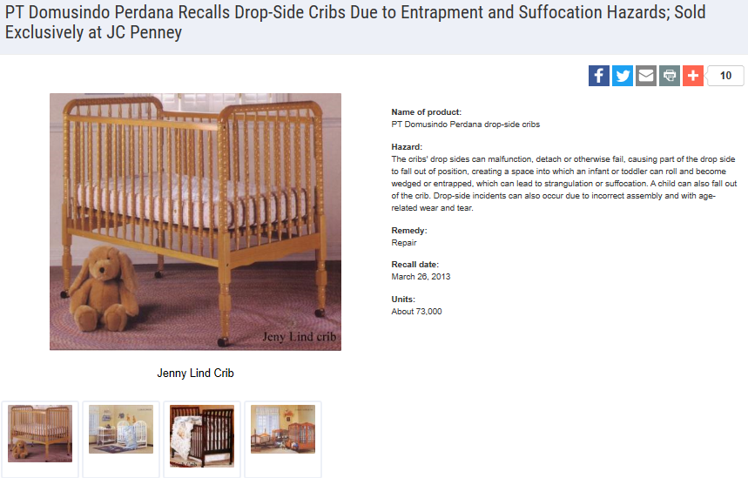
Recall Examples

Slide 35
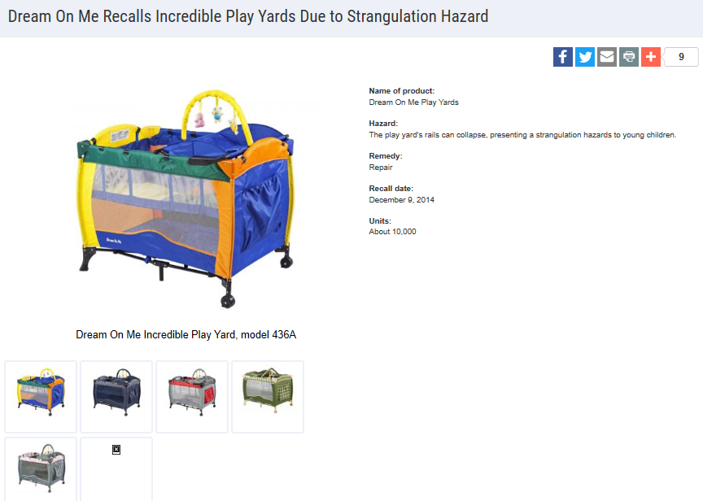
Recall Examples

Slide 36
Questions?
Submit questions in English or Chinese for this podcast:
CPSCinChina@CPSC.GOV

Slide 37
Resources

Slide 38
https://www.cpsc.gov/zh-CN/Business--Manufacturing/Business-Education
Chinese Resources at cpsc.gov

Slide 39
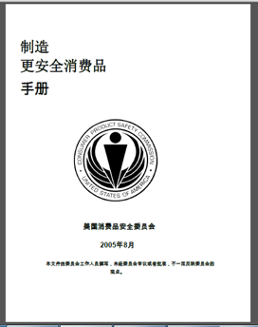
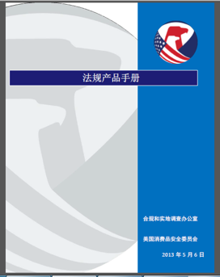
Chinese Resources at cpsc.gov
https://www.cpsc.gov/s3fs-public/HandbookforManufacturingChinese.pdf (中文版本 )
https://www.cpsc.gov/s3fs-public/pdfs/blk_pdf_handbookenglishaug05.pdf (英文版本)
https://www.cpsc.gov/s3fs-public/THE%20REGULATED%20PRODUCT%20HANDBOOK_050613%20CHN%20Final_0.pdf (中文版本 )
https://www.cpsc.gov/s3fs-public/RegulatedProductsHandbook.pdf (英文版本)

Slide 40
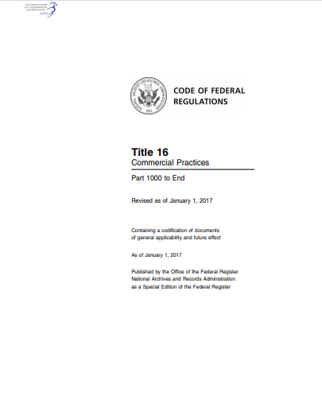
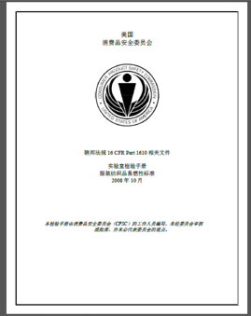
Chinese Resources at cpsc.gov
CFR: Commercial Practices
https://www.govinfo.gov/content/pkg/CFR-2017-title16-vol2/pdf/CFR-2017-title16-vol2.pdf (英文版本)
CPSC Laboratory Manuals:
https://www.cpsc.gov/s3fs-public/Laboratory-test-manual-16-CFR-Part-1610-Ch.pdf?MhtbUWNy6jmOPx9b6f.RErt.n.2n_d_h (中文版本)
https://www.cpsc.gov/s3fs-public/Flammability%20of%20Clothing%20Textiles%20Test%20Manual_1610.pdf (英文版本)

Slide 41
Definition of children’s product – 16 CFR Part 1200
Certificates of conformity – 16 CFR Part 1110
Third-party testing – 16 CFR Parts 1107, 1109, and 1112
Tracking information – 15 USC § 2063(a)(5)
Mandatory reporting requirements – 15 USC §2064
CPSC Business Resources
CPSC-Accepted Laboratories Search Page:
www.cpsc.gov/LabSearch

Slide 42
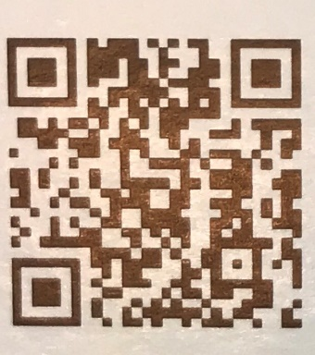
http://business.cpsc.gov
Online tool designed specifically to help businesses comply with federal consumer product safety requirements.
Asks a series of guided questions, and based on the answers produces a downloadable (PDF) report.
Provides customized guidance with links to product safety regulations that may apply to the product and important information on labeling, certification and testing requirements.

Slide 43
Regulatory Robot
Regulatory Robot is a tool to help identify which requirements are applicable
Does not list details of requirements
User inputs product features
Regulatory Robot outputs list of requirements
User references source documents for specific requirements

Slide 44
Revised Final Rules
CPSC Regulatory Update: Section 104 Rules

Slide 45
CPSIA Section 104: Revised Final Rules
Revisions to Safety Standard for Full-Size Baby Cribs
16 CFR part 1219 (incorporates ASTM F1169-19 with no modifications)
Effective Date: October 28, 2019
Revisions to Safety Standard for Non-Full-Size Cribs
16 CFR part 1220 (incorporates ASTM F406-19 )
Effective Date: January 20, 2020
Revisions to Safety Standard for Play Yards
16 CFR part 1221 (incorporates ASTM F406-19)
Effective Date: January 20, 2020

Slide 46
CPSIA Section 104: Revised Final Rules
Revisions to Safety Standard for Toddler Beds
16 CFR part 1217 (incorporate ASTM F1821-19e1)
Effective Date: January 27, 2020

Slide 47
ASTM Reading Room
The ASTM Reading Room is a service where you can view and read ASTM safety standards incorporated in United States regulations. Please visit ASTM’s website for more information:
https://www.astm.org/READINGLIBRARY/

