Slide 1
The slides used in this presentation are intended to be used in an event with verbal elaboration by a knowledgeable presenter. These slides highlight key U.S. product safety requirements for discussion. The text is not a comprehensive statement of legal requirements or policy and should not be relied upon for that purpose. Moreover, with the passage of time, the slides may not reflect the latest information. You should consult official versions of U.S. statutes and regulations, as well as published CPSC guidance when making decisions that could affect the safety and compliance of products entering U.S. commerce. Note that reference materials are listed at the end of the presentation.

Slide 2
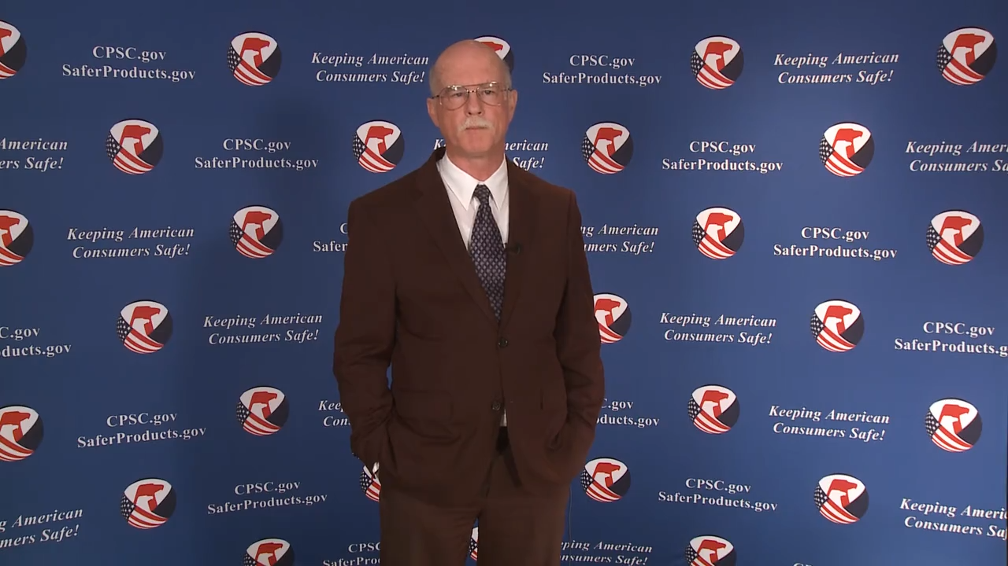
Video: Welcome to the 2021 CPSC Podcast Series - Overview of Consumer Safety and Micromobility Devices

Slide 3
Podcast Series 2021
Overview of Consumer Safety and Micromobility Devices
This presentation was prepared by CPSC Staff. It has not been reviewed or approved by the Commission and may not reflect its views.

Slide 4

Biographies
Sylvia Chen
U.S. Consumer Product Safety Commission
Program Manager for East Asia and Pacific
Office of International Programs
Sylvia Chen is responsible for managing the Commission’s bilateral and multilateral programs related to consumer product safety in Australia, Japan, Korea, Taiwan, and New Zealand. She also supports the CPSC’s work with China. Since she joined the CPSC in 2008, Sylvia has been working with product safety regulators, industry organizations, manufacturers, exporters, buyers, and other sourcing professionals to provide them with guidance and technical support in understanding U.S. requirements, in particular, the latest requirements for consumer products. To that end, she has organized or coordinated many of the agency’s international education and outreach activities.
Sylvia has a Bachelor of Arts degree in English and American Literature from Peking University. In 1991, she graduated from The Ohio State University with a Master’s degree in East Asian Studies.

Slide 5

The US CPSC is the federal government agency charged with protecting the public from unreasonable risks of injury or death associated with the use of consumer products under the agency's jurisdiction.
$1 Trillion
Deaths, injuries, and property damage from consumer product incidents cost the nation more than $1 trillion annually.¹
¹ https://www.cpsc.gov/s3fs-public/FY2019PBR.pdf
CPSC is committed to protecting consumers from products that pose a fire, electrical, chemical, biological, or mechanical hazard.
CPSC's work to improve the safety of the more than 15,000 types of consumer products in its jurisdiction - such as toys, cribs, power tools, cigarette lighters, textiles, and household chemicals – has contributed to a decline in the rate of deaths and injuries associated with consumer products over the past 40 years.

Slide 6
CPSC’s Podcast Series 2021
Podcast | Topics
#1 | Overview of Children’s Sleepwear Requirements
#2 | Enhancing the Safety of Emerging Technology through Risk Assessment: Wearables
#3 | Overview of Battery Safety Requirements
#4 | Overview of Gates and Enclosures Requirements
#5 | Overview of Consumer Safety and Micromobility Devices
#6 | Overview of Cribs and Play Yards Requirements
“Questions on this Presentation? Send an email to CPSCinChina@cpsc.gov”

Slide 7
Overview of Consumer Safety
and Micromobility Devices

Slide 8
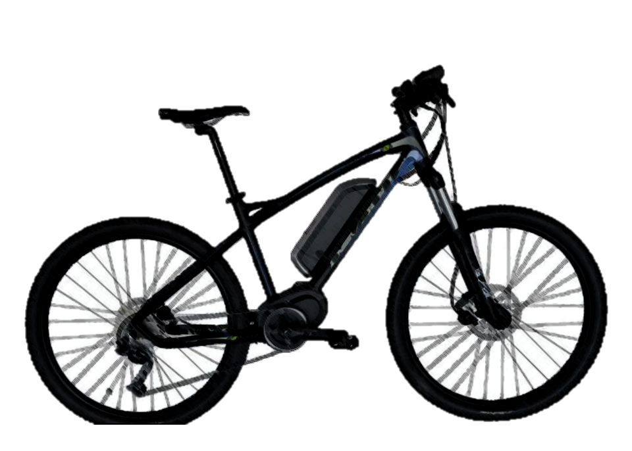
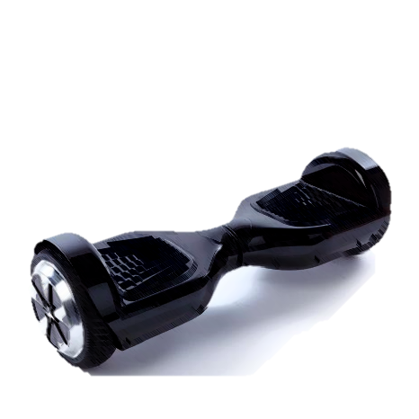
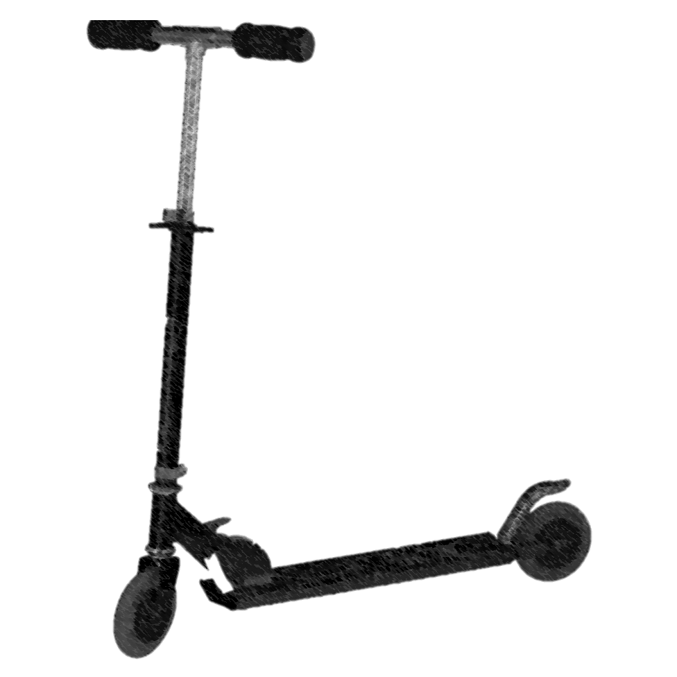
What Is Micromobility?
“Personal Transportation”
“Last Mile Commuting Solution”
“Low Speed”
“Accessible”
“Small Form Factor”
“Convenient”

Slide 9
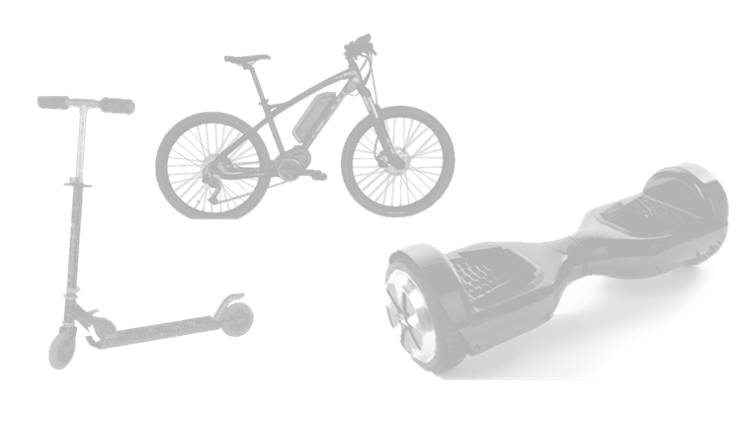
Micromobility and Consumer Safety
Products
  E-scooters
  E-bicycles
  Hoverboards
Electrically powered
Consumer-owned or “ride-share” fleet
Generally, 32 kph / 20 mph speeds or lower

Slide 10
Micromobility Data

Slide 11
NEISS Data Review:
Database of reports from statistically-significant selection of emergency departments in U.S.
Product search codes and parameters:
  E-scooter : 5042
  “Electric scooter”, “e-scooter”, “stand up scooter”, “standup scooter”, relevant e-scooter brands, etc.
  Hoverboard: 5042
  “Self-balancing scooter”, “hoverboard” and other variant spellings and any known brands
  E-bike: 3215
  “Electric bike”, “power (assisted) bicycle”, “motorized bike”, other variant spellings and known brands, etc.
Micromobility Data
Annual Report
Based on NEISS data and reports that occurred between 2017 and 2019

Slide 12
Estimated Micromobility -Related Emergency Department Visits in USA

Slide 13
IDI Review:
More comprehensive look at how incidents were happening
Completed 140 follow-up IDIs related to micromobility products
Hazards Identified:
    E-scooter
      Brake problems
      Unexpected power losses
      Fire hazards
    Hoverboard
      Fire hazards
      Other electrical hazards
    E-bike
      Brake problems
Micromobility Data
Annual Report
Based on reports of incidents in CPSRMS that occurred between 2017 and 2019

Slide 14

How can we enhance micromobility safety for consumers?

Slide 15
Micromobility Requirements and Guidance

Slide 16
Requirements and Guidance: E-Scooter and Hoverboard
ASTM Subcommittee F15.58
  Powered Scooters & Skateboards
ASTM F2641-15
  Standard for Consumer Safety Specification for Recreational Powered Scooters and Pocket Bikes
ASTM F2642-15
  Standard Consumer Safety Specification for Safety Instructions and Labeling for Recreational Powered Scooters and Pocket Bikes
ASTM WK70724
  Draft Standard for Commercial Electric Powered Scooters for Adults
ANSI/CAN/UL 2272:2016
  Electrical Systems for Personal E-Mobility Devices

Slide 17
Requirements and Guidance: Hoverboards
ASTM WK57360
  Draft Standard for Consumer Safety Specification for Self-Balancing Scooters (Hoverboards)

Slide 18
Requirements and Guidance: E-Bikes
CPSC
  16 CFR Part 1512 Requirements For Bicycles
  General Certificate of Conformity (GCC)
ANSI/CAN/UL 2849:2020
  Standard for Safety Electrical Systems for e-Bikes
Various other industry consensus standards, depending on design
  Example: ASTM F2711 Standard Test Method for Bicycle Frames)

Slide 19
Requirements and Guidance: General for Micromobility
SAE J3194
  Taxonomy & Classification of Powered Micromobility Vehicles
SAE J3230
  Kinematic Performance Metrics for Powered Micromobility Vehicles

Slide 20
Requirements and Guidance: Children’s Micromobility Products
E-Scooters, Hoverboards, E-Bikes (ages 12 and under)
  Children’s Product Certificate (CPC)
  Third Party Testing by a CPSC-accepted Laboratory
  Tracking Information
  Lead Content Testing
  Lead in Paint and Surface Coatings Testing
  Small Parts Testing and Small Parts Labeling
E-Bikes
  16 CFR Part 1512 Requirements For Bicycles

Slide 21
CPSC Education and Outreach Activities

Slide 22
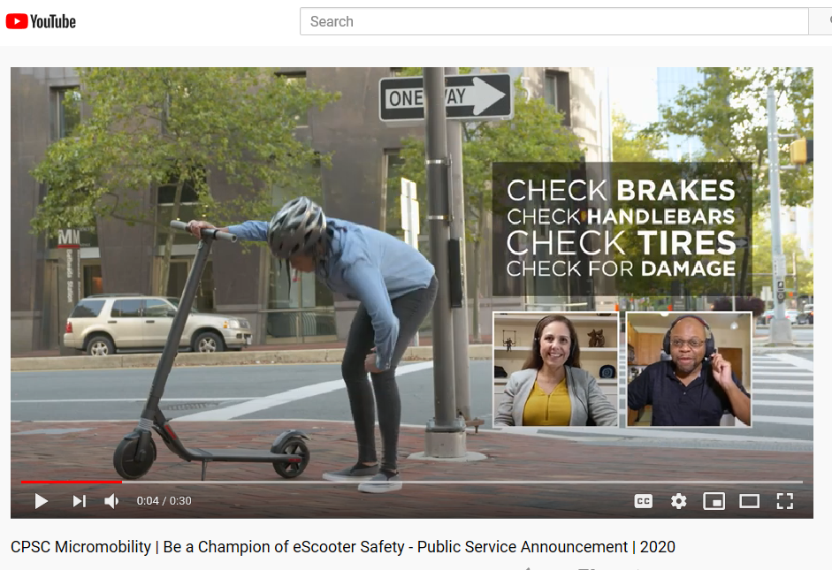
Education: Consumer Outreach
Information and Education Campaign
  E-scooter Press Release (September 2020)
  E-scooter safe riding Public Service Announcement (September 2020)
  Hoverboard Safety Alert (February 2018)
https://www.youtube.com/watch?v=VGVP_4qlIII&feature=youtu.be

Slide 23
Outreach and Data Gathering: CPSC Micromobility Forum
September 15, 2020
Webinar with 200+ participants
Topics:
  Injury Data
  Industry Consensus Standards
  Best Safety Practices for Infrastructure
  Micromobility Design and Research
  Policy and Consumer Safety
The meeting log is located at: https://www.cpsc.gov/s3fs-public/2020-9-15%20%20Micromobility%20Forum.pdf?6UKlMounWEJXRQvhMQHi_gHakYEXQNsb

Slide 24
Outreach and Data Gathering: CPSC Micromobility Forum
Recommendations to Consumer Product Safety Commission
  Continue Activity with Voluntary Consensus Standards
  Work with Federal Government Partners
  Build Relationships with Local Governments and Advocacy Groups
  Examine Alternate and New Data Sources

Slide 25
Enhancing Micromobility Safety
Safety
Policy
Education
Research
Consensus Standards
Regulation
Design and Manufacturing

Slide 26

Questions?
Submit questions in English or Chinese to this podcast:
CPSCinChina@CPSC.GOV

Slide 27
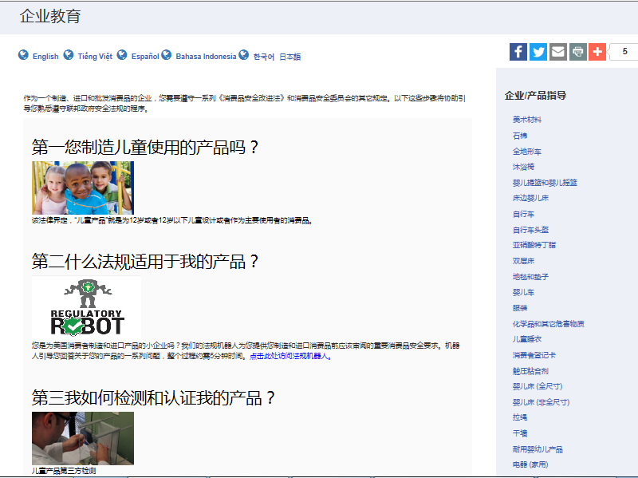
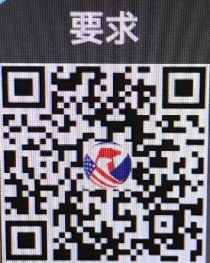
https://www.cpsc.gov/zh-CN/Business--Manufacturing/Business-Education
Chinese Resources at cpsc.gov

Slide 28
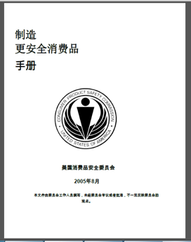
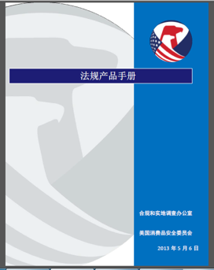
Chinese Resources at cpsc.gov
https://www.cpsc.gov/s3fs-public/HandbookforManufacturingChinese.pdf (中文版本 )
https://www.cpsc.gov/s3fs-public/pdfs/blk_pdf_handbookenglishaug05.pdf (英文版本)
https://www.cpsc.gov/s3fs-public/THE%20REGULATED%20PRODUCT%20HANDBOOK_050613%20CHN%20Final_0.pdf (中文版本 )
https://www.cpsc.gov/s3fs-public/RegulatedProductsHandbook.pdf (英文版本)

Slide 29
Definition of children’s product – 16 CFR Part 1200
Certificates of conformity – 16 CFR Part 1110
Third-party testing – 16 CFR Parts 1107, 1109, and 1112
Tracking information – 15 USC § 2063(a)(5)
Mandatory reporting requirements – 15 USC §2064
CPSC Business Resources
CPSC-Accepted Laboratories Search Page:
www.cpsc.gov/LabSearch

Slide 30

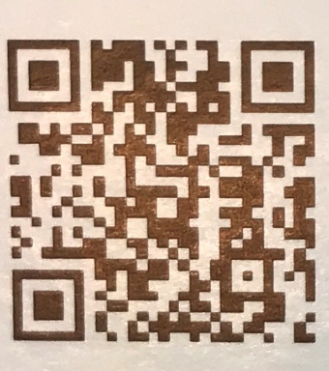
http://business.cpsc.gov
Online tool designed specifically to help businesses comply with federal consumer product safety requirements.
Asks a series of guided questions, and based on the answers produces a downloadable (PDF) report.
Provides customized guidance with links to product safety regulations that may apply to the product and important information on labeling, certification and testing requirements.

Slide 31
Regulatory Robot
Regulatory Robot is a tool to help identify which requirements are applicable
  Does not list details of requirements
User inputs product features
Regulatory Robot outputs list of requirements
User references source documents for specific requirements

Slide 32
“Safety Concerns Associated with Micromobility Products,” April 2020
  https://cpsc.gov/s3fs-public/Report-on-Micromobility-Products_FINAL-to-Commission.pdf?THHIorYXAZ.KiZnobh1o7.7.lN9nNCLo
“Micromobility Products-Related Deaths, Injuries, and Hazard Patterns: 2017–2019,” September 2020
  https://www.cpsc.gov/s3fs-public/Micromobility-Products-Related-Deaths-Injuries-and-Hazard-Patterns-2017–2019.pdf?90dOQxCOSzGvGRFGX6UF6Z6zvQhV9R1P
CPSC Staff Reports

Slide 33
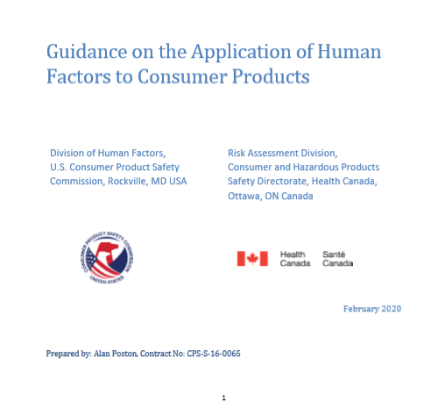
Guidance on the Application of Human Factors to Consumer Products
https://cpsc.gov/s3fs-public/Human-Factors-Standard-Practice-Document-Final-ENGLISH-Feb03-2020_0.pdf?wAUEehL.VtEkpYpx8aLvYrTKqa9w0UMz

Slide 34
National Electronic Injury Surveillance System (NEISS)
  https://www.cpsc.gov/cgibin/NEISSQuery/home.aspx
Consumer Product Safety Risk Management System (CPSRMS)
  https://saferproducts.gov/
CPSC Data Resources

