Slide 1
These slides highlight key U.S. product safety requirements for discussion. The text is not a comprehensive statement of legal requirements or policy and should not be relied upon for that purpose. Moreover, with the passage of time, the slides may not reflect the latest information. You should consult official versions of U.S. statutes and regulations, as well as published CPSC guidance when making decisions that could affect the safety and compliance of products entering U.S. commerce. Note that reference materials are listed at the end of the presentation.

Slide 2
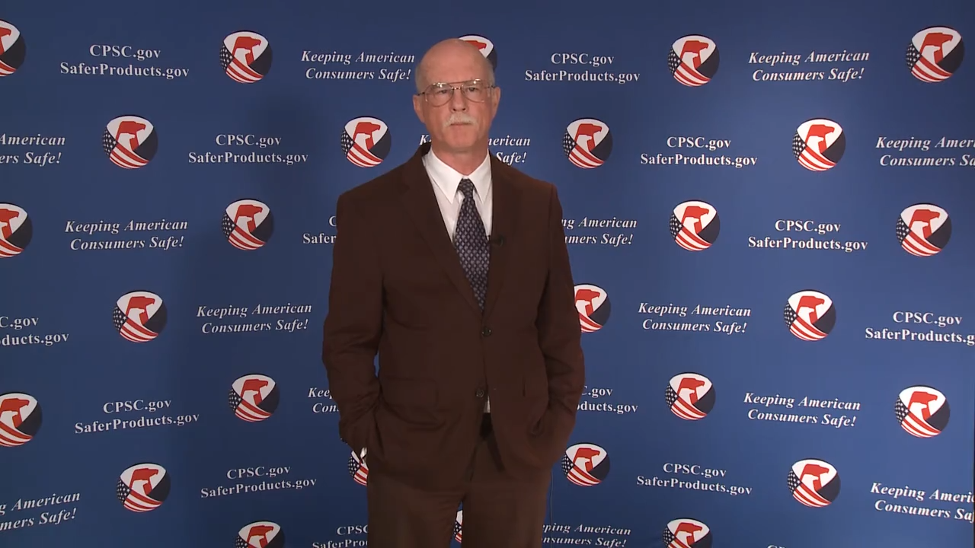
Video: Welcome to CPSC’s China Blog Series—
Infant Sleep Products, Banned Inclined Sleepers for Infants, and Crib Bumpers

Slide 3
2024 China Blog Series
Infant Sleep Products, Banned Inclined Sleepers for Infants, and Crib Bumpers
Disclaimer: This presentation was prepared by CPSC staff. It has not been reviewed or approved by the Commission and may not reflect its views.

Slide 4

Biography
Sylvia Chen
U.S. Consumer Product Safety Commission
Program Manager for East Asia and Pacific
Office of International Programs
Sylvia Chen is responsible for managing the Commission’s bilateral and multilateral programs related to consumer product safety in Australia, Japan, Korea, Taiwan, and New Zealand. She also supports the CPSC’s work with China. Since she joined the CPSC in 2008, Sylvia has been working with product safety regulators, industry organizations, manufacturers, exporters, buyers, and other sourcing professionals to provide them with guidance and technical support in understanding U.S. requirements, in particular, the latest requirements for consumer products. To that end, she has organized or coordinated many of the agency’s international education and outreach activities.
Sylvia has a Bachelor of Arts degree in English and American Literature from Peking University. In 1991, she graduated from The Ohio State University with a Master’s degree in East Asian Studies.

Slide 5

The U.S. CPSC is a federal government agency charged with protecting the public from unreasonable risks of injury or death associated with the use of consumer products.
CPSC is committed to protecting consumers from products that pose a fire, electrical, chemical, biological, or mechanical hazard.
CPSC's work to improve the safety of thousands of types of consumer products in its jurisdiction - such as toys, cribs, power tools, cigarette lighters, textiles, and household chemicals - has contributed to a decline in the rate of injuries associated with consumer products for more than 50 years.
5

Slide 6
Agenda
Infant Sleep Products
Purpose of the Infant Sleep Products Regulation
Definition of Infant Sleep Products
Scope Determination
Requirements of the Infant Sleep Products Regulation
Overview of Safe Sleep for Babies Act of 2021 (SSBA)
  SSBA: Banned Inclined Sleepers for Infants
  SSBA: Crib Bumpers
Overview of Consumer Registration Requirements
Highlights of Children’s Product Certificates
Testing and Certification Requirements
CPSC Business Resources

Slide 7
Infant Sleep Products
Regulatory requirement:
  Incorporates by reference with substantial modifications
  the Standard Consumer Safety Specification for Infant Inclined Sleep Products, ASTM F3118-17a.
  Products not covered by another standard for infant sleep must comply with the Safety Standard for Bassinets and Cradles.
  Sleep surface angles must be 10 degrees or lower.
  Infant sleep products are a category of durable infant or toddler products.
  Effective date: For products manufactured on or after June 23, 2022

Slide 8
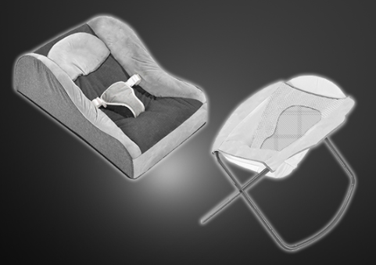
Purpose of the Infant Sleep Products Regulation
Intended to address deaths and incidents associated with
infant sleep hazards, including, but not limited to:
  Fall hazards
  Asphyxiation and suffocation
    Obstruction of the nose and mouth by bedding
    Inclined sleep surfaces

Slide 9
Defining Infant Sleep Products
Marketed or intended to provide a sleeping accommodation for an infant up to 5 months of age
Not already subject to one of CPSC’s regulations for infant sleep products:
        Bassinets and Cradles: 16 CFR part 1218
        Full-Size Baby Cribs: 16 CFR part 1219
        Non-Full-Size Baby Cribs: 16 CFR part 1220
        Play Yards: 16 CFR part 1221
        Bedside Sleepers: 16 CFR part 1222
        * Links to all CFR references are provided at the end of this slide deck.

Slide 10
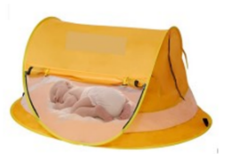
Defining Infant Sleep Products
Examples:
Baby loungers marketed or intended as a place for baby to sleep
Baby boxes
In-bed sleepers
Baby loungers, nests and pods
Rigid-sided and rigid-framed compact bassinets without
a stand or legs
Various designs of travel bassinets with soft padded or
mesh sides
Baby tents

Slide 11
Infant Sleep Products: Scope Determination
CPSC will evaluate the marketed and intended use of a product using all available information to determine whether the product is for sleep. CPSC will consider factors including:
  Marketing, advertising, labeling, and packaging materials
  Product design
  Foreseeable consumer use or misuse
Simply renaming or relabeling a product for non-sleep use will not likely provide a basis to avoid the regulation.

Slide 12


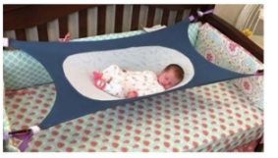
Infant Sleep Products:
Scope Determination
If any material related to the product depicts an infant, animal, or cartoon figure sleeping, snoozing, dreaming, or napping, this will likely bring the product within the scope of the regulation.

Slide 13
Overview of Safe Sleep for Babies Act of 2021
The Safe Sleep for Babies Act of 2021 (SSBA) (P.L. 117-126) bans inclined sleepers for infants and many crib bumpers.
It is unlawful to sell, offer for sale, manufacture for sale, distribute in commerce, or import these products into the United States.
Effective date: November 12, 2022 (regardless of the date of manufacture)

Slide 14
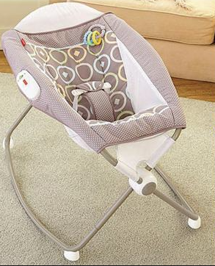
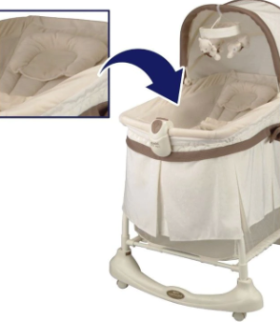
SSBA Bans Inclined Sleepers for Infants
Has a head to toe inclined sleep surface greater than 10 degrees
Is intended, marketed, or designed to provide sleeping accommodations for an infant up to 1 year old

Slide 15
Determining If the Product Has an Incline Subject to the Ban
CPSC staff recommend measuring the maximum seat back/sleep surface angle along the occupant's head to toe axis relative to horizontal using the same test method as described 16 CFR § 1236.2(b)(15)(ii).
Products with a seat back/sleep surface angle greater than 10 degrees are banned if they are intended, marketed, or designed as a place for sleep for an infant up to 1 year old.

Slide 16
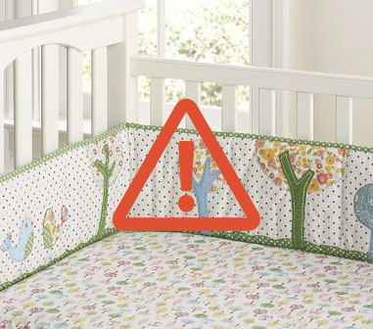
SSBA: Crib Bumpers
Ban codified at 16 CFR part 1309
Any material intended to cover the sides of a crib
Includes: padded crib bumpers, supported and unsupported vinyl bumper guards, and vertical crib slat covers
Does not include non-padded mesh crib liners

Slide 17
Overview of Consumer Registration Requirements
Manufacturers of infant sleep products must include a product registration form attached to the product – 16 CFR Part 1130.
  Provide consumers with postage-paid product registration form
  Provide consumers with option to register their product electronically
  Maintain records of names, addresses, emails, and other contact info on consumers that register their products

Slide 18
Permanently place manufacturer name (for imported product this means the importer name) and U.S. contact info (U.S. mailing address and telephone number, toll free if available), model name and number, and date of manufacture on each durable product
Intended to improve recall effectiveness and safety alert warning to consumers
Product Registration Form FAQs site is a good reference
Registration Forms Business Guidance | CPSC.gov

Slide 19
Highlights of Children’s Product Certificates
  All children’s products require a Children’s Product Certificate (CPC)
  www.cpsc.gov/CPC
Availability of Certificates (CPC/GCC) –
  Certificates must “accompany” each product or shipment of products covered by the same certificate.
  A copy of the certificate must be “furnished to each distributor or retailer of the product” (no requirement to provide to ultimate consumer).

Slide 20
  A copy of the certificate must be available to CPSC and Customs as soon as the product or shipment itself is available for inspection in the United States.
Electronic Certificates are acceptable, but must be created no later than time of shipment or first distribution within the United States.

Slide 21
Elements of Children’s Product Certificates
  Description of product(s) covered by certificate
  Citation to each CPSC safety regulation to which you are certifying compliance
    Total Lead Content --15 U.S.C. §1278a
    Lead in Paint and Similar Surface Coatings -- 16 C.F.R. Part 1303
    Phthalates Prohibition -- 16 C.F.R. Part 1307
    Small Parts Regulation -- 16 C.F.R. Part 1501
    Infant Sleep Products -- 16 C.F.R. Part 1236
  Importer/domestic manufacturer contact information
  Contact information for person maintaining test records
  Date and place of manufacture
  Location of testing and date of test on which certification is based
  Contact information of testing laboratory

Slide 22
Testing and Certification
Third-party testing and certification are required for infant sleep products.
CPSC has not instituted a testing and certification program for the Ban of Inclined Sleepers for Infants; however, CPSC may consider testing, certification and registration requirements in the future, based on additional information that may be collected by the agency.

Slide 23

Questions?
Submit questions in English or Chinese. CPSCinChina@CPSC.GOV

Slide 24
Resources

Slide 25
CPSC’s China Blog Series
Podcast | Topics
#1 | Selling Safe Electrical Products to the U.S. Market
#2 | Overview of U.S. Apparel Requirements
#3 | CPSC Bicycle Regulations and U.S. and International Safety Standards
#4 | Overview of U.S. Mattress Requirements
#5 | Durable Infant or Toddler Products: Common Requirements
#6 | Overview of U.S. Strollers and Carriages Requirements
#7 | Toy Safety Requirements and Mandatory Standards
#8 | Overview of Children’s Sleepwear Requirements
#9 | Enhancing the Safety of Emerging Technology through Risk Assessment: Wearables
#10 | Overview for Battery Safety Requirements
#11 | Overview of Gates and Enclosures Requirements

Slide 26
CPSC’s China Blog Series (Continued)
Podcast | Topics
#12 | Overview of Consumer Safety and Micromobility Devices
#13 | Overview of Cribs and Play Yards Requirements
#14 | Product Safety and Compliance: Best Practices for Buyers Exporting Consumer Goods to the United States
#15 | U.S. Flammability Requirements for Upholstered Furniture
#16 | How to Find Safety Requirements for Your Product Using CPSC’s Regulatory Robot
#17 | CPSC’s Import Screening Program
#18 | Overview of CPSC’s Third Party Laboratory Program for Children’s Products
#19 | Battery Safety Requirements of Toys
#20 | Age Determinations
“Questions on this presentation? Send an email to CPSCinChina@cpsc.gov”

Slide 27
Ban of Inclined Sleepers for Infants
  Final rule codifying ban: Federal Register :: Ban of Inclined Sleepers for Infants
  Regulation codifying ban: eCFR :: 16 CFR Part 1310 -- Ban of Inclined Sleepers for Infants
  Small Business Ombudsman business guidance: Inclined Sleepers Business Guidance | CPSC.gov
Ban of Crib Bumpers
  Final rule codifying ban: Federal Register :: Ban of Crib Bumpers
  Regulation codifying ban: eCFR :: 16 CFR Part 1309 -- Ban of Crib Bumpers
  Small Business Ombudsman business guidance: Crib Bumpers Business Guidance | CPSC.gov
Resources at cpsc.gov

Slide 28

Chinese Resources at cpsc.gov
https://www.cpsc.gov/zh-CN/Business--Manufacturing/Business-Education

Slide 29
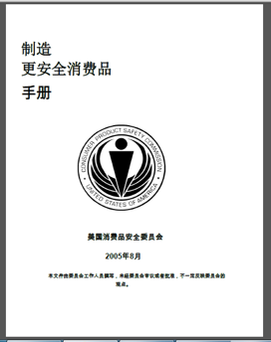
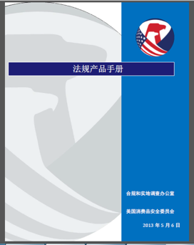
Chinese Resources at cpsc.gov
https://www.cpsc.gov/s3fs-public/HandbookforManufacturingChinese.pdf (中文版本 )
https://www.cpsc.gov/s3fs-public/pdfs/blk_pdf_handbookenglishaug05.pdf (英文版本)
https://www.cpsc.gov/s3fs-public/THE%20REGULATED%20PRODUCT%20HANDBOOK_050613%20CHN%20Final_0.pdf (中文版本 )
https://www.cpsc.gov/s3fs-public/RegulatedProductsHandbook.pdf (英文版本)

Slide 30
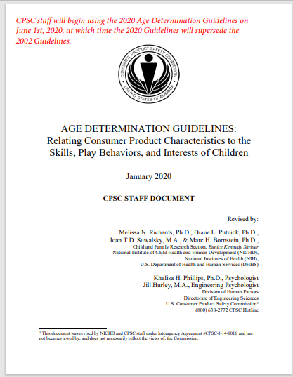
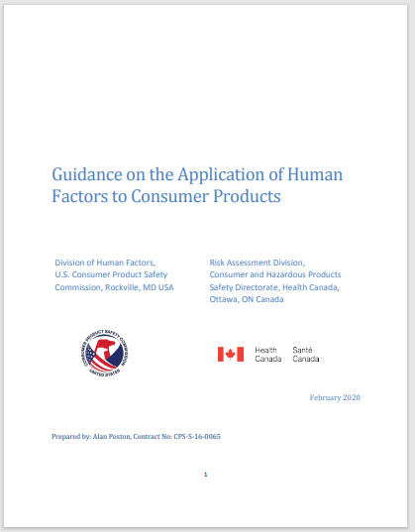
Chinese Resources at cpsc.gov
English: Updating Age Determination Guidelines for Toys (cpsc.gov)
Chinese: Updating Age Determination Guidelines for Toys (cpsc.gov)
English: Human Factors Standard Practice (cpsc.gov)
Chinese: Human-Factors-Standard-Practice-Document-Final-CHINESE-Feb03-2020.pdf (cpsc.gov)

Slide 31
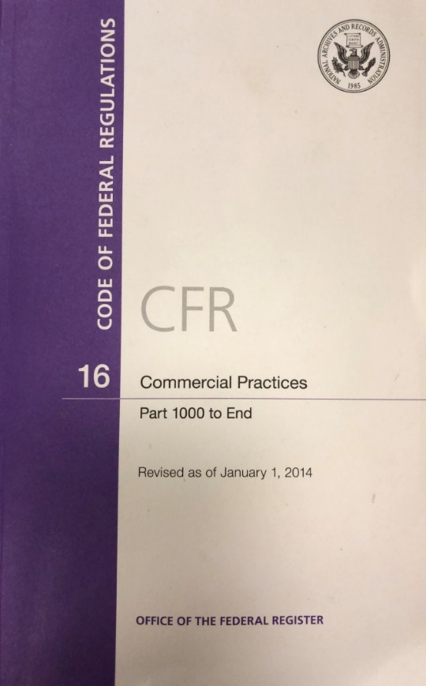
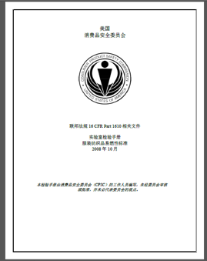
Chinese Resources at cpsc.gov
CFR: Commercial Practices
https://www.govinfo.gov/content/pkg/CFR-2017-title16-vol2/pdf/CFR-2017-title16-vol2.pdf (英文版本)
CPSC Laboratory Manuals:
https://www.cpsc.gov/s3fs-public/Laboratory-test-manual-16-CFR-Part-1610-Ch.pdf?MhtbUWNy6jmOPx9b6f.RErt.n.2n_d_h (中文版本)
https://www.cpsc.gov/s3fs-public/Flammability%20of%20Clothing%20Textiles%20Test%20Manual_1610.pdf (英文版本)

Slide 32

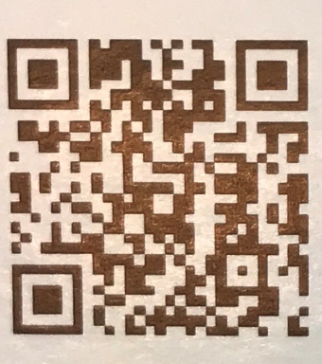
http://business.cpsc.gov
Online tool designed specifically to help businesses comply with federal consumer product safety requirements.
Asks a series of guided questions, and based on the answers produces a downloadable (PDF) report.
Provides customized guidance with links to product safety regulations that may apply to the product and important information on labeling, certification and testing requirements.

