Slide 1
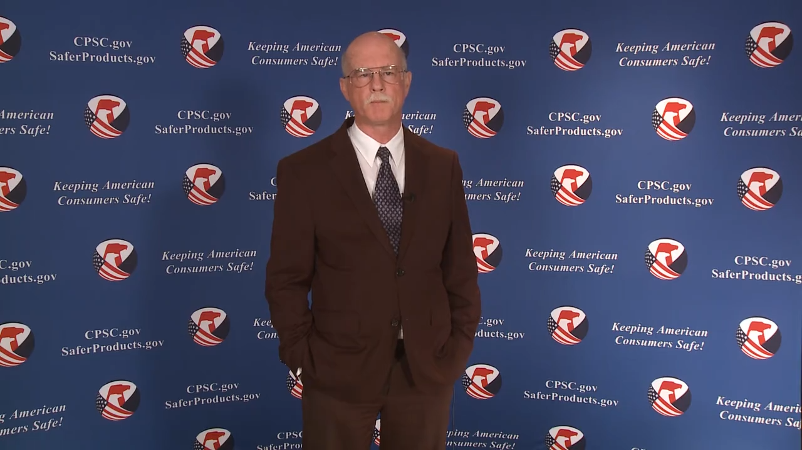
Video: Welcome to the 2020 CPSC Podcast Series - CPSC Bicycle Regulations and Safety

Slide 2
Podcast Series 2020
CPSC Bicycle Regulations and U.S. and International Safety Standards
This presentation was prepared by CPSC Staff. It has not been reviewed or approved by the Commission and may not reflect its views.

Slide 3
Biographies
Sylvia Chen
U.S. Consumer Product Safety Commission
Program Manager for East Asia and Pacific
Office of International Programs
Sylvia Chen is Program Manager for East Asia and Pacific at the U.S. Consumer Product Safety Commission (CPSC). In that role, she is responsible for managing the Commission’s bilateral and multi-lateral programs related to consumer product safety in Australia, Japan, Korea, Taiwan and New Zealand. She also supports the CPSC’s work with China. Since she joined the CPSC in 2008, Sylvia has been working with product safety regulators, industry organizations, manufacturers, exporters, buyers and other sourcing professionals to provide them with guidance and technical support in understanding U.S. requirements, in particular, the latest requirements for consumer products. To that end, she has organized or coordinated many of the agency’s international education and outreach activities.
Sylvia has a Bachelor of Arts degree in English and American Literature from Peking University. In 1991, she graduated from The Ohio State University with a Master’s degree in East Asian

Slide 4
Biographies
Vince Amodeo (Retired)
Mechanical Engineer
National Product Testing and Evaluation Center
U.S. Consumer Product Safety Commission
Caroleene Paul
Mechanical Engineer
National Product Testing and Evaluation Center
U.S. Consumer Product Safety Commission
Mr. Amodeo was a mechanical engineer with the CPSC at its National Product Testing and Evaluation Center (NPTEC) in Rockville, MD. He worked at CPSC from 2001 to 2019.
His work involved safety assessments of various consumer products, review of consumer product incident data, and working with voluntary standards bodies such as ASTM, UL, and ANSI in developing consumer product safety standards. Mr. Amodeo was the primary engineer for bicycle related product issues and worked with the ASTM F08.10 bicycle safety subcommittee for the past 16 years in developing standards for bicycles in addition to developing revisions and providing guidance on the CPSC Federal bicycle regulation.
Prior to his work at CPSC, Mr. Amodeo was a mechanical engineer for the Naval Sea Systems Command where he planned and monitored programs for the development of Navy handling and steering gear systems. He received a B.S. in mechanical engineering from the University of Rochester (NY).
Ms. Paul is a Mechanical Engineer with the CPSC at its National Product Testing and Evaluation Center (NPTEC) in Maryland and has 20 years of experience in consumer product safety. She is the program manager for mechanical hazards not related to children’s products. Her work includes failure, safety, and test and evaluation analysis of off-road vehicles and power tools.
Ms. Paul serves on numerous product standard committees with Underwriters Laboratories (UL), American National Standards Institute/Specialty Vehicle Institute (ANSI/SVIA), American National Standards Institute/Recreational off-highway vehicle association (ANSI/ROHVA), and American National Standards Institute/Outdoor Power Equipment Institute (ANSI/OPEI).
Prior to working at CPSC, Ms. Paul spent 6 years as a design, test and evaluation engineer at the VSE Corporation in Alexandria, VA. Ms. Paul received a B.S. in Mechanical Engineering from the Pennsylvania State University, State College, PA.

Slide 5

The US CPSC is a federal government agency charged with protecting the public from unreasonable risks of injury or death associated with the use of consumer products under the agency's jurisdiction.
$1 Trillion
Deaths, injuries, and property damage from consumer product incidents cost the nation more than $1 trillion annually.¹
¹ https://www.cpsc.gov/s3fs-public/FY2019PBR.pdf
CPSC is committed to protecting consumers from products that pose a fire, electrical, chemical, biological, or mechanical hazard.
CPSC's work to improve the safety of the more than 15,000 types of consumer products in its jurisdiction - such as toys, cribs, power tools, cigarette lighters, textiles, and household chemicals – has contributed to a decline in the rate of deaths and injuries associated with consumer products over the past 40 years.

Slide 6
CPSC’s Podcast Series
Podcast | Topics
#1 | Selling Safe Electrical Products to the U.S. Market
#2 | Overview of U.S. Apparel Requirements
#3 | CPSC Bicycle Regulations and U.S. and International Safety Standards
#4 | Overview of U.S. Mattress Requirements
#5 | Durable Infant or Toddler Products Common Requirements
#6 | Overview of Carriage and Stroller Requirements
#7 | Toy Safety
“Questions on this Presentation? Send an email to CPSCinChina@cpsc.gov”

Slide 7
The slides used in this podcast are not a comprehensive statement of legal requirements or policy and should not be relied upon for that purpose. You should consult official versions of U.S. statutes and regulations, as well as published CPSC guidance when making decisions that could affect the safety and compliance of products entering U.S. commerce. Note that references are provided at the end of the presentation.

Slide 8
CPSC Bicycle Regulations and U.S. and International Bicycle Standards

Slide 9
Today’s Presentation
CPSC Bicycle Regulations
Bicycle Voluntary Standards
Bicycle Usage Conditions
Comparison of test requirements in CPSC Bicycle Regulation to Voluntary Standards
Selected Bicycle Recalls
CPSC Bicycle Incident Data and Case Studies
Resources

Slide 10
CPSC Bicycle Regulations
CPSC requirements for bicycles are found at 16 C.F.R. Part 1512
CPSC Bicycle regulation:
  Mandatory standard for bicycles sold in the United States
  Originally codified in 1978
  Purpose
  Reduce the risk of injury from bicycles used by consumers

Slide 11
CPSC Bicycle Regulations
Conformance
Manufacturers and importers of products subject to 16 C.F.R. part 1512 must certify that their products comply
Certifications of bicycles designed or intended primarily for children 12 years of age or younger must be based on tests conducted by a third party conformity assessment body whose accreditation has been accepted by the CPSC

Slide 12
CPSC Bicycle Regulations
  16 C.F.R. part 1512 Status
  Only minor revisions since originally developed
  Does not address:
    Bicycle usage conditions
        Usage based on intended terrain and type of riding
    Technological improvements in bicycle design
        Disk brakes, electric assist, integrated shift/brake levers
    Use of modern materials
        Composites (carbon fiber)

Slide 13
CPSC Bicycle Regulations
    16 C.F.R. part 1512
    Sets baseline requirements for mechanical and safety systems found on all bicycles, regardless of intended usage
    Includes specific requirements for “sidewalk” bicycles (maximum saddle height less than 635 mm)
    Requirements apply to two- or three-wheeled bicycles with electric motors less than 750 watts (1 h.p.), functioning pedals, and maximum speeds of 20 mph when operated solely on electric power

Slide 14
CPSC Bicycle Regulations
16 C.F.R. part 1512 Requirements
1512.1 Scope
1512.2 Definitions
1512.3 General requirements
1512.4 Mechanical requirements
1512.5 Braking system
1512.6 Steering system
1512.7 Pedals
1512.8 Drive chain
1512.9 Protective guards
1512.10 Tires
1512.11 Wheels
1512.12 Wheel hubs
1512.13 Front fork
1512.14 Fork and frame assembly
1512.15 Seat
1512.16 Reflectors
1512.17 Other requirements

Slide 15
Voluntary Standards
Other organizations with bicycle standards:
  ASTM International
  International Organization for Standardization (ISO)
  European Committee for Standardization (CEN)
ASTM, ISO, and CEN bicycle standards have requirements based on bicycle usage conditions

Slide 16
Bicycle Usage Conditions
ASTM F2043-13 Standard Classification for Bicycle Usage:
  Defines usage conditions for the design of bicycles
  Includes graphical icons for placement on bicycles, aftermarket components, and instructional material to provide retailers and consumers with an indication of the intended usage conditions of the bicycle or aftermarket components
ASTM F2043-13 defines six usage conditions:
  Condition 0, 1, 2, 3, 4, & 5
Other usage conditions used by CEN and ISO:
  BMX, young adult, electrically power assisted cycles (EPAC)

Slide 17
ASTM Bicycle Standards
General
  F2043-13 Standard Classification for Bicycle Usage
  F2680-09 (2014) Standard Specification for Manually Operated Front Wheel Retention Systems for Bicycles
  F2268-03 (2015) Standard Specification for Bicycle Serial Numbers
  F2793-14 Standard Specification for Bicycle Grips
Forks
  F2273-11 (2016) Standard Test Methods for Bicycle Forks
  F2899-11 (2016) Standard Specification for Condition 1 Bicycle Forks
  F2274-11 (2016) Standard Specification for Condition 3 Bicycle Forks
Frames
  F2711-08 (2012) Standard Test Methods for Bicycle Frames
  F2843-10a (2015) Standard Specification for Condition 0 Bicycle Frames
  F2802-09 (2015) Standard Specification for Condition 1 Bicycle Frames
  F2868-10 (2015) Standard Specification for Condition 2 Bicycle Frames
  F2614-09 (2014) Standard Specification for Condition 3 Bicycle Frames

Slide 18
European (CEN) Bicycle Standards
EN 15194:2012 – Cycles – Electrically power assisted cycles - EPAC Bicycles
EN 16054:2012 - BMX Bicycles, Safety Requirements and Test Methods

Slide 19
ISO Bicycle Standards
ISO 8098: 2014– Cycles – Safety requirements for bicycles for young children (maximum saddle height less than 635 mm) (Same as ASTM Condition 0)
ISO 4210-1: 2014 – Cycles – Safety requirements for bicycles – Part 1: Terms and definitions
ISO 4210-2: 2014 – Part 2: Requirements for city/trekking, young adult, mountain, and racing bicycles (Same as ASTM Condition 1, 2, 3, plus Young Adult*)
ISO 4210-3: 2014 – Part 3: Common test methods
ISO 4210-4: 2014 – Part 4: Braking test methods
ISO 4210-5: 2014 – Part 5: Steering test methods
ISO 4210-6: 2014 – Part 6: Frame and fork test methods
ISO 4210-7: 2014 – Part 7: Wheels and rims test methods
ISO 4210-8: 2014 – Part 8: Pedal and drive system test methods
ISO 4210-9: 2014 – Part 9: Saddles and seat-post test methods
* Young adult is defined as bicycles with a saddle height of 635 to 750 mm

Slide 20
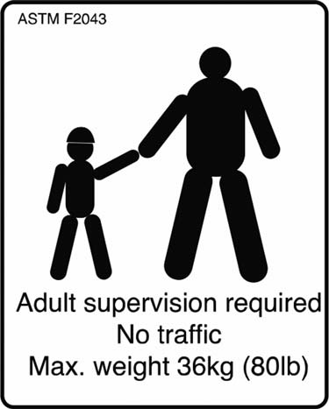
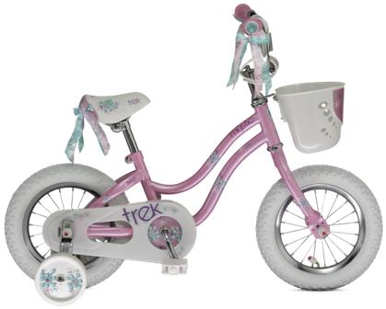
ASTM F2043: Use Condition 0
  Includes “sidewalk” bicycles intended for age 3 and up, under 36 kg (80 lbs) with parental supervision
Condition 0 Icon

Slide 21
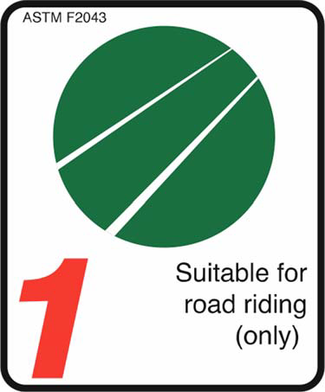
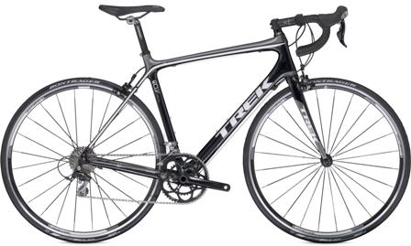
ASTM F2043: Use Condition 1
  Includes bicycles operated on regular paved surface where tires are intended to maintain ground contact
  Similar to ISO “Racing Bicycles”
Condition 1 Icon

Slide 22
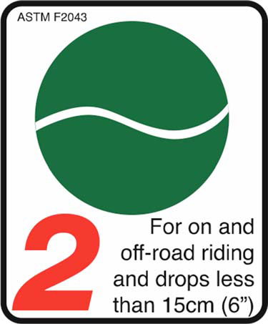
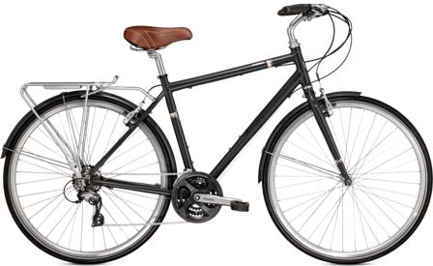
ASTM F2043: Use Condition 2
  Includes Condition 1, plus bicycles operated on unpaved and gravel roads/trails with moderate grades, possible loss of tire contact with the ground, and with drops of 15 cm (6 inch) or less
  Similar to ISO “City and Trekking Bicycles”
Condition 2 Icon

Slide 23
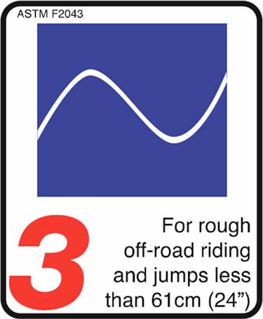
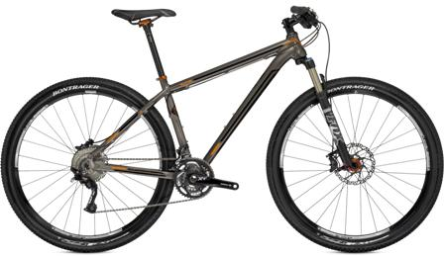
ASTM F2043: Use Condition 3
  Includes Condition 1 & 2, plus bicycles operated on rough unpaved roads/terrain and unimproved trails requiring technical skills, and with jumps/drops up to 61 cm (24 inch)
  Similar to ISO “Mountain Bicycles”
Condition 3 Icon

Slide 24
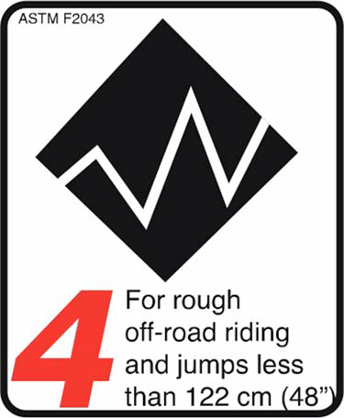
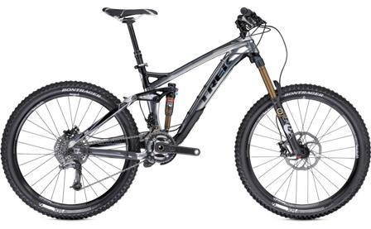
ASTM F2043: Use Condition 4
  Includes Condition 1, 2, & 3, plus bicycles operated on rough trails and downhill grades at speeds up to 40 km/h (25 mph), with jumps up to 122 cm (48 inch)
Condition 4 Icon

Slide 25
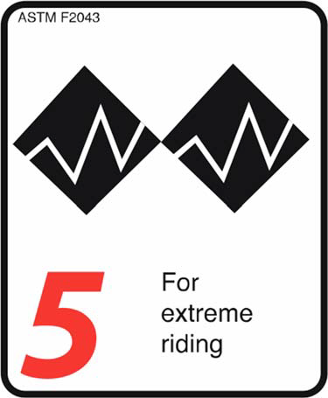
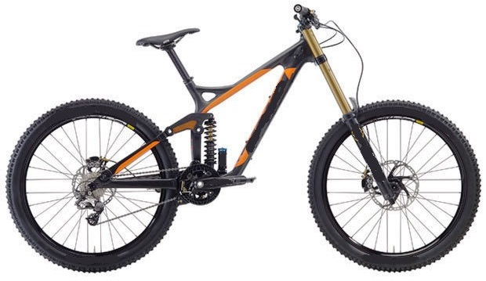
ASTM F2043: Use Condition 5
  Condition 1, 2, 3, and 4, plus bicycles operated on rough trails and downhill grades at speeds over 40 km/h (25 mph), with extreme jumping
Condition 5 Icon

Slide 26
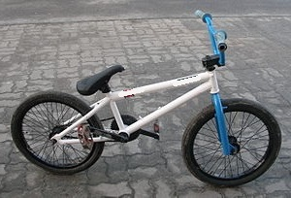
EN 16054: BMX Bicycles
Includes bicycles operated on roads, tracks, or ramps intended for acrobatic ground maneuvers, stunting, and aerobatic maneuvers

Slide 27
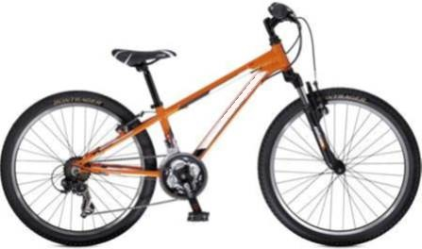
ISO 4210: Young Adult Bicycles
Bicycle operated on public roads by a young adult, whose weight is less than 40 kg with maximum saddle height of 635 mm or more, but less than 750 mm

Slide 28
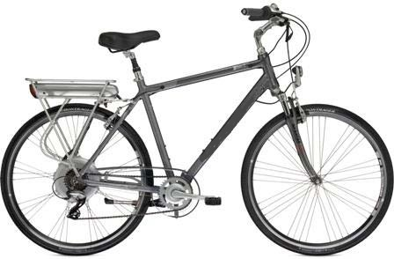
EN 15194: Electrically power assisted cycles - EPAC Bicycles
Electrically power assisted cycles of a type that have a maximum continuous rated power of 0,25 kW, of which the output is progressively reduced and finally cut off as the vehicle reaches a speed of 25 km/h, or sooner, if the cyclist stops pedaling

Slide 29
Comparison
16 CFR 1512 Requirements for Bicycles:
  Mandatory requirements for bicycles, sidewalk bicycles (Condition 0), and electric bicycles.
  Minimum test requirements
ASTM, CEN, and ISO voluntary bicycle standards:
  Requirements for bicycles and bicycle components based on intended usage condition
  Requirements may be more appropriate than CPSC general test requirements to ensure bicycles and bicycle components meet the demands of the user

Slide 30
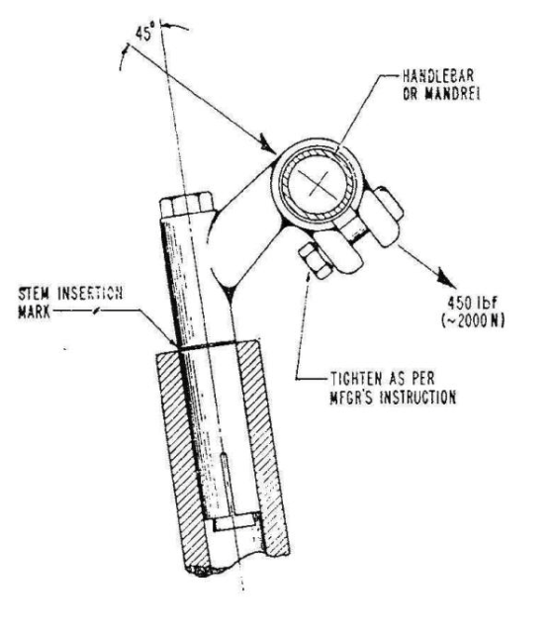
Example 1 – Handlebar Stem Strength
CPSC 1512.6 (b) Handlebar stem strength. The handlebar stem shall be tested for strength in accordance with the handlebar stem test, § 1512.18(g), and shall withstand a force of 2000 N (450 lb) for bicycles and 1000 N (225 lb) for sidewalk bicycles.

Slide 31
Example 1 – Handlebar Stem Strength
Handlebar Stem Forward Bending Strength Test (45 degrees)
Use | CPSC | ASTM | EN | ISO
0 | 1000 N (225 lb) | - | - | 500 N (112 lb)
1 | 2000 N (450 lb) | - | - | 1600 N / 2300 N
2 |  | - | - | 1600 N / 2000 N
3 |  | - | - | 1600 N / 2600 N
4 |  | - | - | -
YA |  | - | - | 1600 N / 2000 N
BMX 1 |  | - | 1600 N (400 lb) | -
BMX 2 |  | - | 3000 N (672 lb) | -

Slide 32
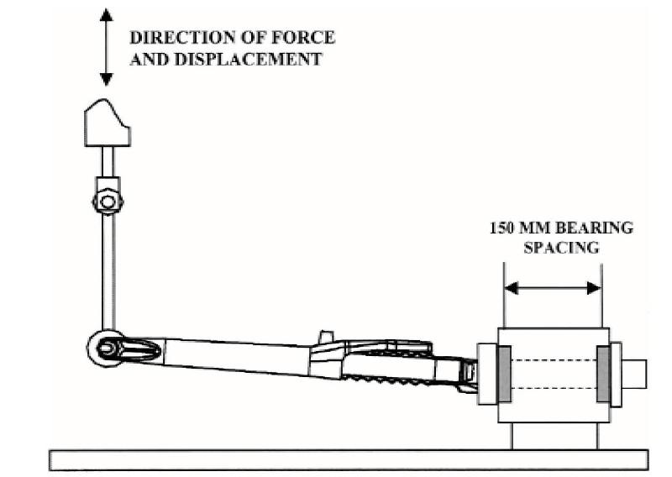
Example 2 – Fork Bending Fatigue
CPSC does not have a fork bending fatigue test.
Fork Bending Fatigue Test - This test method restrains a fork by the steerer tube and applies a fully reversed load perpendicular to the steerer tube axis at the point on the dropout centerline centered between the two dropouts.

Slide 33
Example 2 – Fork Bending Fatigue
Fork Bending Fatigue test
Use | CPSC | ASTM | EN | ISO*
0 | - | - | - | +/- 400 N (90 lb) for 100,000 cycles
1 | - | +/- 620 N (139 lb) for 100,000 cycles | - | +/- 620 N (139 lb) for 100,000 cycles
2 |  | - | - | +/- 450 N (101 lb) for 100,000 cycles
3 |  | +/- 650 N (146 lb) for 100,000 cycles | - | +/- 650 N (146 lb) for 100,000 cycles
4 |  | - | - | -
YA |  | - | - | +/- 450 N (101 lb) for 100,000 cycles
BMX 1 |  | - | +/- 450 N (101 lb) for 100,000 cycles | -
BMX 2 |  | - | +/- 650 N (146 lb) for 100,000 cycles | -
* Forks passing ISO fork bending fatigue test are subsequently subjected to Drop 1 of fork rearward impact test

Slide 34
Example 3 - Fork & Frame Assembly
CPSC 1512.14 Requirements for fork and frame assembly: The fork and frame assembly shall be tested for strength by application of a load of 890 N (200 lbf) or at least 39.5 J (350 in-lb) of energy, whichever results in the greater force, in accordance with the frame test.
This fork and frame assembly static load test is only done for CPSC requirements.
ASTM, CEN, and ISO have fork and frame assembly horizontal loading fatigue test and fork and frame assembly falling mass impact strength test.

Slide 35
Example 3 - Fork & Frame Assembly
Fork and Frame Assembly Horizontal Fatigue Test
Use | CPSC | ASTM | EN | ISO
0 | - | + 600 N (135 lb) / - 300 N (68 lb) for 50,000 Cycles | - | -
1 | - | +/- 600 N (135 lb) for 100,000 cycles | - | +/- 600 N (135 lb) for 100,000 cycles
2 |  | + 800 N (180 lb) / - 600 N (135 lb) for 50,000 Cycles | - | +/- 450 N (101 lb) for 100,000 cycles
3 |  | + 1,200 N (270 lb) / - 600 N (135 lb) for 50,000 Cycles | - | + 1,200 N (270 lb) / - 600 N (135 lb) for 50,000 Cycles
4 |  | - | - | -
YA |  | - | - | +/- 450 N (101 lb) for 50,000 cycles
BMX 1 |  | - | +/- 450 N (101 lb) for 50,000 cycles | -
BMX 2 |  | - | +/- 650 N (146 lb) for 50,000 cycles | -

Slide 36
CPSC Bicycle Recalls 2017 - 2020
 | CPSC Recall | Date | Component | Reason
1 | 17-147 | 5/9/2017 | Handlebar | The bicycle handlebar stems can corrode and break
2 | 17-152 | 5/15/2017 | Wheel Hub | The front fender bolts do not break when an object gets stuck between the front tire and the front fender/mud guard
3 | 17-175 | 6/8/2017 | Handlebar | The handlebars can crack
4 | 17-750 | 6/16/2017 | Fork | The fork leg can crack or become damaged
5 | 18-002 | 10/4/2017 | Braking system | A rivet in the brake assembly can loosen or disengage
6 | 18-025 | 11/7/2017 | Crankset | The cranks can bend or break during use
7 | 18-069 | 12/27/2017 | Braking system | The brake cable housing was not secured properly during manufacturing
8 | 18-074 | 12/21/2017 | Frame | The bicycle’s bottom bracket can break during use
9 | 18-099 | 2/15/2018 | Fork | The fork on the bicycle can break
10 | 18-108 | 2/26/2018 | Frame | The bike’s frame can break during use causing the bicycle to collapse

Slide 37
CPSC Bicycle Recalls 2017 - 2020
 | CPSC Recall | Date | Component | Reason
11 | 18-121 | 3/13/2018 | Braking system | The brake pads can separate from the backplate
12 | 18-151 | 5/9/2018 | Crankset | The driveside crankarm can disengage
13 | 18-166 | 5/24/2018 | Belt | The bicycle belt can break
14 | 18-193 | 7/26/2018 | Pedals | The spindle of one or both of the pedals can break
15 | 18-197 | 8/1/2018 | Fork | Variations in tire dimension, tire pressure, head set play and ride load, can downtube.
16 | 18-236 | 9/27/2018 | Wheel Hub | The right hand wheel hubmount can bend or break
17 | 19-019 | 10/25/2018 | Frame | The downtube on the bicycles can crack
18 | 19-040 | 11/27/2018 | Suspension Fork | The air cartridge can abruptly spring out of the stanchion tube
19 | 19-069 | 2/21/2019 | Wheel Hub | The brakes in the gear hubs can fail.
20 | 19-097 | 4/3/2019 | Fork | The bicycle’s fork legs can break

Slide 38
CPSC Bicycle Recalls 2017 - 2020
 | CPSC Recall | Date | Component | Reason
21 | 19-104 | 4/11/2019 | Steerer Tube | The bicycle’s steerer tube collar can crack
22 | 19-156 | 7/2/2019 | Seat post | The seat post on the bicycles can break
23 | 19-157 | 7/2/2019 | Fork | The fork’s lower leg assembly can break
24 | 19-175 | 7/25/2019 | Fork | The fork can break
25 | 19-729 | 3/19/2020 | Steerer Tube | The bicycle stem can break
26 | 20-035 | 12/6/2019 | Fender | The front fender can fall onto the front wheel
27 | 20-039 | 12/11/2020 | Handlebar | The bicycle aerobars can crack and break
28 | 20-042 | 12/19/2020 | Fork and Frame | The fork steerer tube can crack or break during use.
29 | 20-104 | 4/2/2020 | Pedal | The pedal body can separate from the pedal spindle
30 | 20-728 | 3/9/2020 | Fork | The bicycle’s front fork can loosen and detach

Slide 39
CPSC Bicycle Incident Data and Case Studies

Slide 40
Bicycle Injuries
CPSC's National Electronic Injury Surveillance System (NEISS) collects injury data associated with consumer products from U.S. hospital emergency departments (EDs) across the country. Consisting of a national probability sample of hospitals of differing sizes and locations, NEISS provides national estimates of the number and types of consumer product-related injuries.
  Product code: 5040 (bicycles or accessories), 5033 (mountain bikes)
  Report – Bicycle Injuries Seen in Hospital Emergency Departments (2013)
    531,240 injuries associated with bicycles and accessories seen in hospital emergency departments in 2013.
    Over 90 percent resulted from riding the bicycle.
    More than half (51.9 percent) were described as falls from the bike.
In-depth Investigations (IDIs) of bicycle incidents:
  Provide detailed information on incident and product
  302 IDIs from January 2007 to January 2017
    Includes bike accessories (e.g., helmets) incidents
  Unlike NEISS incidents, cannot use to calculate national estimates

Slide 41
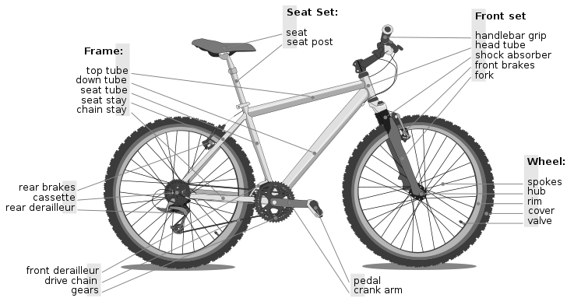
Bicycle Components
Source: Wikipedia.org - Schematic diagram of a bicycle. Sept 22, 2009

Slide 42
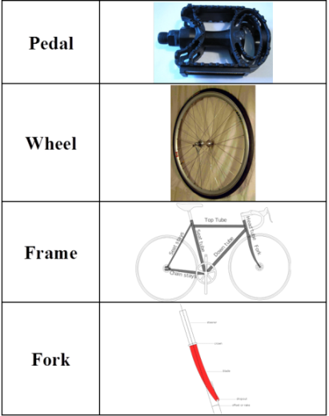
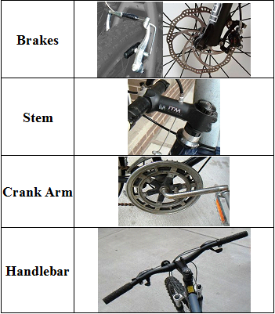
Components Involved in Incidents
Top 8 Bicycle Component Failures Based on IDIs

Slide 43
Failure Modes – Most Commonly Reported
Component Failure Modes Cited in Incident Description | Likely Failure Type
Detached | Assembly or Maintenance
Loosened
Cracked | Structural
Came Apart
Deformed
Fractured
Malfunctioned | Unknown
Note: In some cases, component failure may be the result of an incident rather than the cause

Slide 44
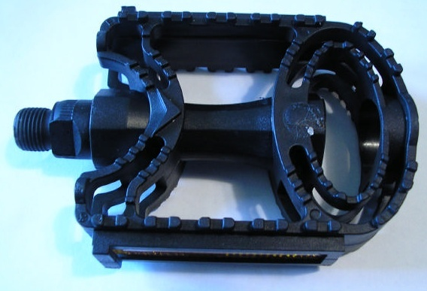
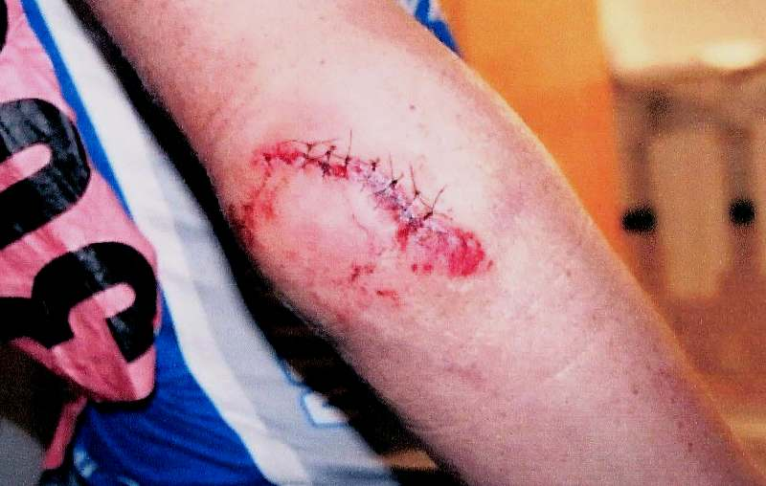
Pedal-Related Incidents
Left pedal detached
  25-year-old female
  Flipped over handlebars
  Taken via ambulance to hospital
  Bruised and swollen stomach, shoulder, and knees
Doc #: IDI 050211CCC1472
Right clipless pedal axle fractured
  19-year-old male
  Fell to pavement
  Lacerations and contusions to his right knee and elbow
Doc #: IDI 090521CNE4429

Slide 45
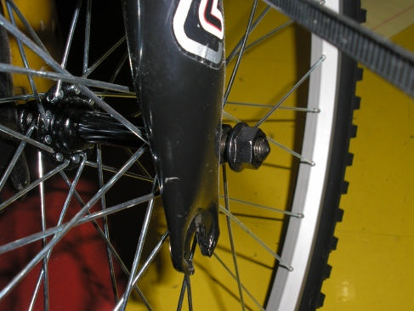
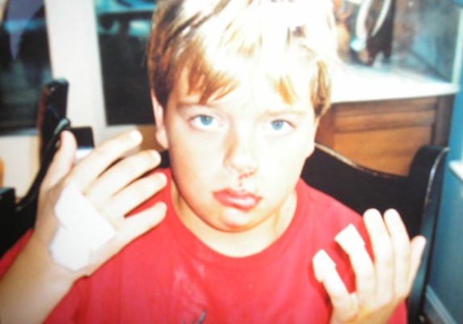
Wheel-Related Incidents
Front wheel detached from suspension fork
  16-year-old male
  Flew over handlebars onto pavement
  Lacerated lip and lost three teeth
Doc #: IDI 050720CCC2977
Front wheel separated from suspension fork
  11-year-old male
  Fell onto paved road
  Abrasions to face, knees, fingers and elbows
  Mild concussion, swollen lip
Doc #: IDI 050728CNE2664

Slide 46
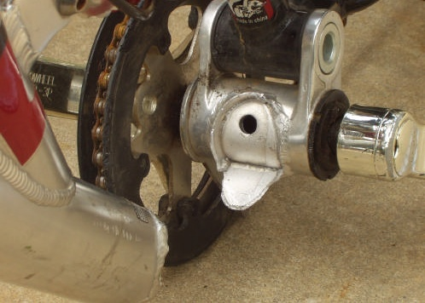

Frame-Related Incidents
Aluminum frame broke in half
  8-year-old male
  Thrown onto gravel driveway
  Scratches and abrasions
Doc #: IDI 041001CNE1784
Head-tube fractured
  20-year-old male
  Thrown over handlebars onto pavement
  Multiple lacerations (10 stitches)
Doc #: IDI 051130CCC2105

Slide 47
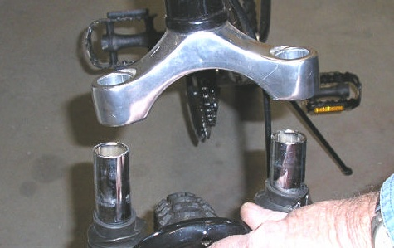
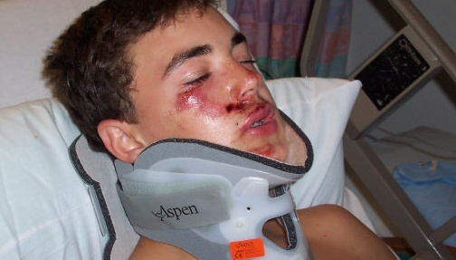
Fork-Related Incidents
Fork came apart
  20-year-old male
  Thrown over handlebars onto pavement
  Contusions, abrasions, and severe laceration on right knee
Doc #: IDI 041216CCC2209
Fork broke
  14-year-old male
  Head and face struck pavement
  Broken jaw, damage to four teeth
  Memory loss
  Hospitalized three days
Doc #: IDI 051011CCC1029

Slide 48
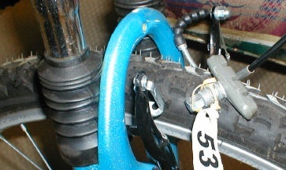
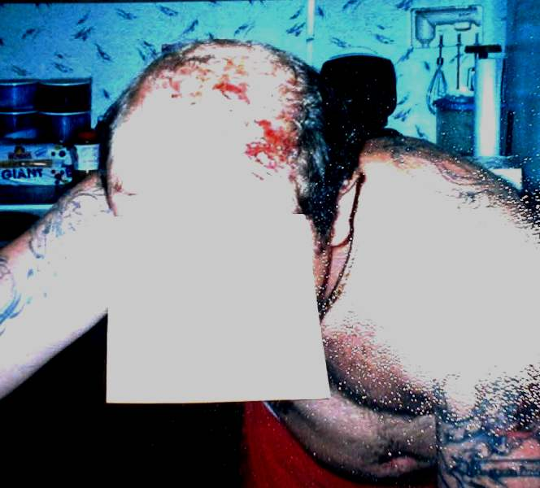
Brakes-Related Incidents
Front wheel locked up when applying brakes
  17-year-old female
  Thrown off bike onto concrete picnic table
  Fractured both arms
  Hospitalized three days
Doc #: IDI 041022CCC2053
Lost control attempting to apply the brakes
  25-year-old male
  Fell onto the paved road
  Head laceration and road rash
Doc #: IDI 041021CCC1070

Slide 49
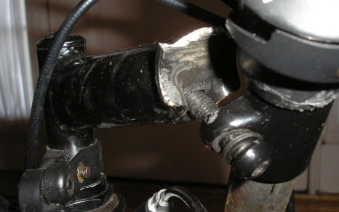
Stem-Related Incidents
Stem fractured
  13-year-old male
  Fell to the ground
  Minor abrasions to hands and arms
Doc #: IDI 061130CCC1142
Turned handlebars, wheel did not turn
  52-year-old female
  Crashed
  Severely fractured leg
Doc #: IDI 050317CCC2542
Stem cracked
  18-year-old male
  Fell to pavement
  Wrist and elbow fractured
Doc #: IPII H07B0161A

Slide 50
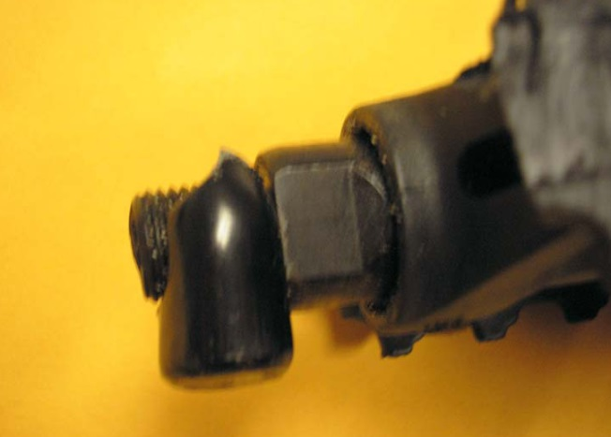
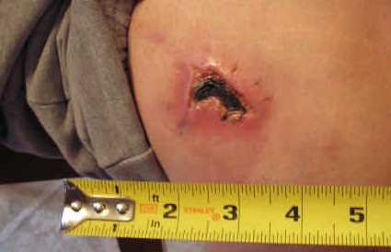
Crankarm-Related Incidents
Crankarm fractured
  15-year-old male
  Fell
  Head injury and broken arm
Doc #: IDI 051011CCC1021
Left crankarm fractured
  35-year-old male
  Fell to pavement
  Abrasion to the right elbow and right knee, and laceration to his left leg
Doc #: IDI 050927CCN0909

Slide 51
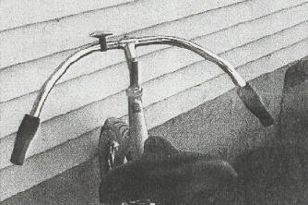
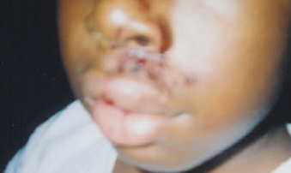
Handlebar-Related Incidents
Handlebars collapsed
  57-year-old female
  Lost control of bicycle and fell
  Surgery to treat broken ankle which needed a plate, screws, and pin
Doc #: IDI 041216CCC2215
Handlebars became loose
  11-year-old male
  Fell over the top of the bicycle
  Injuries to face, various scrapes, cracked tooth, and loss of permanent tooth
Doc #: IDI 050211CCC2408

Slide 52
Case Studies
Case 1: Fork failure
Case 2: Frame failure
Case 3: Seat post failure

Slide 53
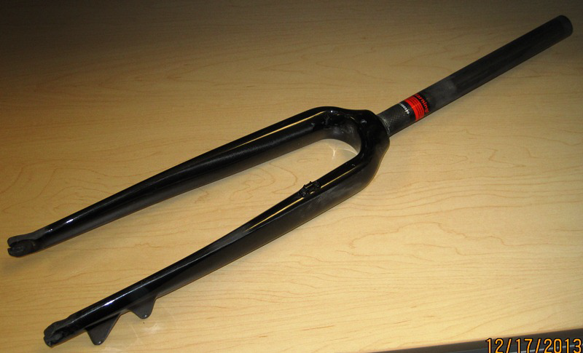
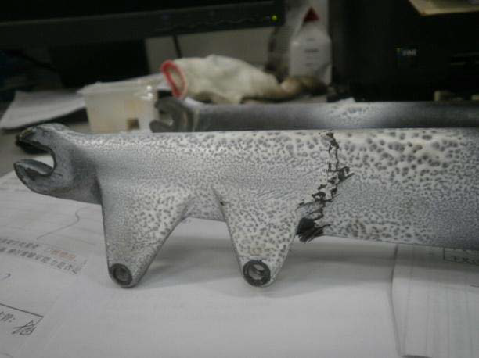
Case 1: Fork Failure
Product:
  Road Bike with Carbon fork
Issue:
  Carbon fork can fracture at disk brake mount

Slide 54
Case 1: Fork Failure
Corrective action:
  Manufacturer redesigned aluminum disc brake mount and modified carbon layups in fork to reduce stress
Validation:
  Redesigned fork tested to fork test requirements in EN 14764 City and Trekking Bicycles

Slide 55
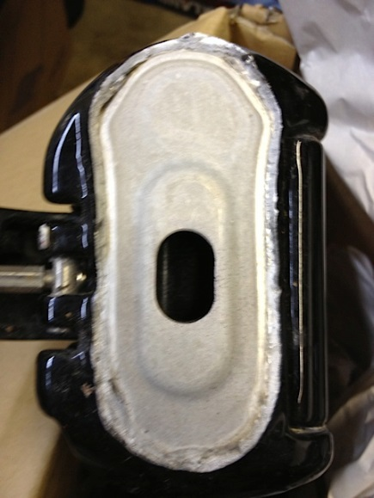
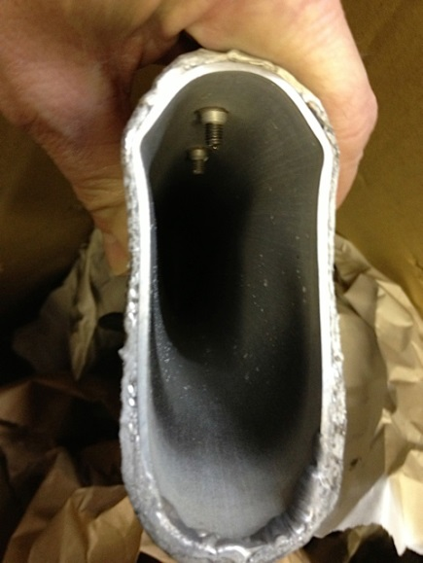
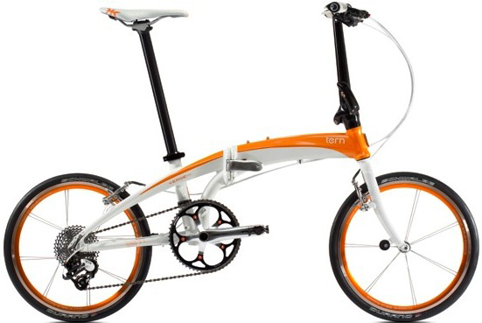
Case 2: Frame Failure
Product:
  Folding bike
Issue:
  Aluminum frame can fracture at frame hinge

Slide 56
Case 2: Frame Failure
Corrective action:
  Manufacturer modified the welding process at the frame hinge to increase thickness where fractures occurred
  Manufacturer improved quality control process to ensure frame meets specifications prior to assembly
Validation:
  Redesigned frame tested to frame fatigue and impact test requirements in EN 14764 City and Trekking Bicycles

Slide 57
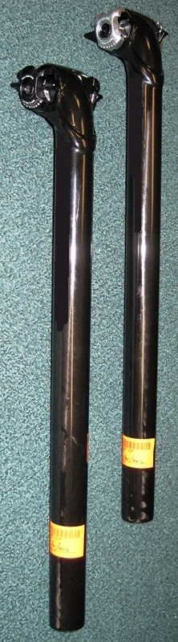
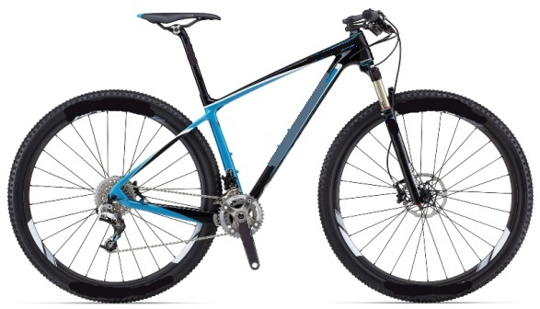
Case 3: Seat Post Failure
Product:
  29er Mountain Bicycle
Issue:
  Carbon seat post can fracture

Slide 58
Case 3: Seat Post Failure
Corrective action:
  Manufacturer modified carbon fiber layering to cover transition area that was failing
Validation:
  Redesigned seat post tested seat post fatigue test requirements in EN 14766 Mountain Bicycles
  Additional in-house static load testing by the manufacturer

Slide 59

Questions?
Submit questions in English or Chinese to this podcast:
CPSCinChina@CPSC.GOV

Slide 60
Resources

Slide 61
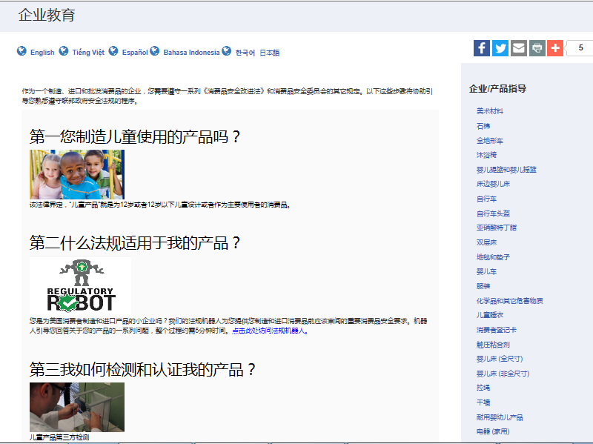
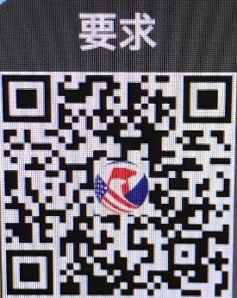
https://www.cpsc.gov/zh-CN/Business--Manufacturing/Business-Education
Chinese Resources at cpsc.gov

Slide 62
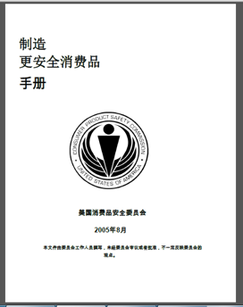
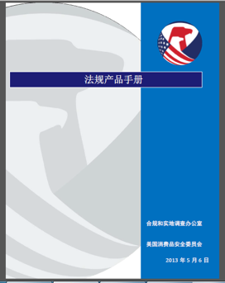
Chinese Resources at cpsc.gov
https://www.cpsc.gov/s3fs-public/HandbookforManufacturingChinese.pdf (中文版本 )
https://www.cpsc.gov/s3fs-public/pdfs/blk_pdf_handbookenglishaug05.pdf (英文版本)
https://www.cpsc.gov/s3fs-public/THE%20REGULATED%20PRODUCT%20HANDBOOK_050613%20CHN%20Final_0.pdf (中文版本 )
https://www.cpsc.gov/s3fs-public/RegulatedProductsHandbook.pdf (英文版本)

Slide 63
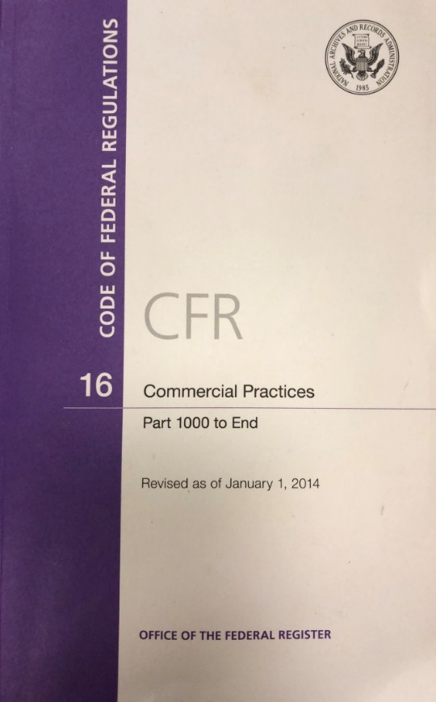
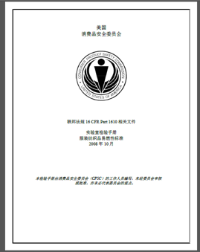
Chinese Resources at cpsc.gov
CFR: Commercial Practices
https://www.govinfo.gov/content/pkg/CFR-2017-title16-vol2/pdf/CFR-2017-title16-vol2.pdf (英文版本)
CPSC Laboratory Manuals:
https://www.cpsc.gov/s3fs-public/Laboratory-test-manual-16-CFR-Part-1610-Ch.pdf?MhtbUWNy6jmOPx9b6f.RErt.n.2n_d_h (中文版本)
https://www.cpsc.gov/s3fs-public/Flammability%20of%20Clothing%20Textiles%20Test%20Manual_1610.pdf (英文版本)

Slide 64
Definition of children’s product – 16 CFR Part 1200
Certificates of conformity – 16 CFR Part 1110
Third-party testing – 16 CFR Parts 1107, 1109, and 1112
Tracking information – 15 USC § 2063(a)(5)
Mandatory reporting requirements – 15 USC §2064
CPSC Business Resources
CPSC-Accepted Laboratories Search Page:
www.cpsc.gov/LabSearch

Slide 65

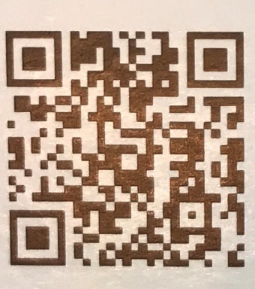
http://business.cpsc.gov
Online tool designed specifically to help businesses comply with federal consumer product safety requirements.
Asks a series of guided questions, and based on the answers produces a downloadable (PDF) report.
Provides customized guidance with links to product safety regulations that may apply to the product and important information on labeling, certification and testing requirements.

Slide 66
Regulatory Robot
Regulatory Robot is a tool to help identify which mandatory standards are applicable
  Does not give details of requirements within a specific standard
User inputs product features
Regulatory Robot outputs list of standards and requirements
User references source documents for specific requirements

Slide 67
Regulations and General Commission Information by Statute (Act)
  www.cpsc.gov/en/Regulations-Laws--Standards/Statutes/
Regulated Products Handbook
  www.cpsc.gov/businfo/8001.pdf
Requirements for Bicycles
  https://www.cpsc.gov/Business--Manufacturing/Business-Education/Business-Guidance/Bicycle-Requirements/
Federal Hazardous Substance Act
  https://www.cpsc.gov/Business--Manufacturing/Business-Education/Business-Guidance/FHSA-Requirements/
Consumer Product Safety Act
  www.cpsc.gov/s3fs-public/pdfs/blk_media_cpsa.pdf?epslanguage=en
Bicycle Helmet Business Guidance:
  https://www.cpsc.gov/Business--Manufacturing/Business-Education/Business-Guidance/Bicycle-Helmets
CPSC Bicycle Resources

