Slide 1
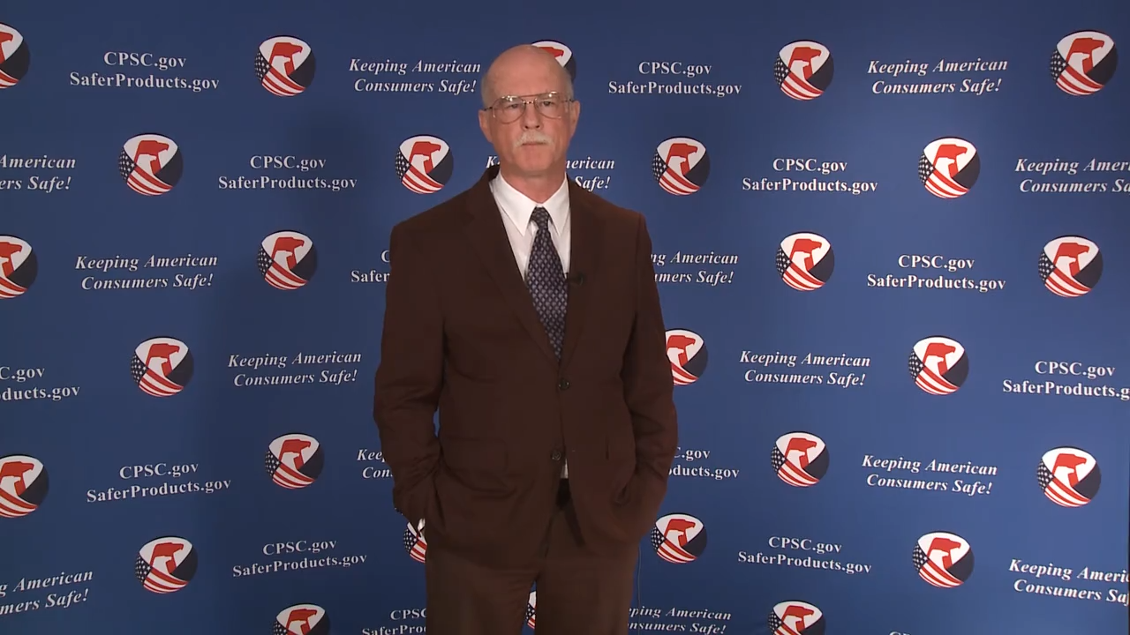
Video: Welcome to the 2020 CPSC Podcast Series-Toy Safety Requirements and Mandatory Standards

Slide 2
Podcast Series 2020
Toy Safety Requirements and Mandatory Standards
This presentation was prepared by CPSC Staff. It has not been reviewed or approved by the Commission and may not reflect its views.

Slide 3
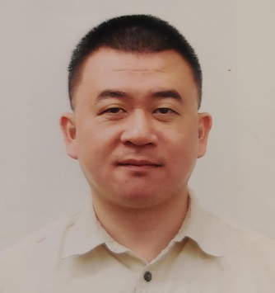

Biographies
Sylvia Chen
U.S. Consumer Product Safety Commission
Program Manager for East Asia and Pacific
Office of International Programs
Joseph Tsai, Senior Compliance Officer
Regulatory Enforcement Division
Office of Compliance and Field Operations
U.S. Consumer Product Safety Commission
Sylvia Chen is Program Manager for East Asia and Pacific at the U.S. Consumer Product Safety Commission (CPSC). In that role, she is responsible for managing the Commission’s bilateral and multi-lateral programs related to consumer product safety in Australia, Japan, Korea, Taiwan and New Zealand. She also supports the CPSC’s work with China. Since she joined the CPSC in 2008, Sylvia has been working with product safety regulators, industry organizations, manufacturers, exporters, buyers and other sourcing professionals to provide them with guidance and technical support in understanding U.S. requirements, in particular the latest requirements for consumer products. To that end, she has organized or coordinated many of the agency’s international education and outreach activities.
Sylvia has a Bachelor of Arts degree in English and American Literature from Peking University. In 1991, she graduated from The Ohio State University with a Master’s degree in East Asian
Joseph joined the U.S. Consumer Product Safety Commission (CPSC) in April 2008, as a Compliance Officer in the Regulatory Enforcement Division of the Office of Compliance and Field Operations.
As a Compliance Officer, he is responsible for enforcing the mandatory regulations for children’s products, such as, toys, pacifiers, and rattles under the Federal Hazardous Substances Act (FHSA) and Consumer Product Safety Act (CPSA).
In addition, he advises stakeholders on requirements for tracking and certification for children’s products under the CPSA. His specific responsibilities include advisement on the implementation of regulations, standards, and bans under the FHSA and the CPSA, and providing advice and guidance to consumers and the regulated industry.
Prior to joining the CPSC, Mr. Tsai was an officer at U.S. Customs and Border Protection, and a research scientist with Scripps Research Institute, La Jolla, California. Mr. Tsai holds a Bachelor of Science degree from University of California, Los Angeles (UCLA), and a Master of Science degree from University of California, San Diego (UCSD).

Slide 4

The US CPSC is a federal government agency charged with protecting the public from unreasonable risks of injury or death associated with the use of consumer products under the agency's jurisdiction.
$1 Trillion
Deaths, injuries, and property damage from consumer product incidents cost the nation more than $1 trillion annually.¹
¹ https://www.cpsc.gov/s3fs-public/FY2019PBR.pdf
CPSC is committed to protecting consumers from products that pose a fire, electrical, chemical, biological, or mechanical hazard.
CPSC's work to improve the safety of the more than 15,000 types of consumer products in its jurisdiction - such as toys, cribs, power tools, cigarette lighters, textiles, and household chemicals – has contributed to a decline in the rate of deaths and injuries associated with consumer products over the past 40 years.

Slide 5
CPSC’s Podcast Series
Podcast | Topics
#1 | Selling Safe Electrical Products to the U.S. Market
#2 | Overview of U.S. Apparel Requirements
#3 | CPSC Bicycle Regulations and U.S. and International Safety Standards
#4 | Overview of U.S. Mattress Requirements
#5 | Durable Infant or Toddler Products Common Requirements
#6 | Overview of Carriage and Stroller Requirements
#7 | Toy Safety
“Questions on this Presentation? Send an email to CPSCinChina@cpsc.gov”

Slide 6
The slides used in this podcast are not a comprehensive statement of legal requirements or policy and should not be relied upon for that purpose. You should consult official versions of U.S. statutes and regulations, as well as published CPSC guidance when making decisions that could affect the safety and compliance of products entering U.S. commerce. Note that references are provided at the end of the presentation.

Slide 7

U.S. Toy Safety Requirements And Mandatory Standards: Common Violations 美国玩具安全要求和强制性标准： 常见的违规

Slide 8
Agenda 事项
Relevant requirements for children’s products under FHSA and CPSC 联邦危险物质法和消费品安全法下的儿童用品之规定
Age Grading 年龄分级
Small Parts Requirements 小部件规定 (toys for children under 3 years of age) (3岁以下儿童的玩具)
Requirements for Labeling for Toys and Games 玩具和游戏标签之规定 (toys for children 3 years of age and above) (3岁以上儿童的玩具)
Labeling of Hazardous Art Materials Act (LHAMA) 危险美术材料品标签法
Lead and Phthalate Requirements 铅和塑化剂的规定
ASTM F963-17 Toy Mandatory Standard (Toy Standards) ASTM F963-17 儿童玩具强制标准
Tracking Label, Third Party Testing and Certification, and Periodic Testing Requirements 追踪标签, 第三方测试和认证, 以及定期测试的规定

Slide 9
CPSC Jurisdictional Authority from Several Acts 消费品安全委员会管辖权来自以下法案
Federal Hazardous Substances Act (FHSA) 《联邦危险物质法》
Small parts, labeling for toys and games, lead in paint, lead content, and art materials
小部件 , 玩具和游戏的标签, 铅含量, 美术材料
Consumer Product Safety Act (CPSA) 《消费品安全法》
Phthalates, ASTM F-963, tracking label, third party testing, certification, periodic
testing 塑化剂, ASTM F-963, 追踪标签, 第三方测试,认证, 定期测试
Flammable Fabrics Act (FFA) 《易燃织物法》
Poison Prevention Packaging Act (PPPA) 《防毒包装法》
Refrigerator Safety Act (RSA) 《冰箱安全法》
Virginia Graeme Baker Pool & Spa Safety Act 《弗吉尼亚·格雷姆·贝克泳池和水疗安全法》
Children’s Gasoline Burn Prevention Act 《儿童汽油烧伤预防法》

Slide 10
Age Grading of Toys 玩具的年龄分级
Age labels should match the attributes of the toy to the abilities/behaviors of the child.
年龄标签应让玩具的属性与孩子的能力/行为相匹配。
The Commission considers: 委员会考虑：
Manufacturer’s stated intent if it is reasonable.
制造商对这个产品的陈述是不是合理的。
Advertising, promotion, & marketing of the toys.
玩具本身的广告，促销, 和行销。
Commonly recognized as a toy for children’s designated
age group.
玩具所指定的适合儿童年龄是不是被一般民众所认可的。

Slide 11
Requirements for Children’s Products under Federal Hazardous Substances Act (FHSA) 联邦有害物质法下的儿童用品之法规
Small parts 小部件
Requirements for labeling for toys and games (cautionary statements) 玩具和游戏的警告标签
Lead content 铅含量
Lead in paint 漆的铅含量
Art materials 美术材料

Slide 12
Small Parts Requirements (Toys for children under 3 years of age) 小部件规定(3岁以下儿童的玩具)
Toys and other articles for children under 3 years of age must not contain any small parts before and after use and abuse testing.
适用于3岁以下儿童的玩具和其他物品在测试前后不得包含任何小部件。
Small parts present a choking, aspiration, or ingestion hazard.
小部件有窒息，误吸或吞食的危险。
Small parts are articles that fit into a small parts cylinder.
小部件是可装入小部件圆筒的物品。

Slide 13
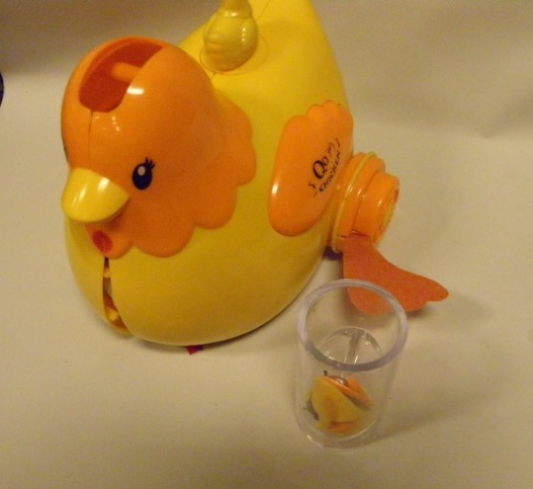
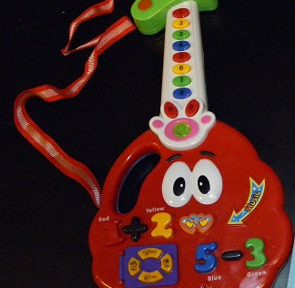
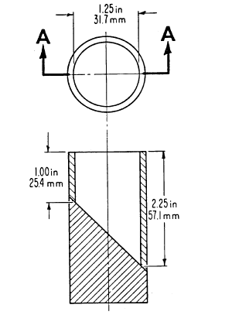
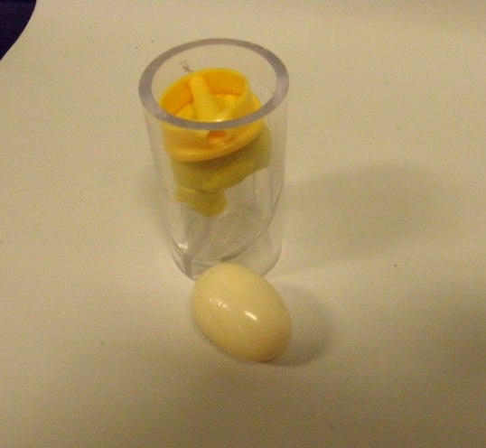
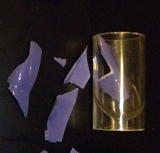
Small Parts Testing Cylinder 小部件圆筒
small parts cylinder
Spherical or ovoid
球形或卵形
Fragments
碎片

Slide 14
Requirements for Labeling for Toys and Games (Toys for children 3 years of age and above) 玩具和游戏标签之规定 (3岁以上儿童的玩具和游戏)
Toys and games for children 3 years of age and above can have small parts, but a cautionary statement is required.
3岁及3岁以上儿童的玩具和游戏可以有小部件，但需要警告标签。

Slide 15

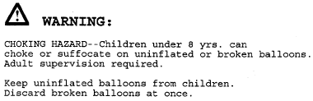




Requirements for Toys and Games (Toys for children 3 years of age and above) 玩具和游戏标签之规定 (3岁以上儿童的玩具和游戏)
Small parts: ages 3-6
小部件 3岁-6岁
Balloons: under age 8
气球：8岁以下
Small ball: ages 3 and older
小球：3岁以上
(a small ball can pass through a circular hole with a diameter of 1.75 inches)
Toy containing a small ball: ages 3-8
有小球的玩具：3-8岁
Marble: ages 3 and older
实心球：3岁以上
(marble is a ball made of hard material, such as glass, agate, or plastic)
Toy contains a marble: ages 3-8
有实心球的玩具：3-8岁

Slide 16
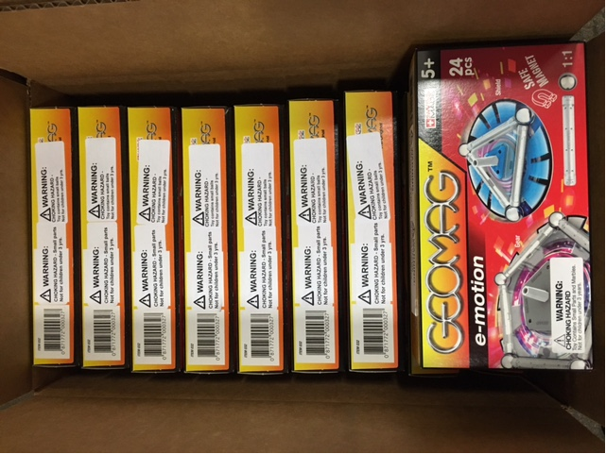
Requirements for Labeling for Toys and Games (Multiple Cautionary Statements) 玩具和游戏标签之规定 （多种风险 = 多种警告标签 )
A product can have more than one warning statement to address hazards associated with the product.
如果一个产品有多种风险, 那么它必须有以有多种警告标签.
Small parts 小部件
Marble = 钢珠

Slide 17
Lead Requirements 铅的规定
Lead content: cannot exceed 100 ppm in children’s products 儿童产品的铅含量不能超过100 ppm
Lead in paint: cannot exceed 90 ppm for surface coating on children’s products 儿童产品表面涂层的铅含量不能超过 90 ppm
The Commission has determined that certain materials would not contain lead, and therefore, do not require lead content testing. Some of the materials that do not contain lead are: wood, paper, most textiles and natural fibers (dyed and undyed), plant and animal-derived materials, and certain precious metals. A complete list of materials can be found at 16 C.F.R. § 1500.91(d). 某些材料不含铅，因此不需要进行铅含量测试。这些不含铅的材料是：木材，纸张，大多数纺织品和天然纤维（染色的和未染色的），动植物来源的材料以及某些贵金属。完整的材料清单在 16 C.F.R.§1500.91（d）。

Slide 18
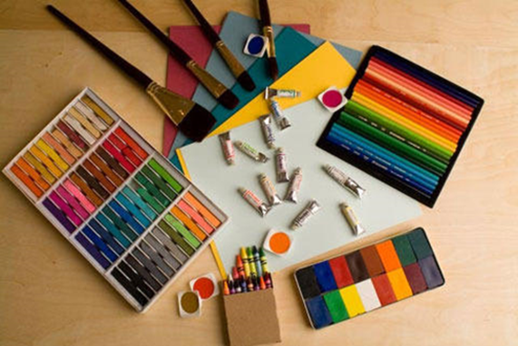
Labeling of Hazardous Art Materials Act (LHAMA) 危险美术材料品标签法
Formulation of art materials must be assessed by a toxicologist for the potential to cause
adverse chronic health effects.
美术材料的配方必须由毒理学家评估是否可能对健康有负面影响。
Art materials must be accompanied by the conformance statement: “Conforms to ASTM D-4236”
美术材料须有 “Conforms to ASTM D-4236” 的符合声明。
CPSC Chronic Hazard guidelines, which are intended to assist manufactures in complying with LHAMA,
are available at www.cpsc.gov/s3fs-public/pdfs/blk_pdf_chronichazardguidelines.pdf
为了帮助制造商遵守危险美术材料品标签法, 请进入以下网址并阅览 CPSC 慢性危害指南。
www.cpsc.gov/s3fs-public/pdfs/blk_pdf_chronichazardguidelines.pdf
Conforms to
ASTM D-4236

Slide 19
Requirements for Children’s Products under Consumer Product Safety Act (CPSA) 消费品安全法下的儿童用品之规定
Phthalates
塑化剂
ASTM F-963 Mandatory Standards (Toy Standards)
ASTM F-963 儿童玩具强制标准
Tracking label
追踪标签
Third Party Testing
第三方测试
Certification
认证
Periodic Testing
定期测试

Slide 20
Phthalates Requirements 塑化剂的规定
Applies to children’s toys and child care articles that facilitate
sleeping or feeding or help with sucking or teething of a child ages 3
years old and younger.
适用于儿童玩具以及让3岁和3岁以下儿童方便入睡,喂食或帮助其吮吸或出牙的用
品。
Permanently banned – No more than 0.1% of DEHP, DBP, BBP, DINP, DIBP, DPENP, DHEXP, DCHP.
永久禁止的塑化剂 – DEHP，DBP，BBP，DINP，DIBP，DPENP，DHEXP, DCHP其个含量不可超过0.1％。

Slide 21
Phthalates Requirements 塑化剂的规定
Effective September 29, 2017, seven types of plastic do not require third party testing for compliance with phthalate requirements (under Code of Federal Regulations 16 CFR 1308.2):
自2017年9月29日起，七种类型的塑料不需要第三方测试来证明其是否符合塑化剂的规定 (请参阅联邦法规 16 CFR §1308.2):
polypropylene (PP),
polyethylene (PE),
high-impact polystyrene (HIPS),
acrylonitrile butadiene styrene (ABS),
general-purpose polystyrene (GPPS),
medium-impact polystyrene (MIPS), and
super-high-impact polystyrene (SHIPS).

Slide 22
Phthalates Requirements (continued) 更多塑化剂的规定
The Commission has stated that it is unnecessary to test and certify materials that are known not to contain phthalates or to certify that phthalates are absent from materials that are known not to contain phthalates.
CPSC 已经表示，没有必要对已知不含塑化剂的材料进行测试和认证，也不必证明不含塑化剂的材料中没有
塑化剂。
The following materials do not require testing for compliance with the prohibition on phthalates, provided that they have not been treated or adulterated by a substance that may contain phthalates: untreated/unfinished wood, metal, natural fibers; and natural latex and mineral products.
以下材料不需要经过塑化剂禁令的测试，前提是未经过可能含有塑化剂的物质的处理或掺假:
未经处理/未加工的木材，金属，天然纤维；以及天然乳胶和矿物产品。
Additional examples of materials that do not require testing and certification include paper products (paper, paperboard, linerboard and medium, and pulp). See the Commission's Notice of Requirements www.cpsc.gov/s3fs-public/pdfs/blk_pdf_tpphthal.pdf
其他不需要测试和认证的材料包括纸产品（纸，纸板，挂面纸板和介质以及纸浆）。请阅览 CPSC 的要求
通知书 www.cpsc.gov/s3fs-public/pdfs/blk_pdf_tpphthal.pdf

Slide 23
ASTM F963-17 Mandatory Standards ASTM F-963-17之强制性标准
All children’s toys manufactured on or after February 28, 2018, must be tested and certified to ASTM F963-17.
在2018年2月28日或之后生产的所有儿童玩具必须符合 ASTM F963-17 的玩具安全标准。

Slide 24
Common Violations under ASTM F963-17 ASTM F963-17 标准中所常见的违规
Cords, straps, elastics in toys 玩具中的绳索，背带，松紧带
Projectile toys 弹射玩具
Battery-operated toys 电池驱动玩具
Magnets 含磁铁的玩具
Accessible (sharp) points 可接触到的尖点
Accessible edges 可接触到的风力边缘
Simulated protective devices 模拟保护装置
Pompoms 绒球
Yo-Yo elastic tether toys 系弹力绳的悠悠球
Sound producing toys 发声玩具
Teether and teething toys 磨牙器和磨牙玩具
Toy gun marking 玩具枪的橘红色标记
Toy with nearly spherical ends 有球形末端的玩具
Expanding materials 膨胀材料
Toy chests 玩具柜
Stability and over-load requirements 稳定性和过载规定
and more 以及更多

Slide 25
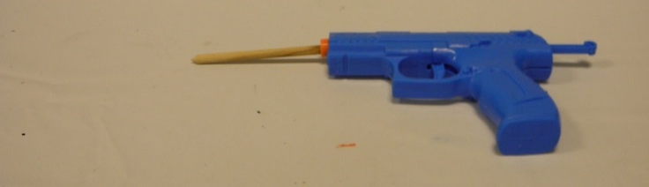
Typical ASTM F963 Violations
Cords, straps, elastics in toys (under 18 months of age)- if the length is more than 12 inches (30.48 cm) long, then it can not have beads or attachment at the end of the cords because this presents a strangulation hazard.
给18个月以下的儿童玩具, 如果玩具中的绳索，背带，或松紧带长度超过12英寸 (30.48 厘米)，则在绳的末端不可带有小珠或附属物。 因为这存在着意外勒死的危险。
Projectile toys- the discharge mechanism shall not be able to launch improvised projectile such as pencils, toothpicks or steel balls.
弹射玩具不可射击简易即兴抛射物,例如铅笔，牙签或钢球。

Slide 26
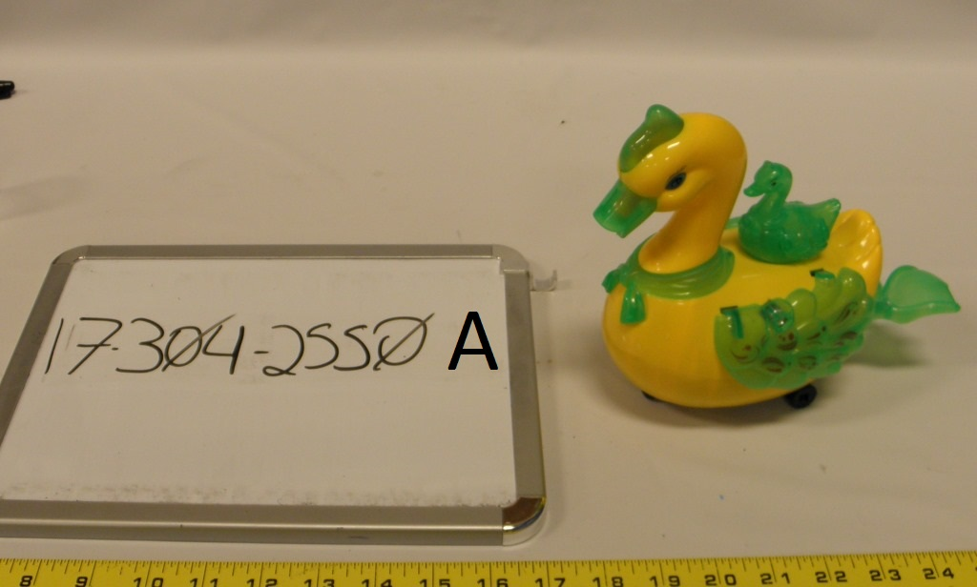
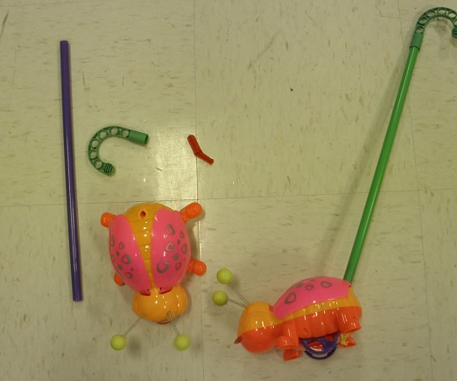
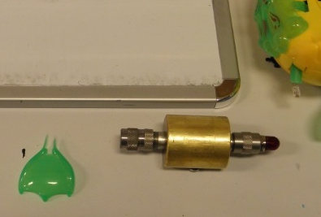
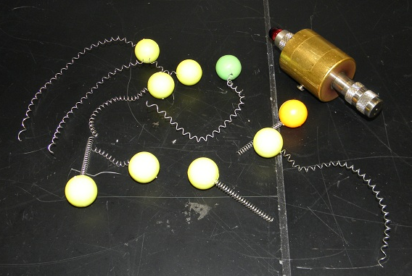
Typical ASTM F963 Violations ASTM F963-17 标准中所常见的违规
Sharp points- products that have accessible sharp points after use and abuse testing.
玩具在测试后产生尖点。
尖点
Sharp Points

Slide 27
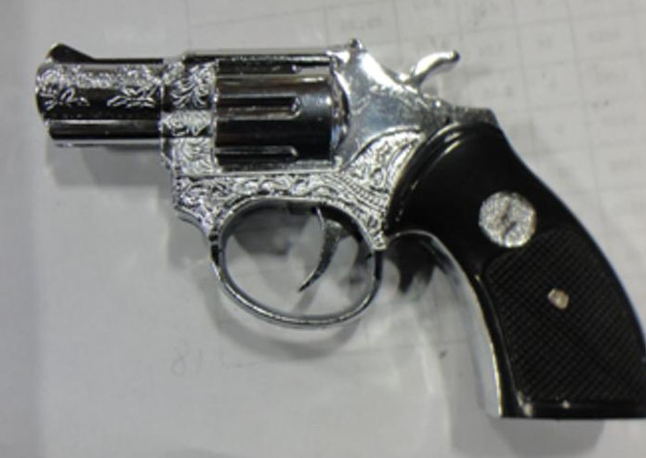
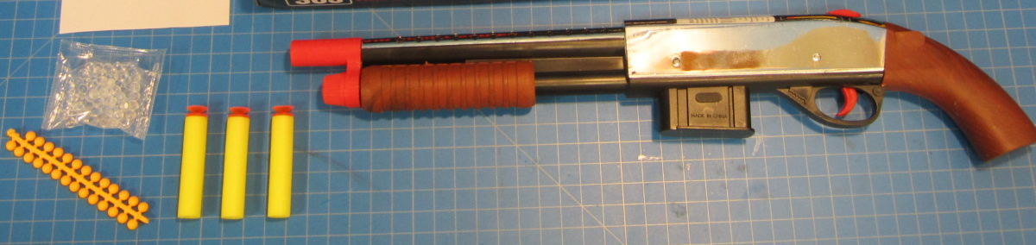
Typical ASTM F963 Violations ASTM F963-17 标准中所常见的违规
Toy Gun Markings:
A blaze orange plug affixed into the muzzle end of the
barrel, the plug shall not be recessed more than 0.25
inch (0.635 cm) from the muzzle end of the barrel, or
枪管的枪口必须有长度至少0.25英寸 (0.635厘米)的橙色栓子, 或者
A blaze orange band covering the circumference of the
muzzle end of the barrel for a length of at least 0.25 inch (0.635 cm). 枪管的枪口有长度至少0.25英寸 (0.635厘米) 的橙色圆形带。

Slide 28
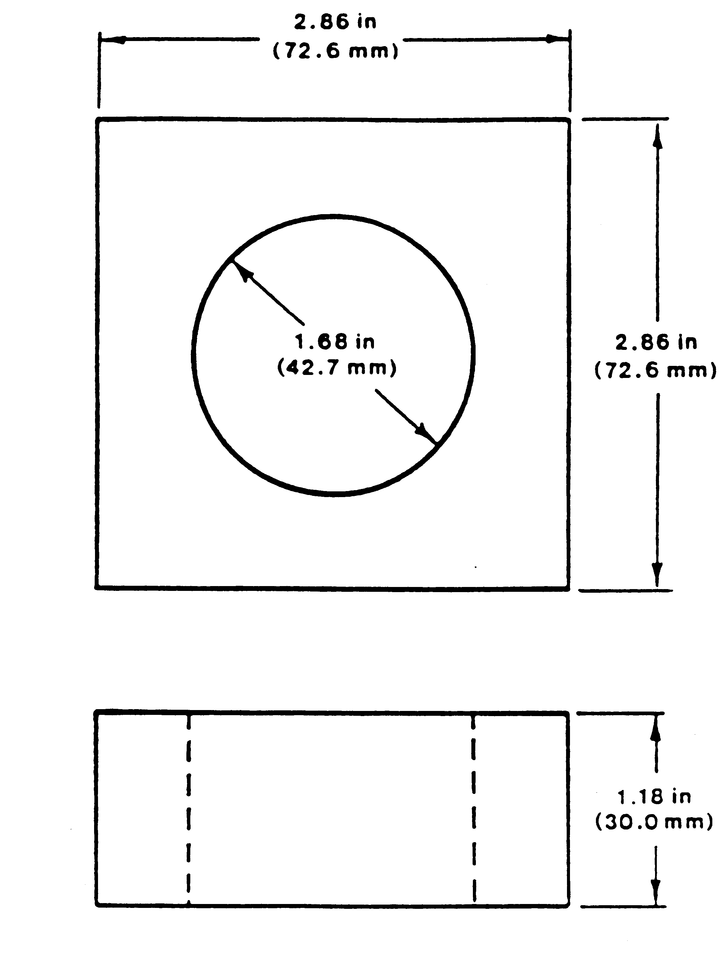
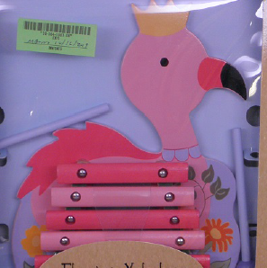
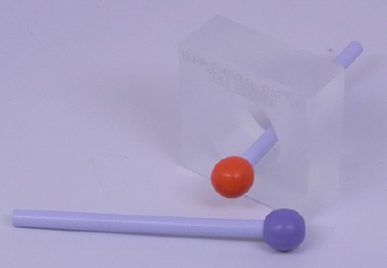
Typical ASTM F963 Violations ASTM F963-17 标准中所常见的违规
Toy with Nearly Spherical Ends
有球形末端的玩具
ASTM F963-17 Figure 21
ASTM F963-17 的 图 21
For toys intended for children up to the age of 18 months, nearly spherical, hemispherical, circular flared, or dome-shaped ends of toys or components of toys shall not be capable of penetrating the full depth of the cavity of the Supplemental Test Fixture (Figure 21 of the ASTM F963-17).
对于18岁以下儿童使用的玩具，其玩具或玩具组件的近球形，半球形，扩散圆形 或 圆顶形之 端部不能穿透 ASTM F963-17 的辅助测试装置的整个深度（请查阅 ASTM F963-17的图21）。

Slide 29
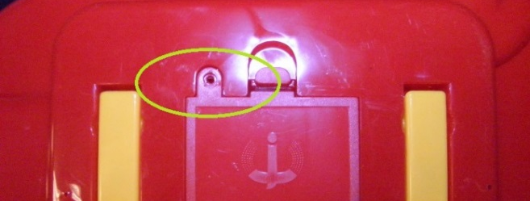
Typical ASTM F963 Violations ASTM F963-17 标准中所常见的违规
Battery-Operated Toys- battery compartment is not secured
为了防止儿童意外吞入电池, 带有电池的玩具其电池仓不可轻易地被儿童被打开。
Magnets- cannot have magnets or magnetic components with a flux index equal to or higher than 50 kG² mm² and fit into the small parts cylinder before and after use and abuse testing.
如果含磁铁的玩具其磁铁或磁性部件在使用和滥用测试前后可装入小部件圆筒, 则其磁通量指数不可在或高于 50 kG² mm² 。

Slide 30
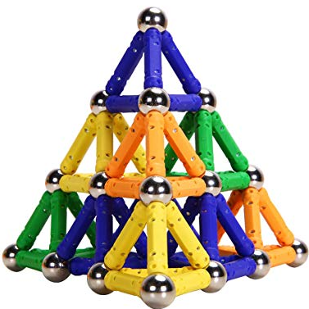
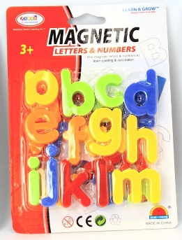
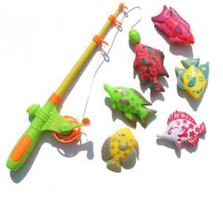
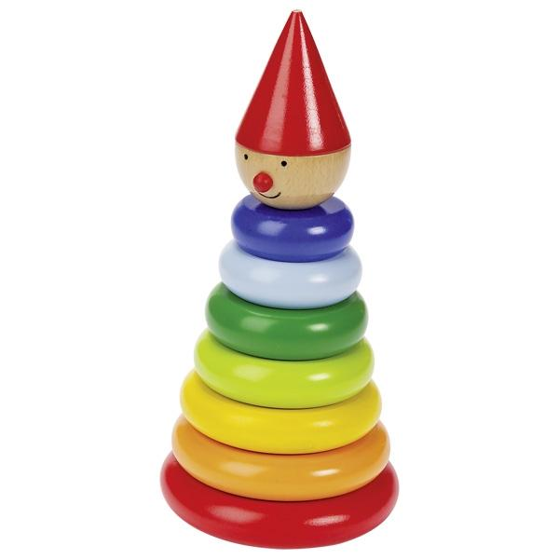
More on Magnets… 更多关于磁铁…
There are typically 4 types of toys that contain magnets:
magnetic building sets, magnetic letters & numbers, magnetic fishing games,
and magnetic stacking games.
含磁铁的玩具基本上有4种类型: 磁性建筑套装，磁性字母和数字，磁性钓鱼游戏,
和磁性堆叠游戏。
Magnets are encased or embedded in wood or plastic. 在这些磁性玩具中, 磁铁都被包裹或嵌入在木头或塑料中。
Magnetic
Building Sets
Magnetic
Letters & Numbers
Magnetic
Fishing Games
Magnetic Stacking Games

Slide 31
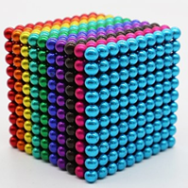
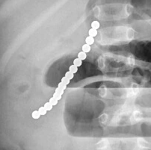
Magnets of Special Concern…Magnetic Balls 需要特别关注的磁性玩具...磁力珠
Magnets (high power rare earth magnets) that are not embedded/encased in plastic or wood.
未嵌入/未包裹在塑料或木材中的裸露的磁体（大功率稀土磁体）。
Usually Spherical with a diameter between 3~5 mm with a flux frequently over 50 kG2 mm2.
通常为球形，直径在3〜5 mm之间，磁通指数经常超过50 kG²mm² 。
Frequently marked as “stress relief toys” “educational toys” or “desk toys”.
通常标记为“减压玩具”，“教育玩具”或“桌上玩具” 。

Slide 32
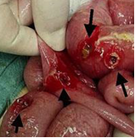
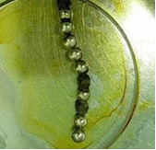
When these magnets are swallowed, they can link together inside a child’s intestines and clamp onto body tissues, causing intestinal obstructions, perforations, sepsis and death.
吞下這些磁鐵後，它們可以在孩子的腸道內連接在一起,並夾在身體內部的組織上，可引起腸梗阻，穿孔，敗血症和死亡。
Si X, Du B, Huang L. Multiple Magnetic Foreign Bodies Causing Severe Digestive Tract Injuries in a Child. Case Reports Gastroenterology. 2016 Nov 25;10(3):720-727.

Slide 33
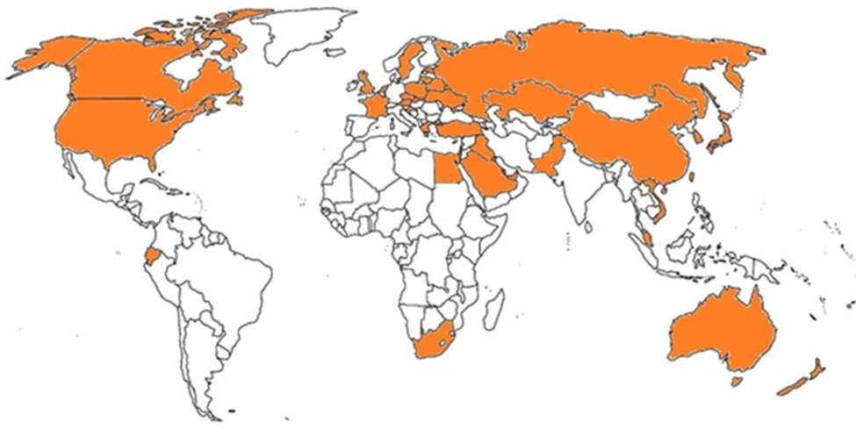
We have collected all global news reports concerning the ingestion of magnets from magnet sets. We discovered that 35 countries (orange areas) have reported such incidents.
在我们所收集的全世界有关于误食磁力珠玩具的新闻中,我们发现目前全世界有35个国家(橙色部分)报道此不幸之事件。

Slide 34
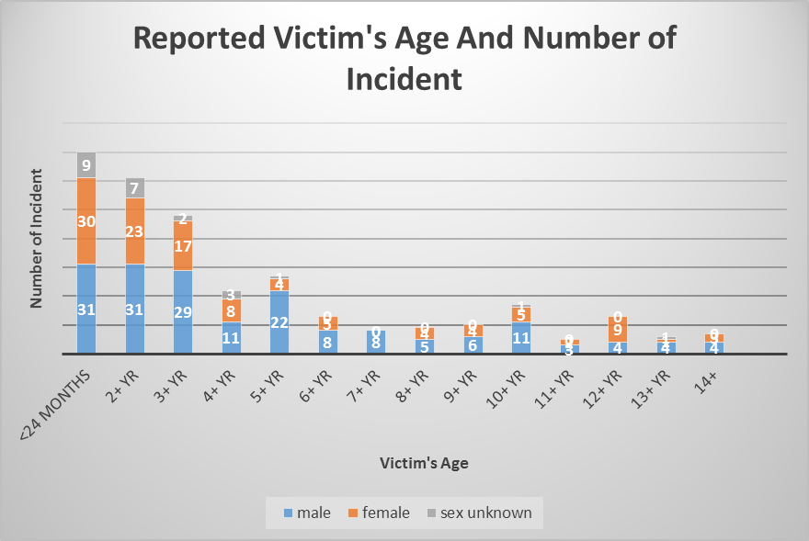
In our global data, we discovered that children ages 3 and under are the most vulnerable age group for magnet set ingestion.
在我们所收集的全世界有关于误食磁力珠玩具的新闻报道中, 我们发现3岁至3岁以下的儿童是误食磁力珠年龄层最多的一群。

Slide 35
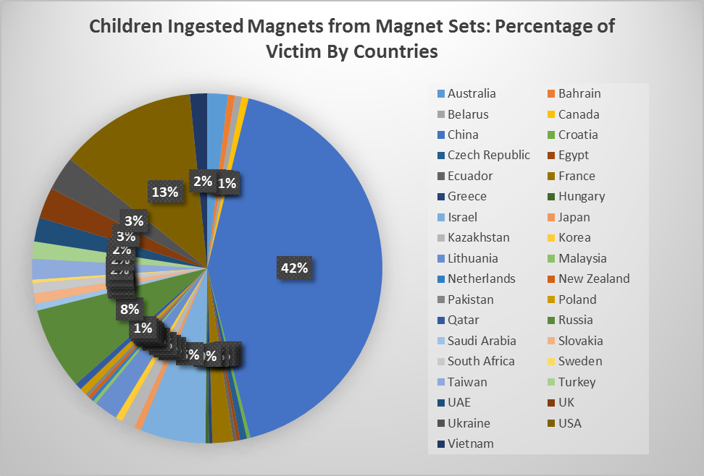
We also discovered from global news reports that China has the most reported incidents concerning magnet set ingestions, followed by the United States.
此外在我们所收集的全世界有关于误食磁力珠玩具的新闻报道中,误食磁力珠事件以中国占的最多, 其次是美国。

Slide 36
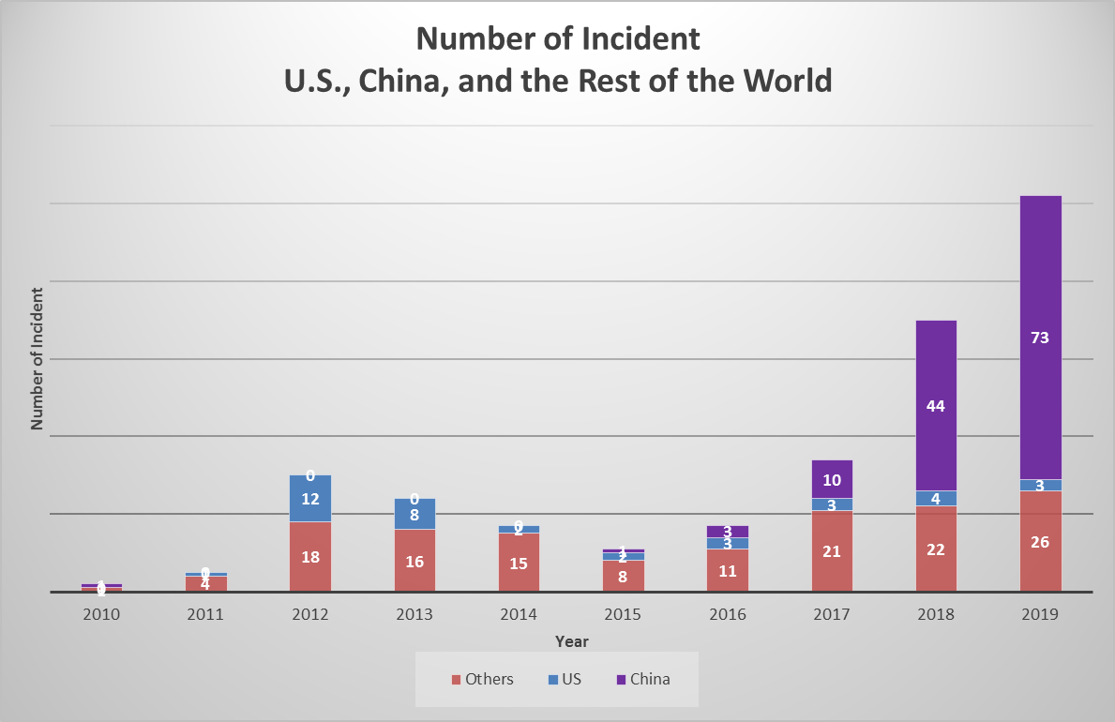
Magnet set ingestion is not a new occurrence, but the frequency of incidences has increased in China.
误食磁力珠事件乃非近事, 但两年来中国发生的次数最多。

Slide 37
Tracking Label Requirements 追踪标签的规定
Purpose - improve recall effectiveness.
追踪标签的目的是为了促进产品召回效能。
What information does a tracking label need to have?
追踪标签需要有什么信息?
Manufacturer or private labeler name 制造商或标签商名称
Location of the product’s production 产品生产地点
Date of the product’s production 产品生产日期
Any other info such as model name or number to ascertain the source of the product
任何其他信息，例如 model名称 或 model编号，以确定产品来源
Tracking labels must be permanently affixed to children’s products and their packaging.
儿童产品及其包装上的追踪标签必须是永久性。

Slide 38
Third Party Testing and Certification for Children’s Products 儿童产品的第三方测试和认证
The Consumer Product Safety Improvement Act of 2008 requires that each manufacturer must have children’s products tested to the applicable requirements by a CPSC-accepted and accredited third party testing laboratory.
2008年消费品安全改进法要求制造商必须将其儿童产品给美国消费品安全委员会
认可的第三方检测机构按照适用的美国法规检验。
Provide a Children’s Product Certificate (CPC) based on passing test reports. This must be provided to the retailer and/or distributor and accompany the shipment at the time of importation into U.S.
经过检验后, 依第三方检测机构的检验报告提供一份儿童产品证书（CPC）。儿童
产品证书必须提供给零售商和/或分销商，并在报关 (美国海关) 时随附。

Slide 39
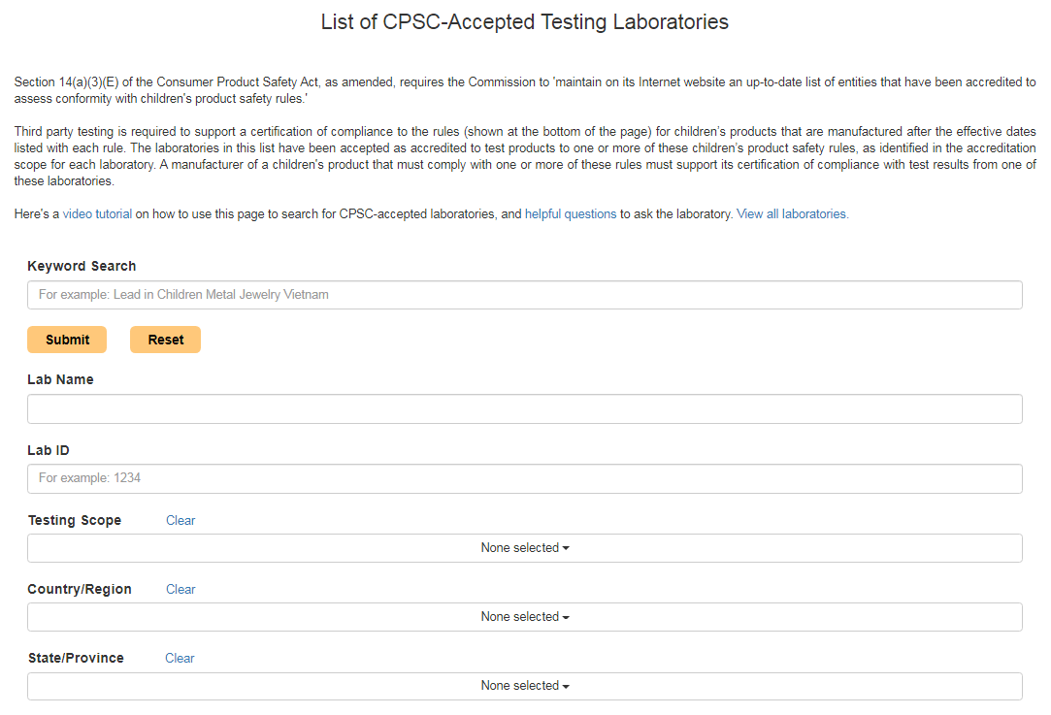
Third Party Testing and Certification for Children’s Products 儿童产品的第三方测试和认证
CPSC-accepted labs can be found at www.cpsc.gov/labsearch
CPSC 所认可的检测机构可以在 CPSC 网站 www.cpsc.gov/labsearch 上找到。

Slide 40
Elements Required in a CPC 儿童产品证书必须有以下信息
Identification of the product covered by the certificate.
产品名称。
Citation to each CPSC children’s product safety rule to which the product is being certified.
列该产品所通过的每个CPSC儿童产品安全规则。
Identification of the importer or domestic manufacturer certifying compliance of the product: Provide the name, full mailing address, and telephone number.
列签署该产品证书的进口商或 (美国) 国内制造商证的名称, 地址, 和电话号码。
Contact information for the individual maintaining records of test results: provide the name, full mailing address, e-mail address, and telephone number of the person maintaining test records in support of the certification.
列检验报告持有者的联系信息: 姓名, 地址, email, 和电话号码。
Date and place where this product was manufactured
本产品的生产日期和其原产国及城市。
Provide the date(s) and place when and where the product was tested for compliance with the consumer product safety rule(s) cited above.
提供本产品检验的日期和地点。
Identify any third party, CPSC-accepted laboratory on whose testing the certificate depends: Provide the name, full mailing address, and telephone number of the laboratory.
提供检验本产品的 CPSC 认可之第三方检测机构的名称，地址和电话号码。

Slide 41
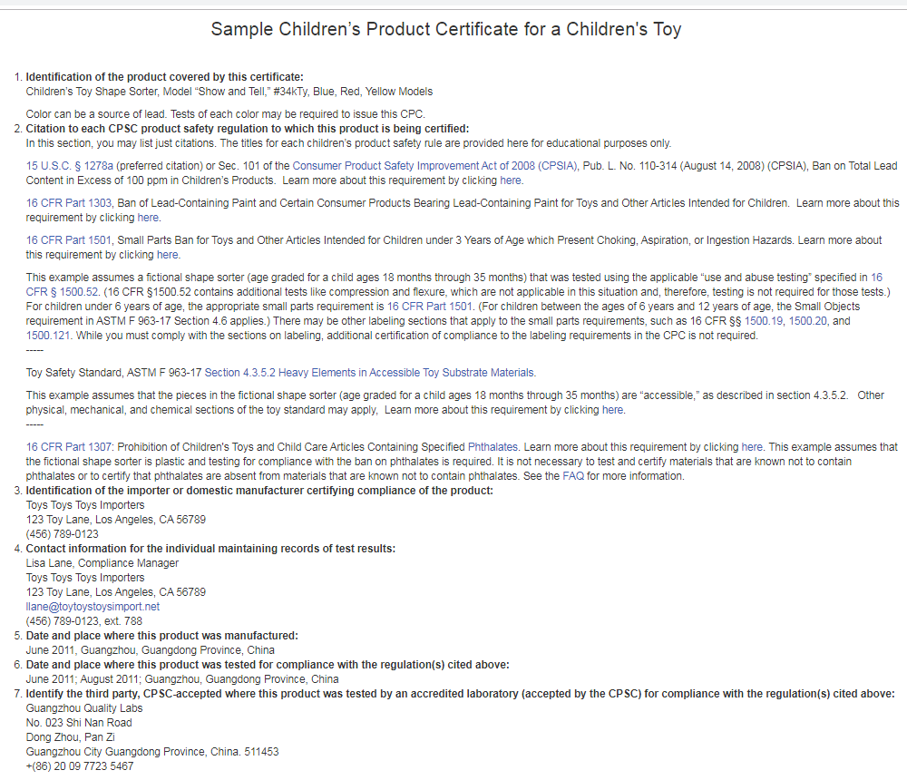
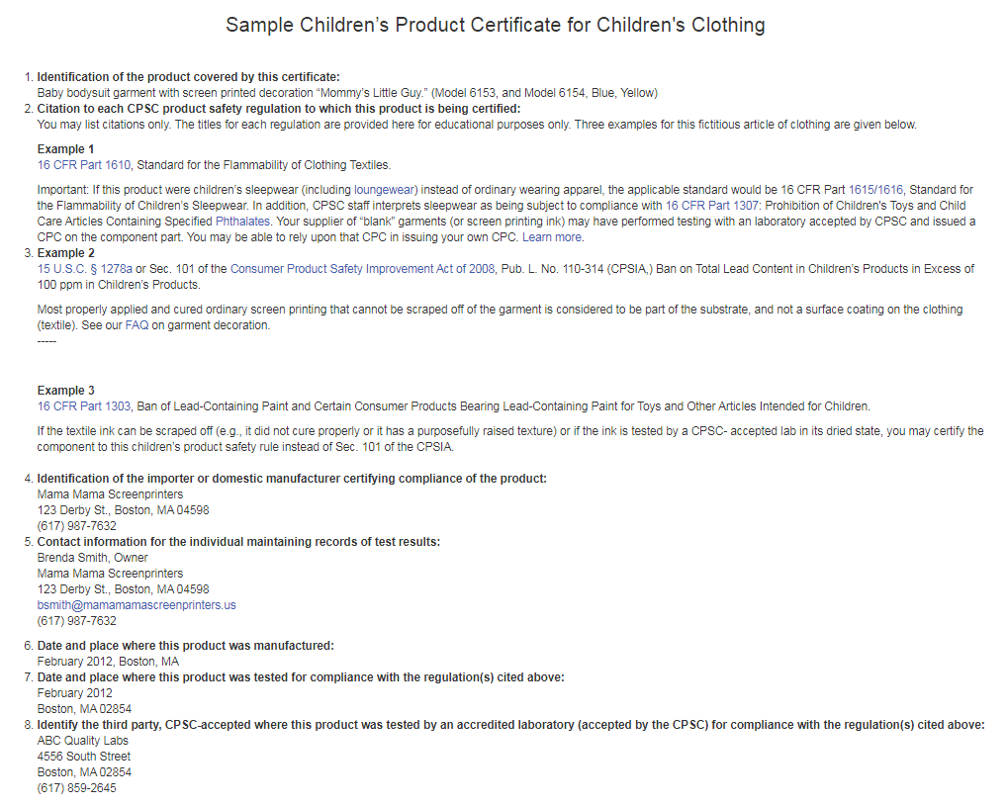
Examples of CPCs Can Be Found at 以下CPSC网址有多种儿童产品证书的范例
https://www.cpsc.gov/Testing-Certification/Childrens-Product-Certificate-CPC

Slide 42
Periodic Testing Requirements 定期测试规定
Testing with a CPSC-accepted lab is required every year unless:
产品每年都需要通过CPSC认可的检验机构检验，除非:
There is a production testing plan in place. In this case testing with an accredited CPSC accepted lab can be done every two years, or 有一个定期的生产测试计划，在这种情况下，可每两年让CPSC认可的检验机构检验，
There is a continuous testing by a laboratory that is ISO/IEC accredited.
In this case testing with a CPSC accepted lab can be done every three
years.
获得国际标准化组织/国际电工委员会 17025 标准所认证之检验机构持续检验，
在这种情况下可被 CPSC 认可的检验机构每三年检验一次。

Slide 43
Who Must Comply with the Periodic Testing Requirements? 谁必须遵守定期测试规定?
The party responsible for providing a written Children’s Product Certificate (CPC) must comply with the periodic testing requirements. For products manufactured domestically, the manufacturer is responsible. For products manufactured outside the United States, the importer is responsible.
负责提供儿童产品证书（CPC）的一方必须遵守定期测试规定。对于美国国产的产品，则由制造商负责。对于在美国国外制造的产品，则由进口商负责。

Slide 44
U.S. Toy Safety Requirements And mandatory Standards Case Study 美国玩具安全要求和强制性标准：案例分析

Slide 45
Which requirements apply? 请问这个玩具需要遵守什么规定和标准?
-Small parts 小部件
Age 19+ months
给年龄19个月以上
-Lead content 铅含量
-Lead and other heavy metals surface coating
铅与其他重金属表面涂层
-Phthalates 塑化剂
-ASTM sound producing toy
ASTM 发声玩具
-ASTM Battery operated toy
有电池的玩具
-Tracking label and
certification
追踪标签和认证

Slide 46
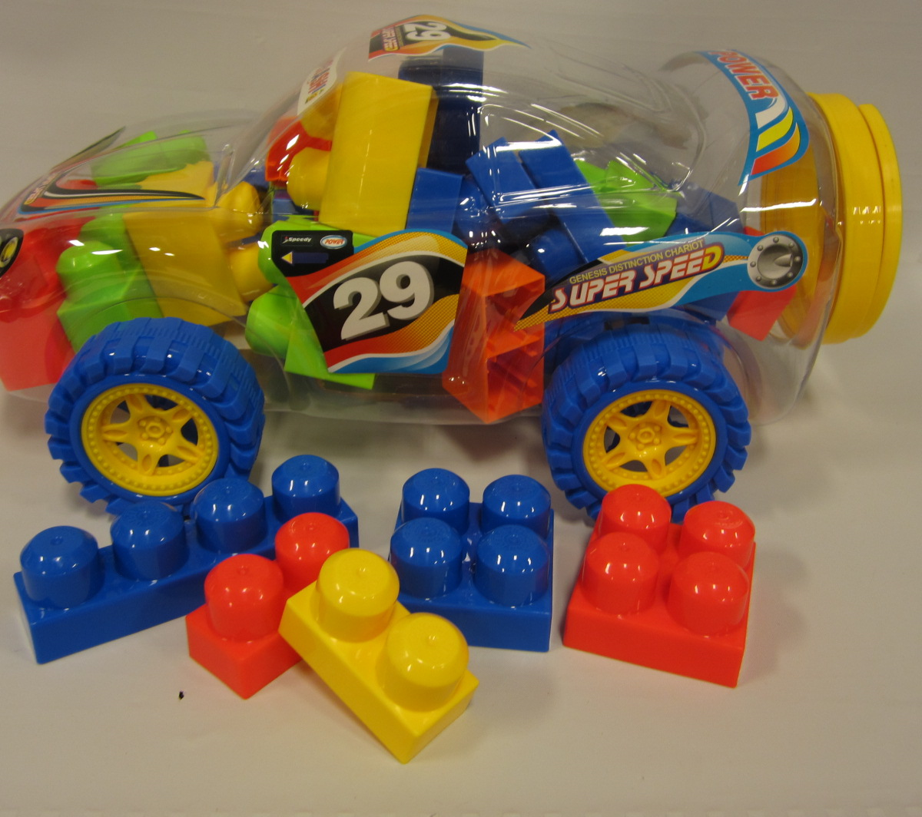
Which requirements apply? 请问这个玩具需要遵守什么规定和标准?
Age 19-35 months, 29 pieces, large blocks that do not fit into the small parts cylinder
适当年龄19〜35个月，29个较大的部件, 部件无法装入小部件圆筒
Age 3+ years, 102 pieces, small blocks that fit into the small parts cylinder
适当年龄3年以上，共102个小部件
-Lead content 铅含量
-Small parts warning label 小部件警告标签
-Phthalates 塑化剂
-Lead content 铅含量
-Small parts 小部件
-Phthalates 塑化剂
-Tracking label 追踪标签
-Certification 认证
-Tracking label 追踪标签
-Certification 认证

Slide 47
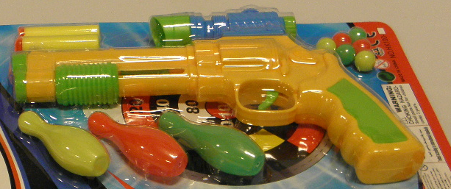
Which requirements apply? 请问这个玩具需要遵守什么规定和标准?
Age 3+ years 适当年龄3年以上
-Lead content 铅含量
-Phthalates 塑化剂
-ASTM F963 projectile toy ASTM F963 弹射玩具
-Small parts warning label 小部件警告标签
-Tracking label 追踪标签
-Certification 认证

Slide 48

Questions?
Submit questions in English or Chinese to this podcast:
CPSCinChina@CPSC.GOV

Slide 49
Resources

Slide 50
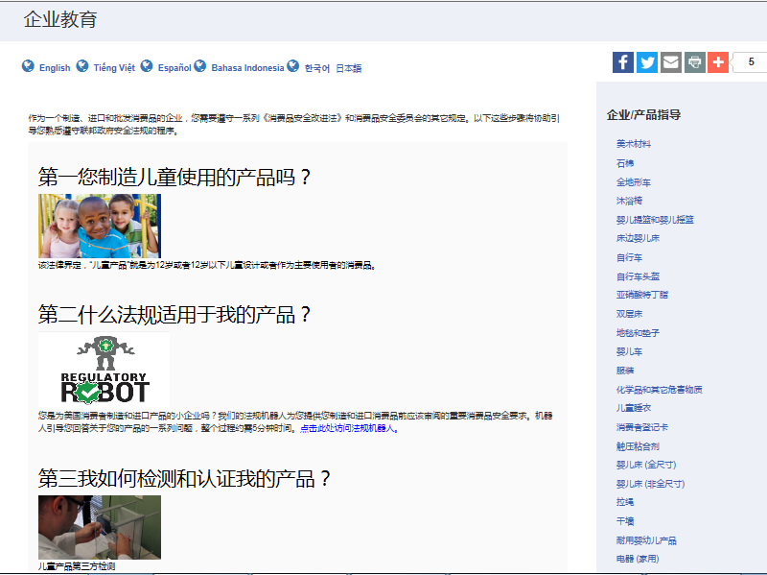
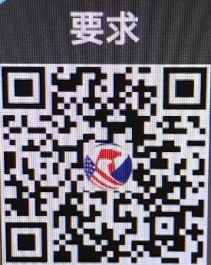
https://www.cpsc.gov/Business--Manufacturing/Business-Education/Durable-Infant-or-Toddler-Products
Chinese Resources at cpsc.gov

Slide 51
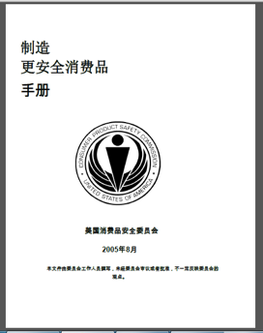
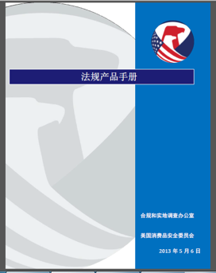
Chinese Resources at cpsc.gov
https://www.cpsc.gov/s3fs-public/HandbookforManufacturingChinese.pdf (中文版本 )
https://www.cpsc.gov/s3fs-public/pdfs/blk_pdf_handbookenglishaug05.pdf (英文版本)
https://www.cpsc.gov/s3fs-public/THE%20REGULATED%20PRODUCT%20HANDBOOK_050613%20CHN%20Final_0.pdf (中文版本 )
https://www.cpsc.gov/s3fs-public/RegulatedProductsHandbook.pdf (英文版本)

Slide 52
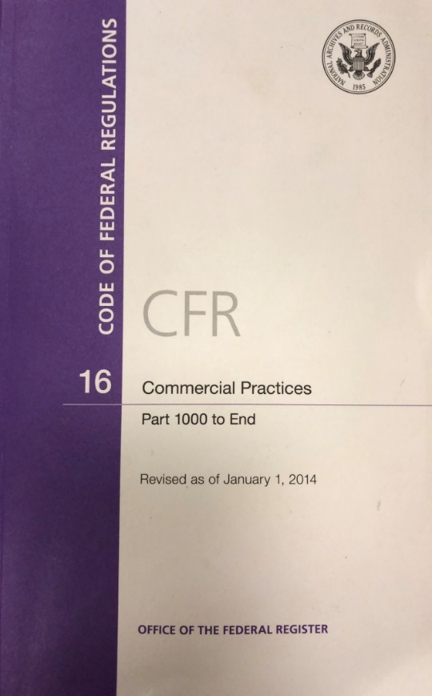
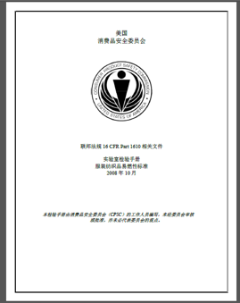
Chinese Resources at cpsc.gov
CFR: Commercial Practices
https://www.govinfo.gov/content/pkg/CFR-2017-title16-vol2/pdf/CFR-2017-title16-vol2.pdf (英文版本)
CPSC Laboratory Manuals:
https://www.cpsc.gov/s3fs-public/Laboratory-test-manual-16-CFR-Part-1610-Ch.pdf?MhtbUWNy6jmOPx9b6f.RErt.n.2n_d_h (中文版本)
https://www.cpsc.gov/s3fs-public/Flammability%20of%20Clothing%20Textiles%20Test%20Manual_1610.pdf (英文版本)

Slide 53
Definition of children’s product – 16 CFR Part 1200
Certificates of conformity – 16 CFR Part 1110
Third-party testing – 16 CFR Parts 1107, 1109, and 1112
Tracking information – 15 USC § 2063(a)(5)
Mandatory reporting requirements – 15 USC §2064
CPSC Business Resources
CPSC-Accepted Laboratories Search Page:
www.cpsc.gov/LabSearch

Slide 54

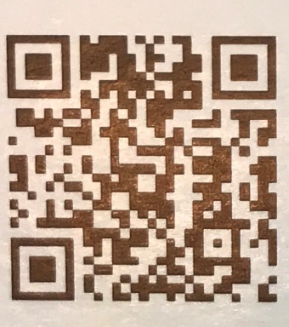
http://business.cpsc.gov
Online tool designed specifically to help businesses comply with federal consumer product safety requirements.
Asks a series of guided questions, and based on the answers produces a downloadable (PDF) report.
Provides customized guidance with links to product safety regulations that may apply to the product and important information on labeling, certification and testing requirements.

Slide 55
Regulatory Robot
Regulatory Robot is a tool to help identify which mandatory standards are applicable
Does not give details of requirements within a specific standard
User inputs product features
Regulatory Robot outputs list of standards and requirements
User references source documents for specific requirements

