Slide 1
Video: Welcome to the 2020 CPSC Podcast Series-Durable Infant or Toddler Products Common Requirements

Slide 2
Podcast Series 2020
Durable Infant or Toddler Products Common Requirements
This presentation was prepared by CPSC Staff. It has not been reviewed or approved by the Commission and may not reflect its views.

Slide 3
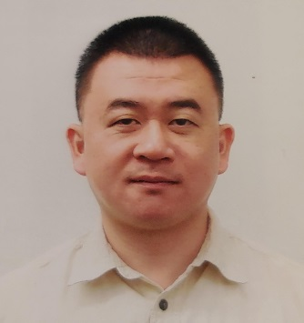
Biographies
Sylvia Chen
U.S. Consumer Product Safety Commission
Program Manager for East Asia and Pacific
Office of International Programs
Joseph Tsai, Senior Compliance Officer
Regulatory Enforcement Division
Office of Compliance and Field Operations
U.S. Consumer Product Safety Commission
Sylvia Chen is Program Manager for East Asia and Pacific at the U.S. Consumer Product Safety Commission (CPSC). In that role, she is responsible for managing the Commission’s bilateral and multi-lateral programs related to consumer product safety in Australia, Japan, Korea, Taiwan and New Zealand. She also supports the CPSC’s work with China. Since she joined the CPSC in 2008, Sylvia has been working with product safety regulators, industry organizations, manufacturers, exporters, buyers and other sourcing professionals to provide them with guidance and technical support in understanding U.S. requirements, in particular the latest requirements for consumer products. To that end, she has organized or coordinated many of the agency’s international education and outreach activities.
Sylvia has a Bachelor of Arts degree in English and American Literature from Peking University. In 1991, she graduated from The Ohio State University with a Master’s degree in East Asian
Joseph joined the U.S. Consumer Product Safety Commission (CPSC) in April 2008, as a Compliance Officer in the Regulatory Enforcement Division of the Office of Compliance and Field Operations.
As a Compliance Officer, he is responsible for enforcing the mandatory regulations for children’s products, such as, toys, pacifiers, and rattles under the Federal Hazardous Substances Act (FHSA) and Consumer Product Safety Act (CPSA).
In addition, he advises stakeholders on requirements for tracking and certification for children’s products under the CPSA. His specific responsibilities include advisement on the implementation of regulations, standards, and bans under the FHSA and the CPSA, and providing advice and guidance to consumers and the regulated industry.
Prior to joining the CPSC, Mr. Tsai was an officer at U.S. Customs and Border Protection, and a research scientist with Scripps Research Institute, La Jolla, California. Mr. Tsai holds a Bachelor of Science degree from University of California, Los Angeles (UCLA), and a Master of Science degree from University of California, San Diego (UCSD).

Slide 4
The US CPSC is a federal government agency charged with protecting the public from unreasonable risks of injury or death associated with the use of consumer products under the agency's jurisdiction.
$1 Trillion
Deaths, injuries, and property damage from consumer product incidents cost the nation more than $1 trillion annually.¹
¹ https://www.cpsc.gov/s3fs-public/FY2019PBR.pdf
CPSC is committed to protecting consumers from products that pose a fire, electrical, chemical, biological, or mechanical hazard.
CPSC's work to improve the safety of the more than 15,000 types of consumer products in its jurisdiction - such as toys, cribs, power tools, cigarette lighters, textiles, and household chemicals – has contributed to a decline in the rate of deaths and injuries associated with consumer products over the past 40 years.

Slide 5
CPSC’s Podcast Series
Podcast | Topics
#1 | Selling Safe Electrical Products to the U.S. Market
#2 | Overview of U.S. Apparel Requirements
#3 | CPSC Bicycle Regulations and U.S. and International Safety Standards
#4 | Overview of U.S. Mattress Requirements
#5 | Durable Infant or Toddler Products Common Requirements
#6 | Overview of Carriage and Stroller Requirements
#7 | Toy Safety
“Questions on this Presentation? Send an email to CPSCinChina@cpsc.gov”

Slide 6
The slides used in this podcast are not a comprehensive statement of legal requirements or policy and should not be relied upon for that purpose. You should consult official versions of U.S. statutes and regulations, as well as published CPSC guidance when making decisions that could affect the safety and compliance of products entering U.S. commerce. Note that references are provided at the end of the presentation.

Slide 7
Durable Infant or Toddler Products Common Requirements

Slide 8
Today’s Presentation
What is a durable infant or toddler product?
什么是婴幼儿耐用产品?
What are the requirements for durable infant or toddler products?
婴幼儿耐用产品需要遵守什么法规?
What are the Product Registration and Labeling Requirements for durable infant or toddler under the Consumer Product Safety Improvement Act (CPSIA) of 2008?
婴幼儿耐用产品在2008年消费品安全改进法案下的产品注册和标签需求。
What are the regulations regarding Third Party Testing and Certification For Children’s Products Under the Consumer Product Safety Improvement Act (CPSIA)?
消费品安全改进法案下之儿童产品的第三方测试和认证需求。
What are other requirements that pertain to lead, phthalates and small parts?
其他共用要求：铅，邻苯二甲酸盐 (塑化剂) 和小部件。

Slide 9
WHAT IS A DURABLE INFANT OR TODDLER PRODUCT? 什么是婴幼儿耐用产品?
“Durable infant or toddler product” is defined as a durable product intended for use, or that may be reasonably expected to be used, by children under the age of 5 years.
“婴儿和幼儿耐用产品”被法律定义为给5岁以下儿童使用或可以合理预期使用的耐用产品。
CPSIA of 2008 requires the CPSC to promulgate consumer product safety standards for durable infant or toddler products.
2008年消费品安全改进法案要求 CPSC 颁布婴幼儿耐用产品的安全标准。
The law requires the standards to be the same as the voluntary standards or made more stringent if it reduces the risk of injury.
法律要求新的标准与现有的自愿标准相同，如果能降低受伤风险则新的标准可以更严格。

Slide 10
WHAT REQUIREMENTS DOES A DURABLE INFANT OR TODDLER PRODUCT NEED TO BE IN COMPLIANCE WITH? 婴幼儿耐用产品需要遵守什么法规?
The performance requirements for each respective durable infant or toddler product
婴幼儿耐用产品其个别专属的产品规格
Product registration and labeling requirements for durable infant or toddler products
婴幼儿耐用产品的产品注册和产品标签之规定
Testing and certification requirements for children’s products
儿童产品的第三方测试和认证之规定
Other common requirements: lead (surface coating and content), phthalates, and small parts
其他共同规定: 铅， 邻苯二甲酸盐 (塑化剂) 和小部件之规定

Slide 11
List of Durable Infant or Toddler Products
Bassinets and Cradles 婴儿提篮和摇篮 (F2194-13) | Soft Infant and Toddler Carriers 婴儿和幼儿软式搬运架 (F2236-14)
Bedside Sleepers 床边婴儿睡眠床 (F2906-13) | Infant Bath Seats 婴儿浴座椅 (F1967-19)
Booster Seats 幼儿增高座位 (用于汽车内的) (F2640-18) | Infant Bath Tubs 婴儿浴缸 (F2670-18)
Carriages and Strollers 婴儿车和婴儿推 (F833-19) | Infant Bouncer Seats 婴儿蹦蹦座 (F2167-19)
Changing Products更換尿布檯 (F2388-18) | Infant Sleep Products 婴儿倾斜睡眠产品 (F3118-17) Final Rule pending
Children’s Folding Chairs and Stools 儿童折叠椅和折叠凳子 (F2613-19) | Infant Swings 婴儿秋千 (F2088-13)
Cribs (Full-size) 婴儿床 (全尺寸) (F1169-19) | Infant Walkers 婴儿学步车 (F977-12)
Cribs (Non Full-size) 婴儿床 (非全尺寸) (F406-19) | Play Yards 婴儿用游戏围栏 (F406-19)
Expansion Gates and Expandable Enclosures 扩张门和可扩展围栏 (F1004-19) Final Rule pending | Portable Bed Rails 携带式床架 (F2085-19)
Frame Child Carriers 儿童搬运架 (F2549-14a) | Portable Hook-On Chairs 携带式挂钩椅 (F1235-18)
High Chairs 高脚椅 (F404-18) | Sling Carriers 婴儿挂带 (F2907-19)
Stationary Activity Centers 固定式婴儿活动座 (F2012-18^{ε1}) | Toddler Beds 幼儿床 (F1821-19^{ε1})
Hand-Held Infant Carriers 手持式婴儿座椅 (F2050-19) | Crib Bumpers and Liners 婴儿床保险垫和床垫 (F1917-12) NPR issued
Crib Mattresses (TBD) NPR pending
27 Different Performance Requirements
27个专属的产品规格

Slide 12
Majority Of The Violations In Durable Infant Or Toddler Products Are In Registration, Labeling, And Certification 婴幼儿耐用产品大多数是在注册，标签和认证上违规
64% of the violations is
not related to the product’s
performance violation
非产品规格违规占64%

Slide 13
Product registration and labeling requirements for a durable infant or toddler product 婴幼儿耐用产品的消费者产品注册和产品标签之规定
CPSIA requires a specific registration form and labeling for durable infant or toddler products.
消费品安全改进法案明文规定婴幼儿耐用产品必须有特定的产品注册表和标签。
Registration form must be attached to the product.
产品注册表必须附在产品上。
Labeling must be on the product and its packaging.
产品标签必须在产品本身和产品包装上。
The on-product labeling must be permanent.
产品上的标签必须是永久性的。
Purpose - improve notification to product owners and promote recall effectiveness.
促进产品召回效能 。

Slide 14
What Information Satisfies The Labeling Requirements For Durable Infant or Toddler Products?
婴幼儿耐用产品的标签需要有什么信息?
Name of manufacturer
制造商名称
Date of manufacture
生产日期
Model name / number
产品式样名称/型号
Product’s city and country of origin
产品的原产国及城市
Include manufacturer’s contact information (must be U.S. address and telephone number).
制造商的联系信息 (必须是美国地址和电话号码)

Slide 15
Durable infant or toddler product registration requirements and the registration form 婴幼儿耐用产品的产品注册需求和产品注册表
Provide a postage-paid consumer registration form with each product.
产品必须有邮费已付的产品注册表。
Registration form must be attached to the product so a consumer notices it after purchasing the
product.
注册表必须附在产品上, 所以消费者在购买产品后注意到它。
The manufacturer’s name and U.S. contact information, model name and number must be on the
registration form.
制造商的名称和制造商在美国的联系信息, 产品的式样名称和型号必须已印在注册表上。
Must keep records of consumers who register their products with the manufacturer.
制造商必须保存消费者所注册的资料与记录。
Must provide an option for consumers to register online.
必须让消费者能在网上注册。

Slide 16
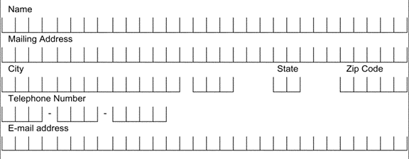
An example of a registration form 产品注册表的范例
Manufacturer’s U.S. contact information: address and registration website.
If no registration website, email is required. 制造商的美国联系信息：
地址和注册网站。如果没有注册网站， 则需要电子邮件。
Purpose statement 目的声明
Manufacturer’s Contact Information
PRODUCT REGISTRATION FOR SAFETY ALERT OR RECALL ONLY
Manufacturer’s Name
111 Main St., Anytown, ST 01234
www.website.com
Phone Number-Toll-Free (if available)
Consumer keeps
消费者保存
We will use the information provided on this card to contact you only if there is a safety alert or recall for this product. We will not sell, rent, or share your personal information. To register your product, please complete and mail the bottom part of this card, or visit our online registration at: www.website.com
Model Name: ABC
Model Number: 123
Manufacture Date: January 1, 2020
Pre-printed product info. 预印产品信息
KEEP THIS TOP PART FOR YOUR RECORD. FILL OUT AND RETURN BOTTOM PART.
Postage paid 邮资已付
Consumer’s Address And Contact Information
Place for consumers to fill in their contact info. 消费者填写联系信息的地方。
Consumer mails out
消费者邮寄
Manufacturer’s Name
Post Office Box 0000
Anytown, ST 01234
Model Name: ABC
Model Number: 123
Manufacture Date: January 1, 2020
Pre-printed product info. 预印产品信息
Manufacturer’s U.S. mailing address.
制造商的美国邮寄地址
FRONT
BACK

Slide 17
Registration Form
产品注册表: 消费者保存的部分
Purpose statement
目的声明
PRODUCT REGISTRATION FOR SAFETY ALERT OR RECALL ONLY
front side 前面
We will use the information provided on this card to contact you only if there is a safety alert or recall for this product. We will not sell, rent, or share your personal information. To register your product, please complete and mail the bottom part of this card, or visit our online registration at: www.website.com
Manufacturer’s U.S. contact information: address and registration website. If no registration website, email is required.
制造商的美国联系信息：
地址和注册网站。
如果没有注册网站，
则需要电子邮件。
Manufacturer’s Contact Information
Manufacturer’s Name
111 Main St., Anytown, ST 01234
www.website.com
Phone Number-Toll-Free (if available)
back side
后面
Model Name: ABC
Model Number: 123
Manufacture Date: January 1, 2020
Pre-printed product info.
预印产品信息
KEEP THIS TOP PART FOR YOUR RECORD. FILL OUT AND RETURN BOTTOM PART.

Slide 18
Registration Form
产品注册表: 消费者邮寄的部分
Postage paid
邮资已付
front side
前面
Manufacturer’s Name
Post Office Box 0000
Anytown, ST 01234
Manufacturer’s U.S. mailing address
制造商的美国邮寄地址
Place for consumers to fill in their contact info.
消费者填写联系信息
的地方
Consumer’s Address And Contact Information
back side
后面
Pre-printed product info.
预印产品信息
Model Name: ABC
Model Number: 123
Manufacture Date: January 1, 2020

Slide 19
Third Party Testing and Certification for Children’s Products 儿童产品的第三方测试和认证
Consumer Product Safety Improvement Act of 2008 requires that each manufacturer must have children’s products, including durable infant or toddler products, tested to the applicable requirements by a CPSC-accepted and accredited third party testing conformity laboratory.
2008年消费品安全改进法要求制造商必须将其儿童产品 (包括婴幼儿耐用产品)
给美国消费品安全委员会认可的第三方检测机构按照适用的美国法规检验。
Provide a Children’s Product Certificate (CPC) based on passing test reports, and it must be provided to the retailer and/or distributor and accompany the shipment at the time of importation into U.S.
经过检验后,依第三方检测机构的检验报告提供一份儿童产品证书（CPC）。儿童产品证书必须提供给零售商和/或分销商，并在报关 (美国海关) 时随附。

Slide 20
Elements Required In A CPC
儿童产品证书必须有以下信息
Identification of the product covered by this certificate.
产品名称。
Citation to each CPSC children’s product safety rule to which this product is being certified.
列该产品所通过的每个CPSC儿童产品安全规则。
Identification of the importer or domestic manufacturer certifying compliance of the product: Provide the name, full mailing address, and telephone number.
列签署该产品证书的进口商或 (美国) 国内制造商证的名称, 地址, 和电话号码。
Contact information for the individual maintaining records of test results: Provide the name, full mailing address, e-mail address, and telephone number of the person maintaining test records in support of the certification.
列检验报告持有者的联系信息: 姓名, 地址, email, 和电话号码。
Date and place where this product was manufactured:
本产品的生产日期和其原产国及城市。
Provide the date(s) and place when the product was tested for compliance with the consumer product safety rule(s) cited above.
提供本产品检验的日期和地点。
Identify any third party, CPSC-accepted laboratory on whose testing the certificate depends: Provide the name, full mailing address, and telephone number of the laboratory.
提供检验本产品的 CPSC 认可之第三方检测机构的名称，地址和电话号码。

Slide 21
Examples of CPCs Can Be Found At
以下CPSC网址有多种儿童产品证书的范例
https://www.cpsc.gov/Testing-Certification/Childrens-Product-Certificate-CPC

Slide 22
Other Common Requirements For Durable Infant or Toddler Products
其他的共用要求
Small Parts 小部件:
Lead 铅:
Lead content : cannot exceed 100 ppm in children’s products.
铅含量不可超过 100 ppm
Lead in paint: cannot exceed 90 ppm for surface coating on children’s products.
漆的铅含量不可超过 90 ppm
Phthalates 塑化剂:
Permanently banned – No more than 0.1% of DEHP, DBP, BBP, DINP, DIBP, DPENP, DHEXP, or DCHP.
塑化剂DEHP, DBP, BBP, DINP, DIBP, DPENP, DHEXP, or DCHP 不可超过 0.1%
Applies to children’s toys and child care articles that facilitate sleeping or feeding or help with sucking or teething of a child ages 3 and younger.
适用于儿童玩具以及让3岁和3岁以下儿童方便入睡,喂食或帮助其吮吸或出牙的用品。

Slide 23
Case Study

Slide 24
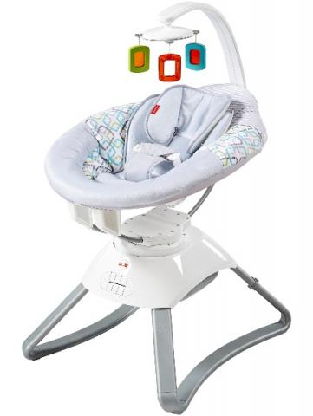
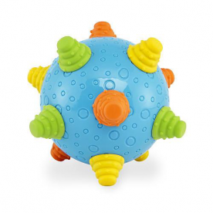
Which product below is a durable infant or toddler product? 以下哪一个产品是婴幼儿耐用产品?

Slide 25
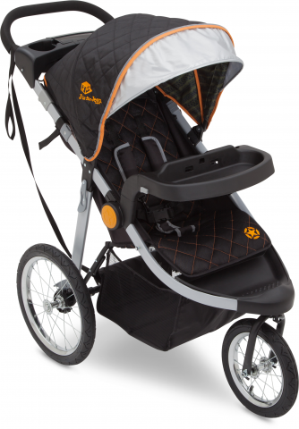
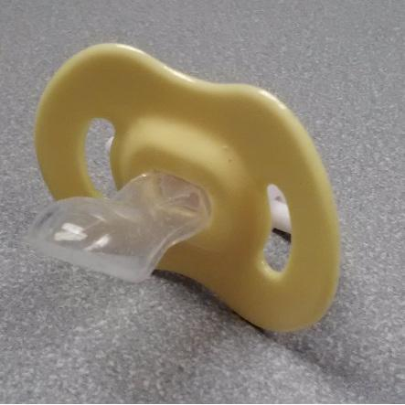
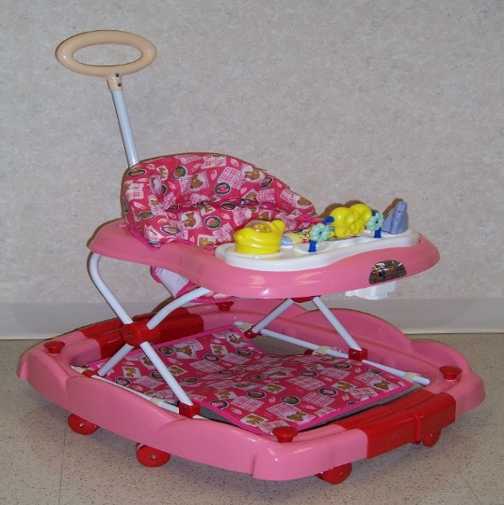
Which product below is not a durable infant or toddler product? 以下哪一个产品不是婴幼儿耐用产品?

Slide 26
What information must the manufacturer place on durable infant or toddler products to meet all the labeling requirements?
婴幼儿耐用产品的标签需要有什么信息?
Name of manufacturer
制造商名称
Date of manufacture
生产日期
Model name / number
产品式样名称/型号
Product’s city and country of origin
产品的原产国及城市
Include manufacturer’s contact information (must be U.S. address and telephone number).
制造商的联系信息 (必须是美国地址和电话号码)
Above information must be on the product and its packaging.以上信息必须在产品本身及其包装上

Slide 27
What Information Needs To Be On The Part Of The Registration Form Which Consumers Keep?
产品注册表: 消费者保存的部分需要有什么?
Purpose statement
目的声明
PRODUCT REGISTRATION FOR SAFETY ALERT OR RECALL ONLY
front side
前面
We will use the information provided on this card to contact you only if there is a safety alert or recall for this product. We will not sell, rent, or share your personal information. To register your product, please complete and mail the bottom part of this card, or visit our online registration at: www.website.com
Manufacturer’s U.S. contact information: address and registration website. If no registration website, email is required.
制造商的美国联系信息：
地址和注册网站。如果没
有注册网站，则需要电子
邮件。
Manufacturer’s Contact Information
Manufacturer’s Name
111 Main St., Anytown, ST 01234
www.website.com
Phone Number-Toll-Free (if available)
back side
后面
Model Name: ABC
Model Number: 123
Manufacture Date: January 1, 2020
Pre-printed product info.
预印产品信息
KEEP THIS TOP PART FOR YOUR RECORD. FILL OUT AND RETURN BOTTOM PART.

Slide 28
What Information Needs To Be On The Part Of The Registration Form Which Consumers Mail Back To The Firm?
产品注册表: 消费者邮寄的部分需要有什么 ?
Postage paid
邮资已付
front side
前面
Manufacturer’s Name
Post Office Box 0000
Anytown, ST 01234
Manufacturer’s U.S. mailing address
制造商的美国邮寄地址
Place for consumers to fill in their contact info.
消费者填写联系信息的地方
Consumer’s Address And Contact Information
back side
后面
Pre-printed product info.
预印产品信息
Model Name: ABC
Model Number: 123
Manufacture Date: January 1, 2020

Slide 29
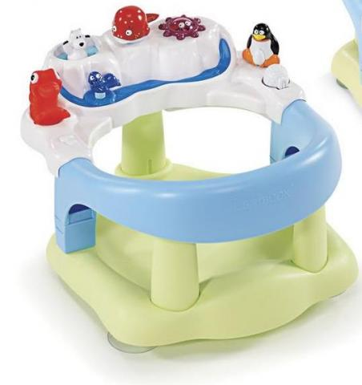
If you want distribute the product pictured below in the U.S., what should you prepare before you bring the product into the U.S.?
您希望在美国销售此产品，在将此产品带入美国之前，您应该准备什么？
Make sure the product has the required labels for durable infant or toddler products. Make sure the
on-product label is permanent.
确保产品本身和其包装上有永久性的婴幼儿耐用产品标签。
Make sure a registration form is attached to the product.
确保产品上附有产品注册表。
Get the product tested by a CPSC-accepted third party testing lab.
Make sure the product is tested to all the applicable CPSC requirements.
让CPSC认可的第三方检测机构检验你的产品, 并确保本产品通过所有适用的
CPSC 法规。
Provide a children’s product certificate (CPC) based on the third party test report, and provide the CPC when you file entry with U.S. Customs.
检验后,依第三方检测机构的检验报告提供一份儿童产品证书 (CPC), 并在报关
(美国海关) 时随附。
Infant Bath Seat
婴儿浴座椅

Slide 30
Questions?
Submit questions in English or Chinese to this podcast:
CPSCinChina@CPSC.GOV

Slide 31
Resources

Slide 32
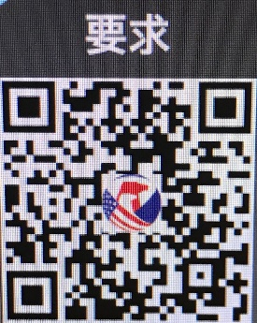
https://www.cpsc.gov/Business--Manufacturing/Business-Education/Durable-Infant-or-Toddler-Products
Chinese Resources at cpsc.gov

Slide 33
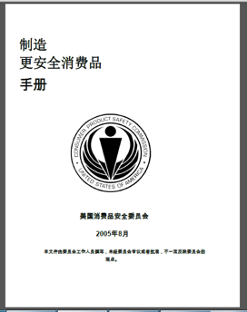
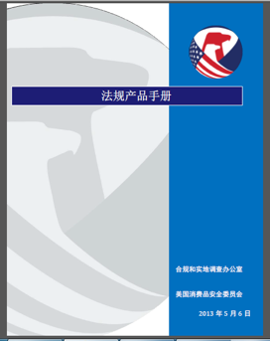
Chinese Resources at cpsc.gov
https://www.cpsc.gov/s3fs-public/HandbookforManufacturingChinese.pdf (中文版本 )
https://www.cpsc.gov/s3fs-public/pdfs/blk_pdf_handbookenglishaug05.pdf (英文版本)
https://www.cpsc.gov/s3fs-public/THE%20REGULATED%20PRODUCT%20HANDBOOK_050613%20CHN%20Final_0.pdf (中文版本 )
https://www.cpsc.gov/s3fs-public/RegulatedProductsHandbook.pdf (英文版本)

Slide 34
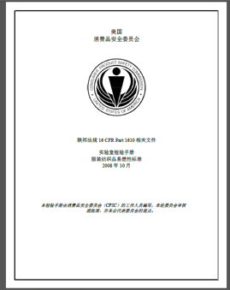
Chinese Resources at cpsc.gov
CFR: Commercial Practices
https://www.govinfo.gov/content/pkg/CFR-2017-title16-vol2/pdf/CFR-2017-title16-vol2.pdf (英文版本)
CPSC Laboratory Manuals:
https://www.cpsc.gov/s3fs-public/Laboratory-test-manual-16-CFR-Part-1610-Ch.pdf?MhtbUWNy6jmOPx9b6f.RErt.n.2n_d_h (中文版本)
https://www.cpsc.gov/s3fs-public/Flammability%20of%20Clothing%20Textiles%20Test%20Manual_1610.pdf (英文版本)

Slide 35
Definition of children’s product – 16 CFR Part 1200
Certificates of conformity – 16 CFR Part 1110
Third-party testing – 16 CFR Parts 1107, 1109, and 1112
Tracking information – 15 USC § 2063(a)(5)
Mandatory reporting requirements – 15 USC §2064
CPSC Business Resources
CPSC-Accepted Laboratories Search Page:
www.cpsc.gov/LabSearch

Slide 36
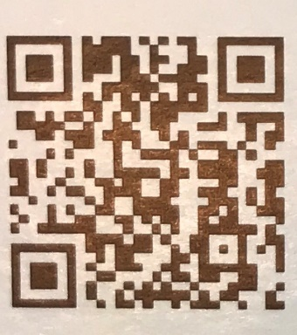
http://business.cpsc.gov
Online tool designed specifically to help businesses comply with federal consumer product safety requirements.
Asks a series of guided questions, and based on the answers produces a downloadable (PDF) report.
Provides customized guidance with links to product safety regulations that may apply to the product and important information on labeling, certification and testing requirements.

Slide 37
Regulatory Robot
Regulatory Robot is a tool to help identify which mandatory standards are applicable
Does not give details of requirements within a specific standard
User inputs product features
Regulatory Robot outputs list of standards and requirements
User references source documents for specific requirements

Slide 38
Durable Infant or Toddler Products Resources

Slide 39
Revised Final Rules
New Final Rules
CPSC Regulatory Update: Section 104 Rules

Slide 40
CPSIA Section 104: Revised Final Rules
Revisions to Safety Standard for Portable Hook-on Chairs
16 CFR part 1233 (incorporates ASTM F1235-18 with no modifications)
Effective Date: January 15, 2019
Revisions to Safety Standard for Infant Bath Tubs
16 CFR part 1234 (incorporates ASTM F2670-18 with no modifications)
Effective Date: January 15, 2019
Revisions to Safety Standard for Full-Size Baby Cribs
16 CFR part 1219 (will incorporate ASTM F1169-19 with no modifications)
Effective Date: October 28, 2019

Slide 41
CPSIA Section 104: Revised Final Rules
Revisions to Safety Standard for Carriages and Strollers
16 CFR part 1227 (will incorporate ASTM F833-19 with no modifications)
Effective Date: November 5, 2019
Revisions to Safety Standard for Infant Bouncer Seats
16 CFR part 1229 (will incorporate ASTM F2167-19 with no modifications)
Effective Date: December 14, 2019
Revisions to Safety Standard for Infant Bath Seats
16 CFR part 1215 (will incorporate ASTM F1967-19 with no modifications)
Effective Date: December 22, 2019

Slide 42
CPSIA Section 104: Revised Final Rules
Revisions to Safety Standard for Non-Full-Size Cribs
16 CFR part 1220 (will incorporate ASTM F406-19 )
Effective Date: January 20, 2020
Revisions to Safety Standard for Play Yards
16 CFR part 1221 (will incorporate ASTM F406-19)
Effective Date: January 20, 2020
Revisions to Safety Standard for Toddler Beds
16 CFR part 1217 (will incorporate ASTM F1821-19e1)
Effective Date: January 27, 2020

Slide 43
CPSIA Section 104: New Final Rules
Safety Standard for Stationary Activity Centers
16 CFR part 1238 (will incorporate ASTM F2012-18ε1 with no modifications)
Effective Date: December 18, 2019
Direct Final Rule: ASTM's Revisions to Safety Standard for Hand-Held Infant Carriers.
The CPSC is revising the mandatory standard for hand-held infant carriers, 16 CFR part 1225, to incorporate by reference the more recent version of the applicable ASTM standard, ASTM F2050-19, Standard Consumer Safety Specification for Hand-Held Infant Carriers.
CPSIA Section 104 Rule Updates, Changes
Revisions to Safety Standard for Portable Bed Rails – Direct Final Rule: Effective 5/20/2020

