Slide 1
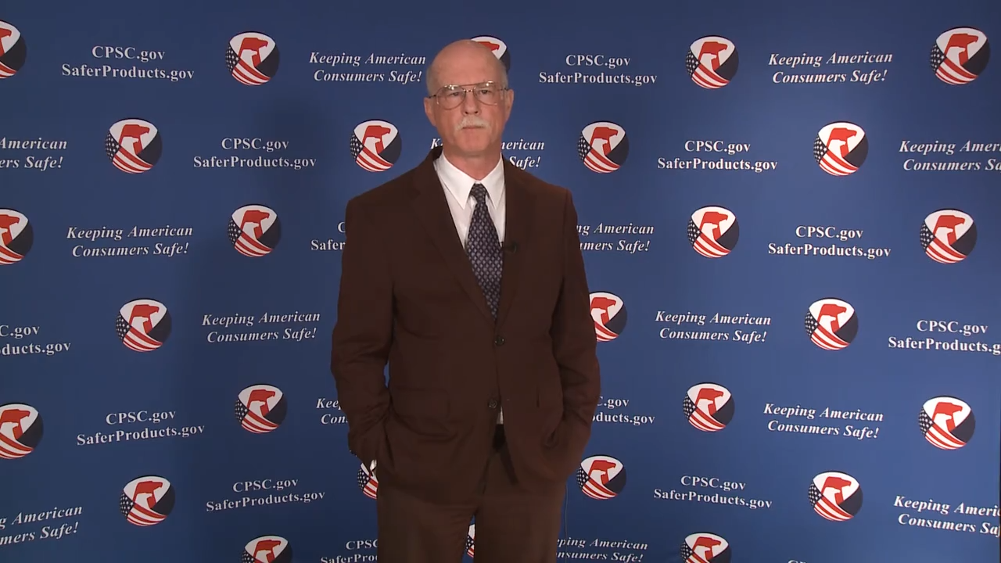
Video: Welcome to the 2020 CPSC Podcast Series-Overview of U.S. Mattress Requirements

Slide 2
Podcast Series 2020
Overview of U.S. Mattress Requirements
This presentation was prepared by CPSC Staff. It has not been reviewed or approved by the Commission and may not reflect its views.

Slide 3

Biographies
Sylvia Chen
U.S. Consumer Product Safety Commission
Program Manager for East Asia and Pacific
Office of International Programs
Sylvia Chen is Program Manager for East Asia and Pacific at the U.S. Consumer Product Safety Commission (CPSC). In that role, she is responsible for managing the Commission’s bilateral and multi-lateral programs related to consumer product safety in Australia, Japan, Korea, Taiwan and New Zealand. She also supports the CPSC’s work with China. Since she joined the CPSC in 2008, Sylvia has been working with product safety regulators, industry organizations, manufacturers, exporters, buyers and other sourcing professionals to provide them with guidance and technical support in understanding U.S. requirements, in particular, the latest requirements for consumer products. To that end, she has organized or coordinated many of the agency’s international education and outreach activities.
Sylvia has a Bachelor of Arts degree in English and American Literature from Peking University. In 1991, she graduated from The Ohio State University with a Master’s degree in East Asian

Slide 4

The US CPSC is a federal government agency charged with protecting the public from unreasonable risks of injury or death associated with the use of consumer products under the agency's jurisdiction.
$1 Trillion
Deaths, injuries, and property damage from consumer product incidents cost the nation more than $1 trillion annually.¹
¹ https://www.cpsc.gov/s3fs-public/FY2019PBR.pdf
CPSC is committed to protecting consumers from products that pose a fire, electrical, chemical, biological, or mechanical hazard.
CPSC's work to improve the safety of the more than 15,000 types of consumer products in its jurisdiction - such as toys, cribs, power tools, cigarette lighters, textiles, and household chemicals – has contributed to a decline in the rate of deaths and injuries associated with consumer products over the past 40 years.

Slide 5
CPSC’s Podcast Series
Podcast | Topics
#1 | Selling Safe Electrical Products to the U.S. Market
#2 | Overview of U.S. Apparel Requirements
#3 | Bicycle Regulations Safety Standards
#4 | Overview of U.S. Mattress Requirements
#5 | Durable Infant or Toddler Products Common Requirements
#6 | Overview of Carriage and Stroller Requirements
#7 | Toy Safety
“Questions on this Presentation? Send an email to CPSCinChina@cpsc.gov”

Slide 6
The slides used in this podcast are not a comprehensive statement of legal requirements or policy and should not be relied upon for that purpose. You should consult official versions of U.S. statutes and regulations, as well as published CPSC guidance when making decisions that could affect the safety and compliance of products entering U.S. commerce. Note that references are provided at the end of the presentation.

Slide 7
Overview of U.S. Mattress Requirements

Slide 8
Topics
What Is a Mattress?
U.S. Mattress Requirements
  Flammability, Labeling, and Recordkeeping
  Certification
  Chemical Content
  Tracking Labels
Designing for Safety
Resources

Slide 9
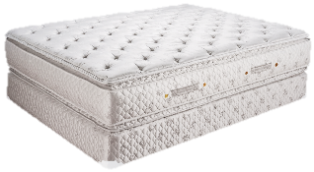
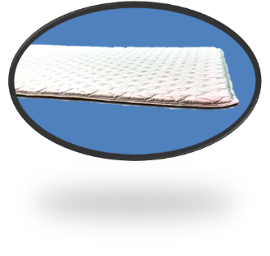
What Is a Mattress?
Regulatory Definitions and Scope:
  A mattress is:
    A ticking filled with a resilient material used alone or in combination with other products intended or promoted for sleeping upon, including mattresses that have undergone renovation.
    Subject to both 16 CFR parts 1632 and 1633.
  A mattress pad is:
    A thin, flat mat or cushion, or ticking filled with resilient material for use on top of a mattress.
    Subject to 16 CFR part 1632 only.

Slide 10
What Is a Mattress?
The definition of mattress includes (but is not limited to):
  Traditional mattresses, in all sizes, with flat or pillow top, single or double sided
  Crib mattresses
  Futons
  Mattresses in sleeper sofas and campers
  Water bed and air mattresses
    If they contain upholstery material between the ticking and mattress core
    Otherwise, exempt from requirements
See §§1632.1(a) or 1633.2(a)-(c) or contact CPSC Compliance staff for more information

Slide 11
U.S. Mattress Requirements
Flammable Fabrics Act (FFA)
  Mattresses and Mattress Pads
  Mattress Sets
Federal Hazardous Substances Act (FHSA)
  Lead Content
Consumer Product Safety Act (CPSA)
  Limitation on Levels of Lead in Paint and Surface Coatings
  Limitation on Concentration of Certain Phthalates
  Certification Requirements
  Tracking Labels

Slide 12
Flammable Fabrics Act (FFA)
Primary authority for CPSC-regulated textiles
Focused on flammability performance
Regulations
  Clothing Textiles (16 CFR part 1610)
  Vinyl plastic film (16 CFR part 1611)
  Children’s sleepwear (16 CFR parts 1615/1616)
  Carpets and rugs (16 CFR parts 1630/1631)
  Mattresses and mattress pads (16 CFR part 1632)
  Mattress sets (16 CFR part 1633)

Slide 13
Flammable Fabrics Act (FFA)
Standard for the Flammability of Mattresses and Mattress Pads (16 CFR part 1632)
  Applies to both mattresses and mattress pads
  Cigarette ignition test
Standard for the Flammability (Open-Flame) of Mattress sets (16 CFR part 1633)
  Applies to mattress sets (mattress alone or with foundation)
  Open-flame ignition test
For mattresses, both standards must be met before the product can be entered into commerce in the U.S.

Slide 14
Mattresses and Mattress Pads (1632)
Purpose of Regulation (1972)
  To improve ignition resistance of mattresses and mattress pads to smoldering cigarettes
Uses prototype testing scheme
  A design that is the same as production units with respect to materials, components, design, and method of assembly.
  New prototypes and material changes require testing
    Substitution tests exist for some material changes

Slide 15
Mattresses (1632)
6 surfaces
  Interim policy is 2 surfaces
Design features
  Smooth surface, tape edge, quilting or tufting
Bare and with sheeting (2 layers)
SRM cigarette ignition source
  Total of 36 observations for interim testing policy
    18 locations on each test specimen
    9 locations on each of bare and sheeting

Slide 16

Mattress Pads (1632)
6 surfaces
Design features
  Smooth surface, tape edge, quilting or tufting
Bare and with sheeting (2 layers)
SRM cigarette ignition source
  Total of 36 observations for interim testing policy
    18 locations on each test specimen
    9 locations on each of bare and sheeting
If FR treated, tested after 10 launderings

Slide 17
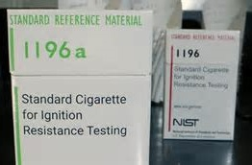
Mattresses and Mattress Pads (1632)
Standard reference material (SRM) cigarette was updated in February 2020
Supply of the previous product was depleted
New SRM is equivalent to previous version:
  Physical dimensions
  Ignition strength
  Test procedure
Amendment to incorporate this change into regulation expected late 2020
Photo credit: NIST
Order SRM 1196a from NIST.gov
https://www-s.nist.gov/srmors/view_detail.cfm?srm=1196a

Slide 18
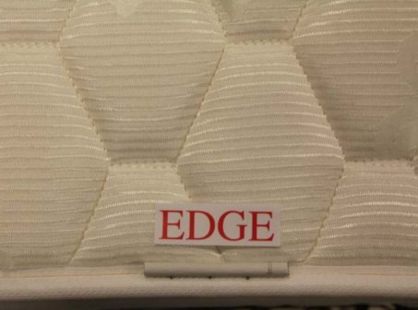
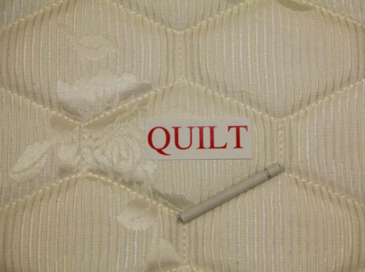
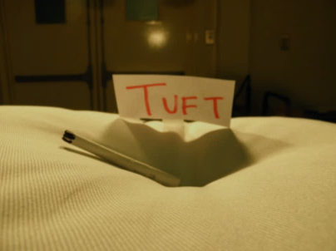
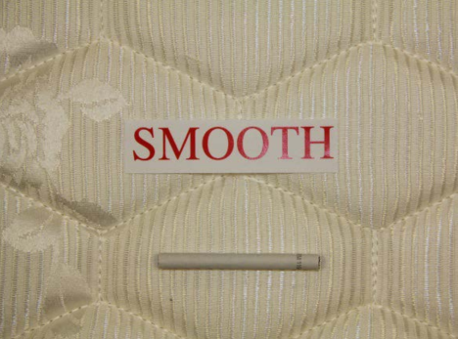
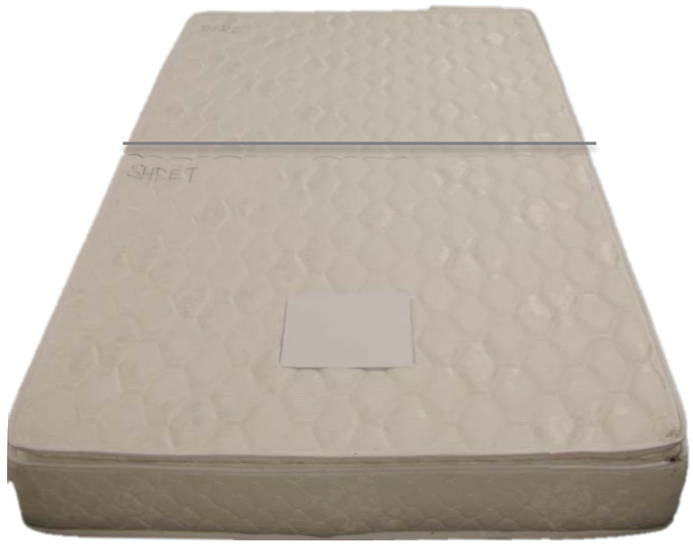
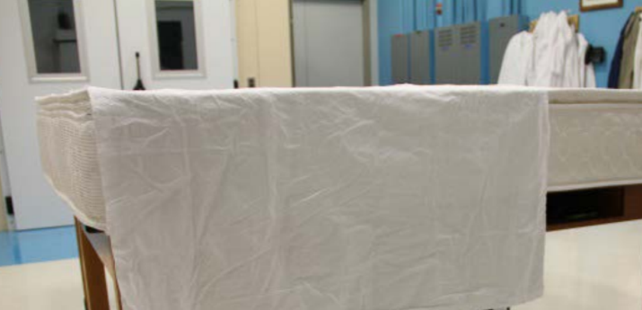
Mattresses and Mattress Pads (1632)

Slide 19
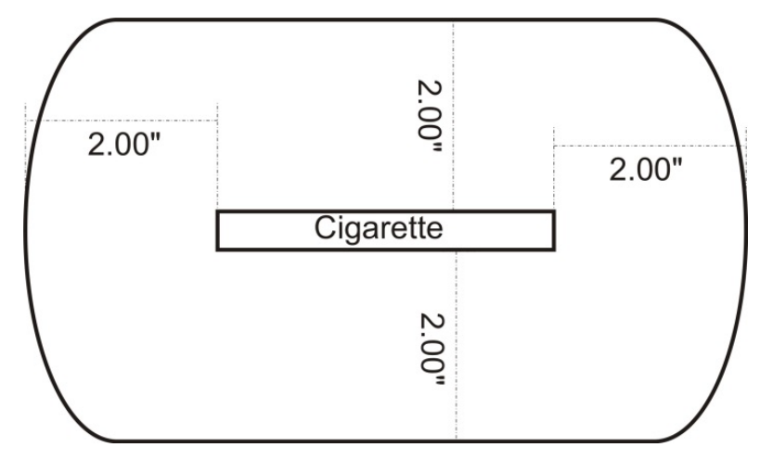
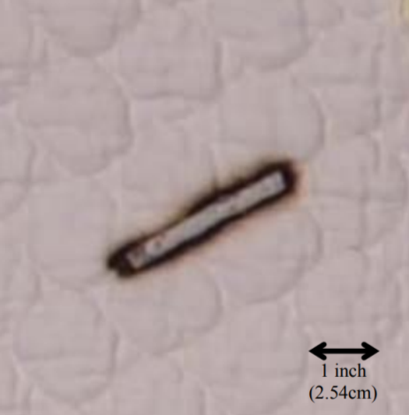
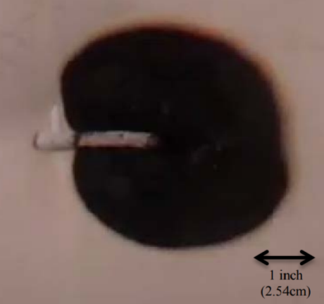
Mattresses and Mattress Pads (1632)
Test criteria:
  Charring may not extend greater than 2 inches in any direction from the ignition cigarette

Slide 20
Mattresses (1632)
Labeling Requirements
  Date of manufacture (MM/YYYY)
  Manufacturing location
    Include all company manufacturing locations by street address
*Note that there may be additional state requirements for labeling.

Slide 21
Mattress Pads (1632)
Labeling Requirements
  Date of manufacture (MM/YYYY)
  Manufacturing location
    Include all company manufacturing locations by street address
  If an FR treatment is used:
    Mark with “T”.
    Include precautionary care instructions to maintain FR efficacy.
*Note that there may be additional state requirements for labeling.

Slide 22
Mattresses and Mattress Pads (1632)
Recordkeeping Requirements
  Manufacturing specifications and descriptions
  Test details and results
  Photographs (before and after testing)
  Other information in §1632.31(c), as applicable
  Must be maintained while prototype is in use and for 3 years after

Slide 23
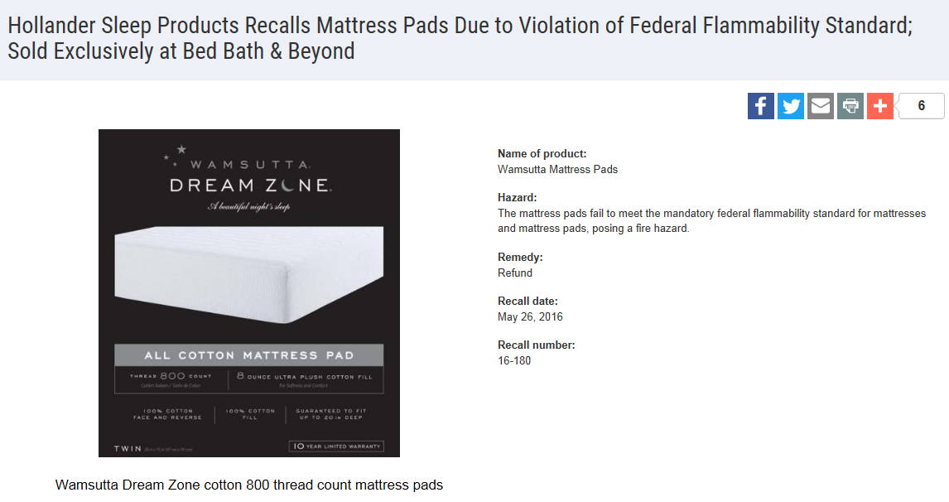

Mattresses and Mattress Pads (1632)

Slide 24
Mattress Sets (1633)
Purpose
  To limit fire intensity
  To increase time for discovery and escape, by preventing or delaying flashover
Effective in 2007
Uses prototype testing scheme

Slide 25
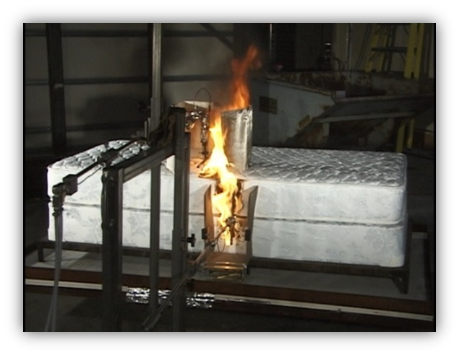
Mattress Sets (1633)
Number of tests depends on stage of prototype testing
Prototype/test as intended to be used
  Mattress alone
  Mattress and foundation
Open flame ignition source
  Pair of gas burners
    Top surface ignited for 70 seconds
    Side surface ignited for 50 seconds
  Ignition source intended to approximate burning bedclothes on a mattress
Performed under an instrumented hood

Slide 26
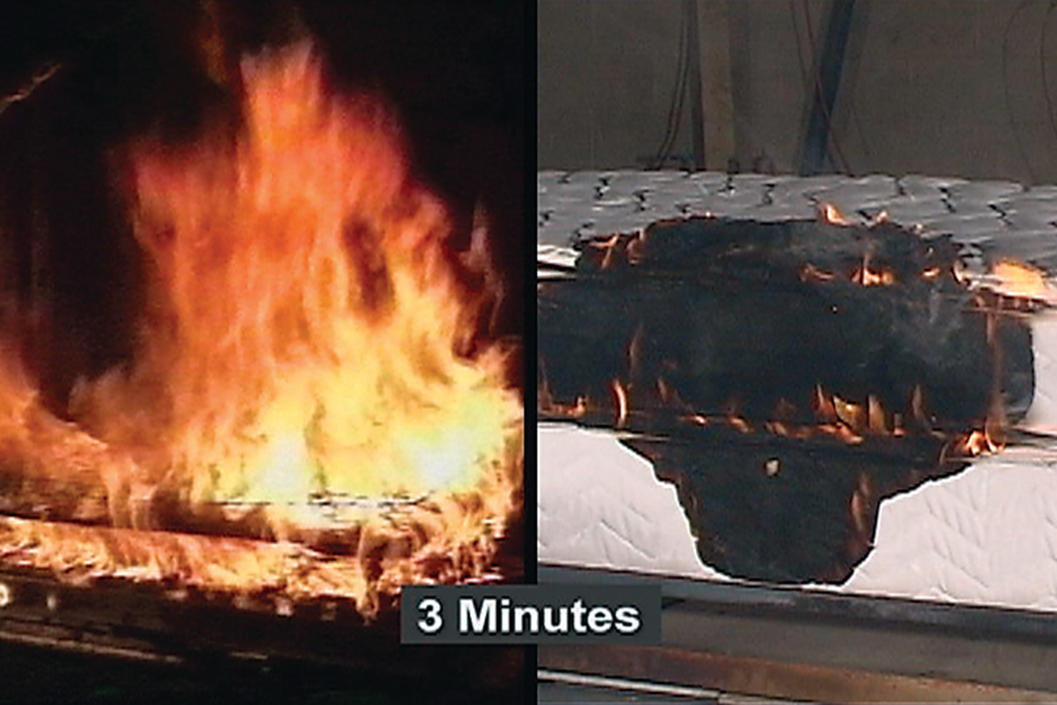
Mattress Sets (1633)

Slide 27
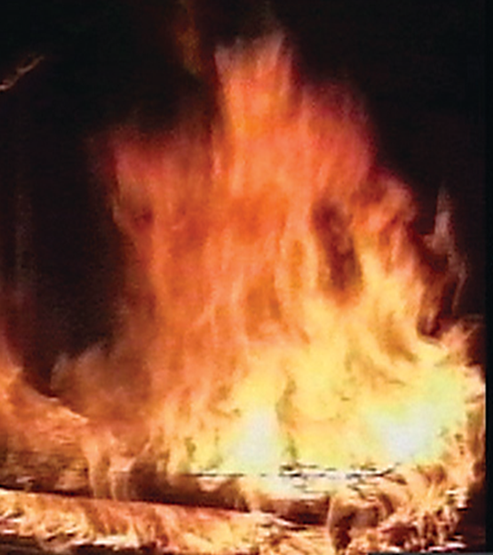
Mattress Sets (1633)
Test Criteria:
  Test lasts 30 minutes
  Total heat release may not exceed 15 MJ in first 10 minutes of test
  Peak heat release rate may not exceed 200 kW

Slide 28
Mattress Sets (1633)
Qualified Prototype
  Initial design tested according to §1633.4(a) that meets flammability requirements
  Minimum of 3 consecutively tested specimens
  Any failures disqualify prototype
Confirmed Prototype
  Same as qualified prototype
  Minimum of 1 test per manufacturing location
  Intended to check manufacturing and confirm same as qualified
Subordinate Prototype
  Some limited differences allowed from qualified or confirmed prototypes
  No testing required

Slide 29
Mattress Sets (1633)
Purpose of prototype scheme
  Lower testing burden by using a qualified prototype on which confirmed or subordinate prototypes can be based, also called prototype pooling
Qualified/confirmed vs. subordinate
  Mattress size
  Ticking
  Other components that are not expected to change flammability performance based on reasonably objective criteria
Reasonably objective criteria
  Evidence-based, demonstrable

Slide 30

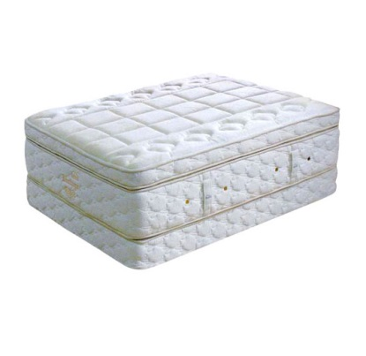

Mattress Sets (1633)
Factory A
Mattress Design
Factory B
Qualified Prototype
Confirmed Prototype
Subordinate Prototype
Subordinate Prototype
Subordinate Prototype
Subordinate Prototype
Subordinate Prototype

Slide 31
Mattress Sets (1633)
Factory A
Mattress Design
Factory B
Qualified Prototype
3 Tests
Confirmed Prototype
1 Test
Subordinate Prototype
Subordinate Prototype
Subordinate Prototype
Subordinate Prototype
Subordinate Prototype

Slide 32
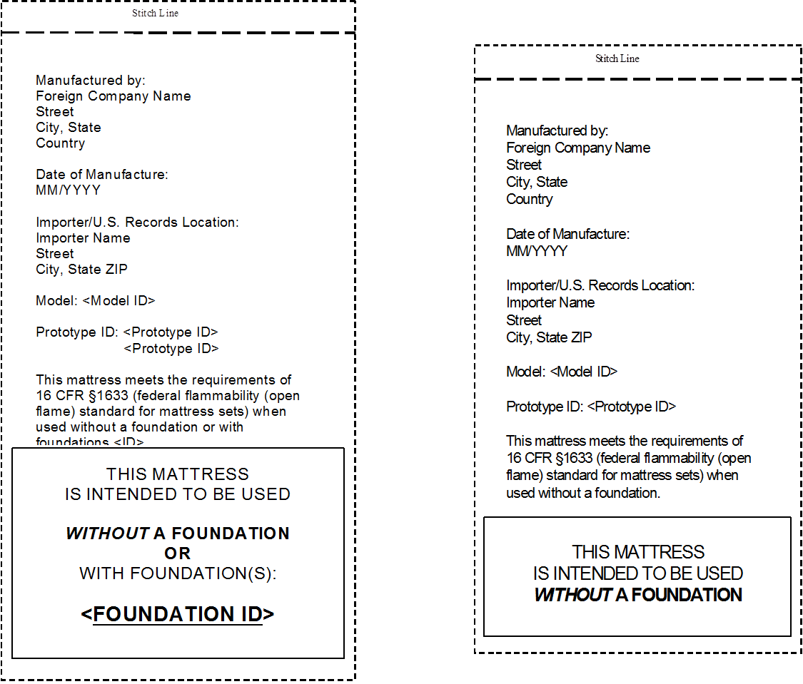
Mattress Sets (1633)
Labeling: Mattresses

Slide 33
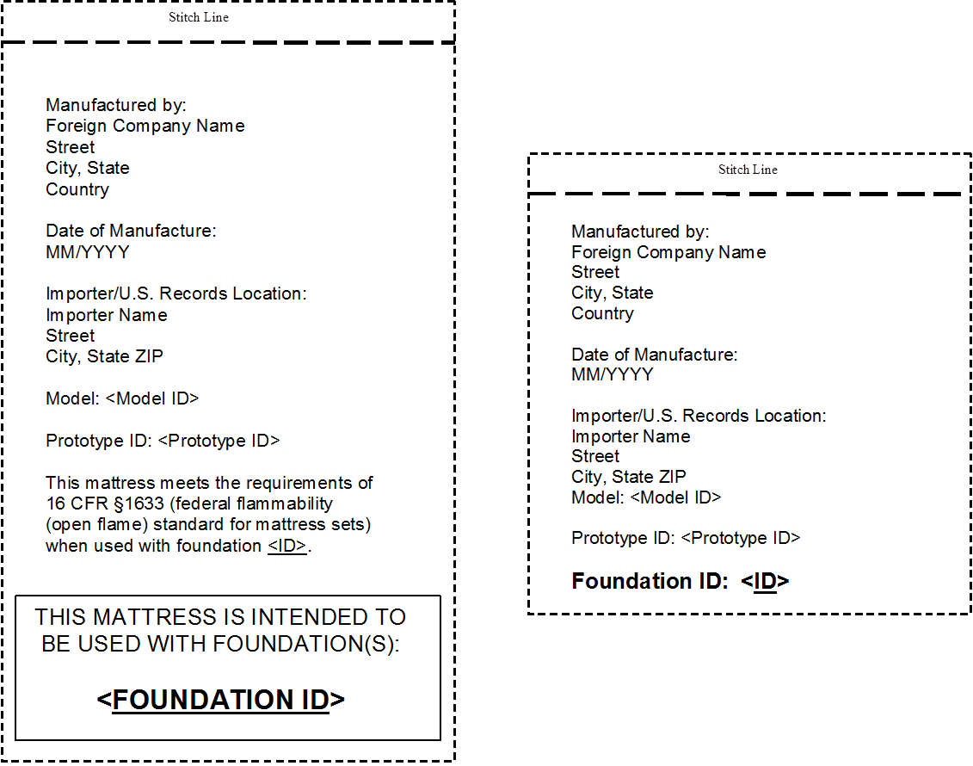
Mattress Sets (1633)
Labeling: Foundations

Slide 34
Mattress Sets (1633)
Recordkeeping Requirements
  Test records
    Test results, video, pictures
  Prototype records
    Unique IDs, detailed description of components and manufacture, models and production lots, subordinate prototypes
  Pooling (Confirmation) records
  Quality Assurance records
    Procedures, production test records, production lot
  Must be maintained while prototype is in use and for 3 years after
  All records must be maintained in English in the U.S.
See §1633.11 and https://www.cpsc.gov/Business--Manufacturing/Business-Education/Business-Guidance/Mattresses/Suggested-Recordkeeping-Forms-for-16-CFR-1633/ for more information

Slide 35
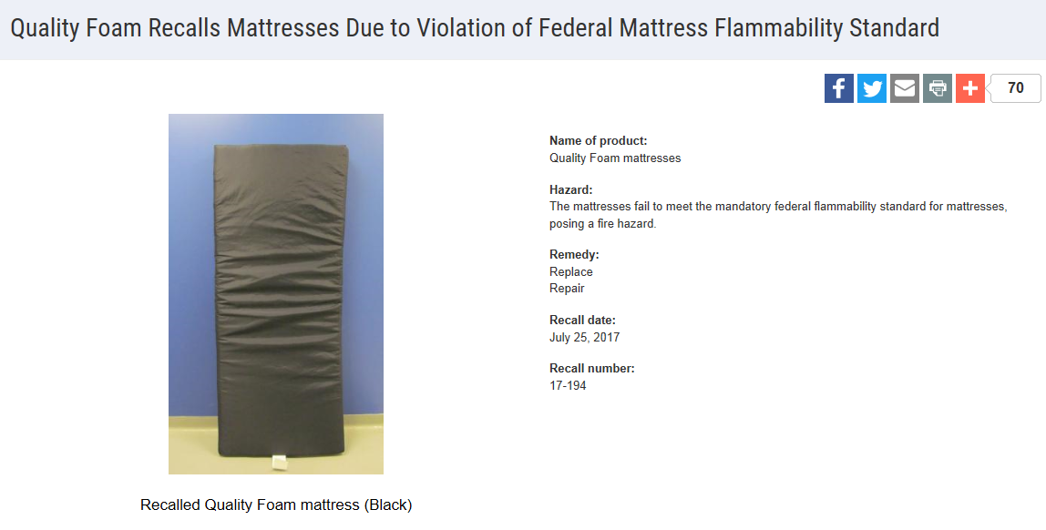
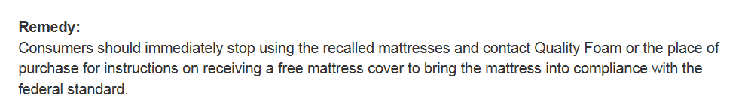
Mattress Sets (1633)

Slide 36
Certification Requirements
General Use Product
  General Certificate of Conformity (GCC)
  Does not require third party testing
Children’s Product
  Children’s Product Certificate (CPC)
  Requires third party testing by a CPSC-accepted laboratory for all regulations to which the product is subject
  Applies to crib and children’s mattresses and mattress pads
Issued by manufacturer (if domestic) or importer of record. An importer can rely on testing provided by a manufacturer to issue a certificate as long as due care is exercised and all CPSC requirements are met.

Slide 37
Chemical Content Requirements
For crib and children’s mattresses and mattress pads:
Lead Content (FHSA)
  Products designed and intended primarily for children 12 years or younger
  Concentration may not exceed 100 ppm
Lead in Paint and Surface Coatings (CPSA)
  Products designed and intended primarily for children 12 years or younger and some general use furniture
  Concentration may not exceed 90 ppm
Phthalate Content (CPSA)
  Children’s toys and child care articles (products used to facilitate sleeping and feeding for children 3 years or younger)
  Only certain phthalates
  Concentration may not exceed 0.1 %
Third party testing by a CPSC-accepted laboratory is required

Slide 38
Tracking Label Requirements
For crib and children’s mattresses and mattress pads:
For products designed and intended primarily for children 12 years or younger, a permanent, distinguishing mark (tracking label) must:
  Be affixed to the product and its packaging, and
  Provide certain identifying information.
The existing required mattress labeling meets this requirement (mattress pads may not).

Slide 39
Designing for Safety
Know and comply with all applicable safety requirements.
Conduct required testing (or exercise due care in accepting test results from another party).
Maintain consistent procedures and retain records.
Monitor components and suppliers.
Confirm materials and component specifications .
Maintain consistent methods of assembly.
Report problems early.
Include safety in your product design from the beginning of your manufacturing or sourcing process.

Slide 40

Questions?
Submit questions in English or Chinese to this podcast:
CPSCinChina@CPSC.GOV

Slide 41
Resources
Notes:
Optional title page with text.

Slide 42
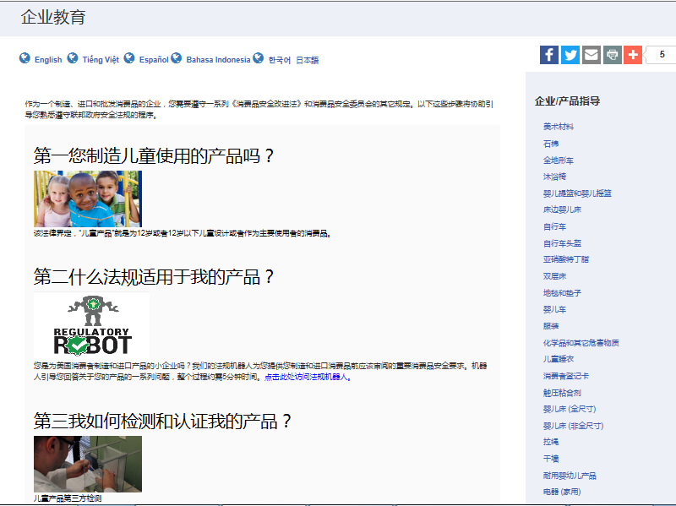

https://www.cpsc.gov/zh-CN/Business--Manufacturing/Business-Education
Chinese Resources at cpsc.gov

Slide 43
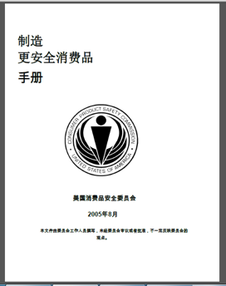
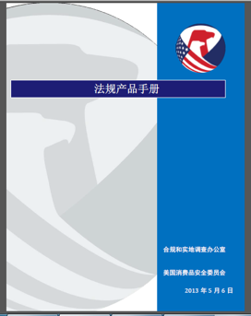
Chinese Resources at cpsc.gov
https://www.cpsc.gov/s3fs-public/HandbookforManufacturingChinese.pdf (中文版本 )
https://www.cpsc.gov/s3fs-public/pdfs/blk_pdf_handbookenglishaug05.pdf (英文版本)
https://www.cpsc.gov/s3fs-public/THE%20REGULATED%20PRODUCT%20HANDBOOK_050613%20CHN%20Final_0.pdf (中文版本 )
https://www.cpsc.gov/s3fs-public/RegulatedProductsHandbook.pdf (英文版本)

Slide 44
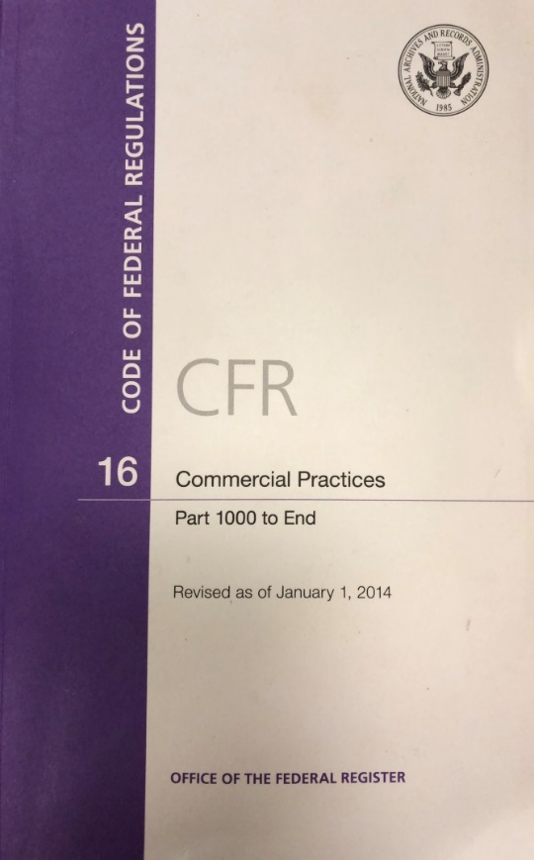
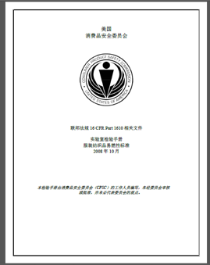
Chinese Resources at cpsc.gov
CFR: Commercial Practices
https://www.govinfo.gov/content/pkg/CFR-2017-title16-vol2/pdf/CFR-2017-title16-vol2.pdf (英文版本)
CPSC Laboratory Manuals:
https://www.cpsc.gov/s3fs-public/Laboratory-test-manual-16-CFR-Part-1610-Ch.pdf?MhtbUWNy6jmOPx9b6f.RErt.n.2n_d_h (中文版本)
https://www.cpsc.gov/s3fs-public/Flammability%20of%20Clothing%20Textiles%20Test%20Manual_1610.pdf (英文版本)

Slide 45
Definition of children’s product – 16 CFR Part 1200
Certificates of conformity – 16 CFR Part 1110
Third-party testing – 16 CFR Parts 1107, 1109, and 1112
Tracking information – 15 USC § 2063(a)(5)
Mandatory reporting requirements – 15 USC §2064
CPSC Business Resources
CPSC-Accepted Laboratories Search Page:
www.cpsc.gov/LabSearch

Slide 46


http://business.cpsc.gov
Online tool designed specifically to help businesses comply with federal consumer product safety requirements.
Asks a series of guided questions, and based on the answers produces a downloadable (PDF) report.
Provides customized guidance with links to product safety regulations that may apply to the product and important information on labeling, certification and testing requirements.

Slide 47
Regulatory Robot
Regulatory Robot is a tool to help identify which mandatory standards are applicable
  Does not give details of requirements within a specific standard
User inputs product features
Regulatory Robot outputs list of standards and requirements
User references source documents for specific requirements

Slide 48
Mattress Information Page
  https://www.cpsc.gov/Business--Manufacturing/Business-Education/Business-Guidance/Mattresses
  (English) https://www.cpsc.gov/s3fs-public/pdfs/blk_pdf_mattqa.pdf
  (Chinese) https://www.cpsc.gov/s3fs-public/pdfs/blk_pdf_openflame_ch.pdf
Regulations
  1632 http://www.ecfr.gov/cgi-bin/text-idx?SID=59ceb81a60d382bcc84bf00de2828ad9&node=16:2.0.1.4.98&rgn=div5
  1633 https://www.ecfr.gov/cgi-bin/text-idx?SID=80fb5cb965175b6f41f2637cf585bad1&mc=true&node=pt16.2.1633&rgn=div5
Laboratory Manuals
  1632 https://www.cpsc.gov/s3fs-public/pdfs/blk_media_testmatt.pdf
  1633 https://www.cpsc.gov/s3fs-public/pdfs/blk_media_labmanual.pdf
Recent Mattress Webinar (September 2017)
  https://www.cpsc.gov/Newsroom/Video/cpsc-small-business-office-webinar-series-mattresses
CPSC Mattress Resources

