Slide 1
Bumper Pads as a Factor in Sleep Related Infant and Child Deaths:
Data from the National Child Death Review Case Reporting System
Teri Covington, MPH, Director

Slide 2

Child Death Review
Multi-disciplinary.
Telling a story through the sharing of case information from multiple sources.
Focused on improving systems and prevention of deaths; not culpability.
Balance between individual cases and accumulation of fatal and non-fatal data for trends.

Slide 3

CDR in 2016
CDR in all 50 states
37 with local teams: over 3500 teams
12 states with only state level teams

Slide 4
The Process
Review Team: Case Selection
Team Members bring records to review
Case Review Discussion
Local Action for Policy, Practice, Prevention
Recommendations and Data Entry into National CDR-CRS
State Advisory Board
State Action for Policy, Practice, Prevention

Slide 5
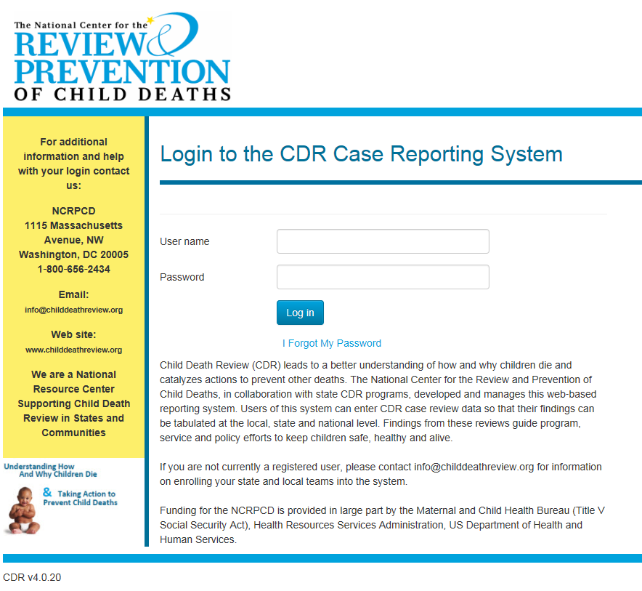
National CDR Case Reporting System
National CDR Case Reporting System since 2005, that allows for data to be collected, entered, analyzed and aggregated across programs at the local, state and national level.
-Web Based
-Over 1200 data elements
-Free
-Housed at Michigan
Public Health Institute

Slide 6
The Case Reporting System: By the Numbers
45 states using the System
Over 2000 authorized users
Over 1300 CDR teams have recorded a death in the System
More than 167,000 deaths have been entered
99% deaths
54% infants
76% cases from 2005-2014
58% males
50% natural deaths; 24% accidents

Slide 7
Limitations*
Except in a few states that review 100% of all SUIDs, it is not population data and rates cannot be calculated, and there may be cases.
Standards vary across jurisdictions as to quality of scene investigations and case reviews.
There may be missing and/or incomplete information.
Teams may classify deaths different than the coroner or medical examiner
*Covington T. The US National Child Death Review Case Reporting System, Injury Prevention 2011; 17 (Supplement 1): 34-37

Slide 8
Sleep Related Infant Deaths
Successful teams
make prevention a priority

Slide 10
Collected through 2008-November 2013

Slide 11
Collected November 2013-present

Slide 12
Presentation of Data from Clean Dataset:
Data download 2/11/16 and approved by states for release: n=95,691
N=95,691
Total number of SUID cases = 16,140; 87% were sleep related
62 cases wherein bumper pad was relevant to death.
After November 2013, 7 cases listed as causing obstruction.
62/16,140=.004

Slide 14
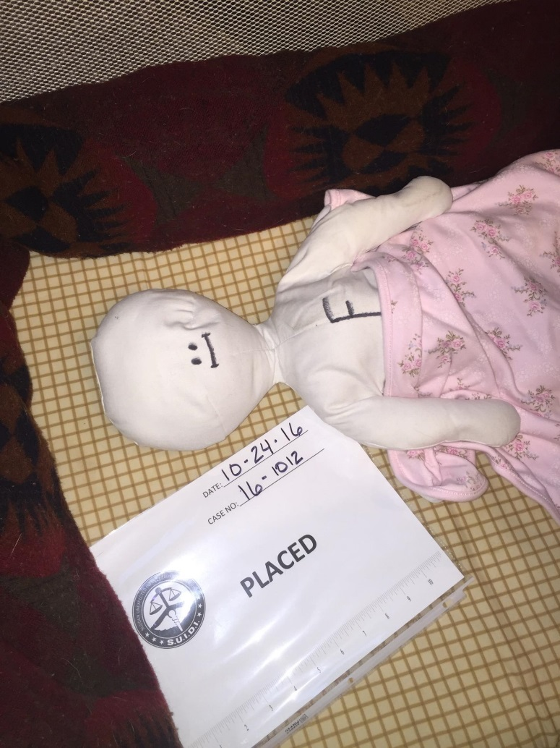
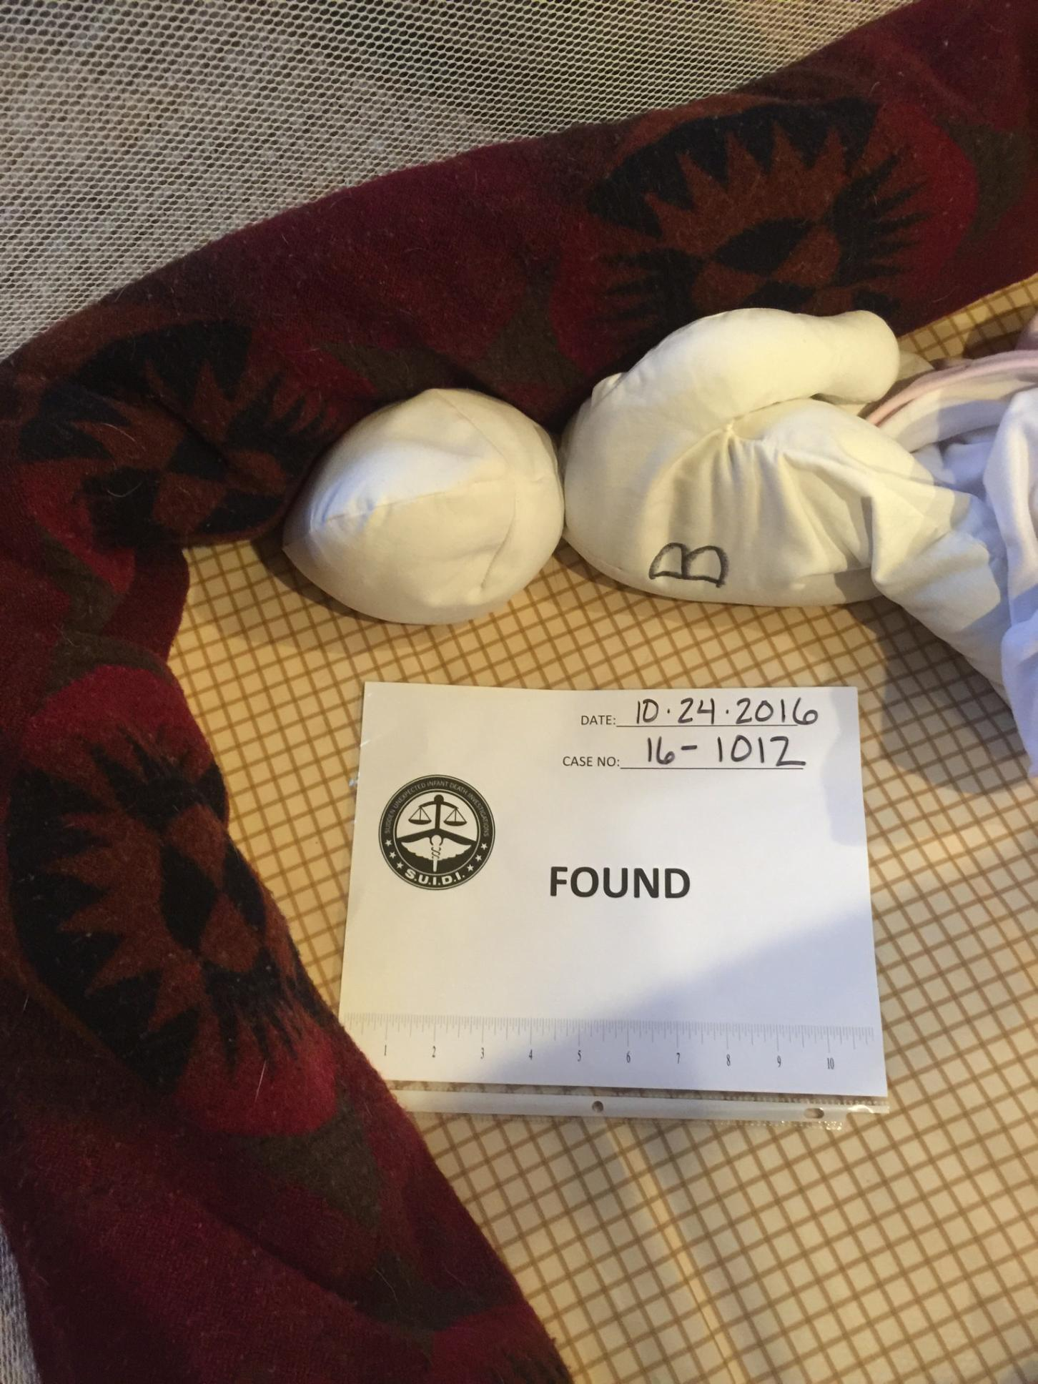

Slide 15
Scene Investigation Agencies, not mutually exclusive
All 62 had an autopsy and death scene investigation completed
Scene Conducted by: | Frequency | Percent
ME | 7 | 11.3
Coroner | 8 | 12.9
ME investigator | 19 | 30.6
Coroner investigator | 15 | 24.2
LE | 55 | 88.7
EMS | 16 | 25.8
CPS | 21 | 33.9
Other | 2 | 3.2

Slide 16
Collected through 2008-November 2013, 55 cases

Slide 17
Collected November 2013-present, 7 cases of 82 where bumper pad was present

Slide 18
Out of all 62 cases, Narratives Describe Bumper Pad as Obstructing Airway in 30 cases

Slide 19
30 Cases from Narratives:
13 states reported cases
27 under age one, 3 ages 1-4
>90% in cribs
>90% in own home

Slide 20
Narratives
Decedent was laid to sleep on his right side in a crib that used rolled up blankets for "bumper pads" and was found unresponsive lying face down in the corner of his crib with his head wedged against these "bumper pads"
“Decd is a 6 month old male who died due to positional asphyxia. Decd was found unresponsive in his crib with his face pressed in to a bumper. “

Slide 21
“Decd was placed face up in his crib covered by light bedding and found face up in his crib with the bumper pad fully covering his face.”
“According to ME (but not documented by anyone else) the child was found on her side with face against crib rail and bumper pad.”
“At approximately 4:00 a.m. the father found the deceased unresponsive, lying prone in a crib, with its face next to bumper pads at the edge of the crib. The deceased had apparently been placed in the crib on a pillow and it appeared the deceased had slid/rolled off the pillow onto his stomach with his face next to the bumper pads.”

Slide 22
“Baby was fed a bottle then placed prone (lying on his stomach) in his crib for a nap. Father saw him last alive in this position around 2:45, around 4:10 his father went to check on him and found him lying prone (more on his right side) with his face up against the crib bumper pad.”
“Child found against bumper in crib.”
“6 MO W/M found unresponsive and lying on his side with face fully prone in bumper pad.”

Slide 23
“Child discovered on tummy with nose pressed into bumper pad on crib.”
“2 mos. old female who died at home with preliminary suspicion of SIDS. Autopsy report revealed that child was found in the crib corner with face covered by a bumper guard and the other side against the mattress. Autopsy exam confirmed positional asphyxia with bilateral frothy pulmonary edema, and well demarcated blanched area on the right side of the face and nose, which was the side found close to the bumper guard pad of the crib. The coroner ruled that the death was accidental due to Positional Asphyxia.”

Slide 24
“He had been placed on his back, was found face down with his face pressed against the bumper pad in the corner of the crib. He had just begun to roll over recently.”
“The mother awoke to check on the baby and found him in prone position completely covered by the blanket with his face pressed into the bumper pads in the crib.”

Slide 25
“19 day old black female - mother put her head propped face up on top of an adult pillow. After checking on baby, found she was wedged between the pillow and the baby pumpers.”
“This 2 month and 12 day-old black female, died of asphyxia (lack of oxygen). It was reported that she was found face down in a crib with her face buried in the space between a pillow and bumper pads.”

Slide 26
“Mother place baby supine on mattress with head resting on adult pillow. At 8am mother saw baby and notes he was sleeping and was found about 4 hours later by father, baby was prone, and wedged between the adult pillow and the bumpers of the crib.”

Slide 27
“This 4 month old infant was fed at 0200 & then placed on his back on a boppy pillow in his crib. He was found 6 hours later on his side with his face in the pillow & wedged between the pillow & bumper pads.”
“Dec is a 24 day old black male infant who was placed to sleep in a crib with an adult size pillow, and/or wedge pillow. The child was placed to sleep on his side and was found in the morning with his face pressed into the bumper pad.”

Slide 28
For more information:
Theresa Covington, MPH
Director
National Center for Fatality Review & Prevention
1115 Massachusetts Avenue, NW
Washington, DC 20005
517-927-1527 cell
800-656-2434 office
517-324-6009 Fax
tcovingt@mphi.org

