Slide 1
Apparent Life-Threatening Events (ALTEs) from Crib Bumpers
Bradley Thach, MD
Neonatologist, St. Louis Children's Hospital
Professor of Pediatrics, Washington University

Slide 2
Incident bumper data
Incidents identified from CPSC data bases -- January 1990 to October 2012
Identified 146 incidents
From these, we identified 11 apparent life-threatening events
Notes:
Incidents – from sources such as consumer complaints, media articles, medical examiners
182 non-fatal incidents. We classified these as 146 injuries and 36 “concerns” of caregivers who identified problems with bumpers, but with no injury. We further classified the injuries by mechanism.

Slide 3
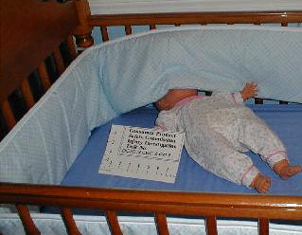
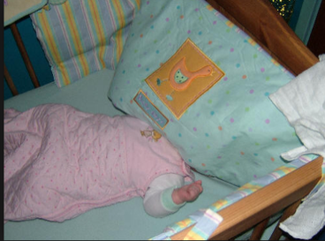
Near Suffocation ALTEs
Baby Monitor alarmed – 1 MOM infant found face pressed against bumper.
Baby Monitor alarmed – 6 MOF found with head between crib and bumper – pale, lips blue.
3 MOM found with face in bumper, blue, limp, not breathing: respiratory distress syndrome
2 MOM found lodged in corner under bumper pad with arm stuck through crib slats. Face red from not being able to breathe.
4 MOM found wedged between bumper pad and mattress. “DX; transient cyanosis probably second to position now resolved.”
Notes:
Near- suffocations occurred with the youngest infants --

Slide 4
Choking, Ingestion, Strangulation ALTEs
13 MOF swallowed a piece of plastic from crib bumper.
Baby monitor alarmed and 7 MOF infant found with crib bumper strap obstructing her airway.
6 MOF “suffered temporary anoxia” from suspected strangulation from tie down straps. Infant stopped breathing but cousin rescued her in time.
Notes:
Choking, ingestion, strangulations occurred to next oldest infants

Slide 5
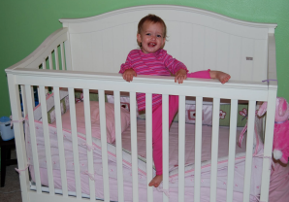
ATLEs from Falls – all went to ER
10 MOF “fell from the crib, stepped on crib bumper” – closed head injury.
17 MOF “Mom thinks baby climbed onto bumper pads and fell out.” Closed head injury.
7 MOF “victim pulled herself up and stepped on crib padding” – crib was at the highest mattress setting. Head injury.
9 MOF “used her bumper pad as a step,” climbed up and leaned over the side of the rail. Lost her balance and fell over the side. Head injury.
Notes:
Falls occurred with the oldest infants

