Slide 1
Review of Crib Bumper Deaths
NJ Scheers, PhD
BDS Data Analytics

Slide 2
Purpose
Review bumper deaths in cribs from our 2016 Journal of Pediatrics article.
  43 of the 48 deaths match deaths reviewed in CPSC’s 2016 staff briefing package.
  5 bumper deaths from the 1980s not reviewed by CPSC staff.

Slide 3
Death Reports
37 asphyxia/suffocation deaths specifically describe bumper involvement:
  “wedged between pillow and bumper pad.”
  “face pressed against bumper pad.”
6 SIDS/SUID - likely bumper-related
  “head hanging off recliner and face pressed
  against crib bumper.”

Slide 4
Bumper (Not Clutter) – 32 deaths
Wedging between bumper/crib mattress (13),
Face against bumper (12),
Arm caught between bumper and mattress/side rails -- face pressed against bumper (3),
Wedged between crib and bureau after a likely climb out (1),
Strangulations from bumper tie (3).

Slide 5
Bumper and Other Object – 16 deaths
Wedged - pillow and bumper (9),
Wedged - recliner and bumper (5),
Wedged - cosleeping twin and bumper (1),
Wedged in crib depression- bumper prevented infant from turning her face to breathe (1).

Slide 6
CPSC Staff Team Review:
Addressability of 43 deaths
3 deaths considered “Likely”
17 deaths considered “Unknown”
23 deaths considered “Unlikely

Slide 7
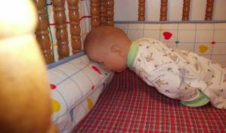
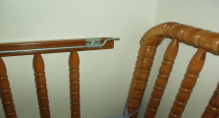
CPSC Team Addressability: “Likely”
Case #42
Case #32
Case #30
Autopsy: Decedent found dead in a crib with her face into a bumper pad.
Death Certificate: Suffocated in corner of crib against crib bumper.
No photographs
Autopsy: Positional asphyxia while laying (sic) face down in thick, soft crib bumper padding at the corner of the crib.
Autopsy: Found with neck extended and face buried into a bumper. Nose and mouth completely blocked by the bumper confirmed by lividity pattern on decedent’s face.

Slide 8
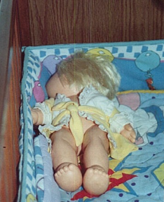
Face Against Bumper (Case #20)
Death Certificate: Positional Asphyxia
Autopsy: “infant's face [found] in a corner of the crib and covered by a pad along the edge of the crib, which would cause asphyxiation due to obstruction of airflow. A crease noted on the infant's forehead is consistent with an impression from the edge of the crib and further supports this conclusion.”
Narrative: Pediatric forensic pathologist agreed with autopsy findings.
CPSC Team Addressability: Unknown

Slide 9
Wedging with Bumper (Case #21)
Death Certificate: Not Available
Autopsy: Asphyxia by suffocation. Infant became wedged between the mattress and the bumper pad of the crib.
Narrative: Father found the baby on his stomach in his crib with his "arms up and his face into the soft padding" surrounding the inside of the crib. The father also noted that the color around the infant's nose and mouth was white and the rest of his face was red.
CPSC Team Addressability: Unlikely

Slide 10
Face Against Bumper (Case #44)
Death Certificate: “Face became pressed against crib bumper pad while sleeping – Asphyxia; suffocation.”
Autopsy: Opinion: …"22 month old male with severe cerebral palsy died as a result of asphyxia due to obstruction of the nose and mouth by the crib bumper pad when he maneuvered into a position while sleeping from which he could not extricate himself"
Narrative: The father recreated the death scene but there was no photograph.
CPSC Team Addressability: Unknown. “Recreation -Victim’s face pointed away from bumper.” Incorrect according to ME.
Positioner

Slide 11
Wedging with Bumper (Case #49)
Death Certificate: Probable Asphyxia, obstruction of nose and mouth. Face wedged against bumper and mattress of crib.
Autopsy: Probable asphyxia due to obstruction of the nose and mouth. Found unresponsive lying with face wedged against the bumper of crib and the mattress.
Narrative: Police reports: father found the baby had "flipped over, crawled up over the [nursing pillow] and his face was against the padded bumper and mattress" with his "mouth up against the bumper almost wedged between the mattress and the bumper.”
CPSC Team Addressability: Unknown
Police officer pointing to area where child was found.

Slide 12
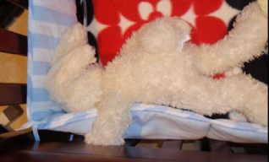
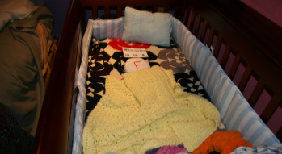
Wedging with Bumper (Case #58)
Death Certificate: A 6 MOM decedent found in crib with face between bumper pad and mattress.
Autopsy: “Suffocation in non-standard sleeping environment: (A) infant reportedly found face-down with face wedged between mattress and bumper pads of crib. (B) numerous pillows, blankets and stuffed animals present with the crib.
Narrative: Mother reported baby’s left arm was over the pad and he appeared to have been pulling the bumper pad toward his face.
CPSC Team Addressability: Unknown

Slide 13
Wedging with Bumper (Case #59)
Death Certificate: Asphyxia; wedging of face in mattress.
Autopsy: The cause of death is attributed to asphyxia from the face being wedged between a crib bumper and mattress. The baby reportedly rolled over a positioner and was found in the above described position.
Narrative: The victim was found prone between a sleep positioner and a bumper, with his face where the bumper meets or intersects with the mattress. He recently was diagnosed with infant asthma.
CPSC Team Addressability: Unknown
Positioner

Slide 14
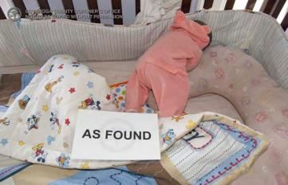
Wedging with Bumper (Case #66)
Death Certificate: Positional Asphyxia (Wedging). Positional Asphyxia sustained when became wedged between crib pads and pillow.
Autopsy: Positional asphyxia (wedging). Infant found with face between pillow and crib bumper.
Narrative: The victim was found face down with his head tilted to the left, wedged between a nursing pillow and the bumper. Based on the reenactment photos, his face appears to be into the pillow.
CPSC Team Addressability: Unknown

Slide 15
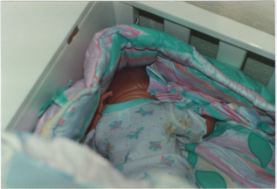
Wedging with Bumper (Case #9)
Death Certificate: Sudden Infant Death Syndrome
Autopsy: Sudden Infant Death Syndrome
Narrative: Infant found with his face straight down into a quilt with his head in the corner of the crib. The fringe of the quilt may have covered his head. Cyanosis noted around nose and mouth.
CPSC Team Addressability: Unlikely
Infant’s Head
Victim as Found

Slide 16
Conclusion
These cases illustrate that crib bumpers can cause asphyxia/suffocation.
There are many more bumper deaths that were identified by Medical Examiners/pathologists than by CPSC staff.
The CPSC team often disagrees with the Medical Examiners/pathologists’ diagnoses.

