Slide 1
In the Matter of Amazon.com, Inc., CPSC Docket No. 21-2 Amazon’s Argument Demonstratives
December 14, 2023

Slide 2
15 U.S.C. § 2052 (a) Definitions and (b) Carve-Out
(a)(7) Distribute in commerce; distribution in commerce. The terms “to distribute in commerce” and “distribution in commerce” mean to sell in commerce, to introduce or deliver for introduction into commerce, or to hold for sale or distribution after introduction into commerce.
(a)(16) Third-party logistics provider. The term “third-party logistics provider” means a person who solely receives, holds, or otherwise transports a consumer product in the ordinary course of business but who does not take title to the product.
(a)(8) Distributor. The term “distributor” means a person to whom a consumer product is delivered or sold for purposes of distribution in commerce, except that such term does not include a manufacturer or retailer of such product.
(b) Common carriers, contract carriers, third-party logistics provider, and freight forwarders. A common carrier, contract carrier, third-party logistics provider, or freight forwarder shall not. . . be deemed to be a manufacturer, distributor, or retailer of a consumer product solely by reason of receiving or transporting a consumer product in the ordinary course of its business as such a carrier or forwarder.

Slide 3
3PLP
receives, holds, or otherwise transports consumer products but does not take title
Activities
Not Amounting
to Distribution
package
orders
inspect
products
process
returns
website operation
payment processing
fair pricing policy
restriction of sales
customer service
warehousing
DISTRIBUTION IN COMMERCE
sell in commerce; introduce or deliver
for introduction into commerce;
hold for sale or distribution after introduction into commerce

Slide 4
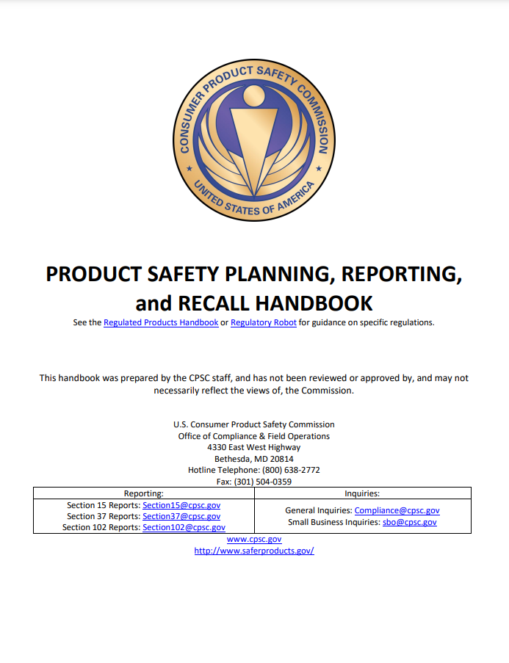

Slide 5
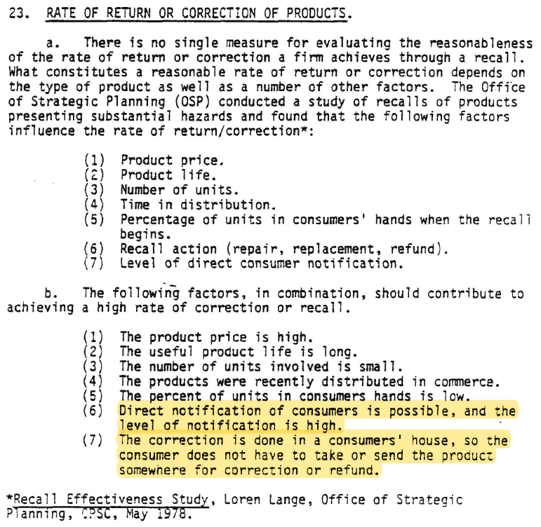

Slide 6
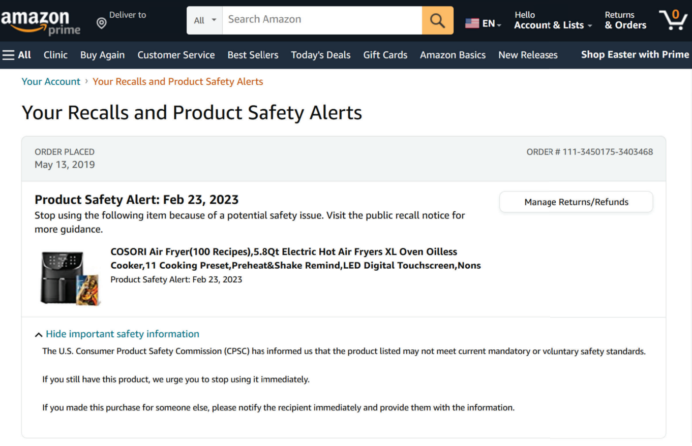

Slide 7
15 U.S.C. § 2064(i)(2)
“Except to the extent that the Commission determines with respect to a particular product that one or more of the following items is unnecessary or inappropriate under the circumstances, the notice shall include the following. . .”

Slide 8
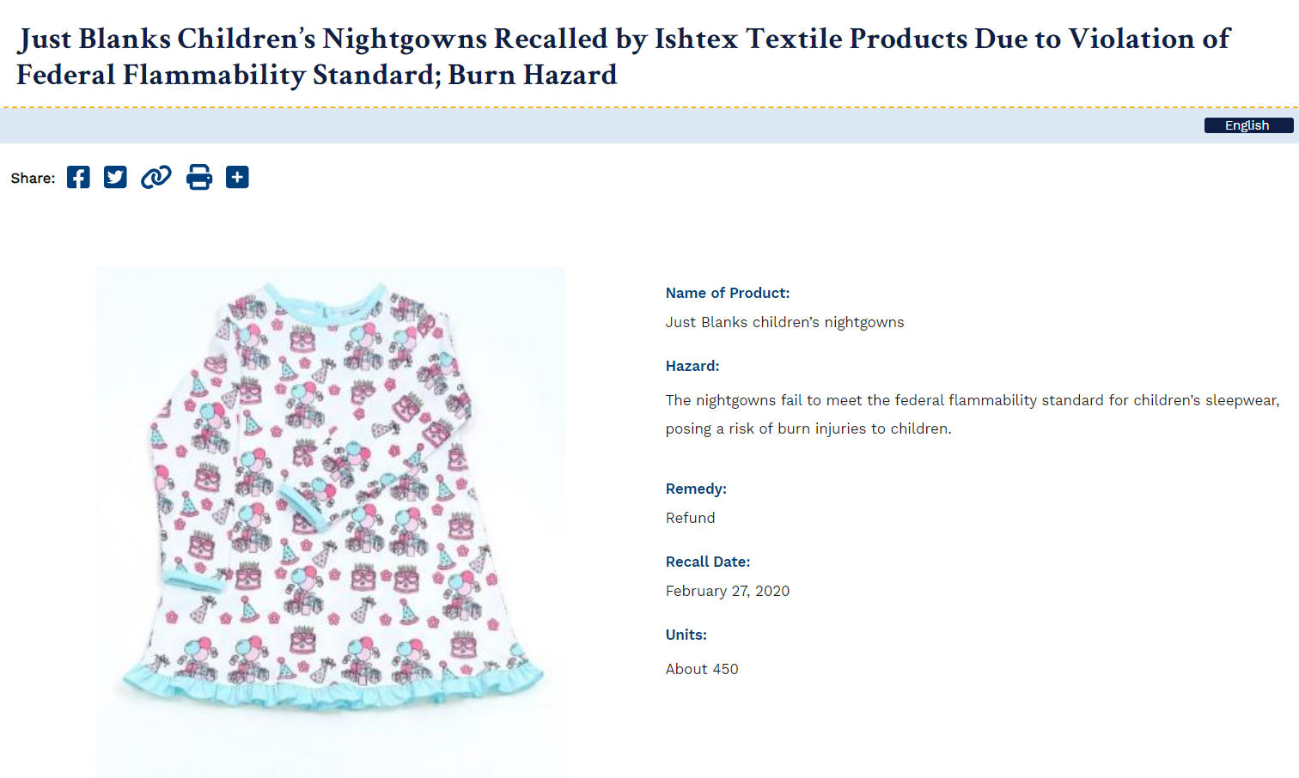
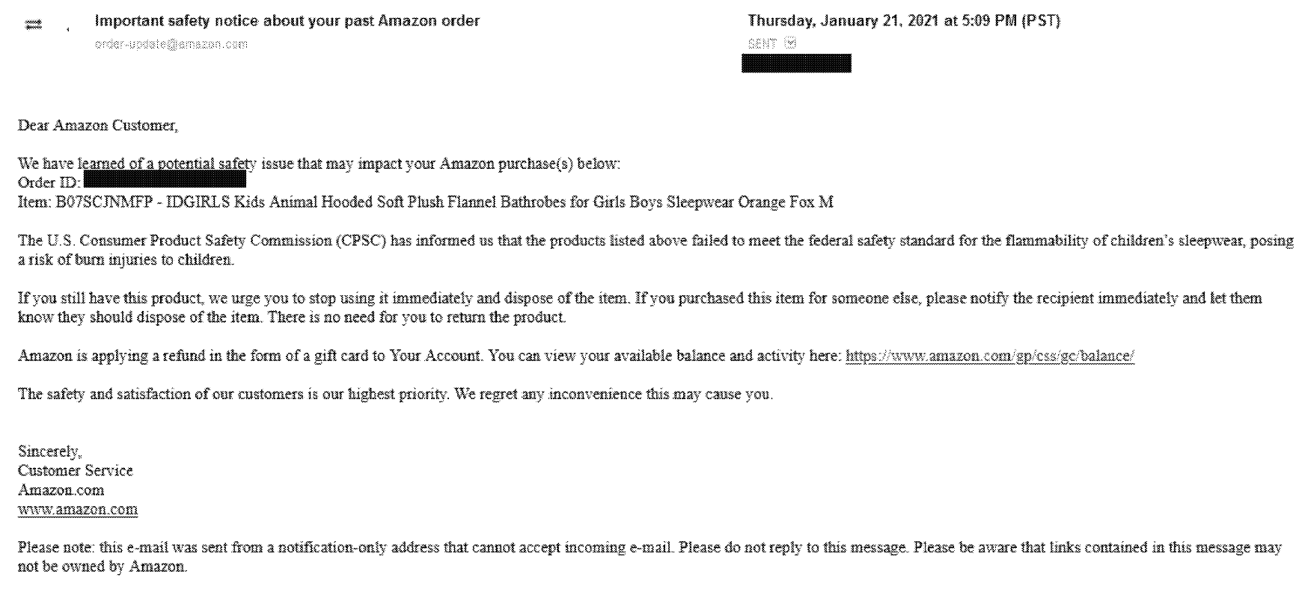
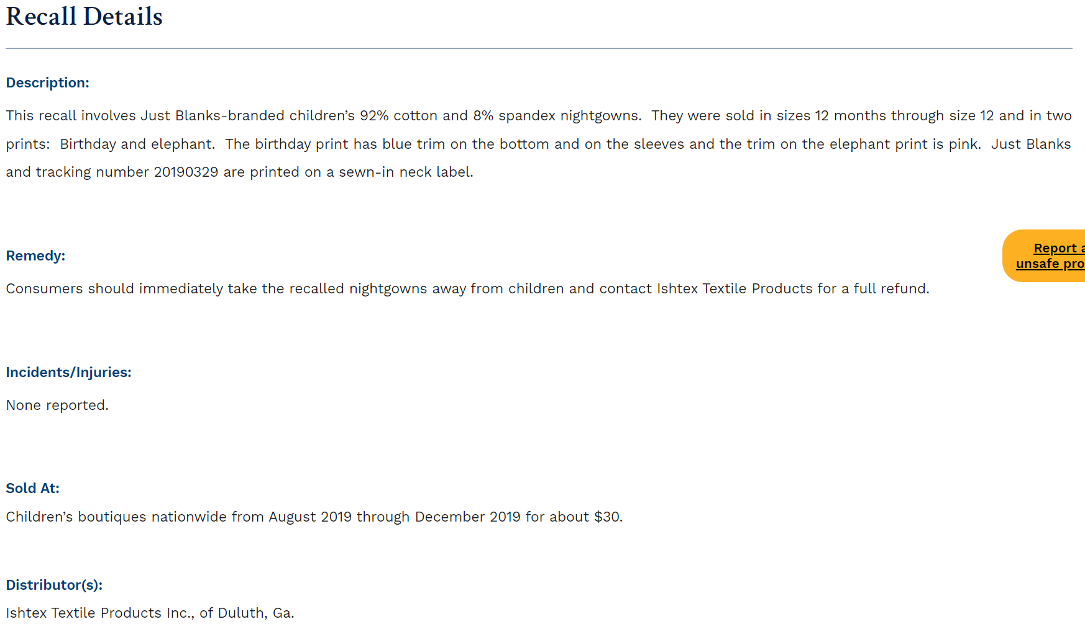
15 U.S.C. § 2064(i)(2)
(A) Product description, including model number, product name, and photo;
(B) Description of the action being taken;
(C) Number of units;
(D) Description of the substantial product hazards and reason for action;
(E) Identification of manufacturer and significant retailers;
(F) Dates of manufacture and sale;
(G) Injuries or deaths associated;
(H) Description of remedies and actions required to obtain such remedy;
(I) Other information the Commission deems appropriate.
CPSC Recall No. 20-082
Amazon’s Notice

